Slide 1
Recent Developments in Genetic Testing and Predicting Genetic Values
Curt Van Tassell
USDA
Agricultural Research Service
AIPL – Animal Improvement Programs Laboratory
BFGL – Bovine Functional Genomics Laboratory
curtvt@ars.usda.gov
301-504-6501
443-878-7110

Slide 2
Overview
A little history
Introduction to genomics
Genetic evaluation
Recent developments
  High density SNP panel
  Low density SNP panel
Future prospects?!

Slide 3
Trends in U.S. Milk Production
Selection Works!
In 2007 U.S. Produced 34% more milk with 48% fewer dairy cows than in 1960

Slide 4
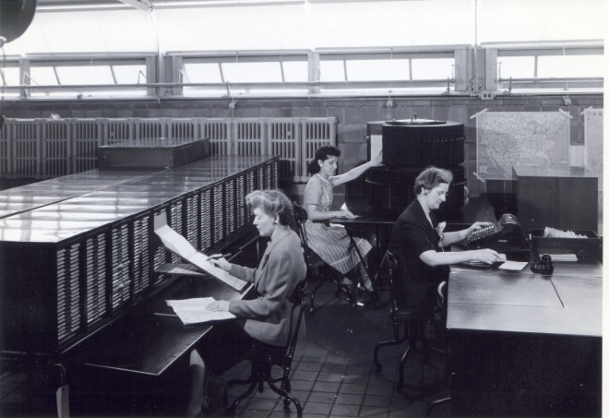
A Little History…
1908 1936 1989 1997 2009 | USDA organizes a national milk-recording program based on success in Michigan The first national sire evaluations are calculated from daughter-dam comparisons Animal model evaluations use the relationships among all cows and bulls InterBULL evaluations introduced to incorporate foreign daughter information January – First official genetic evaluations incorporating genomic data

Slide 5

Traditional Selection Programs
Collect phenotypic data from animals (i.e. milk production, milk composition, conformation, etc.)
Estimate genetic merit for animals in a population
Select superior animals as parents of future generations
Phenotype
Statistical
Methodology
Predicted Genetic Merit
Pedigree

Slide 6
Genetic Evaluations - Limitations
Slow!
  Progeny testing for production traits take 3 to 4 years from insemination
  A bull will be at least 5 years old before his first evaluation is available
Expensive!
  Progeny testing costs $25,000 - $50,000 per bull
  Only 1 in 8 to 10 bulls graduate from progeny test
  At least $200,000 invested in each active bull!!

Slide 7
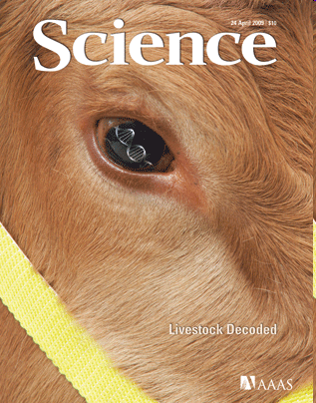
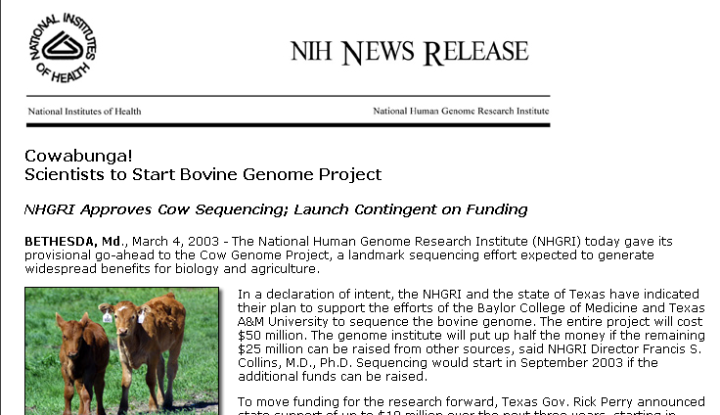
Bovine Genome Sequence

Slide 8
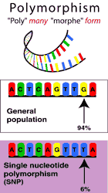
Genetic Markers
Polymorphism
“poly” = many “morph” = form
Allow inheritance to be followed in a region across generations
Single nucleotide polymorphisms (SNiP) are the markers of the future!
Need lots!
  Millions in the genome
General
population
94%
Single nucleotide
polymorphism
(SNP)
6%

Slide 9
Genome Selection
“Train” system using phenotypic and genotypic data
  Large regression system
Predict genetic merit at birth by combining pedigree merit and merit predicted from SNP
Final genetic predictions are transparent to technology

Slide 10
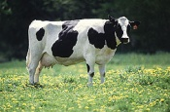
What’s a SNP genotype worth?
Pedigree info is equivalent to information on about 7 daughters
For the protein yield (h2=0.30), the SNP genotype provides information equivalent to an additional 34 daughters!!!

Slide 11
What’s a SNP genotype worth?
And for daughter pregnancy rate (h2=0.04)…131

Slide 12
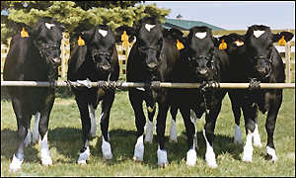
New Way of Looking at an Old Question
Which calf from a group of candidates is the best?

Slide 13
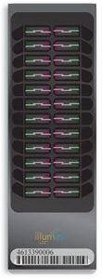
BovineSNP50 Bead Chip
The Illumina BovineSNP50 Bead Chip has been very successful
43,382 SNP used for genetic prediction
47,645 animals genotyped in the US, many more worldwide
2nd generation chip with a slightly different SNP set has been developed

Slide 14
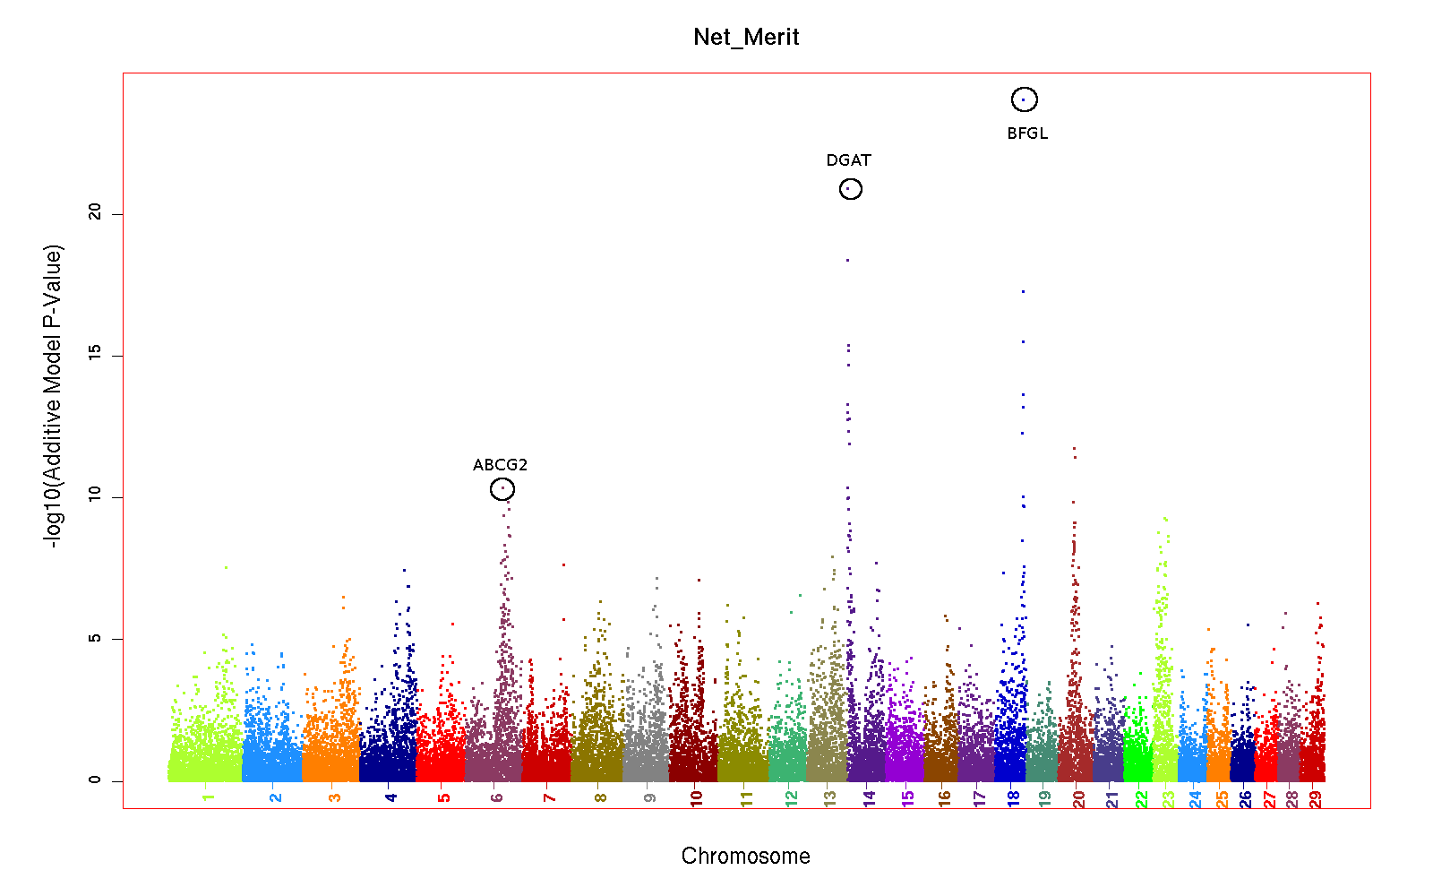
Genomic Prediction

Slide 15
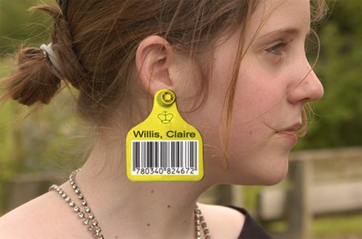
How the system works
Animals nominated through web site
Hair, blood, semen, or extracted DNA sent to labs
Genotypes sent to AIPL monthly
  Conflict and quality checking
Evaluation updates calculated monthly
All evaluations updated at tri-annual runs

Slide 16
Reliability Gain¹ by Breed
Yield traits and NM$ of young bulls
Trait | HO | JE | BS
Net merit | 23 | 9 | 3
Milk | 23 | 11 | 0
Fat | 33 | 15 | 5
Protein | 22 | 4 | 1
Fat % | 43 | 41 | 10
Protein % | 34 | 29 | 5
¹Gain above parent average reliability ~35%

Slide 17
Reliabilities for Young Bulls
Traditional PA
Genomic PTA

Slide 18
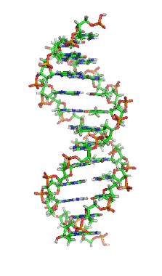
Build a Better Black Box
Genotype!!
Pedigree
Phenotype
New and Improved!
Predicted Genetic Merit

Slide 19
Phenotypes!!
Data is more critical than ever!!
Lowly heritable traits (eg, health and reproduction) are especially well suited to this technology
New traits are easily added
Traits can be measured in a focused, smaller, representative population
  Feed efficiency
  Parasite

Slide 20
Genotyped Holstein by run
Run Date | Old* |  | Young** |  | Total
 | Male | Female | Male | Female
0904 | 7600 | 2711 | 9690 | 1943 | 21944
0906 | 7883 | 3049 | 11459 | 2974 | 25365
0908 | 8512 | 3728 | 12137 | 3670 | 28047
0910 | 8568 | 3965 | 13288 | 4797 | 30618
1001 | 8974 | 4348 | 14061 | 6031 | 33414
1002 | 9378 | 5086 | 15328 | 7620 | 37412
1004 | 9770 | 7415 | 16007 | 8630 | 41822
1005 | 9958 | 7940 | 16594 | 9772 | 44264
1006 | 9958 | 8122 | 17507 | 10713 | 46300
* Animals with traditional evaluation
** Animals with no traditional evaluation

Slide 21
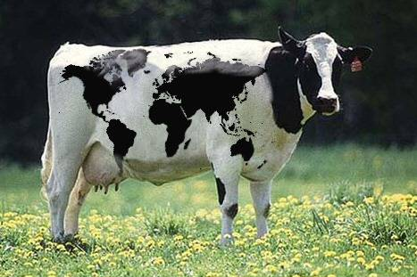
Most Holstein Genotypes*
Country | Reference bulls
Germany | 17,000
Netherlands | 16,000
France | 16,000
Scandinavia (DFS) | 16,000
United States | 9,300
Canada | 8,800
*Feb 2010

Slide 22
Genetic Gain per Year
Genetic change per year =
  (Accuracy x Intensity x Genetic Variation)
  Generation Interval
↑ Accuracy by using genotypic data
↑ Intensity by screening more candidates
↓ Generation interval by obtaining evaluations earlier in life

Slide 23
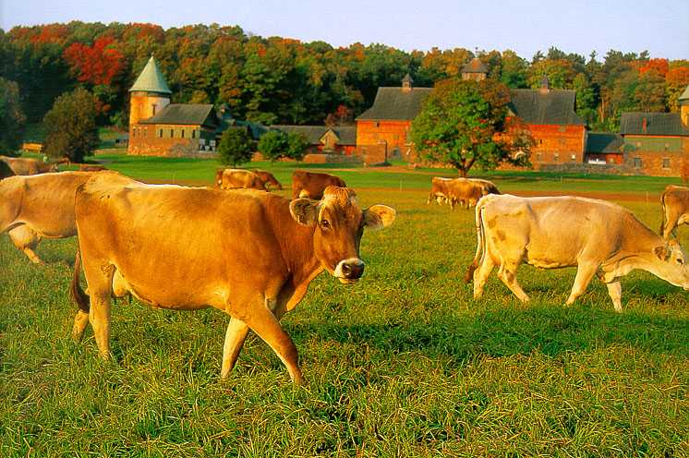
How can this technology apply to cows?

Slide 24
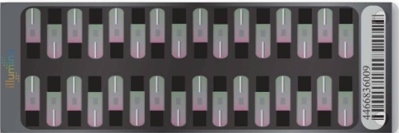
Bovine Low-Density Bead Chip (3K)
Collaboration
  Illumina
  AI organizations & Breed associations
  Genotyping service providers
3K SNP assay = 3240 SNP from SNP50
  3072 SNP evenly spaced & informative across breeds
  96 selected for pedigree verification – ISAG panel?
  Some breed determination and Y specific SNP
  About 2900 SNP passed first design

Slide 25
Applications of the 3K chip
Expect to impute genotypes for 43,382 SNP with high accuracy
  Cheapest solution for genome enhanced female selection
Screening bulls
  Genotype final candidates at full density
  Genotype more candidates for less money
Parentage verification and pedigree discovery

Slide 26
Pedigree Assumptions!!
Notes:
Here is a simple Genomic pedigree chart. 2 separate chromosome segments are shown for each ancestor. (During meiosis , they divide-recombination). The earliest generation, are all one color for illustrative purposes. Dairy cattle have 30 chromosomes, including the X and Y. On average each chromosome carries millions of base pairs, and thousands of genes.
For the first segment, the sire has inherited ½ from each piece. In the second segment, the majority was inherited from one piece (both of these are an example of a crossover). The individual has received portions of the first segment that are traced back to the grandparent generation.
2) The dam has inherited most of one segment from one portion of her sire’s piece, and a mixture (double crossover) from her dam’s piece. The individual has segments that can be traced to all grandparents.
In this example…. Say the light green segment from the paternal grand dam was one that was high milk production; the offspring, inheriting a large segment from her, could mean that through this recombination, this animal would have a higher PTA for milk that a full sib.

Slide 27
Genomic Pedigree!!
Notes:
Here is a simple Genomic pedigree chart. 2 separate chromosome segments are shown for each ancestor. (During meiosis , they divide-recombination). The earliest generation, are all one color for illustrative purposes. Dairy cattle have 30 chromosomes, including the X and Y. On average each chromosome carries millions of base pairs, and thousands of genes.
For the first segment, the sire has inherited ½ from each piece. In the second segment, the majority was inherited from one piece (both of these are an example of a crossover). The individual has received portions of the first segment that are traced back to the grandparent generation.
2) The dam has inherited most of one segment from one portion of her sire’s piece, and a mixture (double crossover) from her dam’s piece. The individual has segments that can be traced to all grandparents.
In this example…. Say the light green segment from the paternal grand dam was one that was high milk production; the offspring, inheriting a large segment from her, could mean that through this recombination, this animal would have a higher PTA for milk that a full sib.

Slide 28
Bull – MGS Relationships

Slide 29

What is imputation?
Prediction of unknown genotypes from observed genotypes
  Pedigree haplotyping
  Matching allele patterns
Genotypes indicate how many copies of each allele were inherited and can be separated into sire and dam contributions
Haplotypes indicate which alleles are on which chromosome

Slide 30
Why impute haplotypes?
Predict animal genotype from SNP genotypes of its parents or progeny or both
Predict unknown SNP from known
  Measure 3,000, predict 50,000 SNP
  Measure 50,000, predict 500,000
  Measure each haplotype at highest density only a few times
Increase reliabilities

Slide 31
Find Haplotypes – AB Coding
Genotypes:
Oman BB,AA,AA,AB,AA,AB,AB,AA,AA,AB
Ostyle BB,AA,AA,AB,AB,AA,AA,AA,AA,AB
Haplotypes:
OStyle (pat) B A A _ A A A A A _
OStyle (mat) B A A _ B A A A A _

Slide 32
Correlations of 3K and PA with 50K
Trait | Corr(3K,50K)² | Corr(PA,50K)² | Gain
NM$ | .899 | .518 | 79%
Milk | .920 | .523 | 83%
Fat | .920 | .516 | 83%
Prot | .920 | .555 | 82%
PL | .933 | .498 | 87%
SCS | .912 | .417 | 85%
DPR | .937 | .539 | 86%
Half of young animals had 3K PTA, half had 50K PTA

Slide 33
REL Using 3K, 50K, or Imputed SNP

Slide 34
Problems…
Upper limit on accuracy of genetic prediction – even for Holstein
What do we do with smaller breeds – marker effects were not consistent enough to justify across-breed genetic prediction

Slide 35
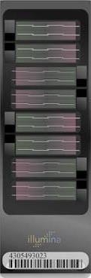
Development of a Bovine High-Density SNP Assay
Increased accuracy in genetic prediction
  We are approaching the limit of BovineSNP50
Utilize across breed information
  Smaller breeds just don’t have enough high accuracy bulls
Enhance gene mapping precision
  Genetic defects
Enhanced performance in Zebu cattle

Slide 36
Collaboration
Illumina provided:
  DNA sequence for a range of breeds
Pfizer provided:
  DNA sequence of additional breeds
  SNP discovery expertise
USDA-ARS provided:
  DNA and library construction
  SNP discovery expertise
  Assay design expertise

Slide 37
Additional Collaborators
University of Missouri
Roslin Institute
UNCEIA (France)
Sao Paulo State University
University of Milan
Technische Universitaet Muenchen
Beef CRC
Embrapa
National University (Korea)

Slide 38
Data Highlights
Enormous amount of DNA sequence data
  ~180x genome equivalent coverage
  ~550 BILLION base-pairs
Represents:
  ~120 libraries
  >300 animals
Animals from breeds representing:
  European and Zebu cattle
  Beef and dairy
  Temperate and tropically adapted

Slide 39
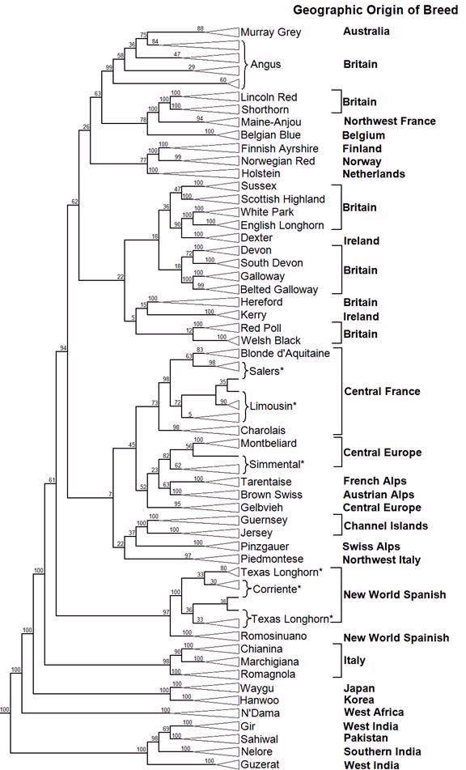
Partners
Deep SNP Discovery
N’Dama
Sahiwal
Simmental
Hanwoo
Blonde d’Aquitaine
Montbeliard
BFGL
Genome Assemblies
Nelore
Water Buffalo
BFGL-Illumina
Deep SNP Discovery
Angus
Holstein
Limousin
Jersey
Nelore
Brahman
Romagnola
Gir
Pfizer
Light SNP Discovery
Angus
Holstein
Jersey
Hereford
Charolais
Simmental
Brahman
Waygu

Slide 40
SNP Chip Design
>45 million SNPs discovered
~6 million were used to design the high density chip
  Selected ~800,000 new SNPs added
  Kept all of the BovineSNP50 SNPs
Breed groups used:
  Holstein, Angus, Nelore, Taurine dairy, Taurine beef, Indicine, tropically adapted Taurine
852,645 total gaps
  850,816 <20kb
  1795 >20kb, < 100kb
  34 > 100 kb

Slide 41
Assay Design Results
All of BovineSNP50 SNP were attempted
~800,000 bead types after 60,800 beads of BovineSNP50 positioned
795,000 SNP positioned on BTA1-29,X
5,000 beads represent unknown contigs, BTA Y, and mitochondrial SNP

Slide 42
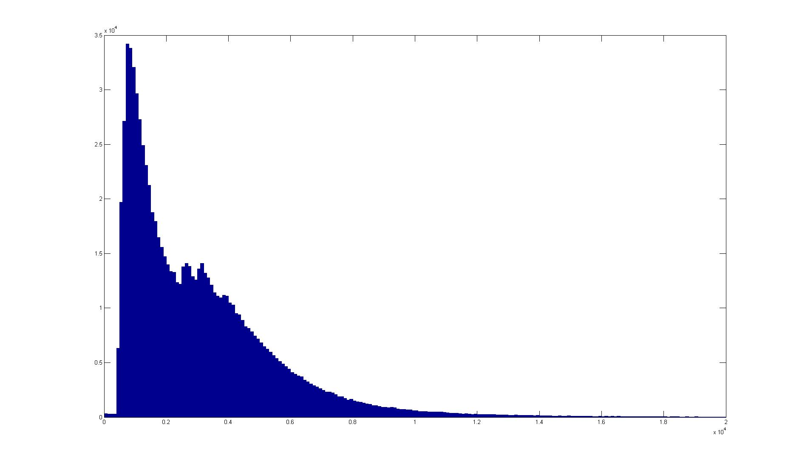
Gaps <20,000 bp

Slide 43
Conclusions
Genomics is radically altering dairy cattle breeding
The Illumina Bovine3K and BovineHD genechips are currently available
A large number of SNP have been discovered and will be made publically available
We are developing with industry partnerships to bring this technology to the producer level

Slide 44
Future… Curt’s Crystal Ball
History would suggest it is not too accurate!!
Genotyping - Competition
  High density – Affymetrix
  Low density – a number of vendors
  Service providors?
Ear tags with tissue capture
International collaboration and cooperation

Slide 45
_{Implementation}
_{Team}
iBMAC Consortium
Funding
Illumina (industry)
  Marylinn Munson
  Cindy Lawley
  Diane Lince
  LuAnn Glaser
  Christian Haudenschild
Beltsville (USDA-ARS)
  Curt Van Tassell
  Lakshmi Matukumalli
  Steve Schroeder
  Tad Sonstegard
Univ Missouri (Land-Grant)
  Jerry Taylor
  Bob Schnabel
  Stephanie McKay
Univ Alberta (University)
  Steve Moore
Clay Center, NE (USDA-ARS)
  Tim Smith
  Mark Allan
AIPL
  Paul VanRaden
  George Wiggans
  John Cole
  Leigh Walton
  Duane Norman
BFGL
  Marcos de Silva
  Tad Sonstegard
  Curt Van Tassell
University of Wisconsin
  Kent Weigel
University of Maryland School of Medicine
  Jeff O’Connell
Partners
  GeneSeek
  DNA Landmarks
  Expression Analysis
  Genetic Visions
USDA/NRI/CSREES
  2006-35616-16697
  2006-35205-16888
  2006-35205-16701
USDA/ARS
  1265-31000-081D
  1265-31000-090D
  5438-31000-073D
Merial
  Stewart Bauck
NAAB
  Gordon Doak
  Accelerated Genetics
  ABS Global
  Alta Genetics
  CRI/Genex
  Select Sires
  Semex Alliance
  Taurus Service
45

Slide 46


