Slide 1
Genomic selection and systems biology – lessons from dairy cattle breeding

Slide 2
Dairy Cattle
9 million cows in US
Attempt to have a calf born every year
Replaced after 2 or 3 years of milking
Bred via AI
Bull semen collected several times/week. Diluted and frozen
Popular bulls have 10,000+ progeny
Cows can have many progeny though super ovulation and embryo transfer
Notes:
2

Slide 3
Data Collection
Monthly recording
  Milk yields
  Fat and Protein percentages
  Somatic Cell Count (Mastitis indicator)
Visual appraisal for type traits
Breed Associations record pedigree
Calving difficulty and Stillbirth
Notes:
3

Slide 4
Traditional evaluations 3X/year
Yield
  Milk, Fat, Protein
Type
  Stature, Udder characteristics, feet and legs
Calving
  Calving Ease, Stillbirth
Functional
  Somatic Cell, Productive Life, Fertility
Notes:
4

Slide 5
Use of evaluations
Bulls to sell semen from
Parents of next generation of bulls
  Cows for embryo donation
Notes:
5

Slide 6
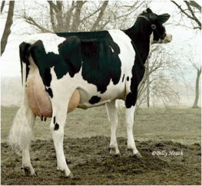
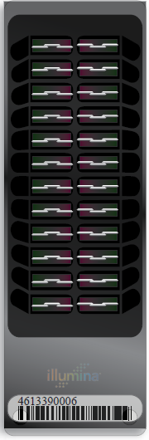
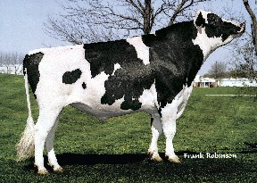
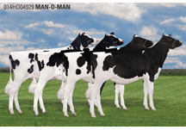
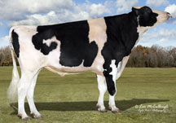
Lifecycle of bull
Parents Selected
Dam Inseminated
  Embryo Transferred to Recipient
  Bull Born
  Genomic Test
Semen collected (1yr)
Daughters Born (9 m later)
Bull Receives Progeny Test
(5 yrs)
Daughters have calves (2yr later)

Slide 7
Benefit of genomics
Determine value of bull at birth
  Increase accuracy of selection
  Reduce generation interval
  Increase selection intensity
  Increase rate of genetic gain
Notes:
7

Slide 8
History of genomic evaluations
Dec. 2007 BovineSNP50 BeadChip available
Apr. 2008 First unofficial evaluation released
Jan. 2009 Genomic evaluations official for
        Holstein and Jersey
Aug. 2009 Official for Brown Swiss
Sept. 2010 Unofficial evaluations from 3K chip
released
Dec. 2010 3K genomic evaluations to be official
Sept. 2011 Infinium BovineLD BeadChip available
Notes:
8

Slide 9
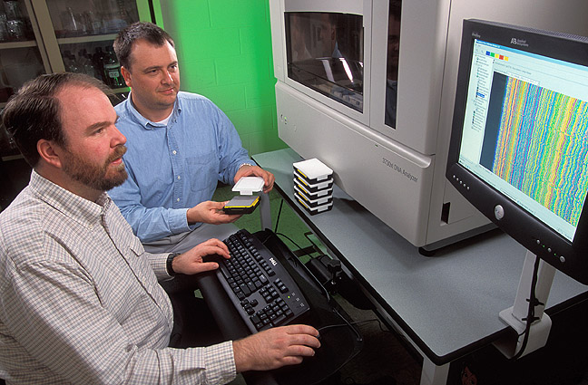
Cattle SNP Collaboration - iBMAC
Develop 60,000 Bead Illumina iSelect® assay
  USDA-ARS Beltsville Agricultural Research Center: Bovine Functional Genomics Laboratory and Animal Improvement Programs Laboratory
  University of Missouri
  University of Alberta
  USDA-ARS US Meat Animal Research Center
Started w/ 60,800 beads – 54,000 useable SNP

Slide 10





Participants
iBMAC Consortium
Funding Agencies
Illumina
  Marylinn Munson
  Cindy Lawley
  Christian Haudenschild
BARC
  Curt Van Tassell
  Lakshmi Matukumalli
  Tad Sonstegard
Missouri
  Jerry Taylor
  Bob Schnabel
  Stephanie McKay
Alberta
  Steve Moore
USMARC – Clay Center
  Tim Smith
  Mark Allan
USDA/NRI/CSREES
  2006-35616-16697
  2006-35205-16888
  2006-35205-16701
USDA/ARS
  1265-31000-081D
  1265-31000-090D
  5438-31000-073D
Merial
  Stewart Bauck
NAAB
  Godon Doak
  ABS Global
  Accelerated Genetics
  Alta Genetics
  CRI/Genex
  Select Sires
  Semex Alliance
  Taurus Service
Notes:
10

Slide 11
Use of HD
Currently only 50K subset of SNP used
Some increase in accuracy from better tracking of QTL possible
Potential for across breed evaluations
Requires few new HD genotypes once adequate base for imputation developed

Slide 12
LD chip
6909 SNP mostly from SNP50 chip
  9 Y Chr SNP included for sex validation
  13 Mitochondrial DNA SNP
  Evenly spaced across 30 Chr (increased density at ends)
Developed to address performance issues with 3K while continuing to provide low cost genotyping
Provides over 98% accuracy imputing 50K genotypes
Included beginning with Nov genomic evaluation
Notes:
12

Slide 13
Development of LD chip
Consortium included researchers from USA, AUS and FRA
Objective: good imputation performance in dairy breeds
  Uniform distribution except heavier at chromosome ends
  High MAF, avg MAF over 30% for most breeds
  Adequate overlap with 3K
Notes:
13

Slide 14
Genomic evaluation program steps
Identify animals to genotype
Sample to lab
Genotype sample
Genotype to USDA
Calculate genomic evaluation
Release monthly
Notes:
14

Slide 15
Responsibilities of requester
Insure animal is properly identified eg HOCANF000123456789
Enroll animal with breed association or insure pedigree on animal and dam reaches AIPL
Collect clean, clearly labeled DNA sample
Get sample to lab in time to be included in desired month’s results
Resolve parentage conflicts quickly
Notes:
15

Slide 16
Steps to prepare genotypes
Nominate animal for genotyping
Collect blood, hair, semen, nasal swab, or ear punch
  Blood may not be suitable for twins
Extract DNA at laboratory
Prepare DNA and apply to BeadChip
Do amplification and hybridization, 3-day process
Read red/green intensities from chip and call genotypes from clusters
Notes:
16

Slide 17
What can go wrong
Sample does not provide adequate DNA quality or quantity
Genotype has many SNP that can not be determined (90% call rate required)
Parent-progeny conflicts
  Pedigree error
  Sample ID error (Switched samples)
  Laboratory error
  Parent-progeny relationship detected that is not in pedigree

Slide 18
Lab QC
Each SNP evaluated for
  Call Rate
  Portion Heterozygous
  Parent-progeny conflicts
Clustering investigated if SNP exceeds limits
Number of failing SNP is indicator of genotype quality
Target fewer than 10 SNP in each category

Slide 19
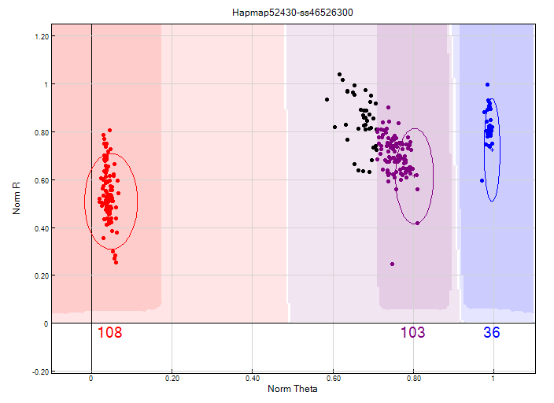
Before clustering adjustment
86% call rate

Slide 20
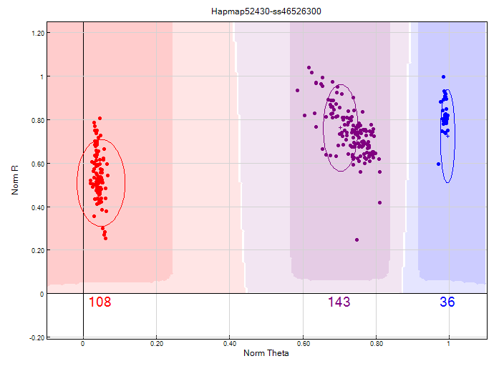
After clustering adjustment
100% call rate

Slide 21
Parentage validation and discovery
Parent-progeny conflicts detected
  Animal checked against all other genotypes
  Reported to breeds and requesters
  Correct sire usually detected
Maternal Grandsire checking
  SNP at a time checking
  Haplotype checking more accurate
Breeds moving to accept SNP in place of microsatellites
Notes:
21

Slide 22
Checking facility
Labs place genotype files on AIPL server
Genotypes run through analysis procedures, but not added to database
Reports on missing nominations and QC data returned to Lab
Lab can
  Detect sample misidentification
  Improve clustering
  Apply the same checks used by AIPL

Slide 23
Imputation
Based on splitting the genotype into individual chromosomes (maternal & paternal contributions)
Missing SNP assigned by tracking inheritance from ancestors and descendents
Imputed dams increase predictor population
3K, LD, & 50K genotypes merged by imputing SNP not on LD or 3K

Slide 24
Recessive defect discovery
Check for homozygous haplotypes
  Most haplotype blocks ~5Mbp long
  7 – 90 expected, but 0 observed
  5 of top 11 haplotypes confirmed as lethal
  Investigation of 936 – 52,449 carrier sire × carrier MGS fertility records found 3.0 – 3.7% lower conception rates

Slide 25
Haplotypes impacting fertility
Breed | BTA chromo-some | Location, Mbases | Carrier frequency, %
Holstein | 5 | 62–68 | 4.5
 | 1 | 93–98 | 4.6
 | 8 | 92–97 | 4.7
Jersey | 15 | 11–16 | 23.4
Brown Swiss | 7 | 42–47 | 14.0

Slide 26
Collaboration
Full sharing of genotypes with Canada
  CDN calculates genomic evaluations on Canadian base
Trading of Brown Swiss genotypes with Switzerland, Germany, and Austria
  Interbull may facilitate sharing
Agreements with Italy and Great Britain provide genotypes for Holstein
  Negotiations underway with other countries
Notes:
26

Slide 27
Calculation of genomic evaluations
Deregressed values derived from traditional evaluations of predictor animals
Allele substitutions random effects estimated for 45,187 SNP
Polygenic effect estimated for genetic variation not captured by SNP
Selection Index combination of genomic and traditional not included in genomic
Applied to yield, fitness, calving and type traits

Slide 28
Reliabilities for young Holsteins*
9000
50K genotypes
8000
3K genotypes
7000
6000
5000
Number of animals
4000
3000
2000
1000
0
40
45
50
55
60
65
70
75
80
Reliability for PTA protein (%)
*Animals with no traditional PTA in April 2011

Slide 29
Use of genomic evaluations
Determine which young bulls to bring into AI service
Use to select mating sires
Pick bull dams
Market semen from 2-year-old bulls

Slide 30
Use of LD genomic evaluations
Sort heifers for breeding
  Flush
  Sexed semen
  Beef bull
Confirm parentage to avoid inbreeding
Predict inbreeding depression better
Precision mating considering genomics (future)

Slide 31
Ways to increase accuracy
Automatic addition of traditional evaluations of genotyped bulls when reach 5 years of age
Possible genotyping of 10,000 bulls with semen in repository
Collaboration with more countries
Use of more SNP from HD chips
Full sequencing – Identify causative mutations

Slide 32
Application to more traits
Animal’s genotype is good for all traits
Traditional evaluations required for accurate estimates of SNP effects
Traditional evaluations not currently available for heat tolerance or feed efficiency
Research populations could provide data for traits that are expensive to measure
Will resulting evaluations work in target population?

Slide 33
Impact on producers
Young-bull evaluations with accuracy of early 1st­crop evaluations
AI organizations marketing genomically evaluated 2-year-olds
Genotype usually required for cow to be bull dam
Rate of genetic improvement likely to increase by up to 50%
Studs reducing progeny-test programs

Slide 34
Summary
Extraordinarily rapid implementation of genomic evaluations
Chips provide genotypes of high accuracy
Comprehensive checking insures quality of genotypes stored
Young-bull acquisition and marketing now based on genomic evaluations
Genotyping of many females because of lower cost low density chips

Slide 35
Why genomics works in dairy
Extensive historical data available
Well-developed genetic evaluation program
Widespread use of AI sires
Progeny test programs
High valued animals, worth the cost of genotyping
Long generation interval which can be reduced substantially by genomics
Notes:
35

Slide 36
History of genomic evaluations
Dec. 2007 BovineSNP50 BeadChip available
Apr. 2008 First unofficial evaluation released
Jan. 2009 Genomic evaluations official for
        Holstein and Jersey
Aug. 2009 Official for Brown Swiss
Sept. 2010 Unofficial evaluations from 3K chip
released
Dec. 2010 3K genomic evaluations to be official
Sept. 2011 Infinium BovineLD BeadChip available
Notes:
36

Slide 37
Current sources of data
PDCA
NAAB
DHI
AIPL
CDCB
Universities
AIPL Animal Improvement Programs Lab., USDA
CDCB Council on Dairy Cattle Breeding
DHI Dairy Herd Improvement (milk recording organizations)
NAAB National Association of Animal Breeders (AI)
PDCA Purebred Dairy Cattle Association (breed registries)

Slide 38
Sources of genomic data
Requester
(Ex: AI, breeds)
samples
nominations
evaluations
Dairy
producers
Genomic Evaluation Lab
samples
samples
genotypes
DNA
laboratories

Slide 39

How does genetic selection work?
ΔG = genetic gain each year
reliability = how certain we are about our estimate of an animal’s genetic merit (genomics can ⬆)
selection intensity = how “picky” we are when making mating decisions (management can ⬆)
genetic variance = variation in the population due to genetics (we can’t really change this)
generation interval = time between generations (genomics can ⬇)

Slide 40
Calculation of genomic evaluations
Deregressed values derived from traditional evaluations of predictor animals
Allele substitutions random effects estimated for 45,187 SNP
Polygenic effect estimated for genetic variation not captured by SNP
Selection Index combination of genomic and traditional not included in genomic
Applied to yield, fitness, calving, and type traits

Slide 41
Genetic merit of Jersey bulls
Net Merit ($)
Breeding Year

Slide 42
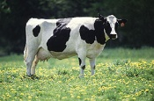
What is a SNP genotype worth?
Pedigree is equivalent to information on about 7 daughters
For the protein yield (h²=0.30), the SNP genotype provides information equivalent to an additional 34 daughters
Notes:
42

Slide 43

What is a SNP genotype worth?
And for daughter pregnancy rate (h²=0.04), SNP = 131 daughters
Notes:
43

Slide 44
Holstein prediction accuracy
Traitª | Bias^{b} | b | REL (%) | REL gain (%)
Milk (kg) | −64.3 | 0.92 | 67.1 | 28.6
Fat (kg) | −2.7 | 0.91 | 69.8 | 31.3
Protein (kg) | 0.7 | 0.85 | 61.5 | 23.0
Fat (%) | 0.0 | 1.00 | 86.5 | 48.0
Protein (%) | 0.0 | 0.90 | 79.0 | 40.4
PL (months) | −1.8 | 0.98 | 53.0 | 21.8
SCS | 0.0 | 0.88 | 61.2 | 27.0
DPR (%) | 0.0 | 0.92 | 51.2 | 21.7
Sire CE | 0.8 | 0.73 | 31.0 | 10.4
Daughter CE | −1.1 | 0.81 | 38.4 | 19.9
Sire SB | 1.5 | 0.92 | 21.8 | 3.7
Daughter SB | − 0.2 | 0.83 | 30.3 | 13.2
a PL=productive life, CE = calving ease and SB = stillbirth.
b 2011 deregressed value – 2007 genomic evaluation.

Slide 45
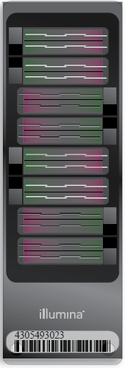

Many chips are available
50KV2
BovineSNP50
  Version 1 54,001 SNP
  Version 2 54,609 SNP
  45,187 used in evaluations
HD
  777,962 SNP
  Only 50K SNP used,
  >1700 in database
LD
  6,909 SNP
  Replaced 3K
HD
LD
Notes:
45

Slide 46
Genotypes and haplotypes
Genotypes indicate how many copies of each allele were inherited
Haplotypes indicate which alleles are on which chromosome
Observed genotypes partitioned into the two unknown haplotypes
  Pedigree haplotyping uses relatives
  Population haplotyping finds matching allele patterns

Slide 47
O-Style Haplotypes Chromosome 15

Slide 48
Haplotyping program – findhap.f90
Begin with population haplotyping
  Divide chromosomes into segments, ~250 to 75 SNP / segment
  List haplotypes by genotype match
  Similar to fastPhase, IMPUTE
End with pedigree haplotyping
  Detect crossover, fix noninheritance
  Impute nongenotyped ancestors

Slide 49
Recessive defect discovery
Check for homozygous haplotypes
  7 to 90 expected but none observed
  5 of top 11 are potentially lethal
  936 to 52,449 carrier sire-by-carrier MGS fertility records
  3.1% to 3.7% lower conception rates
  Some slightly higher stillbirth rates
Confirmed Brachyspina same way

Slide 50
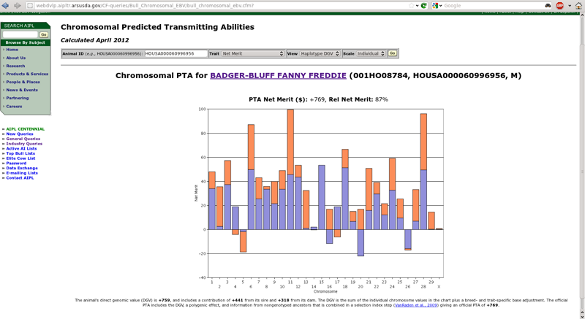
We’re working on new tools
Cole, J.B., and Null, D.J. 2012. AIPL Research Report GENOMIC2: Use of chromosomal predicted transmitting abilities. Available: http://aipl.arsusda.gov/reference/chromosomal_pta_query.html.

Slide 51
Impact on producers
Young-bull evaluations with accuracy of early 1st­crop evaluations
AI organizations marketing genomically evaluated 2-year-olds
Genotype usually required for cow to be bull dam
Rate of genetic improvement likely to increase by up to 50%
Studs reducing progeny-test programs

Slide 52
Bias from Pre-Selection
Expected value of Mendelian sampling no longer equal to 0
Key assumption of animal models
References:
  Patry, Ducrocq 2011 GSE 43:30
  Vitezica et al 2011 Genet Res (Camb) pp. 1–10.

Slide 53
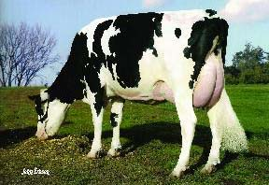
Pre-Selection Bias Now Beginning
Bulls born in 2008, progeny tested in 2009, with daughter records in 2012, were pre-selected:
  3,434 genotyped vs. 1,096 sampled
  Now >10 genotyped per 1 marketed
Potential for bias:
  178 genotyped progeny
  32 sons progeny tested

Slide 54
Methods to Reduce Bias
1-Step to incorporate genotypes
  Flexible models, many recent studies
  Foreign data not yet included
Multi-step GEBV, then insert in AM
  Same trait (Ducrocq and Liu, 2009)
  Or correlated trait (Mantysaari and Stranden, 2010; Stoop et al, 2011)
  Foreign genotyped bulls included

Slide 55

Gene set enrichment analysis-SNP
GWAS results
Gene pathways (G)
SNP ranked by significance (L)
Includes all SNP, S, that are included in L
SNP in pathway genes (S)
Score increases for each L_{i} in S
The more SNP in S that appear near the top of L, the higher the Enrichment Score
Score increase is proportional to SNP test statistic
Permutation test and FDR
Nominal p-value corrected for multiple testing
Pathways with moderate effects
Holden et al., 2008 (Bioinformatics 89:1669-1683. doi:10.2527/jas.2010-3681)

Slide 56
Adaptive weight matrix
Need to add this

Slide 57
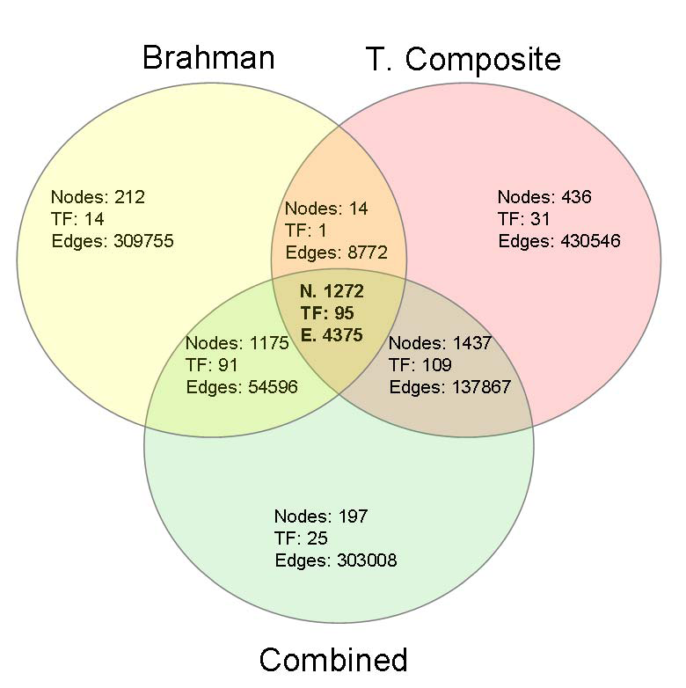
We hope to identify regulatory networks
Candidate genes and pathways that affect age at puberty common to both breeds
Fortes et al., 2011 (J. Animal Sci. 89:1669-1683. doi:10.2527/jas.2010-3681)

Slide 58
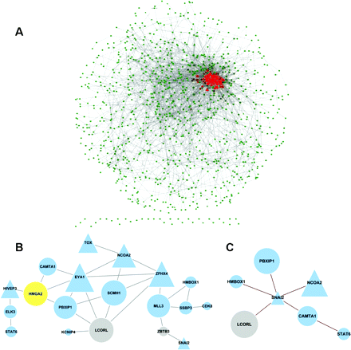
Network analysis
Gene network – the
red center identifies
highly connected nodes.
Subnetwork of interacting
transcription factors from a collection of mouse and human
data. (Validation step.)
Subnetwork of interacting
transcription factors from
the puberty network.
Fortes et al., 2011 (J. Animal Sci. 89:1669-1683. doi:10.2527/jas.2010-3681)

Slide 59
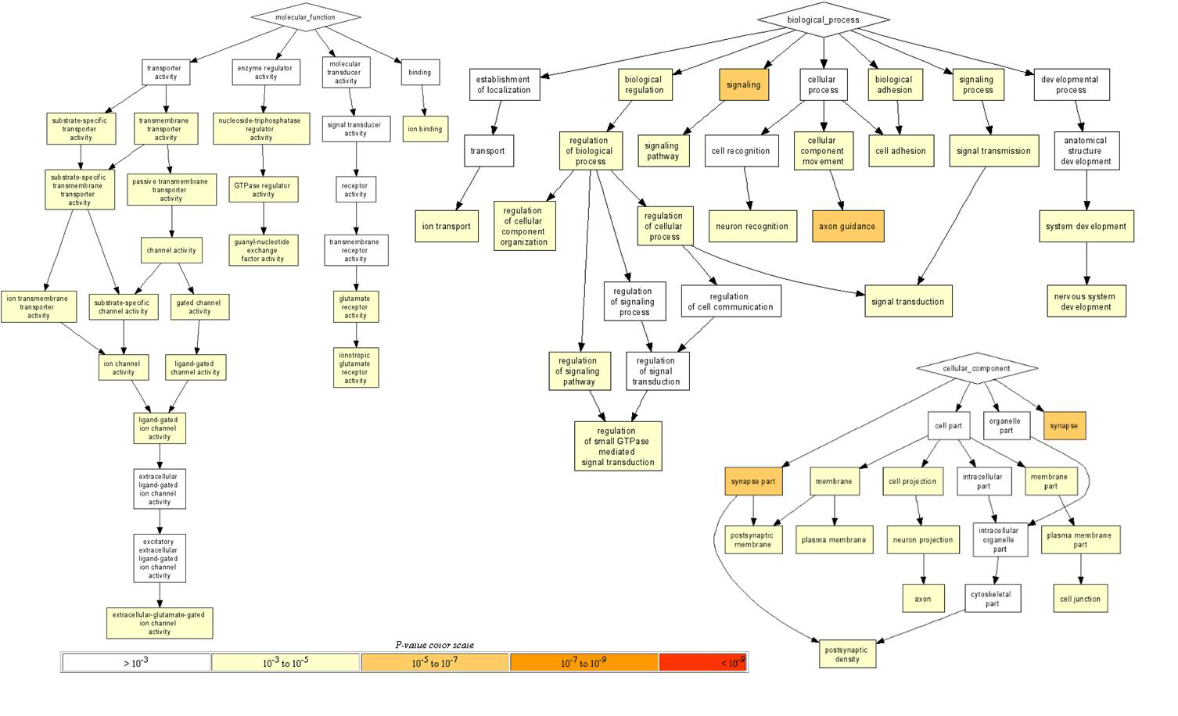
Enriched pathways
Fortes et al., 2011 (J. Animal Sci. 89:1669-1683. doi:10.2527/jas.2010-3681)

Slide 60
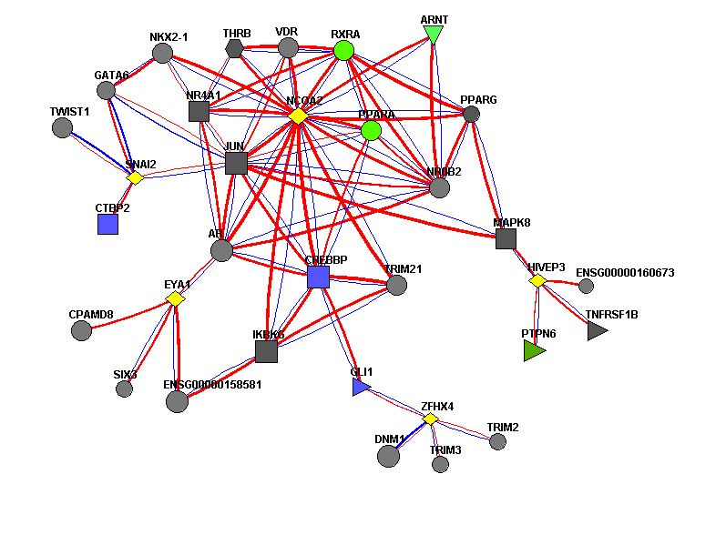
Transcription factor network
Yellow genes were submitted to database.
Other nodes were mined from FunCoup.
Red: protein-protein interaction
Blue: mRNA coexpression
Fortes et al., 2011 (J. Animal Sci. 89:1669-1683. doi:10.2527/jas.2010-3681)

Slide 61
GWAS for birth weight PTA
h
Cole et al.(2013), unpublished data

Slide 62
KEGG pathways for birth weight
Waiting on DMB

Slide 63
We have divergent populations
Cole et al., 2005 (J. Dairy Sci. 88(4):1529–1539)

Slide 64
What can we learn from this?
We are not going to find big QTL
We may identify gene networks affecting complex phenotypes
We’re going to learn how much we don’t know about functional genomics in the cow

Slide 65
Conclusions
…

Slide 66
Acknowledgments
…

Slide 67

Questions?
http://gigaom.com/2012/05/31/t-mobile-pits-its-math-against-verizons-the-loser-common-sense/shutterstock_76826245/

