Slide 1
Genotypes are Useful for More Than Genomic Evaluation

Slide 2
Uses for genotypes
Ancestor discovery within breeds
Inheritance tracking for chromosomes
Mating programs
Genomic inbreeding, dominance
Fertility defects – haplotypes and QTLs
Breed composition of crossbreds

Slide 3
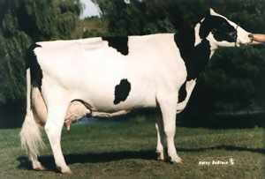
Sources of genotypes used
 | Phenotyped |  | Young
Continent | Female | Male | Female | Male | Totals
N. America | 93,345 | 23,598 | 329,780 | 76,786 | 523,509
Europe | 0 | 12,218 | 36,055 | 17,753 | 66,026
Oceania | 0 | 338 | 3,232 | 1,733 | 5,303
S. America | 0 | 3 | 2,720 | 333 | 3,056
Asia | 0 | 0 | 284 | 35 | 319
Africa | 0 | 0 | 281 | 3 | 284
Totals | 93,345 | 36,157 | 372,352 | 96,643 | 598,497
Notes:
As of March, 2014

Slide 4
Service applies to many chips
Different companies and densities
Illumina, GeneSeek, Zoetis, European LD
3K, 7K, 8K, 10K, 50K, 77K, and 777K chips
Imputed (nongenotyped) dams of ≥4 progeny
All animals imputed to 61,013 markers
Faster service without imputing also possible

Slide 5
Ancestor discovery tests
Database also stores initial pedigree status
Farmers correct pedigrees after DNA test
1 week for corrections before predictions
Sire initial status summarized (actual)
Maternal grandsire (actual and simulation)
5% of MGS set to incorrect and 5% missing

Slide 6
Sire initial status and discovery
 | Animals (N) |  | Animals (%)
Sire status | Females | Males | Females | Males
Correct | 195,770 | 37,416 | 68 | 85
Not genotyped | 17,628 | 2,490 | 6 | 6
Incorrect | 43,636 | 2,537 | 15 | 6
Missing | 32,269 | 1,474 | 11 | 3
Total | 289,390 | 43,931 | 100 | 100
Discovered | 50,538 | 2,968 | 17 | 7

Slide 7
MGS status (after corrections)
 | Animals (N) |  | Animals (%)
Sire status | Females | Males | Females | Males
Confirmed | 141,963 | 38,270 | 49 | 87
Not genotyped | 119,160 | 3,874 | 41 | 9
or missing
Unlikely | 28,267 | 1,787 | 10 | 4
Total | 289,390 | 43,931 | 100 | 100

Slide 8
Separate paternal and maternal DNA
Animal
Sire
1 haplotype of animal matches 1 haplotype of sire
The animal’s other haplotype must be from its dam
Notes:
8

Slide 9
MGS discovery using haplotypes
Animal
MGS
Matches=5, haplotypes tested=10,
50% match vs. 45% expected (due to crossovers)
Thus, MGS is confirmed

Slide 10
Discovery of missing ancestors
 | Ancestor discovered (if genotyped)
 | Sire | MGS | MGGS
Breed | % Correct* | % Correct | % Correct
Holstein | 100 | 97 | 92
Jersey | 100 | 95 | 95
Brown Swiss | 100 | 97 | 85
* % Correct = Top ranked candidate ancestor matches the true ancestor.

Slide 11
MGS accuracy by chip
 | SNP Method |  | HAP Method
Chip | N | % Confirmed | N | % Confirmed
Bovine50K | 3,620 | 97 | 3,197 | 98
Bovine3K | 1,733 | 78 | 1,455 | 94
Imputed dams | -- | -- | 106 | 92
BovineLD & GGP | 7,690 | 96 | -- | --

Slide 12
Genotyped ancestors, actual bull(HOUSA73431994)
777K 777K
50K - - -
50K 50K
50K 50K
777K 777K
50K - - -
3K 777K
50K 50K
777K 777K
50K Imputed
Imputed 50K
50K Imputed
50K 777K
50K 50K
50K 777K
9K - - -
777K 777K
50K Imputed
Imputed 50K
50K Imputed
50K 777K
50K 50K
3K 777K
9K 50K
50K 777K
50K 50K
50K 777K
50K Imputed
777K 777K
50K - - -
Imputed 777K
50K

Slide 13
Haplotype pedigree Chromosome 15, O-Style

Slide 14
Maternal / paternal haplotype values
https://www.cdcb.us/CF-queries/Bull_Chromosomal_EBV/bull_chromosomal_ebv.cfm

Slide 15
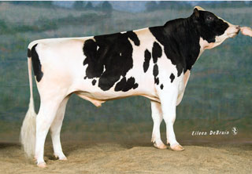
Pedigree or genomic mating?
Computer mating programs have helped breeders identify potential mates with fewer ancestors in common to reduce pedigree inbreeding
Such programs could instead help breeders to identify potential mates with fewer alleles in common to reduce genomic inbreeding
This works best if both mates are genotyped
Pedigree relationships
Genomic relationships

Slide 16
Genomic mating programs
Develop rapid methods to deliver genomic relationships (G) from central database to industry
Compute G for females with only marketed bulls
Compute G elements as needed by query
Compute G once, then retrieve elements as needed
Compare methods to assign mates
Minimize pedigree or genomic relationships
Linear programming (LP)
Sequentially choose least-related mates (Pryce et al., 2012)
Random mating
Include or exclude dominance effects of markers

Slide 17
Mating programs with dominance
With dominant genes, progeny merit may not equal the average of parents’ merit
Predicting dominance effects was difficult from pedigrees, but is easier with genomics
Dominance variance is smaller than additive
4% dominance vs. 25% additive for yield
1% dominance vs. 9% additive for SCS

Slide 18
Mating program results
With linear programming, genomic inbreeding was:
3% lower than with random mating
1% lower than with sequential mate selection
Genomic instead of pedigree relationships:
Added value was $32 * 184,693 calves = $5.9 million / year for Holstein females genotyped in 2013
Extra benefits from predicting dominance were small
Developed mating software is ready for service

Slide 19
Genomic mating computation
Times and disk storage required to compute G for all animals or recalculate elements of G as needed
Breed | G for cows and all proven bulls |  |  |  | G for cows and only marketed bulls
 | Time (h:min:s) |  | Disk Storage Gbytes |  | Animals (no.) |  | Computing time
 |  |  |  |  |  |  | Extraction (h:min:s) |  | Recalcu-lation (s)
Holstein | 16:22:42 |  | 426 |  | 1,817 |  | 1:58:06 |  | 31
Jersey | 00:17:11 |  | 7 |  | 585 |  | 0:01:46 |  | 6
Brown Swiss | 00:00:13 |  | 0.03 |  | 338 |  | 0:00:01 |  | 4

Slide 20
Fertility and stillbirth defects
Track new defects by haplotype or gene test
Holstein HH1, HH2, HH3, HH4 (Sebastien), HH5
Brown Swiss BH1, BH2 (Schwarzenbacher)
Jersey JH1, Fertility1 (LIC)
Montbeliarde MH1 and MH2 (Sebastien)
Ayrshire AH1
Track previous defects by haplotype or test
BLAD, Brachyspina, CVM, DUMPS, Mulefoot, SDM, SMA, Weaver, etc.
Not included on early chips, can impute from markers

Slide 21
Economics of fertility defect HH1
Pawnee Farm Arlinda Chief (born 1962)
Contributed 14% of global Holstein genes
$25 billion value of increased milk yield
$0.4 billion cost of HH1 mid-term abortions
How many more fertility defects are there?
Average 0.2 / animal based on inbreeding depression (VanRaden and Miller, 2006 JDS)

Slide 22
Haplotype tests, then lab tests
 | Frequency |  | Lab tests¹
Genotypes | JH1 | HH1 | JH1 | HH1
Normal | 76.5 | 97.2 | 9,867 | 113,792
Carrier | 21.3 | 2.4 | 2,750 | 2,793
Homozygous | 0.0 | 0.0 | 0 | 0
No call | 2.1 | 0.4 | 276 | 464
Total | 100.0 | 100.0 | 12,893 | 117,049
¹Data from the Geneseek Genomic Profiler (GGP) and GGP-HD for causative mutations (JH1 = CWC15 and HH1 = APAF1)

Slide 23
Jay Lush, 1948 (The Genetics of Populations)
“The rapid rate at which genes have been found in each species, whenever people started to study it genetically, and the fact that in most of these species the rate of finding new genes actually seemed to increase with continued study until so many genes were known that interest in keeping stocks of each new one waned.” (p. 32)

Slide 24
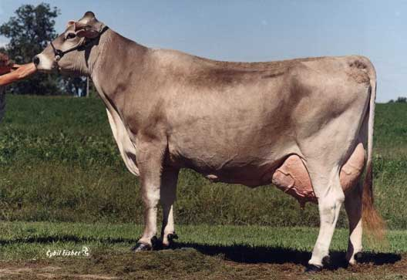
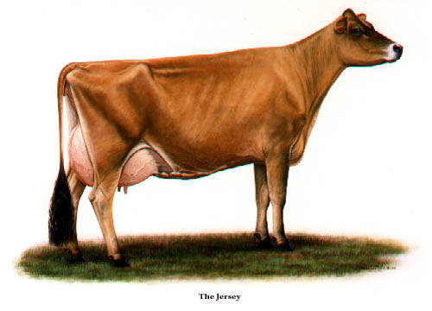
Predict breed and breed composition
Used purebred Holsteins, Jerseys, and Brown Swiss genotypes to develop equations
Predict breed fractions for crossbred animals

Slide 25
Predict breed composition as a ‘trait’
Y- variable was breed of animal
A Holstein would receive a 1 in the Holstein analysis and a 0 in the Jersey and Brown Swiss analyses
Animal Breed | Holstein Analysis | Jersey Analysis | BSW Analysis
HOL | 1 | 0 | 0
JER | 0 | 1 | 0
BSW | 0 | 0 | 1

Slide 26
Number of SNP to predict breed
3 different SNP sets were used for genomic prediction of breed composition (Bayes A)
The full 43,385 SNP set
A reduced 3K SNP set
The original 600 breed check SNPs
Each breed (HOL, JER, BSW) has ~200 SNP used for a quick check (not a genomic prediction)
Included 22,679 males and 6,480 females

Slide 27
Accuracy of breed prediction
Means and standard deviations for predicting breed percentages for young, validation animals
Markers: Breed: | 43 K | 3 K | 600
Holstein N = 14,794 | 100.0 ± 0.8 | 100.4 ± 3.1 | 100.2 ± 1.9
Jersey N = 919 | 99.6 ± 2.8 | 97.8 ± 6.3 | 98.9 ± 3.6
Brown Swiss N = 96 | 99.4 ± 2.1 | 98.9 ± 3.6 | 99.2 ± 5.1

Slide 28
Breed prediction example (crossbred)
Animal pedigree = 87.5% HOL, 12.5% JER
43K prediction = 85.9% HOL, 13.3% JER
3K prediction = 84.4% HOL, 15.5% JER
600 SNP predict= 83.0% HOL, 16.6% JER
Accuracy is lower for very old or foreign animals with unusual pedigrees
Genotypes for each pure breed are needed

Slide 29
Manage differently by genotype?
Known as personalized medicine for humans
Different management is costly in livestock
Early culling instead of veterinary treatment
Total mixed ration replaced individual rations
Several breeds and crossbreds grouped together
Estimate herd management effects more accurately after subtracting genomic effects

Slide 30
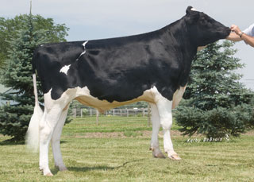
Top young bulls from April 2010
 | Net Merit |  |  | Daughters
Bull | 2014 | 2010 | PA 2010 | 2014 | 2010
Observer | 646 | 848 | 552 | 2101 | 0
Robust | 834 | 821 | 522 | 511 | 0
Twist | 800 | 817 | 491 | 337 | 0
Edward | 584 | 789 | 532 | 184 | 0
Erdman | 821 | 778 | 529 | 349 | 0
Networth | 619 | 771 | 566 | 218 | 0
Bookem | 699 | 761 | 575 | 1482 | 0
Mauser | 656 | 759 | 464 | 288 | 0
Top 8 Avg | 707 | 793 | 529 | 684 | 0

Slide 31
Embryo transfer calves, by year

Slide 32
Conclusions
75,905 females had missing or incorrect sires; a true sire was suggested for 50,538 (67%)
MGS and great grandsires can be discovered; pedigree corrections are more difficult
Genomic mating programs will be profitable
New defects are easy to discover and track
Genotypes also useful for genomic evaluation

Slide 33
Acknowledgments
Katie Olson, Mel Tooker, Jan Wright, Lillian Bacheller, George Wiggans, and Jeff O’Connell contributed to the computation and graphics
Members of the Council on Dairy Cattle Breeding (CDCB) provided the data

Slide 34
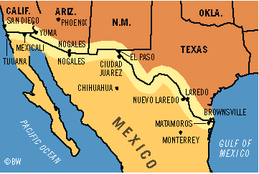
Tear down this wall

