Slide 1
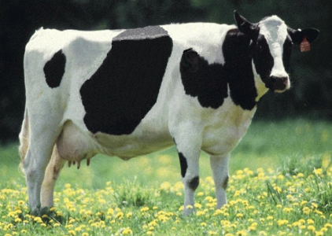
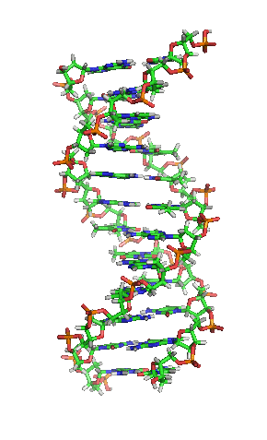
AGIL Technical Report
Animal Improvement Program (AIP) Project

Slide 2
AIP objectives
Expand national and international collection of phenotypic and genotypic data
Develop a more accurate genomic evaluation system with advanced, efficient methods to combine pedigrees, genotypes, and phenotypes
Use economic analysis to maximize genetic progress and financial benefits from collected data

Slide 3
AIP scientists
Paul VanRaden (project leader)
Genomic evaluation methods, haplotypes
George Wiggans (CDCB liaison)
SNP selection, genotype exchange, goats
John Cole
Fertility, health, heat stress resistance, indexes
Derek Bickhart
Sequence data analysis, genome assembly
correction and gene annotation
Kristen Parker Gaddis (UFL postdoctoral associate)
Fertility, health, use of sequence data, data-mining

Slide 4
Primary traits evaluated
Yield (milk, fat, and protein)
Longevity (productive life)
Fertility (conception and pregnancy rates)
Calving (calving ease and stillbirth)
Health (somatic cell score)
Conformation

Slide 5
Changes during past year
New software for traditional PTAs
Replaced programs used since 1989
Multitrait evaluation
Changed input data for pregnancy rate
Base change for all traits
Net merit revision with more traits
Weekly instead of monthly genomic evaluation
Added 140K chip

Slide 6
In the pipeline or recently implemented
Genomic evaluations for Guernseys
Breed composition and GPTAs for crossbreds
Increase to 77,531 SNPs used for evaluations
(includes 30 gene tests provided by GeneSeek)
New GeneSeek 7K chip
Goats (separate management groups for miniature and standard)

Slide 7
Research areas
Develop applications for sequence data
Develop evaluations for new traits
Acquire data for additional traits
Improve evaluations

Slide 8
Impute to sequence
Determine variants in sequence data of most interest
Impute genotypes of bulls in predictor population to sequence
Include HD genotypes to add imputation accuracy

Slide 9
Sequencing to aid imputation
Cooperative project with CDDR to build haplotype library
Bulls homozygous for haplotype give highest accuracy
Selected over 200 bulls to identify rare variants needed for high accuracy imputation

Slide 10
Further use of sequence data
Discovery of causative genetic variants
Refinement of SNPs used in genomic evaluation
Add discovered causative variants
Use some SNPs for imputation but not for estimation of SNP effects
Create genotypes for genomic evaluation from sequence data to enable immediate use through imputation of any new SNPs

Slide 11
Evaluation of new traits
Mortality
Days to first breeding
Gestation length
Resistance to heat stress
(predicting genotype × environment interactions)
Persistency

Slide 12
Additional traits requiring data
Clinical mastitis
Displaced abomasum
Ketosis
Foot health
Immune response
Other health traits
Feed efficiency
Methane production
Milk fatty acid composition from mid-infrared

Slide 13
Improved evaluation techniques
Avoid bias due to genomic preselection
1-step evaluation
Include genotypes along with trait observations in a single analysis
Developments by University of Georgia enable inversion of large genomic relationship matrix

Slide 14
Mating programs
Genomic relationships of genotyped females with available bulls provided
Determination of best mate possible
Dominance effects could be considered

Slide 15
Take-home message
Ongoing research to improve genetic evaluations
Sequence data provides great opportunity to make genomic evaluations more accurate
CDCB plans to acquire data necessary for evaluating new traits

Slide 16
Acknowledgments
CDCB
Binational Agricultural Research and Development (BARD)
National Institute of Food and Agriculture (NIFA), USDA
Washington State University (NIFA grant)

Slide 17
AIP research team

