Slide 1
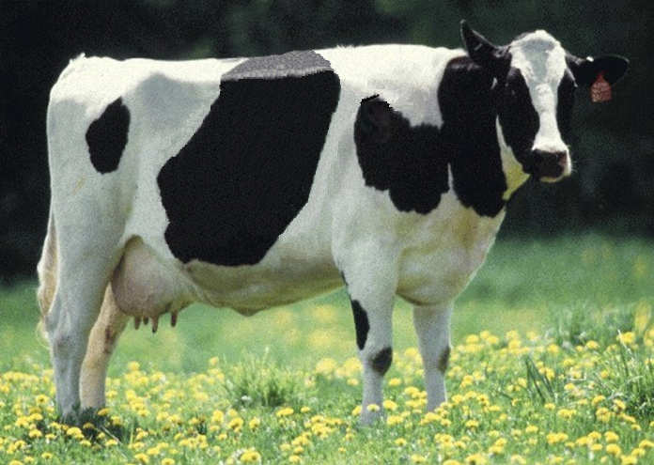
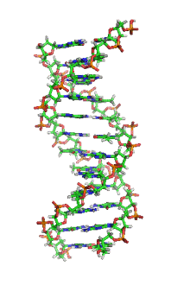
US genomic evaluation system

Slide 2
History of genomic evaluations
BovineSNP50 BeadChip available Dec. 2007
First unofficial evaluation released Apr. 2008
Official evaluations for Holsteins and Jerseys Jan. 2009
Official evaluations for Brown Swiss Aug. 2009
Monthly evaluation Jan. 2010
Official 3K evaluations Dec. 2010
BovineLD BeadChip available Sept. 2011
Official evaluations for Ayrshires Apr. 2013
Weekly evaluation Nov. 2014
Notes:
2

Slide 3
Collaboration with industry
Council on Dairy Cattle Breeding (CDCB) responsible for receiving data and for computing and delivering US genetic evaluations for dairy cattle
Animal Genomics and Improvement Lab (AGIL) responsible for research and development to improve the evaluation system
CDCB and AGIL employees co-located in Beltsville
Dr. João Dürr is CDCB CEO

Slide 4
Staff
Research team
  4 senior scientists
  6 support scientists
  4 information technology specialists
  1 administrative assistant
On-site collaborators
  Council of Dairy Cattle Breeding
  (CEO, systems administrator, and 2 consultants)

Slide 5

Funding
CDCB evaluation calculation and dissemination funded by fee system
  Based on animals genotyped
  87% of revenue from bulls
  Higher fees for herds that
  contribute less information
USDA research on evaluation methodology funded by US Federal Government
$

Slide 6
Council on Dairy Cattle Breeding
CDCB
PDCA
NAAB
DRPC
DHI
Purebred Dairy
Cattle Association
National Association of Animal Breeders
Dairy Records
Processing Centers
Dairy Herd
Information
3 members from each organization
Total of 12 voting members
2 nonvoting industry members

Slide 7
Genomic data flow
Dairy Herd Information (DHI) producer
DNA samples
DNA samples
genomic
evaluations
DNA laboratory
DNA samples
AI organization,
breed association
genotypes
genotypes
nominations,
pedigree data
genotype
quality reports
genomic
evaluations
Council on Dairy Cattle Breeding (CDCB)
Notes:
7

Slide 8
Evaluation flow
Animal nominated for genomic evaluation by approved nominator
DNA source sent to genotyping lab (2014)

Source | Samples (no.) | Samples (%)
Blood | 10,727 | 4
Hair | 113,455 | 39
Nasal swab | 2,954 | 1
Semen | 3,432 | 1
Tissue | 149,301 | 51
Unknown | 12,301 | 4

Slide 9

Evaluation flow (continued)

DNA extracted and placed on chip for 3-day genotyping process
Genotypes sent from
genotyping lab to CDCB
for accuracy review


Slide 10
Genotype chips
Chip | SNP (no.) |  | Chip | SNP (no.)
50K | 54,001 |  | GP2 | 19,809
50K v2 | 54,609 |  | ZLD | 11,410
3K | 2,900 |  | ZMD | 56,955
HD | 777,962 |  | ELD | 9,072
Affy | 648,875 |  | LD2 | 6,912
LD | 6,909 |  | GP3 | 26,151
GGP | 8,762 |  | ZL2 | 17,557
GHD | 77,068 |  | ZM2 | 60,914

Slide 11
Laboratory quality control
Each SNP evaluated for
  Call rate
  Portion heterozygous
  Parent-progeny conflicts
Clustering investigated if SNP exceeds limits
Number of failing SNP indicates genotype quality
Target of <10 SNP in each category

Slide 12

Parentage validation and discovery
Parent-progeny conflicts detected
  Animal checked against all other genotypes
  Reported to breeds and requesters
  Correct sire usually detected
Maternal grandsire checking
  SNP at a time checking
  Haplotype checking more accurate
Breeds moving to accept SNP in
place of microsatellites
Who’s your daddy?
Notes:
12

Slide 13
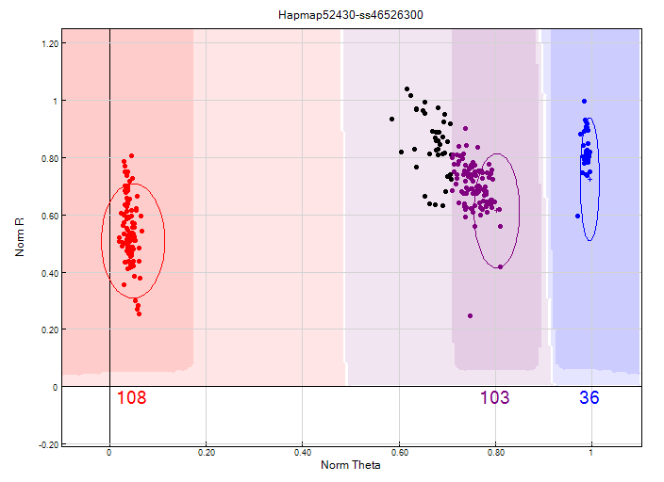
Before clustering adjustment
86% call rate

Slide 14
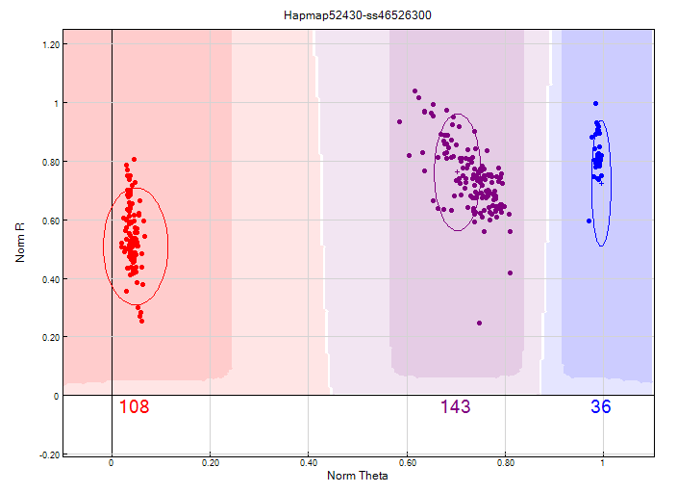
After clustering adjustment
100% call rate

Slide 15
Evaluation flow (continued)


Genotype calls modified as necessary
Genotypes loaded into database
Nominators receive reports of parentage and other conflicts
Pedigree or animal assignments corrected
Genotypes extracted and imputed to 61K
SNP effects estimated
Final evaluations calculated






Slide 16
Evaluation flow (continued)

Evaluations released to dairy industry
  Download from CDCB FTP site with
  separate files for each nominator
  Weekly release of evaluations of new animals
  Monthly release for females and bulls not marketed
  All genomic evaluations updated 3 times each year with traditional evaluations

Slide 17
2014 genotypes by chip SNP density
Chip SNP density | Female | Male | All animals
Low | 239,071 | 29,631 | 268,702
Medium | 9,098 | 14,202 | 23,300
High | 140 | 28 | 168
All | 248,309 | 43,861 | 292,170

Slide 18
2014 genotypes by breed and sex
Breed | Female | Male | All animals | Female: male
Ayrshire | 1,485 | 209 | 1,694 | 88:12
Brown Swiss | 944 | 8,641 | 9,585 | 10:90
Guernsey | 1,777 | 333 | 2,110 | 84:16
Holstein | 212,765 | 30,883 | 243,648 | 87:13
Jersey | 31,323 | 3,793 | 35,116 | 89:11
Milking Shorthorn | 2 | 1 | 3 | 67:33
Normande | 0 | 1 | 0 | 0:100
Crossbred | 13 | 0 | 13 | 100:0
All | 248,309 | 43,861 | 292,170 | 85:15

Slide 19
Genotypes by animal age (last 12 months)
≤
≥

Slide 20
Growth in bull predictor population
Breed | Jan. 2015 | 12-mo gain
Ayrshire | 711 | 29
Brown Swiss | 6,112 | 336
Holstein | 26,759 | 2,174
Jersey | 4,448 | 245

Slide 21
Holstein prediction accuracy
Trait | Bias* | Reliability (%) | Reliability gain (% points)
Milk (kg) | −80.3 | 69.2 | 30.3
Fat (kg) | −1.4 | 68.4 | 29.5
Protein (kg) | −0.9 | 60.9 | 22.6
Fat (%) | 0.0 | 93.7 | 54.8
Protein (%) | 0.0 | 86.3 | 48.0
Productive life (mo) | −0.7 | 73.7 | 41.6
Somatic cell score | 0.0 | 64.9 | 29.3
Daughter pregnancy rate (%) | 0.2 | 53.5 | 20.9
Sire calving ease | 0.6 | 45.8 | 19.6
Daughter calving ease | −1.8 | 44.2 | 22.4
Sire stillbirth rate | 0.2 | 28.2 | 5.9
Daughter stillbirth rate | 0.1 | 37.6 | 17.9
*2013 deregressed value – 2009 genomic evaluation

Slide 22
Holstein prediction accuracy
Trait | Bias* | Reliability (%) | Reliability gain (% points)
Final score | 0.1 | 58.8 | 22.7
Stature | −0.2 | 68.5 | 30.6
Dairy form | −0.2 | 71.8 | 34.5
Rump angle | 0.0 | 70.2 | 34.7
Rump width | −0.2 | 65.0 | 28.1
Feed and legs | 0.2 | 44.0 | 12.8
Fore udder attachment | −0.2 | 70.4 | 33.1
Rear udder height | −0.1 | 59.4 | 22.2
Udder depth | −0.3 | 75.3 | 37.7
Udder cleft | −0.2 | 62.1 | 25.1
Front teat placement | −0.2 | 69.9 | 32.6
Teat length | −0.1 | 66.7 | 29.4
*2013 deregressed value – 2009 genomic evaluation

Slide 23
Reliability gains
Reliability (%) | Ayrshire | Brown Swiss | Jersey | Holstein
Genomic | 37 | 54 | 61 | 70
Parent average | 28 | 30 | 30 | 30
Gain | 9 | 24 | 31 | 40
Reference bulls | 680 | 5,767 | 4,207 | 24,547
Animals genotyped | 1,788 | 9,016 | 59,923 | 469,960
Exchange partners | Canada | Canada, Interbull | Canada, Denmark | Canada, Italy, UK
Source: VanRaden, Advancing Dairy Cattle Genetics: Genomics and Beyond presentation, Feb. 2014

Slide 24
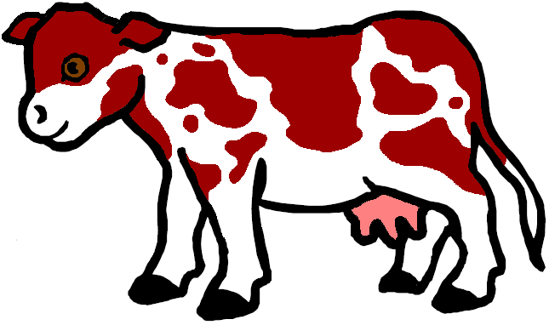
Gene tests (imputed and actual)
Bovine leucocyte adhesion deficiency (BLAD)
Complex vertebral malformation (CVM)
Deficiency of uridine monophosphate synthase (DUMPS)
Syndactyly (mulefoot)
Weaver Syndrome, spinal dismyelination (SDM), spinal muscular atrophy (SMA)
Red coat color
Polledness

Slide 25
New fertility haplotype for Jerseys (JH2)
Chromosome 26 at 8.8 – 9.4 Mbp
Carrier frequency
  14 – 28% in decades before 1990
  Only 2.6% now
Estimated effect on conception rate of – 4.0% ± 1.5%
Additional sequencing needed to find causative genetic variant

Slide 26
Parent ages for marketed Holstein bulls

Slide 27
Inbreeding for Holstein cows
– Inbreeding
– Expected future inbreeding

Slide 28
Active AI bulls that were genomic bulls

Slide 29
Marketed Holstein bulls
Year entered AI | Traditional progeny- tested | Genomic marketed | All bulls
2008 | 1,768 | 170 | 1,938
2009 | 1,474 | 346 | 1,820
2010 | 1,388 | 393 | 1,781
2011 | 1,254 | 648 | 1,902
2012 | 1,239 | 706 | 1,945
2013 | 907 | 747 | 1,654
2014 | 661 | 792 | 1,453

Slide 30
Genetic merit of marketed Holstein bulls
Average gain:
$87.49/year
Average gain:
$47.95/year
Average gain:
$19.42/year

Slide 31
Stability of genomic evaluations
642 Holstein bulls
  Dec. 2012 NM$ compared with Dec. 2014 NM$
  First traditional evaluation in Aug. 2014
  ≥50 daughters by Dec. 2014
Top 100 bulls in 2012
  Average rank change of 9.6
  Maximum drop of 119
  Maximum rise of 56
All 642 bulls
  Correlation of 0.94 between 2012 and 2014
  Regression of 0.92
Notes:
31

Slide 32
Haplotypes affecting fertility
Rapid discovery of new recessive defects
  Large numbers of genotyped animals
  Affordable DNA sequencing
Determination of haplotype location
  Significant number of homozygous animals expected, but none observed
  Narrow suspect region with fine mapping
  Use sequence data to find causative mutation

Slide 33
Haplotypes affecting fertility
Name | BTA chromo- some | Location* (Mbp) | Carrier frequency (%) | Earliest known ancestor
HH1 | 5 | 63.2* | 3.8 | Pawnee Farm Arlinda Chief
HH2 | 1 | 94.9 – 96.6 | 3.3 | Willowholme Mark Anthony
HH3 | 8 | 95.4* | 5.9 | Glendell Arlinda Chief, Gray View Skyliner
HH4 | 1 | 1.3* | 0.7 | Besne Buck
HH5 | 9 | 92.4 – 93.9 | 4.4 | Thornlea Texal Supreme
JH1 | 15 | 15.7* | 24.2 | Observer Chocolate Soldier
JH2 | 26 | 8.8 – 9.4 | 2.6 | Liberators Basilius
BH1 | 7 | 42.8 – 47.0 | 13.3 | West Lawn Stretch Improver
BH2 | 19 | 10.6 – 11.7 | 15.6 | Rancho Rustic My Design
AH1 | 17 | 65.9* | 26.0 | Selwood Betty’s Commander
*Causative mutation known

Slide 34
Haplotype tracking of known recessives
Recessive | Haplo-type | BTA chromo- some | Tested animals (no.) | Concord- ance (%) | New carriers (no.)
Brachyspina | HH0 | 21 | ? | ? | ?
BLAD | HHB | 1* | 11,782 | 99.9 | 314
CVM | HHC | 3* | 13,226 | — | 2,716
DUMPS | HHD | 1* | 3,242 | 100.0 | 3
Mule foot | HHM | 15* | 87 | 97.7 | 120
Polled | HHP | 1 | 345 | — | 2,050
Red coat color | HHR | 18* | 4,137 | — | 5,927
SDM | BHD | 11* | 108 | 94.4 | 108
SMA | BHM | 24* | 568 | 98.1 | 111
Weaver | BHW | 4 | 163 | 96.3 | 32
*Causative mutation known

Slide 35
Recent accomplishments
Introduction of imputed indicators for inherited defects of dairy cattle
Introduction of genomic evaluations for Ayrshires
Discovery of additional haplotypes that affect fertility
Improved accuracy of genomic evaluations by an increase to 60,671 DNA markers
Improved weighting of cow evaluations
Multitrait traditional evaluations for heifer and cow conception rates

Slide 36
December 2014 changes
Net merit update
Grazing index
Genomic mating program
Base change
Weekly evaluations
New computer programs for traditional evaluations
New definition of daughter pregnancy rate

Slide 37
Weekly evaluations
Released to nominators, breed associations, and dairy records processing centers at 8 am each Tuesday
Calculations restricted to genotypes that first became usable during the previous week
Computing time minimized by not calculating reliability or inbreeding

Slide 38
Application to more traits
Animal’s genotype good for all traits
Traditional evaluations required for accurate estimates of SNP effects
Traditional evaluations not currently available for heat tolerance or feed efficiency
Research populations could provide data for traits that are expensive to measure
Will resulting evaluations work in target population?

Slide 39
What’s already planned
Genomic evaluations for new traits
  Health
  Feed efficiency
Genomic mating programs
  Selection of favorable minor alleles
  Reduction of genomic inbreeding
Adding SNP for causative genetic variants

Slide 40
What’s already planned (continued)
BARD project (Volcani Center, Israel)
  A posteriori granddaughter design (APGD)
  Identification of causative variants for economically important traits
International collaboration on sequencing
  United States, United Kingdom, Italy, Canada
  Bulls selected using APGD
  Participation in 1000 Bull Genomes project

Slide 41
GeneSeek 77K chip (GHD)
Designed to include the most informative SNP
76,934 SNP typically provided, including
  Y
  Single-gene tests
About 28,200 50K SNP included
(mostly low MAFs excluded)
Other SNP selected from HD based on MAF and magnitude of effect

Slide 42
Current SNP set for genomic evaluations
60,671 SNP used after culling on
  MAF
  Parent-progeny conflicts
  Percentage heterozygous (departure from HWE)
SNP for HH1, BLAD, DUMPS, CVM, polled, red, and mulefoot included
  JH1 included for Jerseys
Some SNP eliminated because incorrect location  haplotype non-inheritance

Slide 43
New GHD version (Expected this month)
Around 143,000 SNPs expected
Include 16,248 among 60,671 SNPs currently used that are not on GHD
Many added SNPs have low to moderate minor allele frequency
  Increasing to 85,000 SNP improves evaluation accuracy

Slide 44
Low-cost chip (expected this month)
~4,100 SNPs
Built-in validation
Single-gene tests
Lower imputation accuracy if neither parent genotyped
Imputation accuracy within 1% of LD chip if at least 1 parent genotyped

Slide 45
Mating programs
Match genotypes of parents to minimize genomic inbreeding
Avoid mating carriers
Consider nonadditive gene action
May attempt to increases variance to get outliers

Slide 46
Why genomics works for dairy cattle
Extensive historical data available
Well-developed genetic evaluation program
Widespread use of AI sires
Progeny-test programs
High-value animals worth the cost of genotyping
Long generation interval that can be reduced substantially by genomics
Notes:
46

Slide 47
Future
Discovery of causative genetic variants
  Do not have linkage decay
  Added to chips as discovered
  Used when enough genotypes exist to support imputation
  Accelerated by availability of sequence data at a lower cost
Evaluation of benefit from larger SNP sets as cost per SNP genotype declines
Application of genomics to more traits
Across-breed evaluation
Accounting for genomic pre-selection

Slide 48
Conclusions
Genomic evaluation has dramatically changed dairy cattle breeding
Rate of gain has increased primarily because of large reduction in generation interval
Genomic research is ongoing
  Detect causative genetic variants
  Find more haplotypes that affect fertility
  Improve accuracy

Slide 49
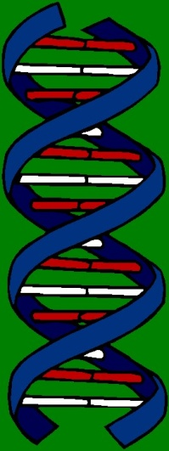
Questions?

