Slide 1
If we would see further than others: research & technology today and tomorrow

Slide 2
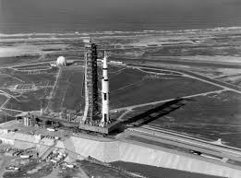

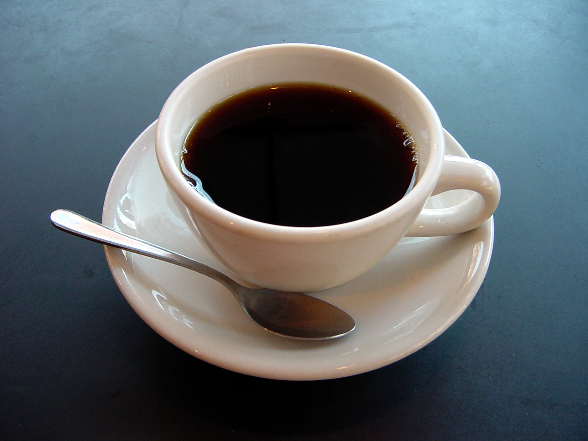
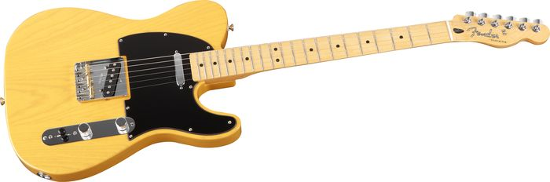
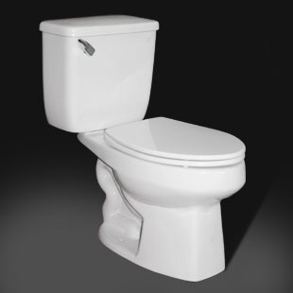
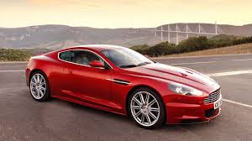
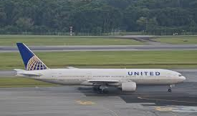
We all have our favorite technologies

Slide 3
Benefits of technology
Technologies provide benefits by making our work…
  Faster – More outputs are produced per unit of time.
  Cheaper – The cost of producing a unit of output decreases.
  Easier – Tasks require less physical or mental labor.
Notes:
3
3

Slide 4
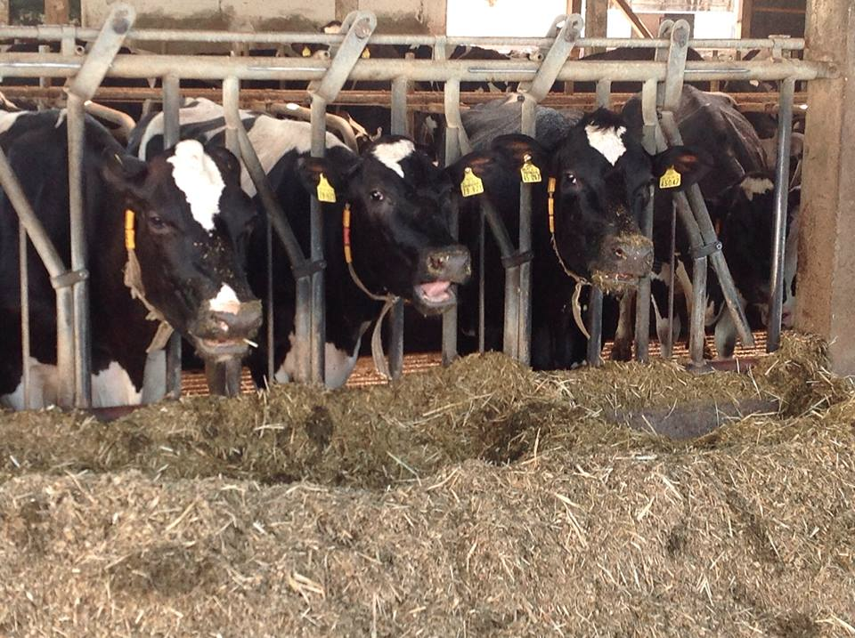
This is the age of precision
We now have technologies to monitor what goes into and what comes out of cows with great precision.
Inputs and outputs are inextricably linked.
We want the highest quality available at the possible lowest cost.
Notes:
4
4

Slide 5
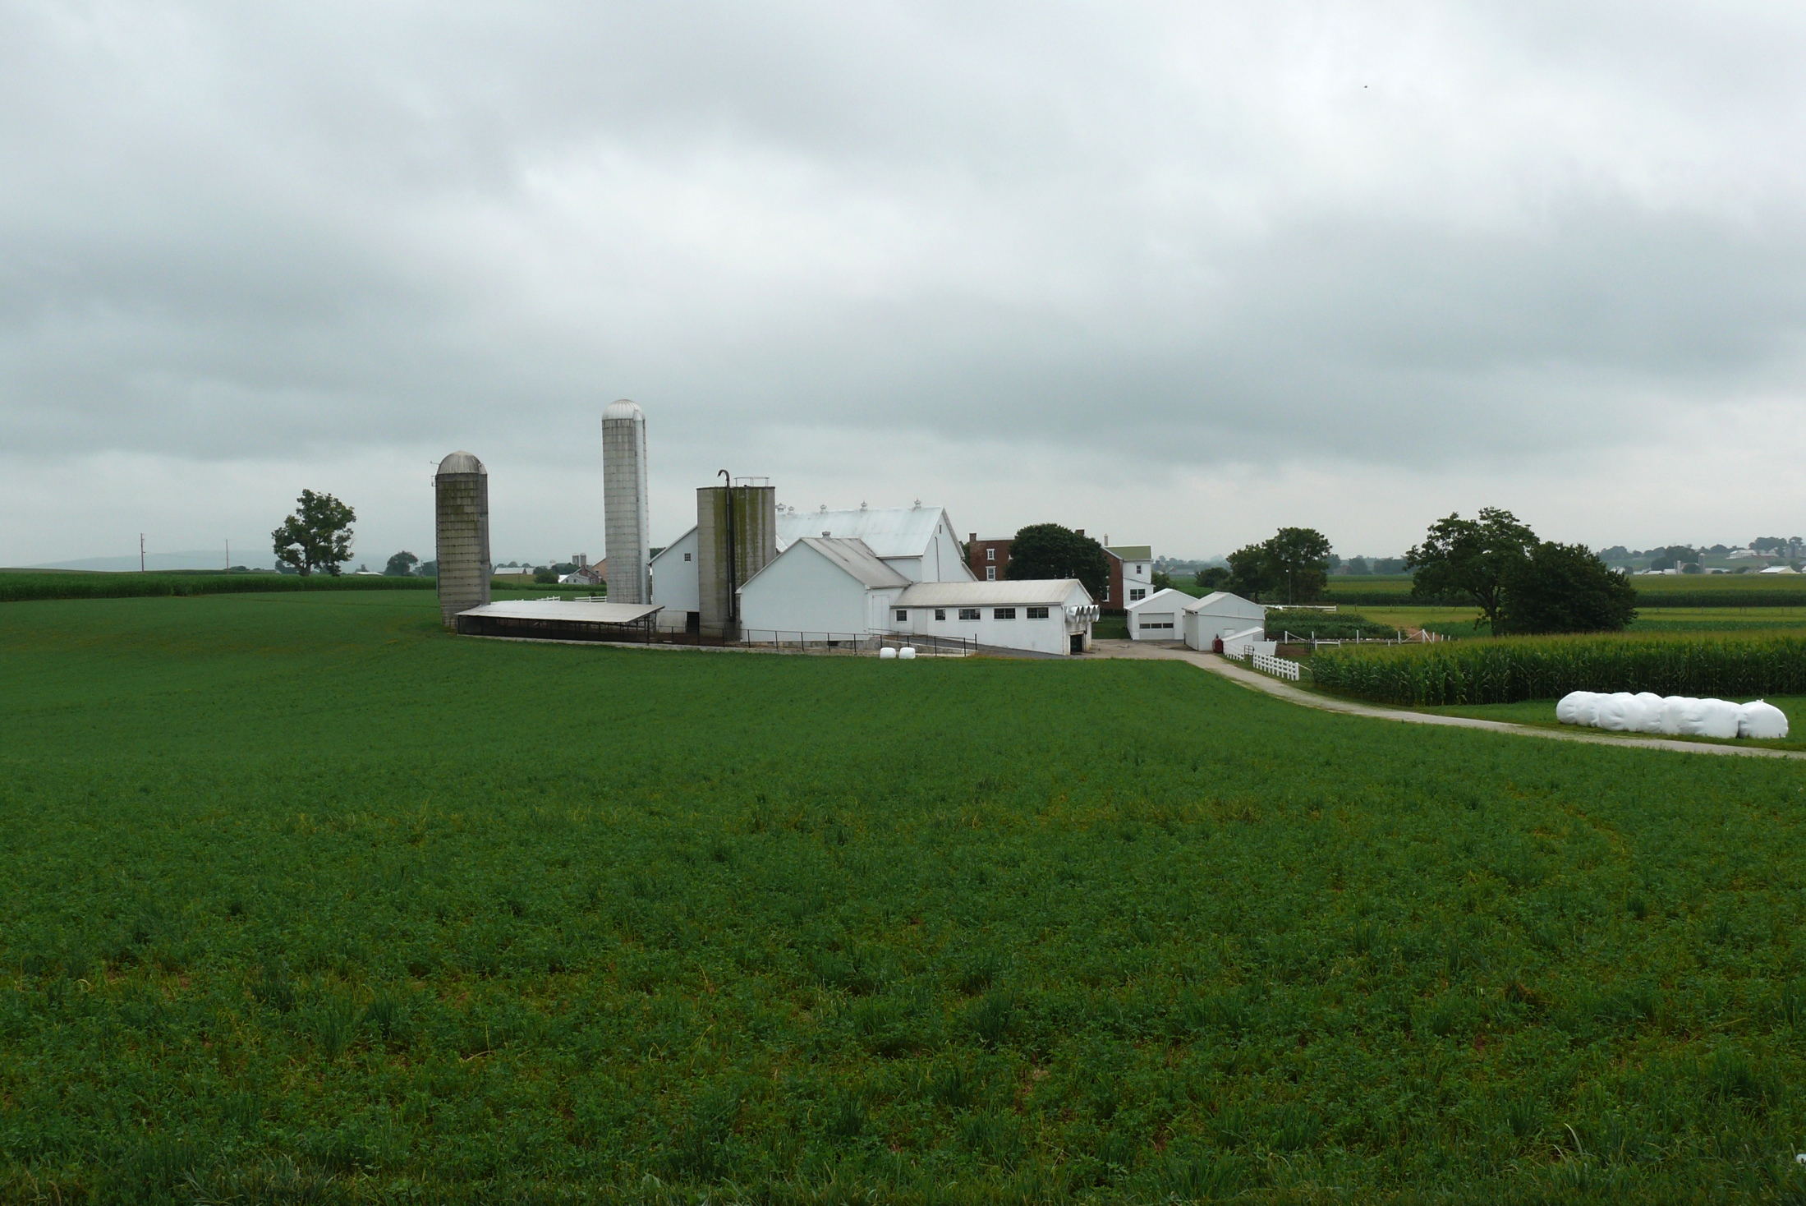
Everything needs to support cows
Barn: provides a safe and health habitat for animal production
Herdsmen/consultants: experts ensure that cows have an optimal environment in which to perform
Cow: the dairy cow is the machine without which the farm cannot function
Parlor: milk and milk solids are the primary source of dairy farm income
Silo/bunker: cattle cannot perform without high-quality diets
Pasture: provides nutrition and supports animal welfare
http://commons.wikimedia.org/wiki/File:Amish_dairy_farm_3.jpg

Slide 6
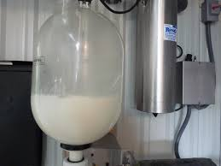
High technology on my first farm…
Source: http://seasonalontariofood.blogspot.com/2011/04/visit-to-wooldrift-farm.html.

Slide 7

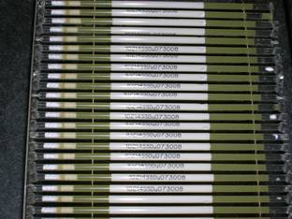
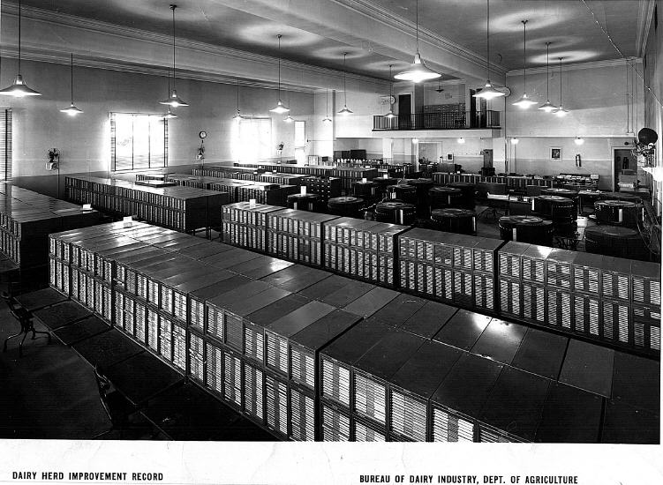
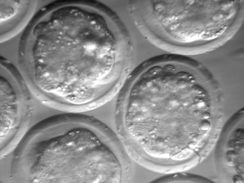
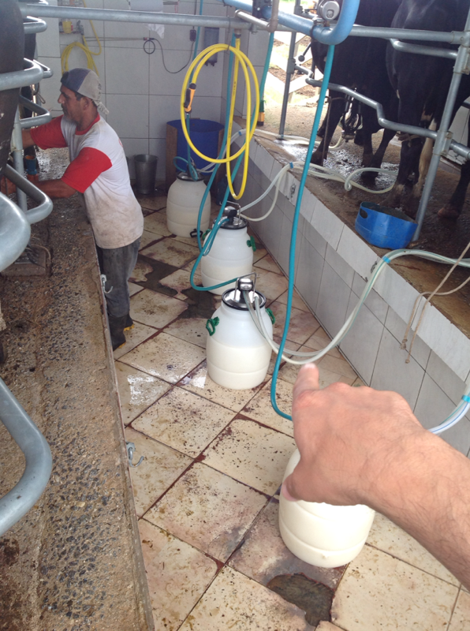
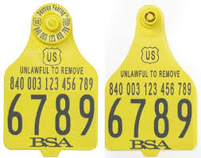
The dairy industry has been a leader
Source: http://vet.tufts.edu/tas/images/002.png.
Source: http//www.shopbrownswiss.com/.

Slide 8
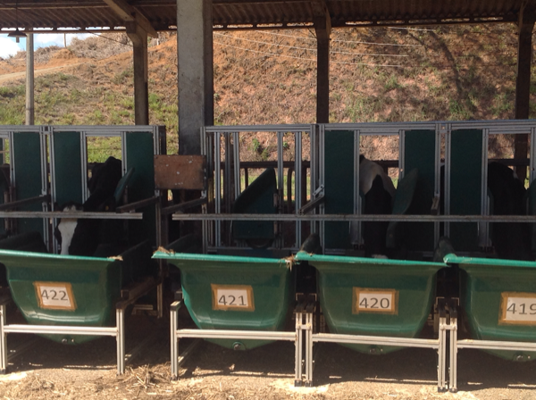
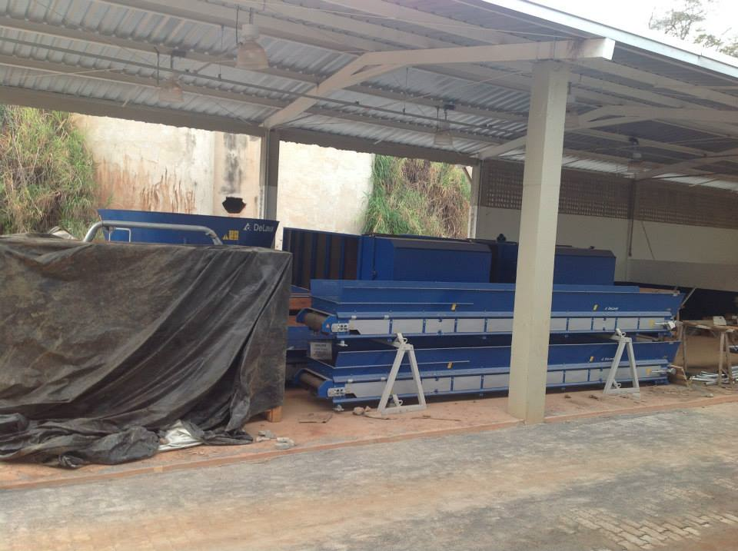
Feeding the dairy cow
Top: Automated system for measuring feed intake.
Bottom: Automated feeding system being installed at Embrapa Gado de Leite.

Slide 9
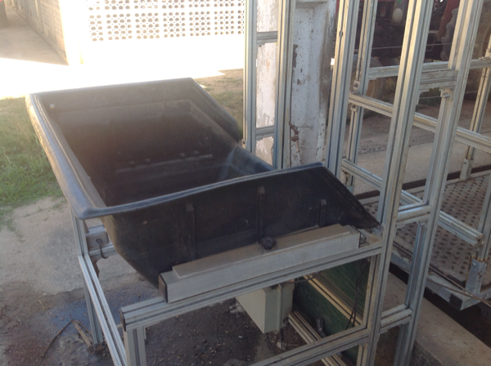
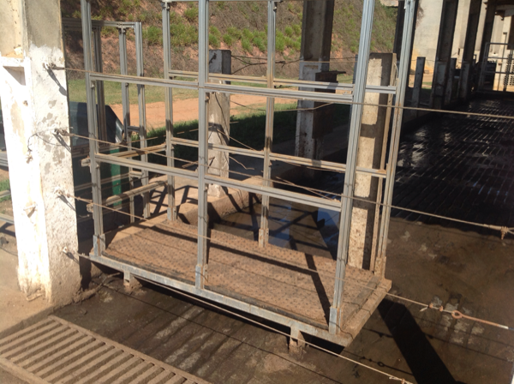
Watering the dairy cow
Top: Automated waterer with scale for measuring intake.
Bottom: Automated scale that weighs cows at the waterer.

Slide 10
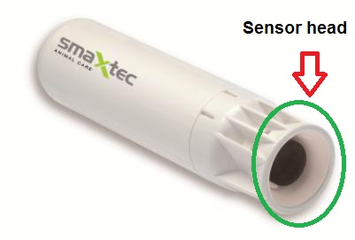
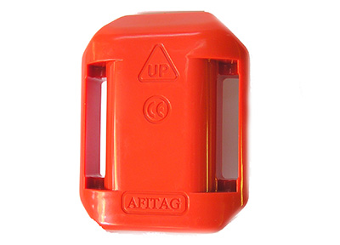
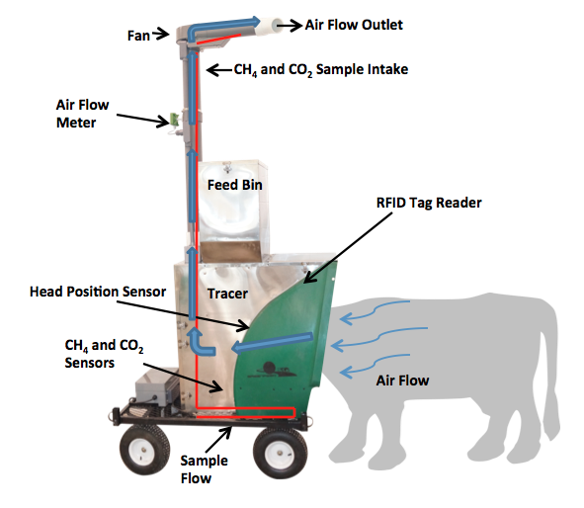
Monitoring the dairy cow
Source: http://support.smaxtec-animalcare.com/.
Source: http://c-lockinc.com/.
Source: http://www.afimilk.com/.

Slide 11
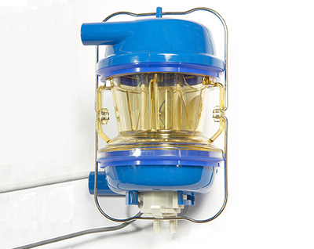
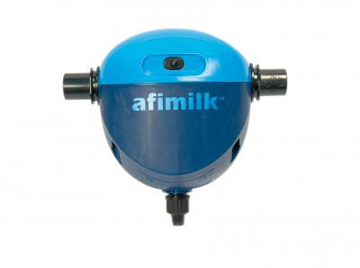
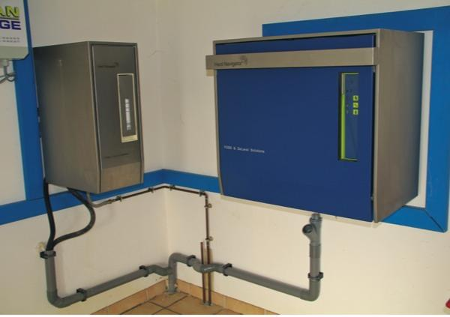
Milking the dairy cow
Source: http://www.afimilk.com/.
Source: http://www.afimilk.com/.
Manufacturers such as Afimilk and DeLaval provide intelligent milk meters, inline milk analysis sensors (e.g., AfiLab), and herd management systems (e.g., Herd Navigator).
Source: http://goo.gl/wu8YtR.

Slide 12
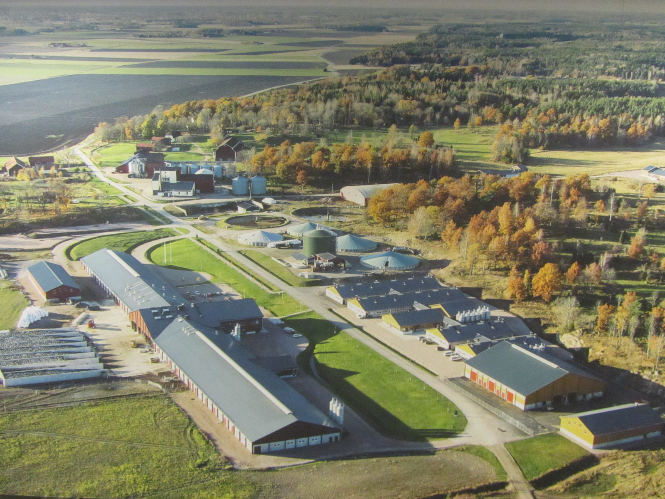
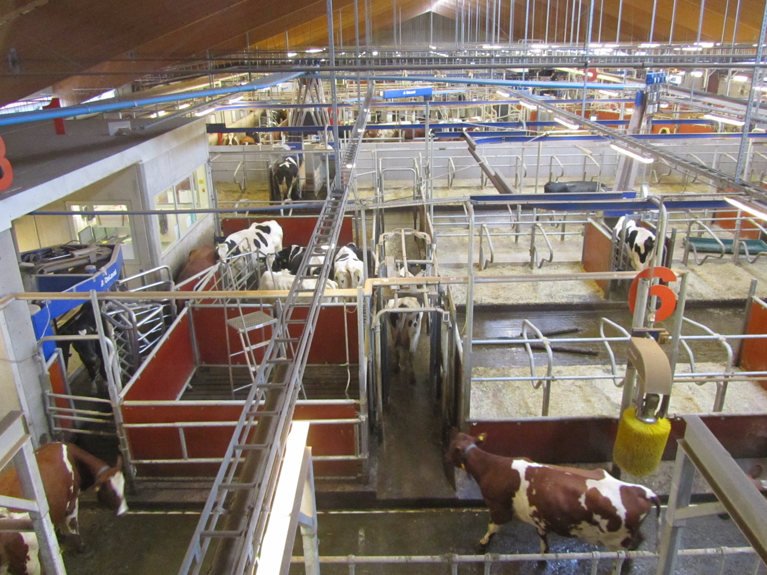
…and innovation is ongoing
The Swedish Agricultural University dairy research center has a state-of-the-art facility equipped with the latest DeLaval technology.
Photos courtesy of Albert de Vries.

Slide 13
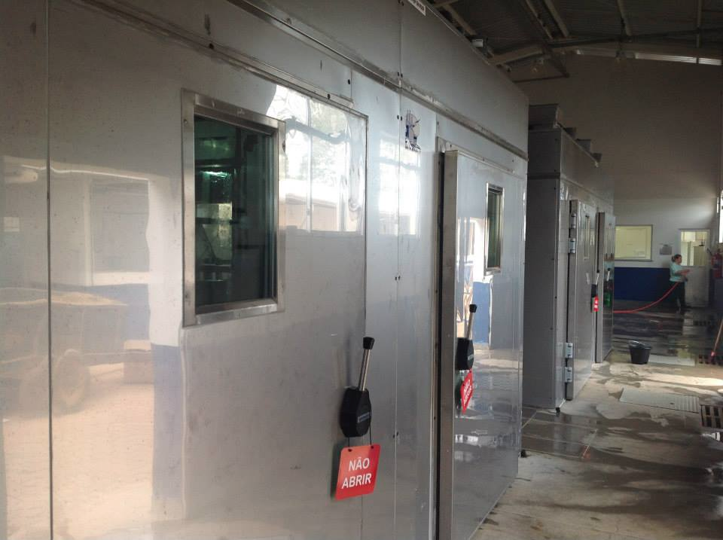
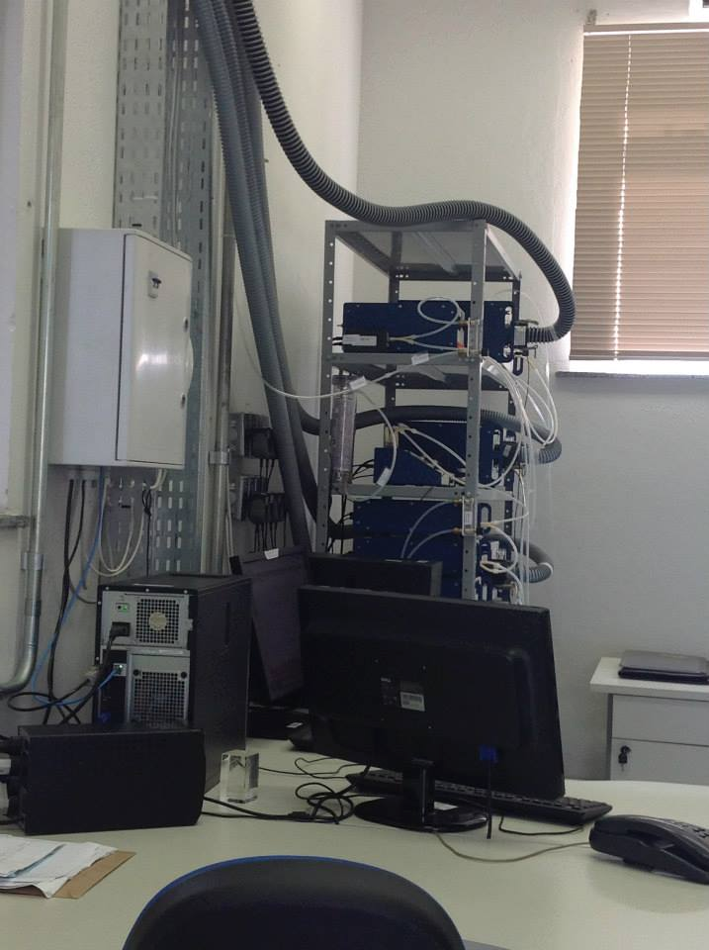
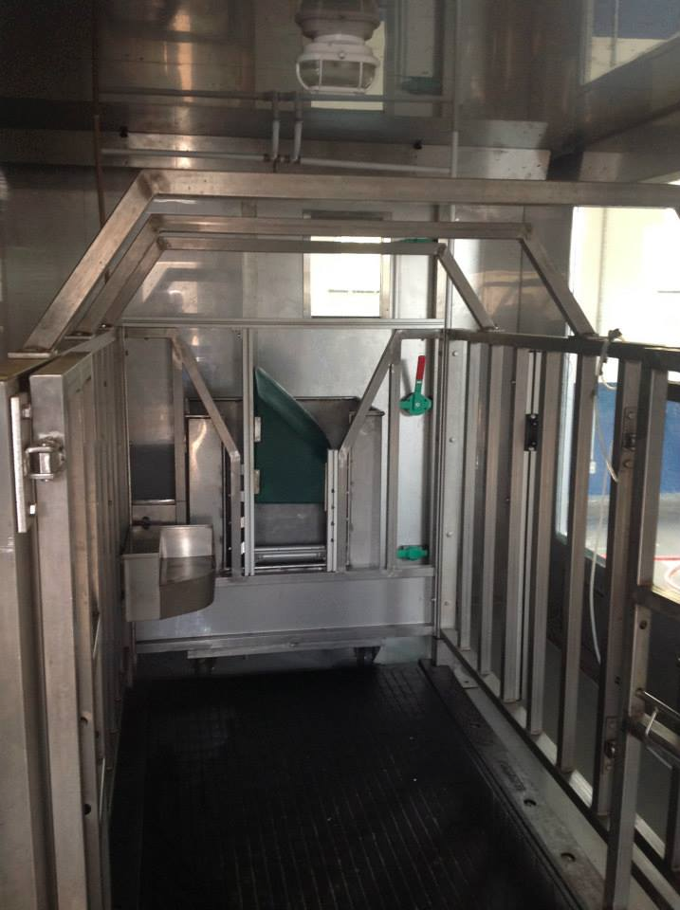
What else comes out of the cow?
Environment chambers at Embrapa Gado de Leite, Coronel Pacheco, MG, Brasil.

Slide 14
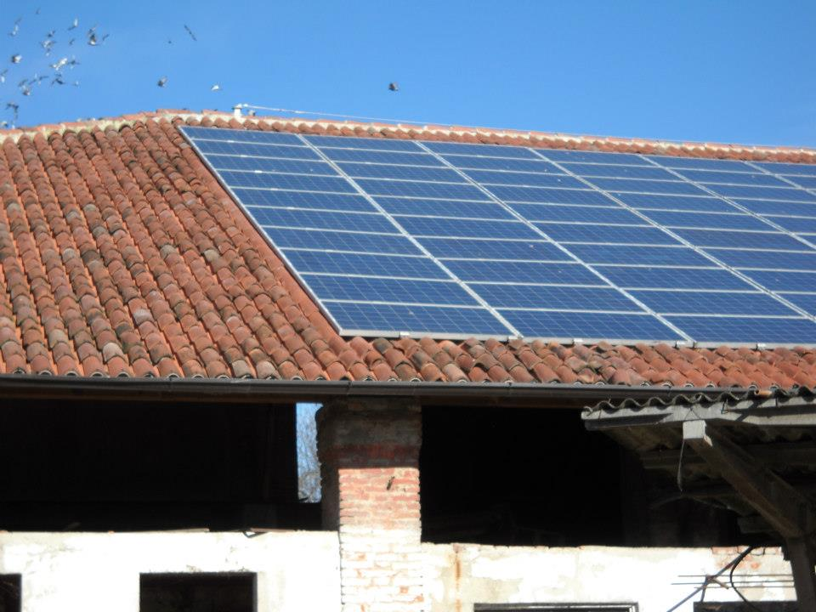
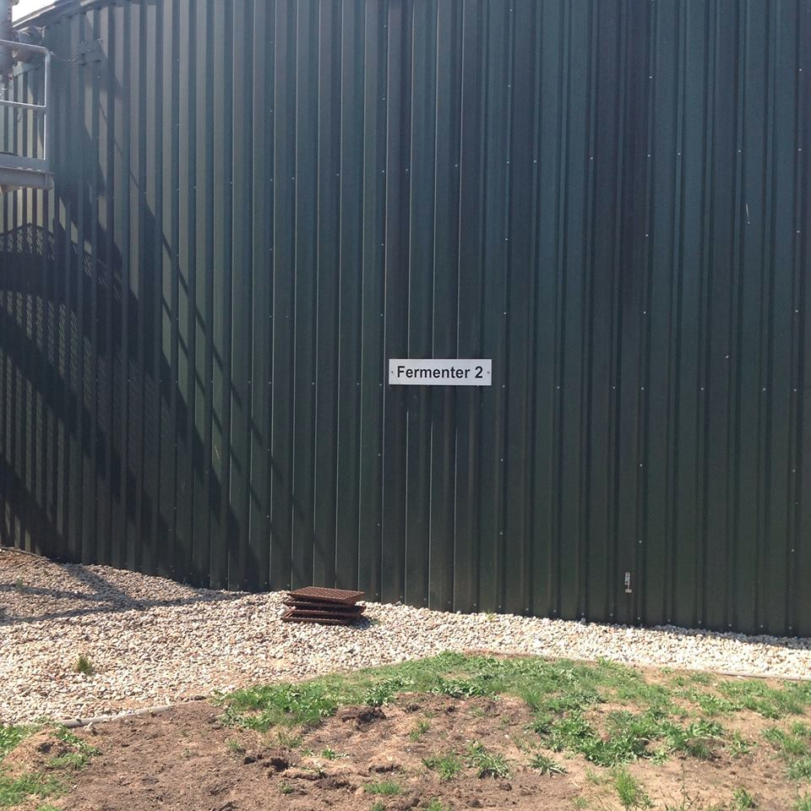
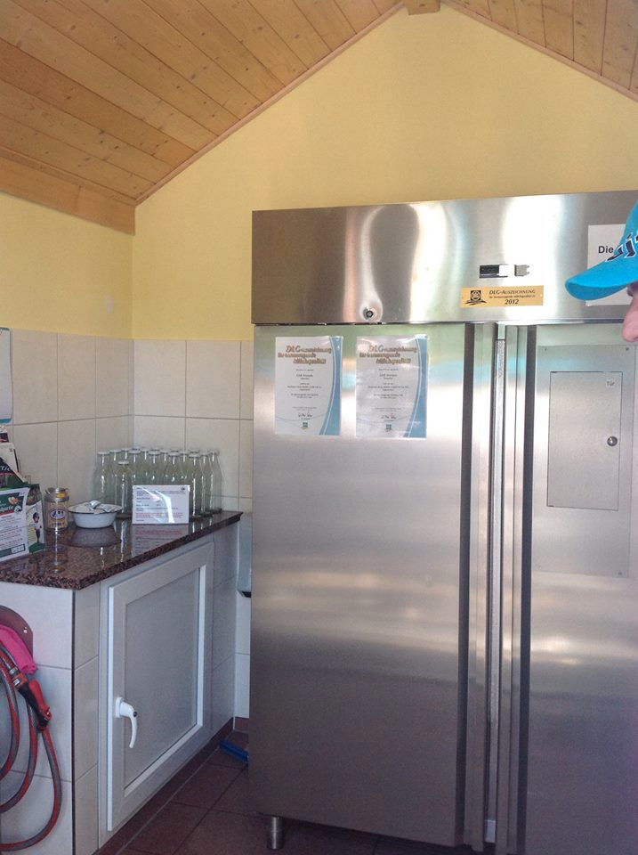
Other uses of on-farm technology
Left, middle: Dairies in Germany and Italy sell energy from biogas plants and rooftop solar cells.
Right: A dairy in Germany sells fresh milk directly to consumers from an automated, on-farm shop.

Slide 15
But you don’t get something for nothing
New technologies often require considerable capital investment.
They sometimes fail to work as advertised, or do not deliver the promised gain.
The data are often most useful when combined with observations from many farms.
Notes:
15
15

Slide 16
What challenges are on the horizon?
Monthly milk samples are too infrequent for modern management.
Many large farms do not see a value proposition in milk recording.
The amount of data collected on-farm are growing, but they are not being collected in a central database.
Notes:
16
16

Slide 17
Our focus has changed over time
Trait |  | Relative emphasis on traits in index (%)
 |  | NM$ 1994 | NM$ 2000 | NM$ 2003 | NM$ 2006 | NM$ 2010 | NM$ 2014 | GM$ 2014
Milk |  | 6 | 5 | 0 | 0 | 0 | -1 | -1
Fat |  | 25 | 21 | 22 | 23 | 19 | 22 | 20
Protein |  | 43 | 36 | 33 | 23 | 16 | 20 | 18
PL |  | 20 | 14 | 11 | 17 | 22 | 19 | 10
SCS |  | –6 | –9 | –9 | –9 | –10 | –7 | -6
UDC |  | … | 7 | 7 | 6 | 7 | 8 | 8
FLC |  | … | 4 | 4 | 3 | 4 | 3 | 3
BDC |  | … | –4 | –3 | –4 | –6 | –5 | -4
DPR |  | … | … | 7 | 9 | 11 | 7 | 19
HCR |  | … | … | … | … | … | 2 | 3
CCR |  | … | … | … | … | … | 1 | 5
CA$ |  | … | … | 4 | 6 | 5 | 5 | 5
Notes:
17
17

Slide 18
New phenotypes should add information
Novel phenotypes
include some
new information
Novel phenotypes
contain little
new information
high
Phenotypic correlation
with existing traits
Novel phenotypes
include much
new information
Novel phenotypes
contain some
new information
low
low
high
Genetic correlation with
existing traits
Notes:
18
18

Slide 19
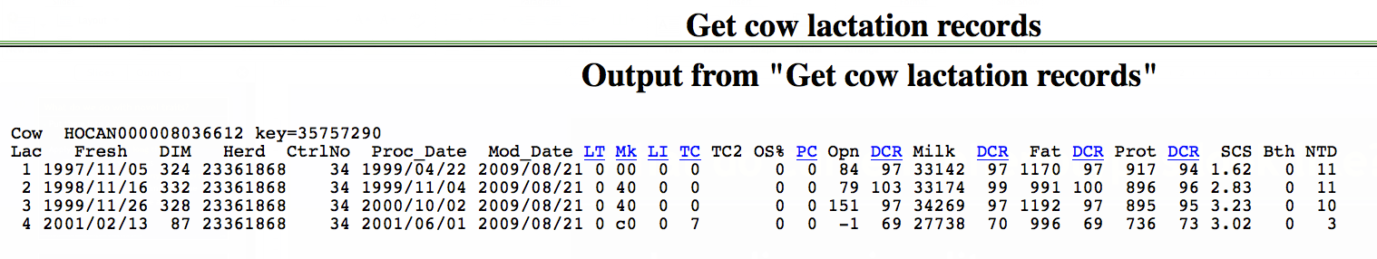
What do current phenotypes look like?
Low-dimensionality
  Usually few observations per lactation
  Close correspondence of phenotypes with values measured
  Easy transmission and storage
Notes:
19
19

Slide 20
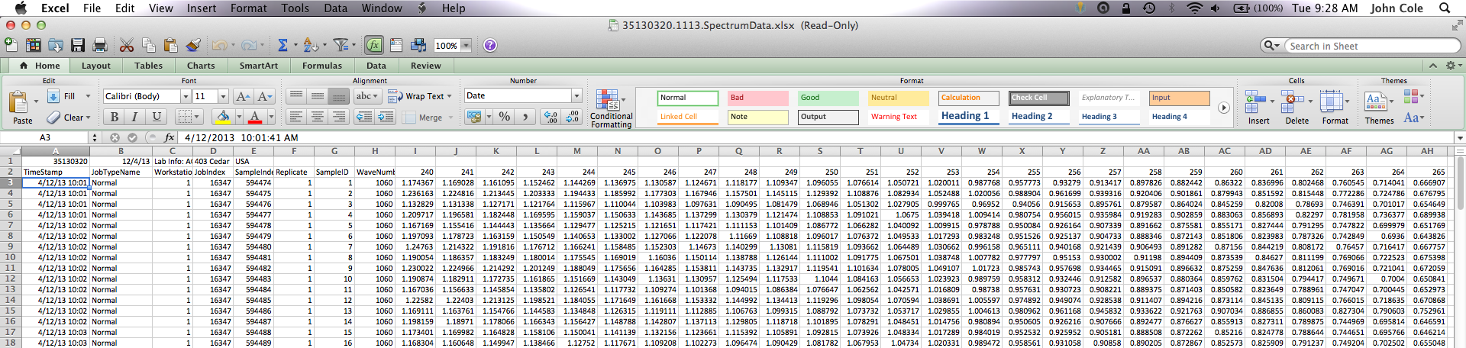
What do new phenotypes look like?
High dimensionality
  Ex.: MIR produces 1,060 points/obs.
  Disconnect between phenotype and measurement
  More resources needed for transmission, storage, and analysis

Slide 21
Phenotypes may come from genotypes
Name | Chrome | Location (Mbp) | Freq of minor haplotype |  | Gene Name
HH1 | 5 | 63.15 | 1.92 |  | APAF1
HH2 | 1 | 94.8 to 96.6 | 1.66 |  | unknown
HH3 | 8 | 95.41 | 2.95 |  | SMC2
HH4 | 1 | 1.27 | 0.37 |  | GART
HH5 | 9 | 92 to 94 | 2.22 |  | unknown
JH1 | 15 | 15.70 | 12.10 |  | CWC15
JH2 | 26 | 8.81 to 9.41 | 1.3 |  | unknown
BH1 | 7 | 42.8 to 47.0 | 6.67 |  | unknown
BH2 | 19 | 10.6 to 11.7 | 7.78 |  | unknown
AH1 | 17 | 65.92 | 13.0 |  | UBE3B
For a complete list, see: http://aipl.arsusda.gov/reference/recessive_haplotypes_ARR-G3.html.

Slide 22
Genotypes in the national database

Slide 23
Genotyped ancestors, actual bull(HOUSA73431994)
777K 777K
50K - - -
50K 50K
50K 50K
777K 777K
50K - - -
3K 777K
50K 50K
777K 777K
50K Imputed
Imputed 50K
50K Imputed
50K 777K
50K 50K
50K 777K
77K - - -
777K 777K
50K Imputed
Imputed 50K
50K Imputed
50K 777K
50K 50K
3K 777K
9K 50K
50K 777K
50K 50K
50K 777K
50K Imputed
777K 777K
50K - - -
Imputed 777K
50K
Genotyped or imputed animals
Both parents
All 4 grandparents
All 8 great grandparents
All 16 great, great grandparents
28 of 32 great, great, great grandparents
56 of 60 ancestors in pedigree

Slide 24
Genome assembly (simplified)
Reads must be assembled into chromosomes
Assembly is a computational process (Liu et al., 2009; Zimin et al., 2009)
This process is imperfect – repetitive regions are hard to assemble correctly!
Sometimes, this…
should be this.

Slide 25
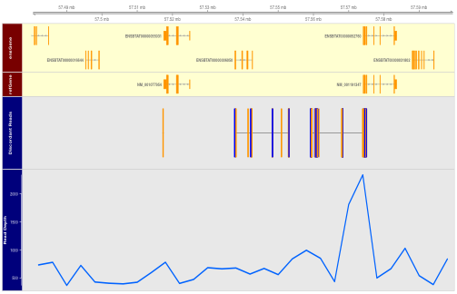
Possible assembly problem on BTA18
This could be a GC-rich region (bias in
Illumina chemistry).
More reads than expected may align
here because repetitive elements were
combined during assembly.

Slide 26
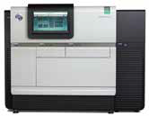
Can it be corrected using long reads?
BTA18 genomic DNA extracted
from CHORI-240 BAC library
(L1 Domino 99375) at AGIL
Sequencing libraries constructed at USDA MARC, pooled, and run on PacBio RS II
Source: Pacific Biosystems
BAC ID | Insert size (bp) | Start | End
CH240-389P14 | 174,682 | 56,954,654 | 57,129,335
CH240-234E12 | 178,618 | 57,058,248 | 57,236,865
CH240-280L6 | 175,831 | 57,092,237 | 57,268,067
CH240-34N7 | 158,841 | 57,129,383 | 57,288,223
Notes:
Transition/explain why PacBio & Illumina are different

Slide 27
Conclusions
Modern sensor technology is routinely producing large amounts of data.
Those data have the potential to improve herd management and profitability.
They can support development of new management practices and research into novel phenotypes.
Notes:
27
27

Slide 28
Acknowledgments
AFRI Competitive Grant No 2013-68004-20365, “Improving Fertility of Dairy Cattle Using Translational Genomics”
Cooperative Dairy DNA Repository
Council on Dairy Cattle Breeding
Paul VanRaden and George Wiggans, AGIL
Albert de Vries, University of Florida
Kent Weigel, University of Wisconsin

Slide 29
Note
Mention of trade names or commercial products in this presentation is solely for the purpose of providing specific information and does not imply recommendation or endorsement by the US Department of Agriculture.

Slide 30
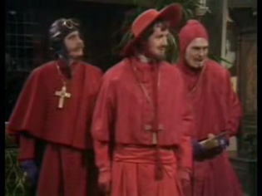
Questions?

