Slide 1
Cow Livability Evaluation and Calf Livability Research

Slide 2
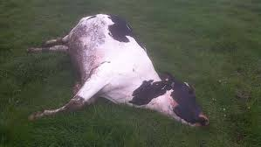
Cow livability data
Reasons for disposal have been reported and stored in DHI records since 1970
92 million records on 32 million cows
About 17% of cows die instead of being sold across all lactations
Death loss per lactation averages 6%
Higher in later and lower in earlier lactations

Slide 3
Cow livability evaluation
Methods
Multibreed model including heterosis and inbreeding
Multitrait model with productive life (PL) by lactation using similar edits and same software as other traits
Lactation PL not reported, only lifetime PL
Heritability of 1.3 (Miller et al., JDS, 2008)
Genetic correlation with lactation PL of 0.50
First country to evaluate livability
Official PTAs began August 2016

Slide 4
PTA correlations of livability with other traits Bull minimums: 1990 birth year, 50 daughters, 0.50 reliability for PTA livability
Trait | Holstein | Jersey
Milk | 0.09 | –0.08
Fat | 0.21 | 0.01
Protein | 0.16 | –0.01
PL | 0.70 | 0.54
SCS | –0.28 | –0.07
DPR | 0.40 | 0.54
CCR | 0.40 | 0.33
HCR | 0.28 | 0.32
Bulls (no.) | 45,840 | 3,893

Slide 5
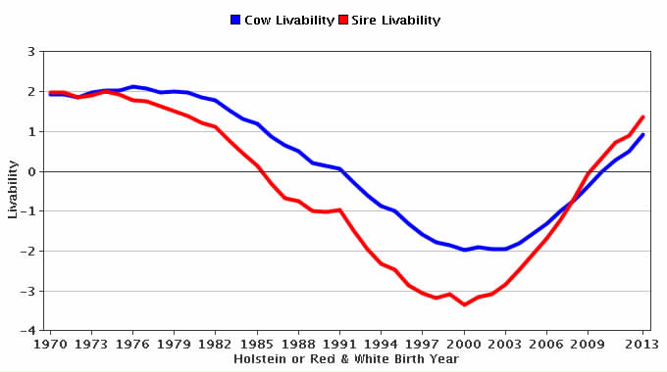
Genetic trend for cow livability - HO

Slide 6
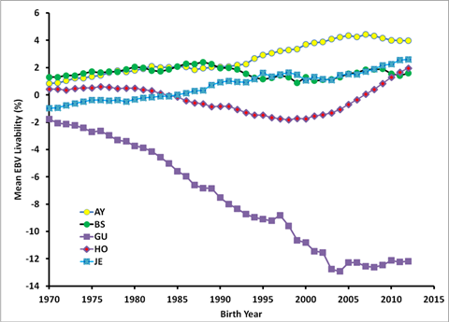
Genetic trend for LIV – All breeds

Slide 7
Calf livability data
Extract data from CDCB database
10,976,884 heifer births
495,282 with “left herd” codes (6 = died)
2,061,454 with no calving or breeding to confirm that they lived
6,343,337 calves born in years 2001–2013
2,826,352 in herds where 2–25% died
>99% of data used was from one source (DRMS)

Slide 8
Calf livability edits
Some farms only report heifer deaths (100%); others report no deaths (0%)
Edits required herds to have a minimum of 2% calf loss; maximum of 25%
Heifers that have a calf or an insemination are considered alive

Slide 9
Calf livability edits (continued)
Heifer 2 days not used for livability
Death loss 2 days is reported as stillbirth
Heifers that live ≥18 months get full credit
Older losses are often associated with 1st calving
After edits, livability scored as 100 or 0

Slide 10
Calf livability results
23% of reported calf deaths during first 2 months
33% during month 18 and later but not used because many were near fresh date
Edited calf livability averaged 97%
0.004 heritability estimated by sire model REML (VanRaden, 1986 programs)

Slide 11
HCD haplotype
Holstein haplotype for cholesterol deficiency (HCD)
Discovered by German researchers in 2015
Heterozygous animals have reduced cholesterol, but homozygotes have no cholesterol and die after a few months
Causative mutation discovered in Europe in 2016, lab test results now sent by Holstein USA to CDCB

Slide 12
Calf livability and HCD
For reported calf livability data:
4% more death loss from carrier sire  carrier MGS matings (significant)
12% expected if carrier  carrier matings are lethal
Could be under-reporting of death loss, or homozygous HCD sick calves are sold before they die
GPTAs for calf livability not attempted yet

Slide 13
Conclusions

Slide 14
Acknowledgments
DRMS for sending calf livability data

