Slide 1
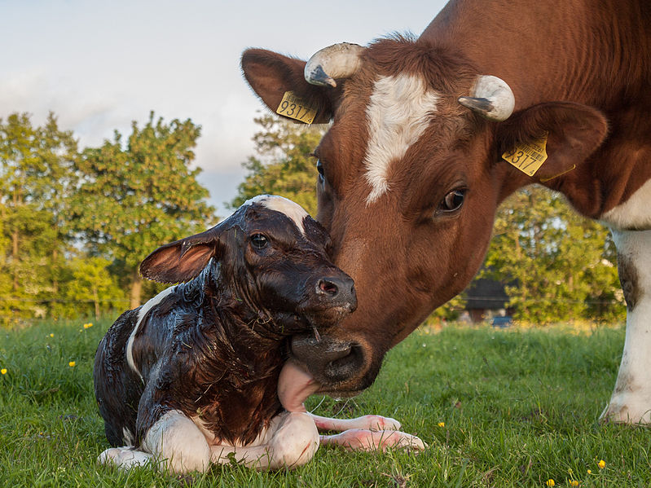
Genetic improvement for fertility, livability, and heat stress

Slide 2
Topics
Selection strategies for fertility
Fertility traits evaluated
Lethal haplotypes
Genomic mating programs
Cow and calf livability
Genetic rankings for heat stress
GE within and across countries

Slide 3
Fertility trait evaluations
Trait | Code | By | Began
Service sire nonreturn rate | ERCR | DRMS | 1986
Service sire conception rate | SCR | USDA | 2006
Daughter pregnancy rate | DPR | USDA | 2003
Cow conception rate | CCR | USDA | 2010
Heifer conception rate | HCR | USDA | 2010
Calving to first insemination | CFI | To Interbull | 2012
Gestation length | GL | CDCB | soon

Slide 4
Recessive defect discovery
Check for homozygous haplotypes
7–90 expected but none observed
5 of top 11 confirmed as lethal
936–52,449 carrier sire  carrier MGS fertility records
3.0– 3.7% lower conception rates (CRs)
Some slightly higher stillbirth rates
Confirmed brachyspina same way

Slide 5
Cost / benefit in marketing
5 haplotypes with recessive effects on fertility discovered
Additive effects small and in EBVs
All populations already carry these
At least 19 countries have “health” laws excluding carriers of defects
Only countries that test are banned?
Import restrictions make little sense

Slide 6
Haplotypes affecting fertility
Name | BTA chromo- some | Location (Mbp) | Carrier frequency (%) | Earliest known ancestor
HH1 | 5 | 63.2* | 3.8 | Pawnee Farm Arlinda Chief
HH2 | 1 | 94.9–96.6 | 3.3 | Willowholme Mark Anthony
HH3 | 8 | 95.4* | 5.9 | Glendell Arlinda Chief, Gray View Skyliner
HH4 | 1 | 1.3* | 0.7 | Besne Buck
HH5 | 9 | 93.3* | 4.4 | Thornlea Texal Supreme
JH1 | 15 | 15.7* | 24.2 | Observer Chocolate Soldier
JH2 | 26 | 8.8–9.4 | 2.6 | Liberators Basilius
BH1 | 7 | 42.8–47.0 | 13.3 | West Lawn Stretch Improver
BH2 | 19 | 11.1* | 15.6 | Rancho Rustic My Design
AH1 | 17 | 65.9* | 26.0 | Selwood Betty’s Commander
*Causative mutation known

Slide 7
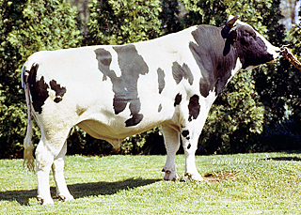
Economics of fertility defect HH1 Adams et al., JDS, 2016
Pawnee Farm Arlinda Chief (born 1962)
Contributed 14% of global Holstein genes
$25 billion value of increased milk yield
$0.4 billion cost of HH1 mid-term abortions
Caused by 1-base mutation in APAF1 gene

Slide 8
Additive and nonadditive effects Nonreturn rates (NRs), full-gestation CR
Haplo- type | Additive effect, CR | Sire  MGS interaction
 |  | NR60 | NR100 | NR140 | CR280
CVM | –0.12 | –0.9 | –1.5 | –1.9 | –2.9
BY | –0.46 | –2.2 | –2.3 | –2.3 | –2.5
HH1 | –0.35 | –1.1 | –1.6 | –2.0 | –3.1
HH2 | –0.36 | –1.7 | –3.0 | –2.9 | –3.0
HH3 | –0.36 | –3.1 | –3.4 | –3.4 | –3.2
JH1 | –2.22 | –3.7 | –3.7 | –3.6 | –3.7
BH1 | –0.98 | –2.5 | –3.7 | –2.9 | –3.4

Slide 9
Carrier bulls with high fertility 2011 data
Haplo- type | Bull | CRs
 |  | Service sire | Heifer | Cow
BY | Ramos | N/A | +0.1 | +5.2
HH1 | Lucius | +3.1 | +2.5 | +2.5
HH2 | Colby | +2.2 | +5.2 | +5.4
HH3 | O-Man | +0.6 | +2.1 | +3.5
JH1 | Country | -0.5 | +2.7 | +3.2
BH1 | Payoff | +1.5 | +1.5 | +3.4

Slide 10
Detection with 3K genotypes 500 carriers, 500 noncarriers, with imputation
Haplotype | False positive (%) | False negative (%) | Error rate (%)
BY | 0.0 | 2.2 | 1.1
HH1 | 0.4 | 6.4 | 3.4
HH2 | 0.0 | 1.8 | 0.9
HH3 | 0.2 | 2.8 | 1.5
JH1 | 0.4 | 6.4 | 3.4

Slide 11
Using crossovers to fine map
75-marker haplotype (50K), ~5 Mbases
Source
Combined
with
source
Suspect area
Carrier
Possible

Slide 12
Haplotypes for known recessives Holstein
Recessive | Haplo-type | BTA chromo- some | Location (Mbp) | Carrier frequency (%)
BLAD | HHB | 1 | 145.1* | 0.5
Brachyspina | HH0 | 21 | 21.2 | 5.5
Cholesterol deficiency | HCD | 11 | 78.0* | 5.0
Coat color Red | HHR | 18 | 14.8* | 10.8
Black/red | HBR | 18 | 14.8 | 1.6
Dominant red | HDR | 3 | 9.5* | 0.1
CVM | HHC | 3 | 43.4* | 2.7
DUMPS | HHD | 1 | 69.8* | <0.1
Mule foot | HHM | 15 | 77.7 | 0.1
Polled | HHP | 1 | 1.7–2.0 | 1.4
*Causative mutation known

Slide 13
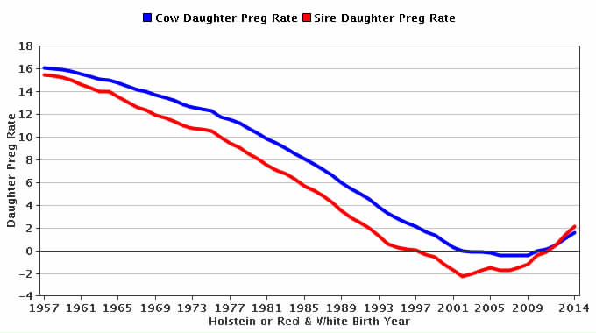
Genetic trend for DPR
Source:
CDCB

Slide 14
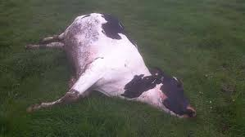
Cow livability data
Reasons for disposal have been reported and stored in DHI records since 1970
92 million records on 32 million cows
About 20% of cows die instead of being sold across all lactations
Death loss per lactation averages 7%
Higher in later and lower in earlier lactations

Slide 15
Cow livability evaluation
Methods
Multibreed model including heterosis and inbreeding
Multitrait model with productive life (PL) by lactation using similar edits and same software as other traits
Lactation PL not reported, only lifetime PL
Heritability of 1.3 (Miller et al., JDS, 2008)
Genetic correlation with lactation PL of 0.50
First country to evaluate livability
Official PTAs began August 2016

Slide 16
PTA correlations of livability with other traits Bull minimums: 1990 birth year, 50 daughters, 0.50 reliability for PTA livability
Trait | Holstein | Jersey
Milk | 0.09 | –0.08
Fat | 0.21 | 0.01
Protein | 0.16 | –0.01
PL | 0.70 | 0.54
SCS | –0.28 | –0.07
DPR | 0.40 | 0.54
CCR | 0.40 | 0.33
HCR | 0.28 | 0.32
Bulls (no.) | 45,840 | 3,893

Slide 17
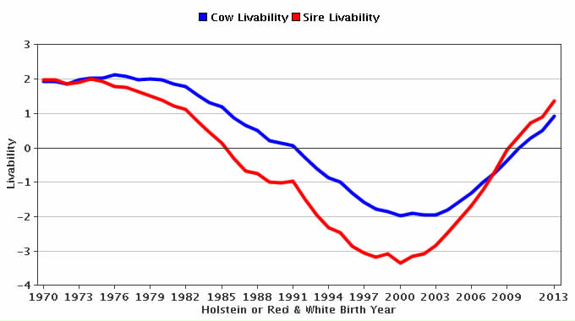
Genetic trend for cow livability
Source:
CDCB

Slide 18
Calf livability data
Extract data from CDCB database
10,976,884 heifer births
495,282 with “left herd” codes (6 = died)
2,061,454 with no calving or breeding to confirm that they lived
6,343,337 calves born 2001–13
2,826,352 in herds where 2–25% died
>99% of data used from one source (DRMS)

Slide 19
Calf livability edits
Some farms only report heifer deaths (100%); others report no deaths (0%)
Edits required herds to have a minimum of 2% calf loss; maximum of 25%
Heifers that have a calf are considered alive

Slide 20
Calf livability edits (continued)
Heifer 2 days not used for livability
Covered by stillbirth
Heifer > 8 months old set to 18 months
After edits, livability scored as 100 or 0

Slide 21
Calf livability results
23% of reported calf deaths during first 2 months
33% during month 18 and later but not used because many were near fresh date
Edited calf livability averaged 97%
0.004 heritability estimated by sire model REML (VanRaden, 1986 programs)

Slide 22
HCD haplotype
Holstein haplotype for cholesterol deficiency (HCD)
Discovered by German researchers in 2015
Heterozygous animals have reduced cholesterol, but homozygotes have no cholesterol and survive only a few months
Causative mutation discovered in 2016, lab test results now sent by Holstein USA to CDCB

Slide 23
Calf livability and HCD
For reported calf livability data:
4% more death loss from carrier sire  carrier MGS matings (significant)
12% expected if carrier  carrier matings are lethal
Could be under-reporting of death loss, or homozygous HCD sick calves are sold before they die

Slide 24
Heat stress research
Genetic x environment interaction in national genetic evaluation
Random regression on state average for temperature-humidity index in July
Differences between northern and southern states
Tested ability of GxE predictions from domestic traits to predict foreign data from Interbull or future US data

Slide 25
Heat stress (HS) and foreign rankings†
Country | Bulls | Milk | Fat | Protein
CAN | 1,184 | Cold*** | Cold*** | Cold***
DFS | 531 | Cold*** | Cold*** | Cold***
DEU | 862 | Cold*** | Cold*** | Cold
NLD | 766 | Cold*** | Cold*** | Cold***
ITA | 868 | Cold*** | Cold | Cold***
AUS | 452 | Hot | Hot | Hot
ARG | 416 | Hot | Cold | Hot*
URY | 303 | Hot | Cold** | None
† Predicted using Interbull data and HS from U.S. data
Cold = Bulls ranked higher if daughters performed better in cooler U.S. states
Hot = Bulls ranked higher if daughters performed better in warmer U.S. states
*P < 0.05; **P < 0.01; ***P < 0.001

Slide 26
Protein PTAs for FL vs. WI
 | Bull rank for PTA protein in
Bull | USA | WI | FL
Coyne | 1 | 1 | 2
Nobleland | 2 | 4 | 1
Listen | 3 | 2 | 7
Tyrone | 4 | 6 | 4
AltaGreatest | 5 | 7 | 3
Ruble | 6 | 3 | 12
AltaStone | 7 | 15 | 6
Lonzo | 8 | 33 | 11
Syrup | 9 | 11 | 20
Picardus | 10 | 8 | 95

Slide 27
HS conclusions
Yield traits had some rank changes
Corr (FL, U.S.) = 0.912
Corr (WI, U.S.) = 0.986
Most trait predictions gained little
R² = 0.1499 vs. 0.1501 with HS for PL
R² = 0.1189 vs. 0.1190 with HS for DPR
R2 = 0.2083 vs. 0.2083 with HS for SCS
http://aipl.arsusda.gov/publish/presentations/ADSA15/ADSA15_jrw.ppt

Slide 28
Embryo experiments done or yet to do
Heritability of embryo or ovum production
Kristen Parker-Gaddis et al. 2016 (UFL, USDA-AGIL)
Physiology of homozygous lethal embryos
Effects of abortions on dam
Embryo genotyping before implantation
464 have been genotyped so far

Slide 29
Conclusions
Fertility progress from new tools
Select for several traits
Use genomic mating programs
Identify recessive defects
Cow and calf livability with low heritability but much data
Heat stress predictions small but highly significant

