Slide 1
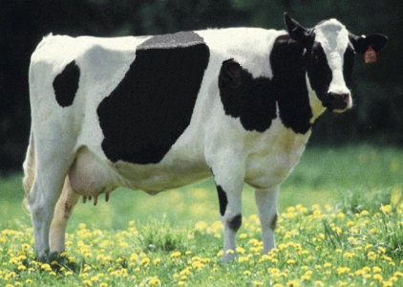
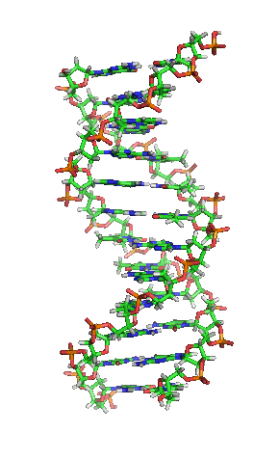
US genomic evaluation system

Slide 2
History of genomic evaluations
BovineSNP50 BeadChip available Dec. 2007
First unofficial evaluation released Apr. 2008
Official evaluations for Holsteins and Jerseys Jan. 2009
Official evaluations for Brown Swiss Aug. 2009
Monthly evaluation Jan. 2010
Official 3K evaluations Dec. 2010
BovineLD BeadChip available Sept. 2011
Official evaluations for Ayrshires Apr. 2013
Weekly evaluation Nov. 2014
Official evaluations for Guernseys Apr. 2016
Notes:
2

Slide 3
Collaboration with industry
Council on Dairy Cattle Breeding (CDCB) responsible for receiving data and for computing and delivering US genetic evaluations for dairy cattle
Animal Genomics and Improvement Lab (AGIL) responsible for research and development to improve the evaluation system
CDCB located in Bowie
Dr. João Dürr is CDCB CEO

Slide 4
Staff
Research team
  4 senior scientists
  5 support scientists
  3 information technology specialists
  1 administrative assistant
On-site collaborators
  4 visiting scientists

Slide 5

Funding
CDCB evaluation calculation and dissemination funded by fee system
  Based on animals genotyped
  ~82% of revenue from bulls
  Higher fees for herds that
  contribute less information
USDA research on evaluation methodology funded by US Federal Government
$

Slide 6
Council on Dairy Cattle Breeding
CDCB
PDCA
NAAB
DRPC
DHI
Purebred Dairy
Cattle Association
National Association of Animal Breeders
Dairy Records
Processing Centers
Dairy Herd
Information
3 members from each organization
Total of 12 voting members
2 nonvoting industry members

Slide 7
Genomic data flow
Dairy Herd Information (DHI) producer
DNA samples
DNA samples
genomic
evaluations
DNA laboratory
DNA samples
AI organization,
breed association
genotypes
genotypes
nominations,
pedigree data
genotype
quality reports
genomic
evaluations
Council on Dairy Cattle Breeding (CDCB)
Notes:
7

Slide 8
Evaluation flow
Animal nominated for genomic evaluation by approved nominator
DNA source sent to genotyping lab (2015)

Source | Samples (no.) | Samples (%)
Blood | 6,893 | 2
Hair | 124,523 | 31
Nasal swab | 1,903 | <1
Semen | 277 | <1
Tissue | 252,468 | 64
Unknown | 10,906 | 3

Slide 9

Evaluation flow (continued)

DNA extracted and placed on chip for 3-day genotyping process
Genotypes sent from
genotyping lab to CDCB
for accuracy review


Slide 10
Genotype chips
Chip | SNP (no.) |  | Chip | SNP (no.) |  | Chip | SNP (no.)
50K | 54,001 |  | GHD | 77,068 |  | ZL2 | 17,557
50K v2 | 54,609 |  | GP2 | 19,809 |  | ZM2 | 60,914
3K | 2,900 |  | ZLD | 11,410 |  | GH2 | 139,480
HD | 777,962 |  | ZMD | 56,955 |  | G7K | 7,083
Affy | 648,875 |  | ELD | 9,072 |  | GP4 | 30,112
LD | 6,909 |  | LD2 | 6,912 |  | ZL4 | 18,815
GGP | 8,762 |  | GP3 | 26,151 |  | AMD | 44,705

Slide 11
Laboratory quality control
Each SNP evaluated for
  Call rate
  Portion heterozygous
  Parent-progeny conflicts
Clustering investigated if SNP exceeds limits
Number of failing SNPs indicates quality of submission
Target of <10 SNPs in each category

Slide 12

Parentage validation and discovery
Parent-progeny conflicts detected
  Animal checked against all other genotypes
  Reported to breeds and requesters
  Correct sire usually detected
Maternal grandsire checking
  SNP at a time checking
  Haplotype checking more accurate
Breeds accept SNPs along with
microsatellites
Who’s your daddy?
Notes:
12

Slide 13
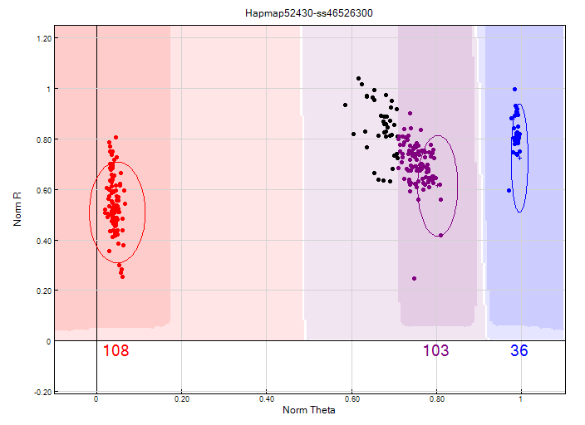
Before clustering adjustment
86% call rate

Slide 14
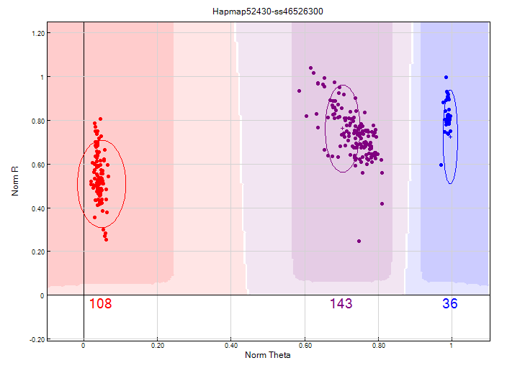
After clustering adjustment
100% call rate

Slide 15
Evaluation flow (continued)


Genotype calls modified as necessary
Genotypes loaded into database
Nominators receive reports of parentage and other conflicts
Pedigree or animal assignments corrected
Genotypes extracted and imputed to 61K
SNP effects estimated
Final evaluations calculated






Slide 16
Evaluation flow (continued)

Evaluations released to dairy industry
  Download from CDCB FTP site with
  separate files for each nominator
  Weekly release of evaluations of new animals
  Monthly release for females and bulls not marketed
  All genomic evaluations updated 3 times each year with traditional evaluations

Slide 17
2015 genotypes by chip SNP density
Chip SNP density | Female | Male | All animals
Low | 340,017 | 31,900 | 371,917
Medium | 11,782 | 5,848 | 17,630
High | 126 | 0 | 126
All | 351,925 | 37,748 | 389,673

Slide 18
2015 genotypes by breed and sex
Breed | Female | Male | All animals | Female: male
Ayrshire | 942 | 262 | 1,204 | 78:21
Brown Swiss | 1,191 | 582 | 1,173 | 67:33
Guernsey | 15 | 199 | 214 | 07:92
Holstein | 305,190 | 34,589 | 339,779 | 90:10
Jersey | 38,871 | 3,939 | 42,810 | 91:90
All | 346,209 | 39,571 | 385,780 | 90:10

Slide 19
Genotypes by animal age (last 12 months)
≤
≥

Slide 20
Growth in bull predictor population
Breed | Jan. 2016 | 12-mo gain
Ayrshire | 752 | 42
Brown Swiss | 6,363 | 271
Holstein | 28,917 | 2,168
Jersey | 4,712 | 265

Slide 21
Holstein prediction accuracy
Trait | Bias* | Reliability (%) | Reliability gain (% points)
Milk (kg) | −80.3 | 69.2 | 30.3
Fat (kg) | −1.4 | 68.4 | 29.5
Protein (kg) | −0.9 | 60.9 | 22.6
Fat (%) | 0.0 | 93.7 | 54.8
Protein (%) | 0.0 | 86.3 | 48.0
Productive life (mo) | −0.7 | 73.7 | 41.6
Somatic cell score | 0.0 | 64.9 | 29.3
Daughter pregnancy rate (%) | 0.2 | 53.5 | 20.9
Sire calving ease | 0.6 | 45.8 | 19.6
Daughter calving ease | −1.8 | 44.2 | 22.4
Sire stillbirth rate | 0.2 | 28.2 | 5.9
Daughter stillbirth rate | 0.1 | 37.6 | 17.9
*2013 deregressed value – 2009 genomic evaluation

Slide 22
Holstein prediction accuracy
Trait | Bias* | Reliability (%) | Reliability gain (% points)
Final score | 0.1 | 58.8 | 22.7
Stature | −0.2 | 68.5 | 30.6
Dairy form | −0.2 | 71.8 | 34.5
Rump angle | 0.0 | 70.2 | 34.7
Rump width | −0.2 | 65.0 | 28.1
Feed and legs | 0.2 | 44.0 | 12.8
Fore udder attachment | −0.2 | 70.4 | 33.1
Rear udder height | −0.1 | 59.4 | 22.2
Udder depth | −0.3 | 75.3 | 37.7
Udder cleft | −0.2 | 62.1 | 25.1
Front teat placement | −0.2 | 69.9 | 32.6
Teat length | −0.1 | 66.7 | 29.4
*2013 deregressed value – 2009 genomic evaluation

Slide 23
Reliability gains
Reliability (%) | Ayrshire | Brown Swiss | Jersey | Holstein
Genomic | 37 | 54 | 61 | 70
Parent average | 28 | 30 | 30 | 30
Gain | 9 | 24 | 31 | 40
Reference bulls | 680 | 5,767 | 4,207 | 24,547
Animals genotyped | 1,788 | 9,016 | 59,923 | 469,960
Exchange partners | Canada | Canada, Interbull | Canada, Denmark | Canada, Italy, UK
Source: VanRaden, Advancing Dairy Cattle Genetics: Genomics and Beyond presentation, Feb. 2014

Slide 24
Parent ages for marketed Holstein bulls

Slide 25
Inbreeding for Holstein cows
– Inbreeding
– Expected future inbreeding

Slide 26
Active AI bulls (April 2016) that were genomic bulls

Slide 27
Marketed Holstein bulls
Year entered AI | Traditional progeny- tested | Genomic marketed | All bulls
2008 | 1,778 | 170 | 1,948
2009 | 1,508 | 346 | 1,854
2010 | 1,414 | 393 | 1,807
2011 | 1,279 | 648 | 1,927
2012 | 1,254 | 711 | 1,965
2013 | 913 | 771 | 1,684
2014 | 679 | 929 | 1,608
2015 | 645 | 918 | 1,563

Slide 28
Genetic merit of marketed Holstein bulls
Average gain:
$85.20/year
Average gain:
$46.25/year
Average gain:
$18.42/year

Slide 29
Stability of genomic evaluations
642 Holstein bulls
  Dec. 2012 NM$ compared with Dec. 2014 NM$
  First traditional evaluation in Aug. 2014
  ≥50 daughters by Dec. 2014
Top 100 bulls in 2012
  Average rank change of 9.6
  Maximum drop of 119
  Maximum rise of 56
All 642 bulls
  Correlation of 0.94 between 2012 and 2014
  Regression of 0.92
Notes:
29

Slide 30
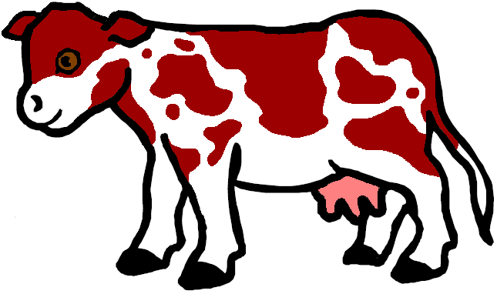
Gene tests (imputed and actual)
Holstein
  Bovine leucocyte adhesion deficiency (BLAD)
  Complex vertebral malformation (CVM)
  Deficiency of uridine monophosphate synthase (DUMPS)
  Syndactyly (mulefoot)
  Cholesterol deficiency
  Red coat color
Brown Swiss
  Weaver Syndrome
  Spinal dismyelination (SDM)
  Spinal muscular atrophy (SMA)
Polledness (Holstein, Jersey, Brown Swiss)

Slide 31
Haplotypes affecting fertility
Rapid discovery of new recessive defects
  Large numbers of genotyped animals
  Affordable DNA sequencing
Determination of haplotype location
  Significant number of homozygous animals expected, but none observed
  Narrow suspect region with fine mapping
  Use sequence data to find causative mutation

Slide 32
Haplotypes affecting fertility
Name | BTA chromo- some | Location* (Mbp) | Carrier frequency (%) | Earliest known ancestor
HH1 | 5 | 63.2* | 3.8 | Pawnee Farm Arlinda Chief
HH2 | 1 | 94.9 – 96.6 | 3.3 | Willowholme Mark Anthony
HH3 | 8 | 95.4* | 5.9 | Glendell Arlinda Chief, Gray View Skyliner
HH4 | 1 | 1.3* | 0.7 | Besne Buck
HH5 | 9 | 92.4 – 93.9 | 4.4 | Thornlea Texal Supreme
JH1 | 15 | 15.7* | 24.2 | Observer Chocolate Soldier
JH2 | 26 | 8.8 – 9.4 | 2.6 | Liberators Basilius
BH1 | 7 | 42.8 – 47.0 | 13.3 | West Lawn Stretch Improver
BH2 | 19 | 11.1* | 15.6 | Rancho Rustic My Design
AH1 | 17 | 65.9* | 26.0 | Selwood Betty’s Commander
*Causative mutation known

Slide 33
Fertility haplotype for Jerseys (JH2)
Chromosome 26 at 8.8 – 9.4 Mbp
Carrier frequency
  14 – 28% in decades before 1990
  Only 2.6% now
Estimated effect on conception rate of – 4.0% ± 1.5%
Additional sequencing needed to find causative genetic variant

Slide 34
Haplotypes for known recessives (Holstein)
Recessive | Haplo- type | BTA chromo- some | Location* (Mbp) | Carrier frequency (%)
Brachyspina | HH0 | 21 | 21.2 | 5.5
BLAD | HHB | 1* | 145.1 | 0.5
CVM | HHC | 3* | 43.4 | 2.7
DUMPS | HHD | 1* | 69.8 | <0.1
Mule foot | HHM | 15 | 77.7 | 0.1
Polled | HHP | 1 | 1.7 – 2.0 | 1.4
Coat color
Red | HHR | 18* | 14.8 | 10.8
Black/red | HBR | 18 | 14.8 | 1.6
Dominant red | HDR | 3* | 9.5 | 0.1
Cholesterol deficiency | HCD | 11* | 78.0 | 5.0
*Causative mutation known

Slide 35
Haplotypes for known recessives (other breeds)
Recessive | Haplo- type | BTA chromo- some | Location* (Mbp) | Carrier frequency (%)
Polled | JHP | 1 | 1.7 – 2.0 | 4.4
 | BHP | 1 | 1.7 – 2.0 | 0.8
SDM | BHD | 11* | 14.7 | 4.4
SMA | BHM | 24 | 62.1 – 62.2 | 7.2
Weaver | BHW | 4* | 49.9 | 3.1
*Causative mutation known

Slide 36
Weekly evaluations
Released to nominators, breed associations, and dairy records processing centers at 8 am each Tuesday
Calculations restricted to genotypes that first became usable during the previous week

Slide 37
April 2016 changes to evaluation system
Genomic evaluation implemented for Guernseys
Preliminary values for breed base representation
Edits and adjustments updated for heifer conception rate
Exact mutation locations used for HCD and BH2 tests
Genomic reliability, genomic inbreeding, and genomic future inbreeding included in weekly evaluations
Genotype exchange with Switzerland and Japan

Slide 38
Application to more traits
Animal’s genotype good for all traits
Traditional evaluations required for accurate estimates of SNP effects
Traditional evaluations not currently available for heat tolerance or feed efficiency
Research populations could provide data for traits that are expensive to measure
Will resulting evaluations work in target population?

Slide 39
What’s already planned
Genomic evaluations for new traits
  Health
  Feed efficiency
Genomic mating programs
  Selection of favorable minor alleles
  Reduction of genomic inbreeding
Adding SNPs for causative genetic variants

Slide 40
What’s already planned (continued)
BARD project (Volcani Center, Israel)
  A posteriori granddaughter design (APGD)
  Identification of causative variants for economically important traits
International collaboration on sequencing
  Participation in 1000 Bull Genomes Project

Slide 41
GeneSeek 77K chip (GHD)
Designed to include the most informative SNPs
76,934 SNPs typically provided, including
  Y
  Single-gene tests
About 28,200 50K SNPs included
(mostly low MAFs excluded)
Other SNPs selected from HD based on MAF and magnitude of effect

Slide 42
Current SNP set for genomic evaluations
60,671 SNPs used after culling on
  MAF
  Parent-progeny conflicts
  Percentage heterozygous (departure from HWE)
SNPs for HH1, BLAD, DUMPS, CVM, polled, red, and mulefoot included
  JH1 included for Jerseys
Some SNPs eliminated because incorrect location  haplotype non-inheritance

Slide 43
GHD, version 2 (GH2)
139,480 SNPs
Includes 14,436 among 60,671 SNPs currently used that are not on GHD
Many added SNPs have low to moderate MAF
  Increasing to 77,097 SNPs improves evaluation accuracy
Includes single-gene tests planned for 77,097 SNP set

Slide 44
Low-cost chip (G7K)
7,083 SNPs
Built-in validation
Single-gene tests
Lower imputation accuracy if neither parent genotyped

Slide 45
Mating programs
Match genotypes of parents to minimize genomic inbreeding
Avoid mating carriers
Consider nonadditive gene action
May attempt to increases variance to get outliers

Slide 46
Why genomics works for dairy cattle
Extensive historical data available
Well-developed genetic evaluation program
Widespread use of AI sires
Progeny-test programs
High-value animals worth the cost of genotyping
Long generation interval that can be reduced substantially by genomics
Notes:
46

Slide 47
Future
Discovery of causative genetic variants
  Do not have linkage decay
  Added to chips as discovered
  Used when enough genotypes exist to support imputation
  Accelerated by availability of sequence data at a lower cost
Evaluation of benefit from larger SNP sets as cost per SNP genotype declines
Application of genomics to more traits
Across-breed evaluation
Accounting for genomic pre-selection

Slide 48
Conclusions
Genomic evaluation has dramatically changed dairy cattle breeding
Rate of gain has increased primarily because of large reduction in generation interval
Genomic research is ongoing
  Detect causative genetic variants
  Find more haplotypes that affect fertility
  Improve accuracy

Slide 49





Funding acknowledgments
U.S. taxpayers (USDA appropriated project)
Council on Dairy Cattle Breeding
Binational Agricultural Research & Development
National Institute of Food and Agriculture
Washington State University (NIFA grant)

Slide 50
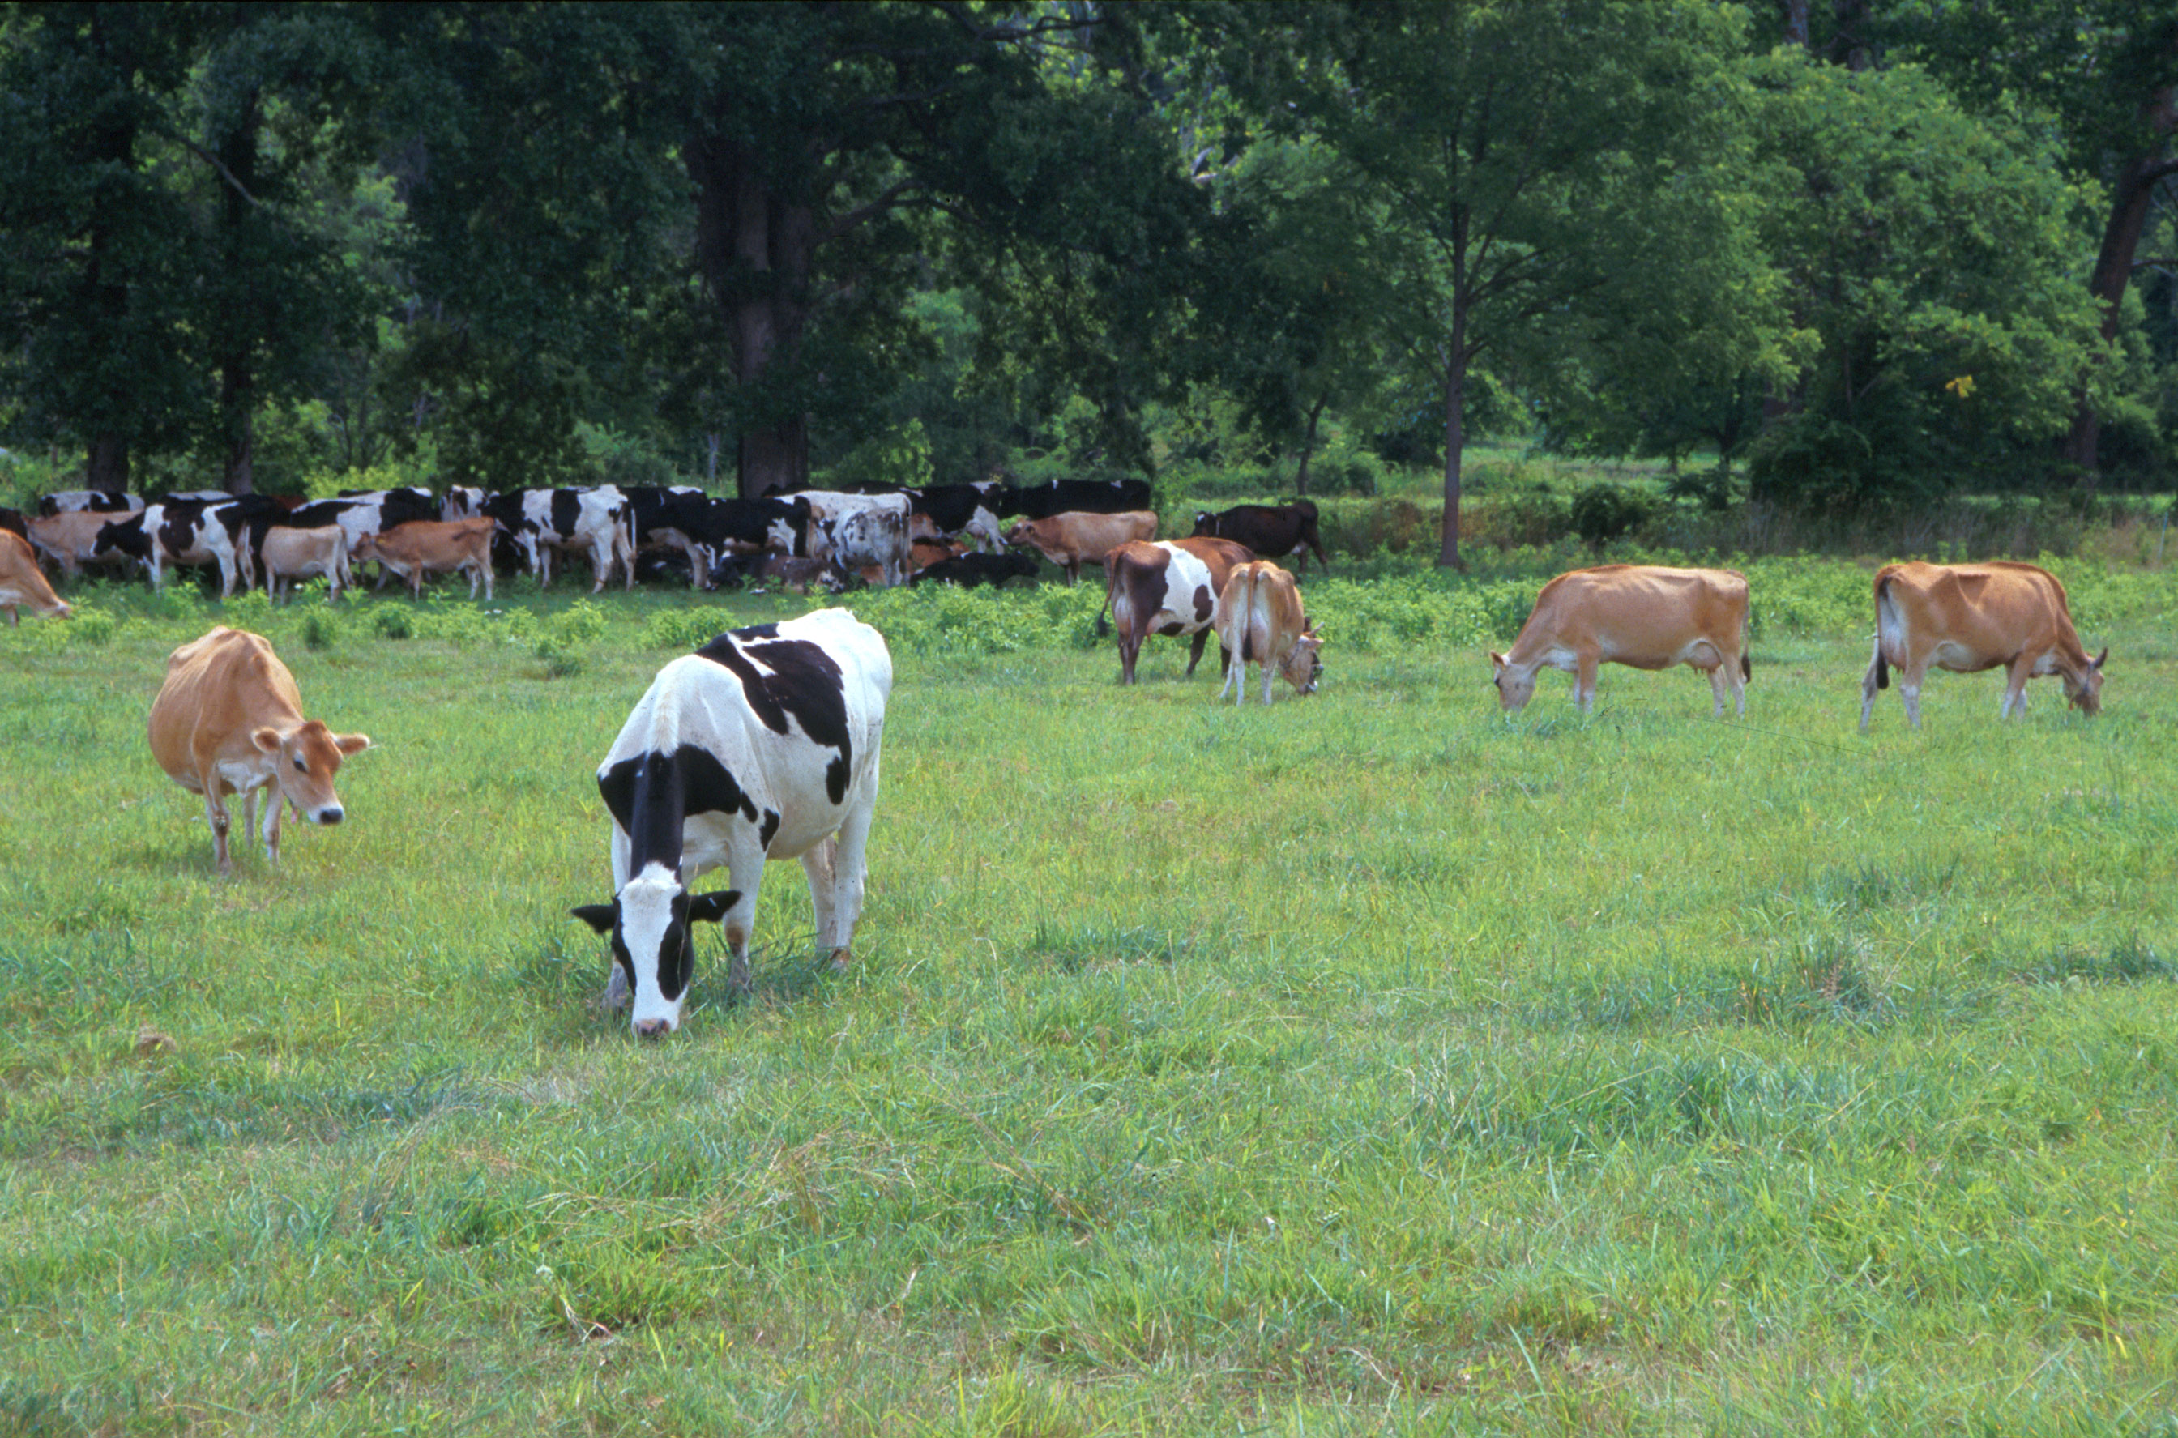
Questions?
AIP web site:
http://aipl.arsusda.gov
Holstein and Jersey crossbreds graze on American Farm Land Trust’s
Cove Mountain Farm in south-central Pennsylvania
Source: ARS Image Gallery, image #K8587-14; photo by Bob Nichols

