Slide 1
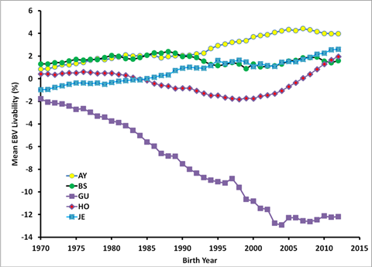
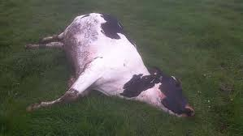
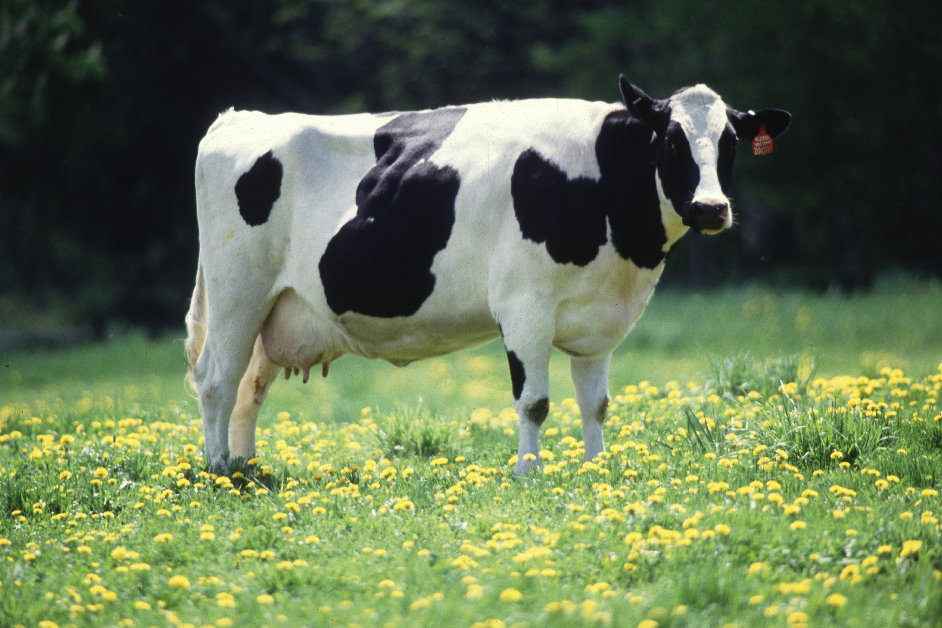
Genetic evaluation of dairy cow livability
J.R. Wright* and P.M. VanRaden
Abstract 16043
Animal Genomics and Improvement Laboratory, Agricultural Research Service, USDA, Beltsville, MD 20705-2350  http://aipl.arsusda.gov
INTRODUCTION
RESULTS
RESULTS (cont.)
Reasons for disposal have been reported and stored in Dairy Herd Improvement records since 1970 (large amount of potential data)
About 20% of cows die instead of being sold (across all lactations)
Death loss per lactation averages 7% (higher for later parity, lower for earlier parity)
Productive life (PL) measures cow’s ability to avoid dying or being culled
Livability (LIV) measures cow’s ability to stay alive
LIV is a subset of PL ($1,200 more value based on dead cow = $0, culled cow = $1,200)
Heritability
Ranged from 0.004 (parity 1) to 0.007 (parity 5)
0.0062 across parities
Genetic trend for LIV
Means and SD for PTALIV
Breed | Bulls* (no.) | Mean (%) | SD (%)
Ayrshire | 246 | 0.5 | 2.0
Brown Swiss | 692 | 0.1 | 2.0
Guernsey | 182 | –0.3 | 3.5
Holstein | 45,840 | –1.1 | 2.2
Jersey | 3,893 | –0.2 | 1.7
Milking Shorthorn | 64 | 0.7 | 1.9
*Bulls with birth year of ≥1990, ≥50 daughters, and REL for PTA LIV of ≥0.50)
DATA & METHODS
Data
92 million lactation disposition records
32 million cows
LIV definition
Reverse of mortality (0 = died this lactation, 100 = lived this lactation)
Multiplied by average lactations per cow (2.8) to put on same lifetime scale as PL
Expressed as percentage of all cows leaving the herd
Methodology
Multitrait model with PL (by parity) using similar edits as for other traits (PL by parity not reported)
Records pre-adjusted for herd variance
Variance estimated by parity using sire-model REML (allowed for use of over 5 million 1st-parity records)
Correlation of PTALIV with PTA of other traits
Trait | Holstein* | Jersey*
Milk yield | 0.09 | –0.08
Fat yield | 0.21 | 0.01
Protein yield | 0.16 | –0.01
PL | 0.70 | 0.54
SCS | –0.28 | –0.07
Daughter pregnancy rate | 0.40 | 0.54
Cow conception rate | 0.40 | 0.33
Heifer conception rate | 0.28 | 0.32
CONCLUSIONS
LIV correlation with PL (0.70) seems sufficiently below 1 to add value from selecting for both LIV and PL
LIV evaluations for bulls and cows will be released by CDCB later this year
Future plans include incorporation of LIV into Net Merit with ~ 7% emphasis
A similar LIV evaluation for heifer calves is under development, though data is much more limited
*Bulls with birth year of ≥1990, ≥50 daughters, and REL for PTA LIV of ≥0.50)
or

