Slide 1
Management of Mendelian traits in breeding programs by gene editing
John B. Cole^{1,*} and Maci L. Mueller²
¹Animal Genomics and Improvement Laboratory
Agricultural Research Service, USDA, Beltsville, MD, USA
²Department of Animal Science
University of California, Davis, CA, USA
john.cole@ars.usda.gov

Slide 2
Introduction
High-density SNP genotypes used to identify many new recessives that affect fertility in dairy cattle (Cole et al., 2016a)
Also used to track conditions such as polled
Faster allele frequency changes through sequential mate allocation (Cole, 2015)
Accounts for increases in genomic inbreeding and economic impact of affected matings
Should consider effects of gene editing on selection programs
May dramatically alter rates of allele frequency change

Slide 3
Estimated cost of genetic load
Cole et al. (2016a) estimated losses of at least $10,743,308 because of known recessives
Average losses were $5.77 for Ayrshires, $3.65 for Brown Swiss, $0.94 for Holsteins, and $2.96 for Jerseys
Economic impact of genetic load as it affects fertility and perinatal mortality
Actual losses likely to be higher

Slide 4
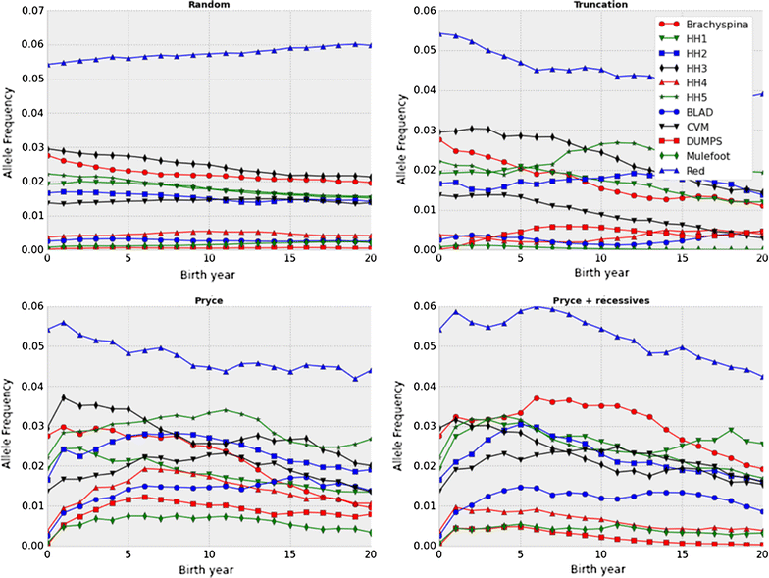
Selection may not be fast enough!
Source: Cole (2015)

Slide 5
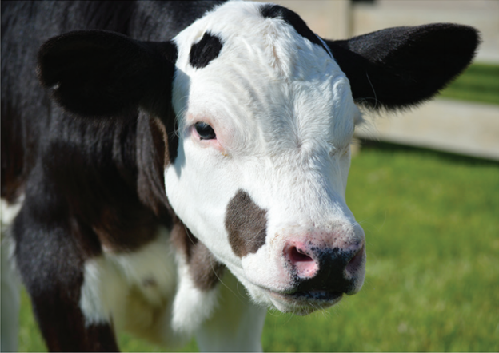
Gene editing in livestock

Slide 6
Objectives
Determine rates of allele frequency change for several genome editing technologies
Consider varying numbers of recessives as well as different proportions of bulls and cows to be edited

Slide 7
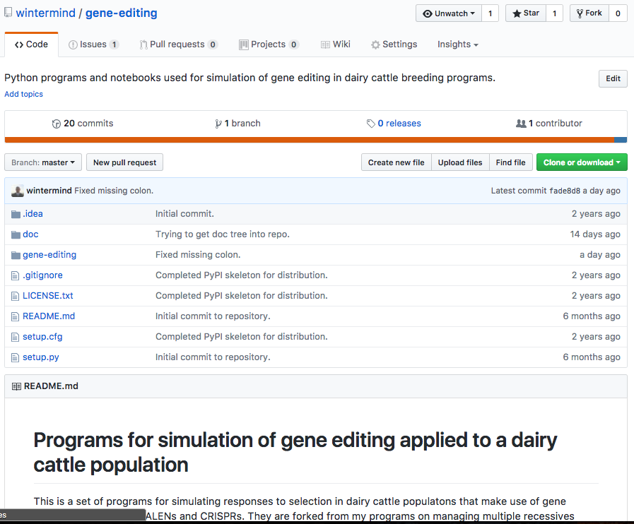
Simulation program
The multiple-recessives program of Cole (2015) was modified to accommodate gene editing
Code is available on GitHub under a CC0 1.0 license
Any number or combination of recessives may be edited
Written in Python 2.7 with Jupyter notebooks for analysis

Slide 8
Recessives in U.S. Holsteins
Haplo- type | Functional/Gene name | BTA chromosome | Location (Mbp) | Haplotype frequency (%) | Timing¹
HBR | Black/red coat color/MC1R(MSHR) | 18 | 14.8 | 0.80 | —
HCD | Cholesterol deficiency/APOB | 11 | 78.0* | 2.50 | W
HDR | Dominant red color/MC1R(MSHR) | 3 | 9.5* | 0.04 | —
HH0 | Brachyspina/FANCI | 21 | 21.2 | 2.76 | E,B
HH1 | APAF1 | 5 | 63.2* | 1.92 | E
HH2 | — | 1 | 94.9 – 96.6 | 1.66 | E
HH3 | SMC2 | 8 | 95.4* | 2.95 | E
HH4 | GART | 1 | 1.3* | 0.37 | E
HH5 | TFB1M | 9 | 93.2 – 93.4 | 2.22 | E
HHB | BLAD/ITGB2 | 1 | 145.1* | 0.25 | W
HHC | CVM/SLC35A3 | 3 | 43.4* | 1.37 | E,B
HHD | DUMPS/UMPS | 1 | 69.8* | 0.01 | E
HHM | Mule foot/LRP4 | 15 | 77.7 | 0.07 | B
HHP | Polledness (dominant)/POLLED | 1 | 1.7 – 2.0 | 0.71 | —
HHR | Red coat color/MC1R(MSHR) | 18 | 14.8* | 5.42 | —
*Causative mutation known
¹Timing of embryonic loss/calf death for homozygous animals: B = calf death at/shortly after birth,
E = embryonic loss/abortion, W = calf death weeks/months after birth
Source: Cole et al. (2016a,b)

Slide 9
Sequential mate allocation
Mating PA are adjusted for inbreeding (Pryce et al., 2012) and expected embryonic losses (Cole, 2015):
$$B_{ij}=0.5\left({TBV}_{i}+{TBV}_{j}\right)−λF_{ij}−\sum_{r=1}^{n_{r}}{{P\left(aa\right)}_{r}×v_{r}}$$
B_{ij} is a matrix of PA, TBV are true breeding values, λ is the value of a 1% increase in inbreeding, F_{ij} is the inbreeding of the mating, P(aa) is the probability of an affected embryo, and v_{r} is the economic loss associated with an affected embryo.

Slide 10
Sequential mate allocation (cont’d)
A matrix, M, is used to allocate bulls to cows
M_{ij} is set to 1 if B_{ij} is the greatest value in column j (largest PA available for mating to that cow)
If the sum of row i < the number of permitted matings for that bull the mating is allocated
Else, the bull with the next-highest value of B_{ij} is selected, until each column has only one element equal to 1

Slide 11
Gene editing algorithm
The best (elite) animals in the population are edited
Bernoulli random variate drawn (to determine if edit is successfully made to animal) and checked for success
After all recessives edited
Bernoulli random variate drawn (to determine if a live birth is produced) and checked for success
Failure means that no edited animal was produced and the edited animal is removed from the population
This model is not very realistic and needs refinement

Slide 12
Gene editing algorithm (cont’d)
Several scenarios can be accommodated in the software
Single edit and ET events (e.g., establish worst-case baseline)
Limited numbers of edit and ET events repeated until success or the supply is exhausted (e.g., limited embryos available for elite animals)
Unlimited numbers of edit and ET events repeated until success (e.g., many embryos available in a population of genetically similar animals)

Slide 13
Properties of gene editing strategies
Technology¹ | Editing success rate | ET success rate | Probability of success² | Trials for live calf³
CRISPR | 0.63 | 0.21 | 0. 13 | 34
TALEN | 0.21 | 0.12 | 0.03 | 152
Perfect | 1.00 | 1.00 | 1.00 | 1
ZFN | 0.11 | 0.08 | 0.01 | 459
¹CRISPR = clustered regularly interspaced short palindromic repeats;
TALEN = transcription activator-like effector nuclease;
Perfect = hypothetical technology with perfect success rate;
ZFN = zinc finger nuclease
²Calculated as editing success rate × ET success rate
³Trials required to for 99% probability of a live birth of an edited calf

Slide 14
Recessives by scenario
Scenario¹ | No.² | Frequency | Value ($)³ | Name | Lethal
All recessive loci | 12 | 0.0276 | 150 | Brachyspina | Yes
 |  | 0.0192 | 40 | HH1 | Yes
 |  | 0.0166 | 40 | HH2 | Yes
 |  | 0.0295 | 40 | HH3 | Yes
 |  | 0.0037 | 40 | HH4 | Yes
 |  | 0.0222 | 40 | HH5 | Yes
 |  | 0.0025 | 150 | BLAD | Yes
 |  | 0.0137 | 70 | CVM | Yes
 |  | 0.0001 | 40 | DUMPS | Yes
 |  | 0.0007 | 150 | Mulefoot | Yes
 |  | 0.9929 | 40 | Horned | No
 |  | 0.0542 | –20 | Red coat color | No
Horned locus | 1 | 0.9929 | 40 | Horned | No
¹Specific scenario simulated for each trait or group of traits
²Number of recessive loci in scenario
³Positive values undesirable and negative values desirable

Slide 15
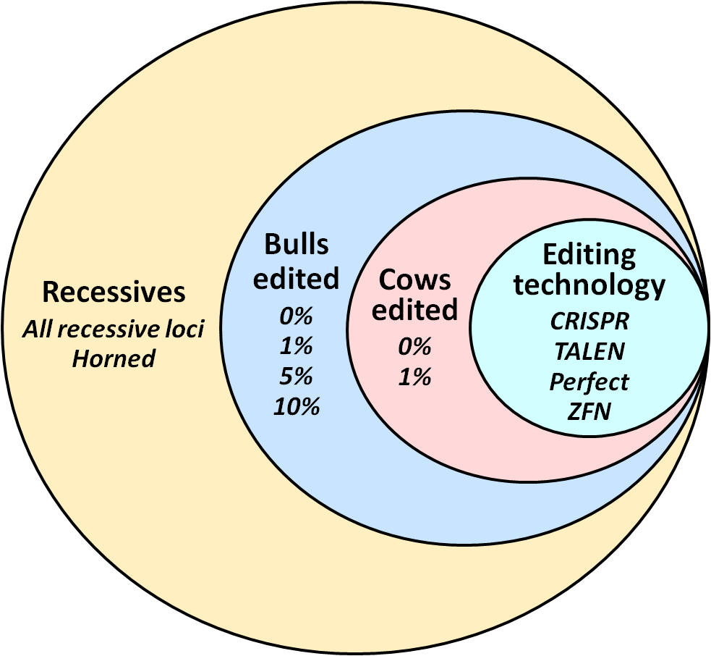
Recessives by scenario (continued)

Slide 16
Allele frequency change for all recessives with CRISPR
Top 1% of bulls and 0% of cows edited using CRISPR
Top 10% of bulls and 1% of cows edited using CRISPR

Slide 17
HH3 allele frequency change by editing method
Top 1% of bulls and 0% of cows edited
Top 10% of bulls and 1% of cows edited

Slide 18
Actual versus observed HH3 allele frequency
Top 1% of bulls and 0% of cows edited
Top 10% of bulls and 1% of cows edited

Slide 19
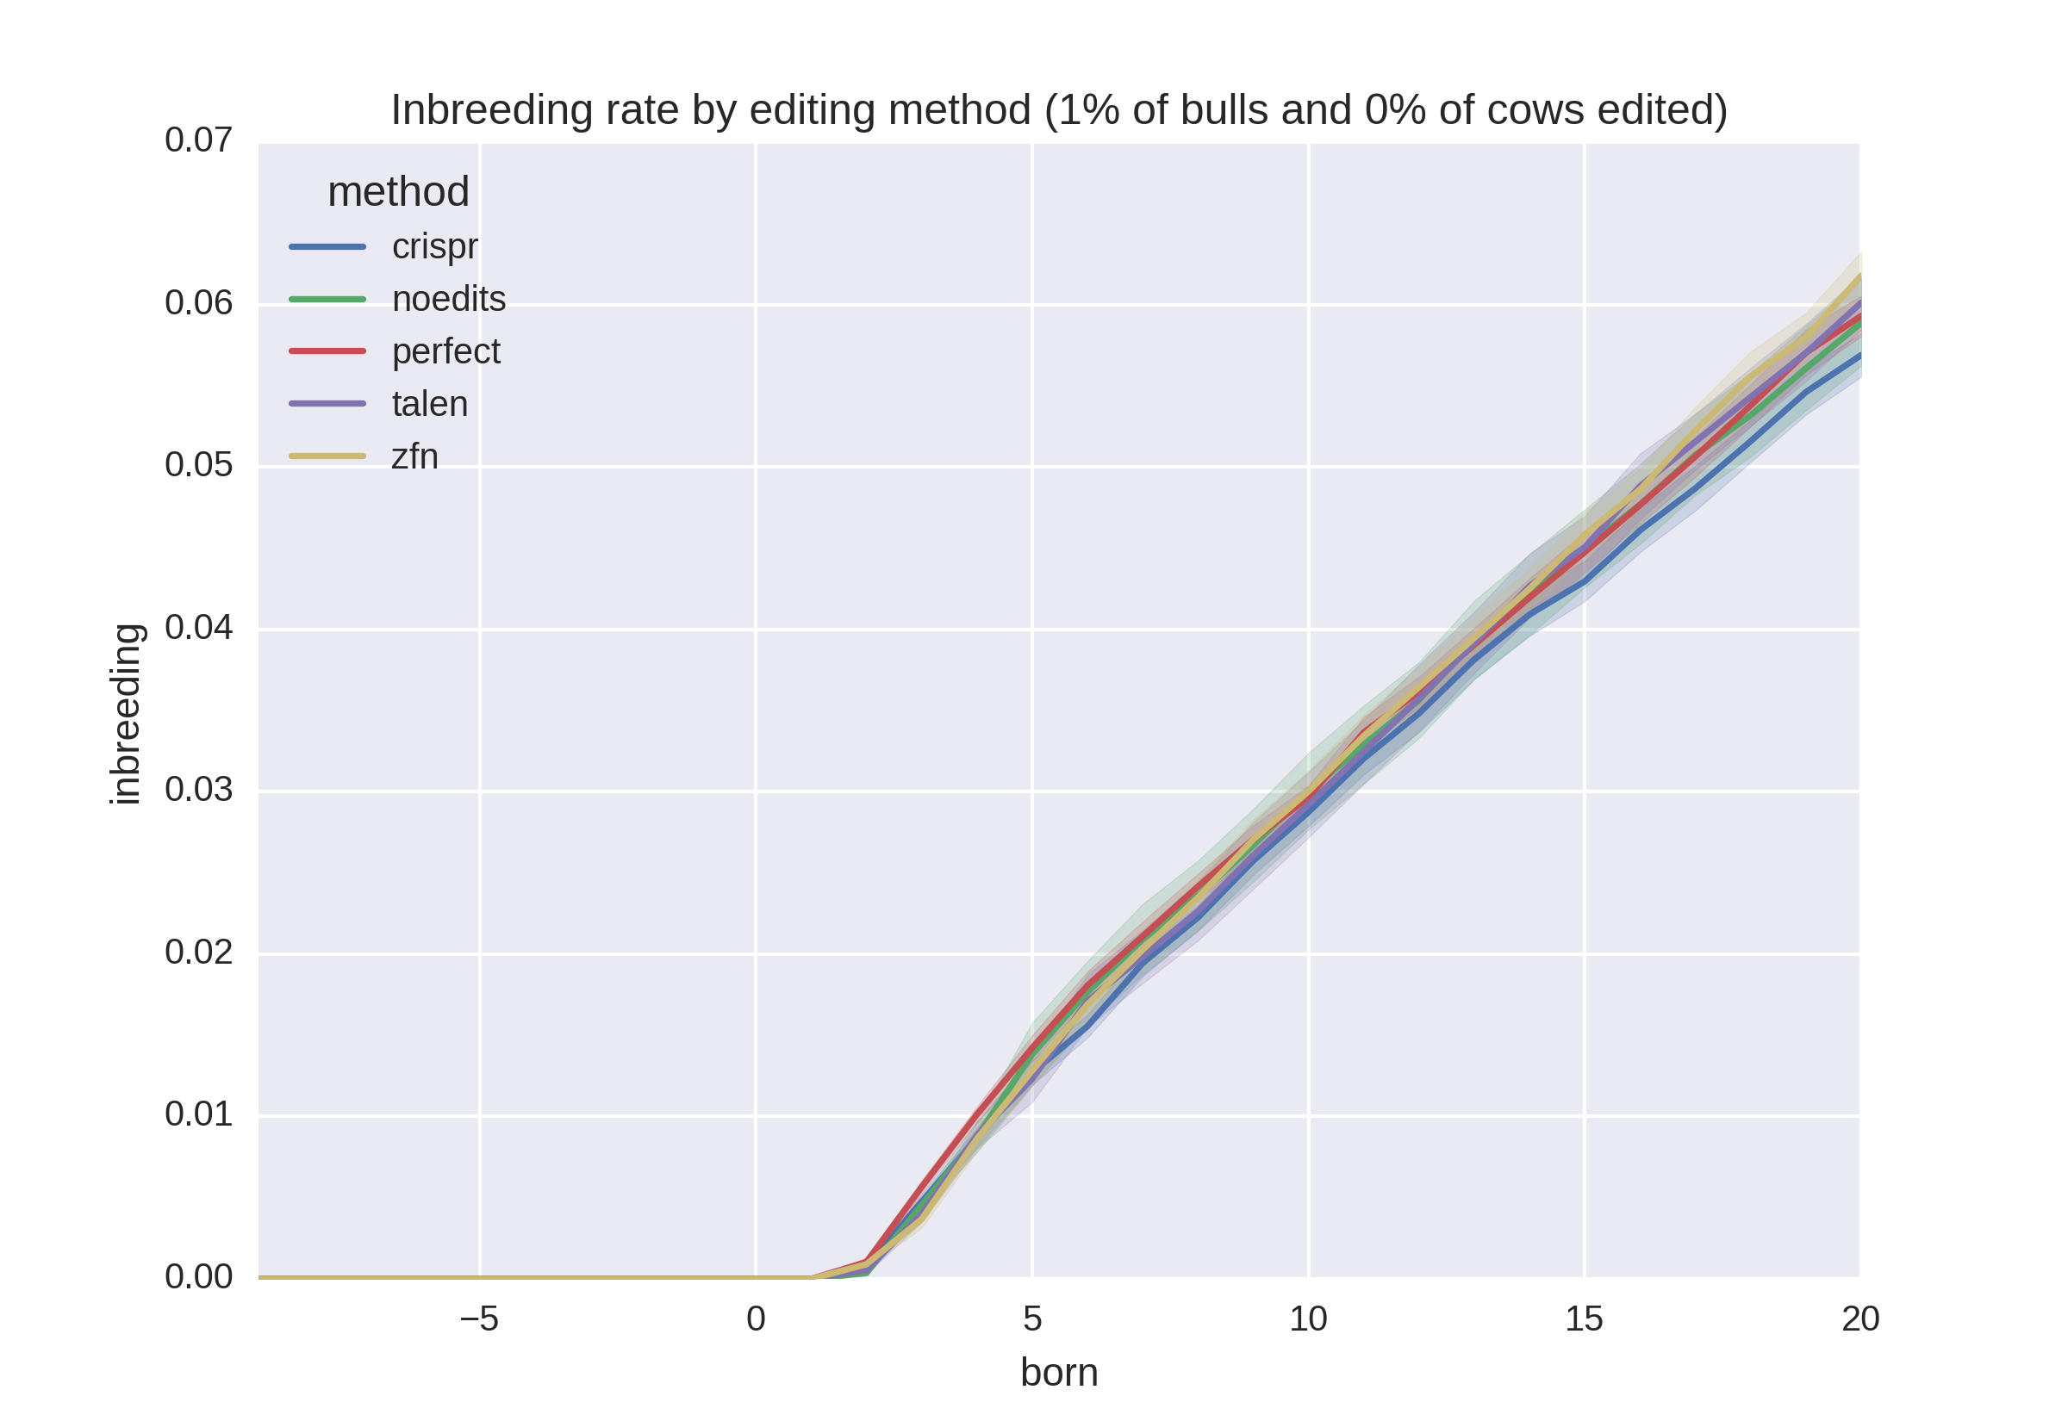
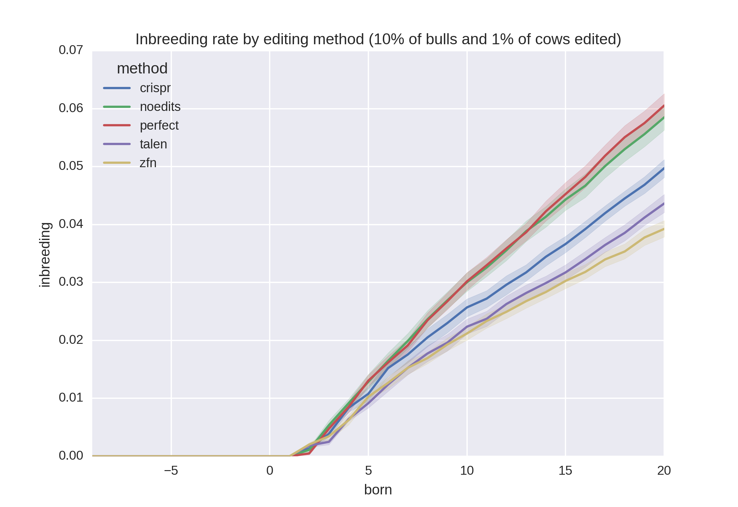
Inbreeding rates
Top 1% of bulls and 0% of cows edited
Top 10% of bulls and 1% of cows edited

Slide 20
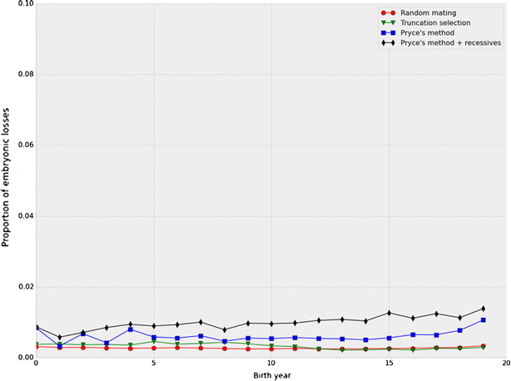
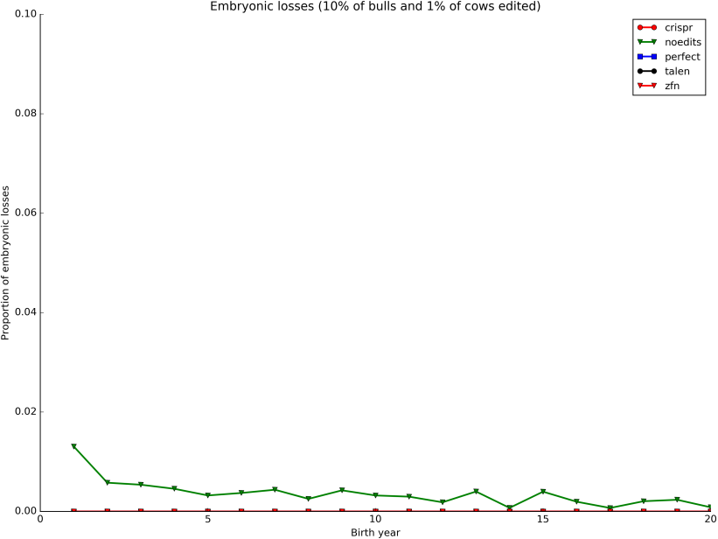
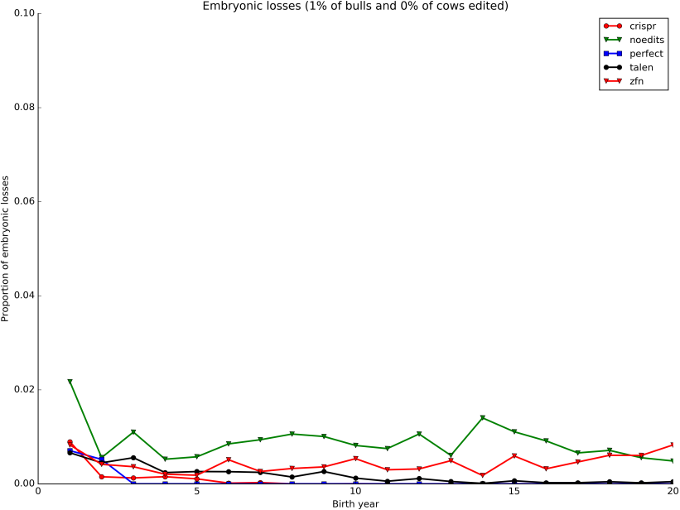
Embryonic deaths by generation

Slide 21
Why edit for polled?
Increasing polled frequency is slow without a sudden, substantial increase in value
Adding polled to selection indices a long-term (slow) solution
Gene editing to produce high-genetic merit polled bulls may be a short-term (fast) solution

Slide 22
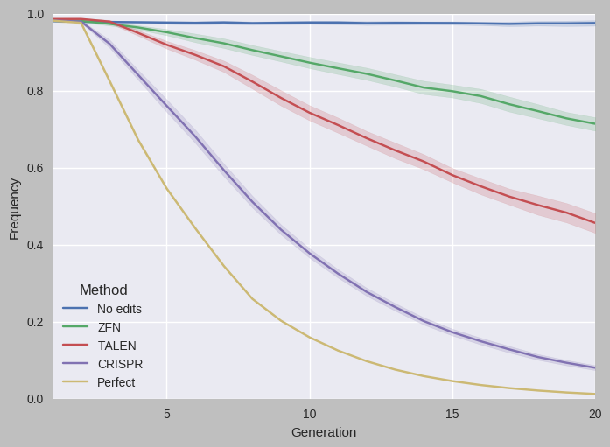
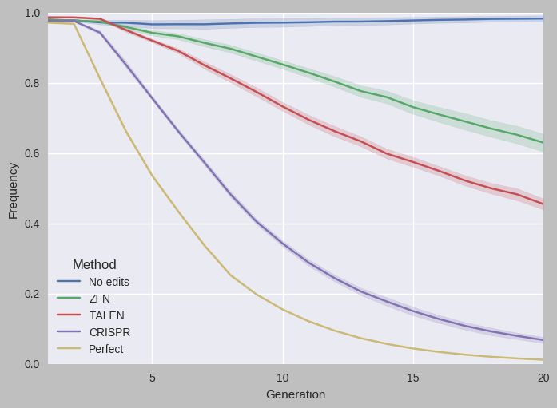
Change in Holstein horned allele frequency
Top 1% of bulls and 0% of cows edited
Top 10% of bulls and 1% of cows edited

Slide 23
Actual versus observed horned allele frequency
Top 1% of bulls and 0% of cows edited
Top 10% of bulls and 1% of cows edited

Slide 24
More edits result in faster progress

Slide 25
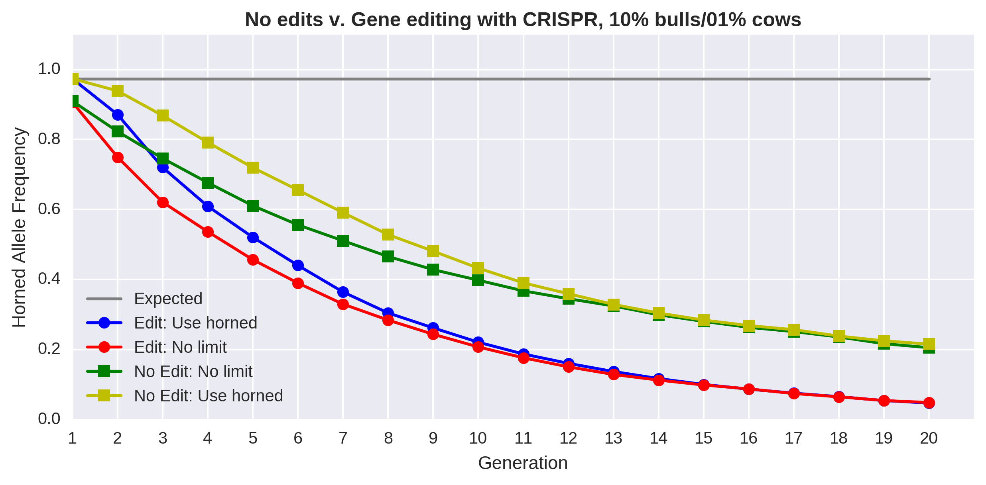
Change is faster with editing and few restrictions

Slide 26
Key findings
Proportion of bulls edited had only a small effect on allele frequencies
Editing elite cows had little effect on allele frequencies
The efficiency of the editing technology is more important than the proportion edited
The more efficient the editing technology used the lower the rate of inbreeding
Progress is faster in early generations when bulls can be used for more matings

Slide 27
Acknowledgments and disclaimers
USDA-ARS project 8042-31000-101-00, “Improving Genetic Predictions in Dairy Animals Using Phenotypic and Genomic Information”
USDA is an equal opportunity provider and employer
Mention of trade names or commercial products in this presentation is solely for the purpose of providing specific information and does not imply recommendation or endorsement by USDA

Slide 28
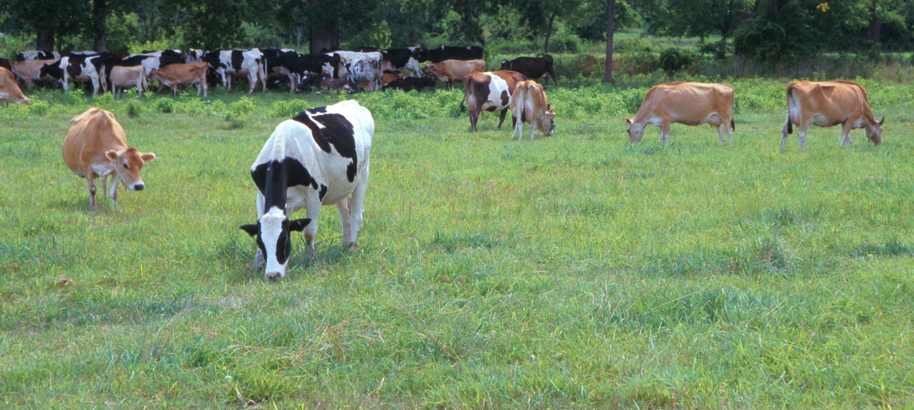
Questions?
AIP web site:
http://aipl.arsusda.gov
Holstein and Jersey crossbreds graze on American Farm Land Trust’s
Cove Mountain Farm in south-central Pennsylvania
Source: ARS Image Gallery, image #K8587-14; photo by Bob Nichols

