Slide 1
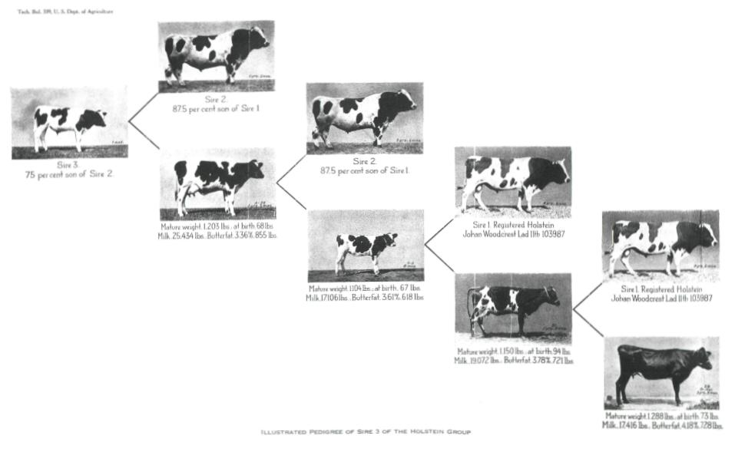

Methods to implement ancestor discovery in the US dairy cattle database
Juan P. Nani, John B. Cole and Paul M. VanRaden
USDA, Agricultural Research Service, Animal Genomics and Improvement Laboratory, Beltsville, MD
juanonani@gmail.com
https://aipl.arsusda.gov/

Slide 2
Complete pedigrees
Genomic evaluations have improved plant and animal breeding by estimating more accurately the genetic potential of individuals
Confirmation, discovery, and correction of parentage
complete pedigrees
usable phenotypic records
accuracy of predictions
Numbers of genotypes growing the need for optimized tools to effectively detect and fill in missing pedigree information is imperative

Slide 3
Discovering pedigrees in the US database
Each animal entering the database is checked for dam and sire (counting opposite homozygotes)
Mendelian conflicts resolved
Imputation to 80K Findhap.f90
Proportions of validated sires and dams are different:
  2,868,531 genotypes (88.1% cows)
  78% sires confirmed - 33% dams confirmed
  80% calves with no pedigree information received a Sire suggestion
  18% calves with no pedigree information received a Dam suggestion

Slide 4
Discovering pedigrees
Fixped.f90 uses haplotypes to discover distant relationships as MGS and MGGS when DAM is missing or nor reported (VanRaden et al., 2013)
https://aipl.arsusda.gov/publish/jds/2013/96_1874.pdf

Slide 5
Accuracy of ancestor discovery
Accuracy of discovery is very high (true ancestor is genotyped)
Accuracy of detection also high when reported pedigree is wrong
With lower density chips, accuracy is slightly reduced (94% for MGS 3K panel)
Fixped can also detect close relationships such as: CLONES, FSIBS, SIRE, DAM, PGS
Ancestor | Correctly discovered
SIRE | ~100%
MGS | 97%
MGGS | 92%

Slide 6
Linking pedigree information with FindDam
Finddam creates the constructed dam and/or MGD ID to link calves to MGS and MGGS in the pedigree
~ 300,000 animals with no dam ID can be linked to their discovered MGS and MGGS by creating a constructed dam or maternal granddam (MGD) ID
Sire
Calf
MGS
✓
DAM
MGGS
✓
MGD

Slide 7
Filling in pedigrees
Constructed ID: HO USA DAM (MGD) calf ID numeric
  HOUSADAM004235395
  HOUSAMGD004235395
First check if true dam can be discovered in same herd (33,810 found)
  Match birth and fresh dates, only 1 dam’s pedigree matches calf’s
Discovered ~60,000 MGS and MGGS not previously added because their dam and MGD ID were already reported

Slide 8
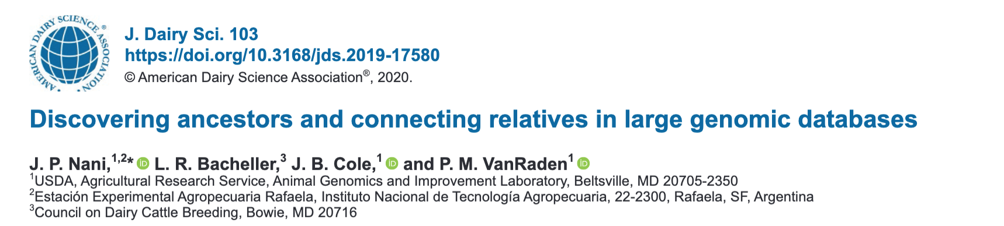
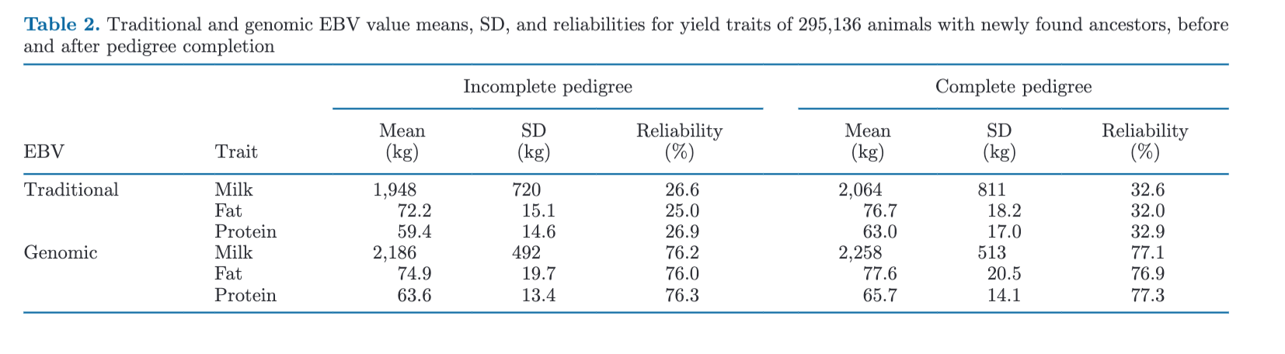
Filled pedigree results

Slide 9
Summary and implementation
Linking disconnected animals improved genetic and genomic estimations
Identifying pedigree errors can help to make better mating decisions
Fixped can increase the speed of genotype loading and avoid processing delays
Finddam can provide the discovered ancestors quickly
Complete pedigrees can assure accuracy and consistency of genomic and pedigree data.
Real dam IDs will be preferred over constructed IDs unless it does not match the calf and grandsire
Pedigree providers will have an option to remove discovered relationships

Slide 10
Acknowledgments
Council on Dairy Cattle Breeding (CDCB) and its industry suppliers for data
Agricultural Research Service (ARS) Research Participation Program administered by the Oak Ridge Institute for Science and Education (ORISE; Oak Ridge, TN)

