Slide 1
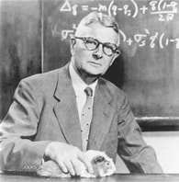
Sewall Wright’s relationship matrix
by Paul VanRaden
2022

Slide 2
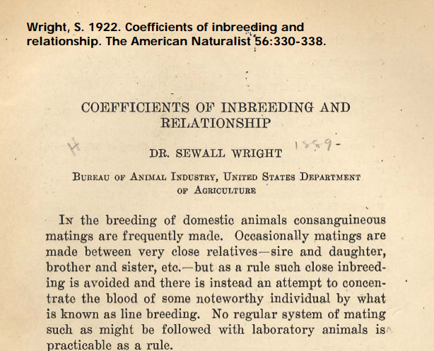
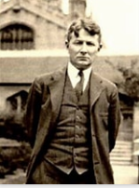
Pedigree relationship matrix – 100 years!

Slide 3
Sewall Wright – Biography and USDA research
Year | Research discoveries at USDA
1917 | Cattle color inheritance
1920 | Heritability (h²)
1920 | Livestock breeding (75-page book)
1921 | Systems of mating
1921 | Multiple regression accuracy (R²)
1921 | Effective population size
1921 | Correlation is not causation
1922 | Inbreeding coefficient (F)
1923 | Path coefficients
1925 | Computing relationships and F
Year | Biography | Location
1889 | Born | MA
1892 | Raised | Galesburg, IL
1911 | B.S. | Galesburg, IL
1912 | M.S. | U. IL, Urbana
1915 | PhD | Harvard U., MA
1916 | USDA | Beltsville, MD
1926 | Professor | Chicago, IL
1955 | Retired | Madison, WI
1988 | Died | Madison, WI

Slide 4
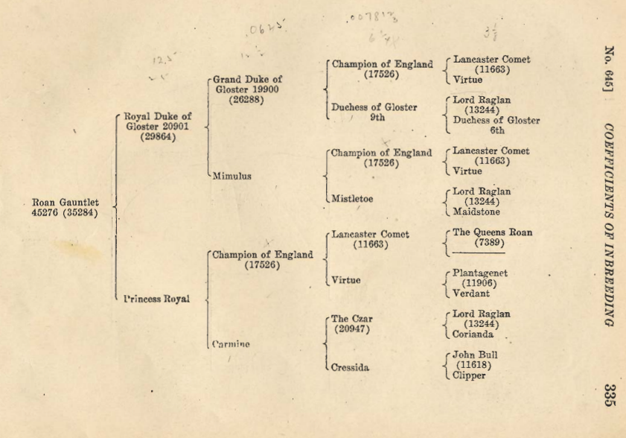
Example pedigree: Shorthorns

Slide 5
Genotype Parents and Grandparents
 |  | Manfred
 | O-Man
 |  | Jezebel
O-Style
 |  | Teamster
 | Deva
 |  | Dima
Notes:
We are all familiar with a traditional pedigree chart. Animal is expected to be an average of his parents.

Slide 6
Expected Relationship Matrix¹ 1HO9167 O-Style
 | PGS | PGD | MGS | MGD | Sire | Dam | Bull
Manfred | 1.0 | .0 | .0 | .0 | .5 | .0 | .25
Jezebel | .0 | 1.0 | .0 | .0 | .5 | .0 | .25
Teamster | .0 | .0 | 1.0 | . 0 | .0 | .5 | .25
Dima | .0 | .0 | .0 | 1.0 | .0 | .5 | .25
O-Man | .5 | .5 | .0 | .0 | 1.0 | .0 | .5
Deva | .0 | .0 | .5 | .5 | .0 | 1.0 | .5
O-Style | .25 | .25 | .25 | .25 | .5 | .5 | 1.0
¹Calculated assuming that all grandparents are unrelated

Slide 7
Pedigree Relationship Matrix 1HO9167 O-Style
 | PGS | PGD | MGS | MGD | Sire | Dam | Bull
Manfred | 1.053 | .090 | .090 | .105 | .571 | .098 | .334
Jezebel | .090 | 1.037 | .051 | .099 | .563 | .075 | .319
Teamster | .090 | .051 | 1.035 | .120 | .071 | .578 | .324
Dima | .105 | .099 | .120 | 1.042 | .102 | .581 | .342
O-Man | .571 | .563 | .071 | .102 | 1.045 | .086 | .566
Deva | .098 | .075 | .578 | .581 | .086 | 1.060 | .573
O-Style | .334 | .319 | .324 | .342 | .566 | .573 | 1.043

Slide 8
Genomic Pedigree - 2009
Notes:
Here is a simple Genomic pedigree chart. 2 separate chromosome segments are shown for each ancestor. (During meiosis , they divide-recombination). The earliest generation, are all one color for illustrative purposes. Dairy cattle have 30 chromosomes, including the X and Y. On average each chromosome carries millions of base pairs, and thousands of genes.
For the first segment, the sire has inherited ½ from each piece. In the second segment, the majority was inherited from one piece (both of these are an example of a crossover). The individual has received portions of the first segment that are traced back to the grandparent generation.
2) The dam has inherited most of one segment from one portion of her sire’s piece, and a mixture (double crossover) from her dam’s piece. The individual has segments that can be traced to all grandparents.
In this example…. Say the light green segment from the paternal grand dam was one that was high milk production; the offspring, inheriting a large segment from her, could mean that through this recombination, this animal would have a higher PTA for milk that a full sib.

Slide 9
Genomic Relationship Matrix 1HO9167 O-Style
 | PGS | PGD | MGS | MGD | Sire | Dam | Bull
Manfred | 1.201 | .058 | .050 | .093 | .609 | .054 | .344
Jezebel | .058 | 1.131 | .008 | .135 | .618 | .079 | .357
Teamster | .050 | .008 | 1.110 | .100 | .014 | .613 | .292
Dima | .093 | .135 | .100 | 1.139 | .131 | .610 | .401
O-Man | .609 | .618 | .014 | .131 | 1.166 | .080 | .626
Deva | .054 | .079 | .613 | .610 | .080 | 1.148 | .613
O-Style | .344 | .357 | .292 | .401 | .626 | .613 | 1.157

Slide 10
Difference (Genomic – Pedigree) 1HO9167 O-Style
 | PGS | PGD | MGS | MGD | Sire | Dam | Bull
Manfred | .149 | -.032 | -.040 | -.012 | .038 | -.043 | .010
Jezebel | -.032 | .095 | -.043 | .036 | .055 | .004 | .038
Teamster | -.040 | -.043 | .075 | -.021 | -.057 | .035 | -.032
Dima | -.012 | .036 | -.021 | .097 | .029 | .029 | .059
O-Man | .038 | .055 | -.057 | .029 | .121 | -.006 | .060
Deva | -.043 | .004 | .035 | .029 | -.006 | .087 | .040
O-Style | .010 | .038 | -.032 | .059 | .060 | .040 | .114

Slide 11
Conclusions
Relationships can be defined as matrix:
A = expected genes in common from pedigree (Wright, 1922)
G = actual genes in common from DNA (VanRaden, 2008)
Full sibs share 50% ± 3.5% of DNA.
“Unrelated” animals share more or fewer unknown ancestors than average.
Predictions are more reliable using genomic (G) instead of pedigree (A) relationships
Notes:
Paul follows this talk, and his presentation will hopefully answer any mathematics questions you may have…

Slide 12
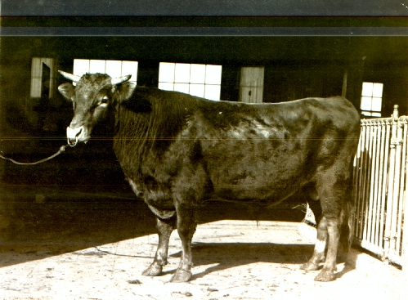
Extreme Inbreeding at Beltsville 1912-1949

Slide 13
Experimental Design
8 consecutive generations of mating sires to their daughters, and dams to their sons
Highest inbreeding coefficients ever obtained in cattle (maximum F = 75.1%)
Foundation Guernsey sire (Prince Billy) imported from the Isle of Guernsey in 1910
Foundation Holstein sire (Lad 11th) purchased from Minnesota in 1912

Slide 14
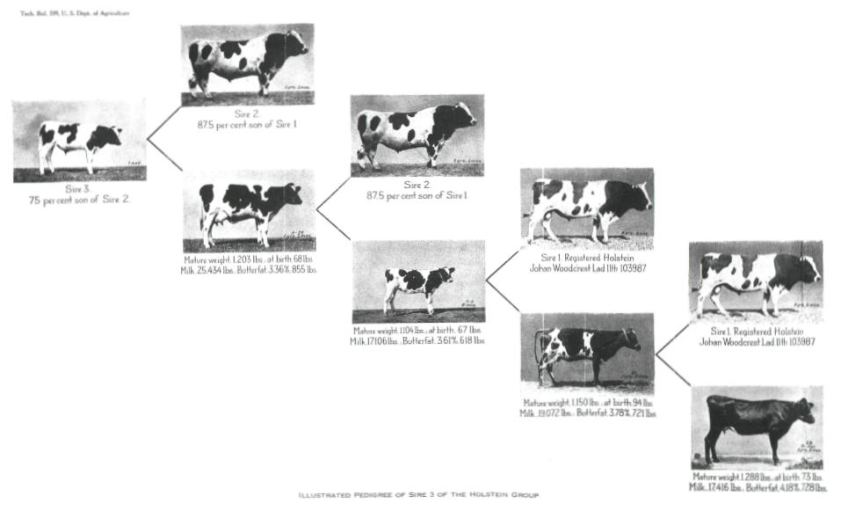
Early Matings in the Holstein Line
USDA Tech. Bulletin No. 339

Slide 15
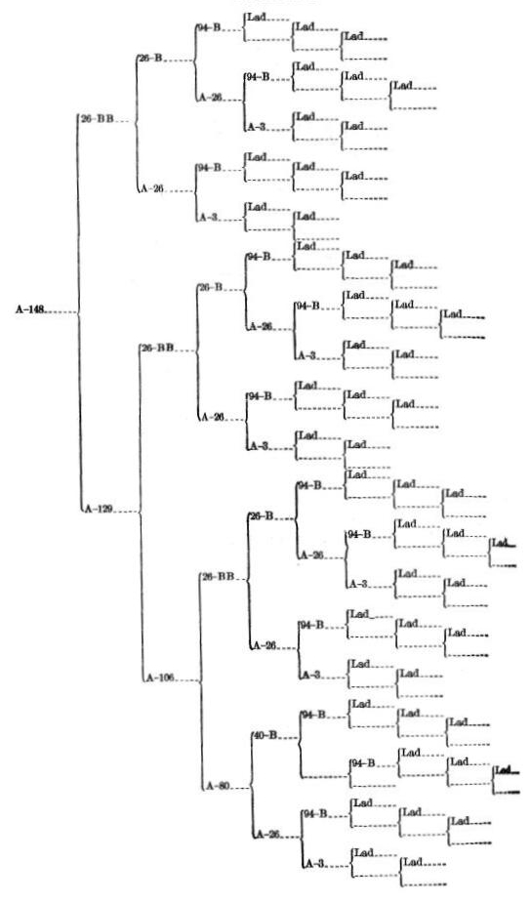
Sire Lad Appears 50 Times (64.6% F)

Slide 16
Conclusions on Extreme Inbreeding
Guernsey line died due to lethal recessive and Brucellosis epidemic
Holstein birth weights decreased from 37 kg to 29 kg
Milk yield decreased by 7% and fat yield by 17% with inbreeding levels near 50%
“Continued inbreeding of whole herds, however, is almost certain to be disastrous.”

