Slide 1
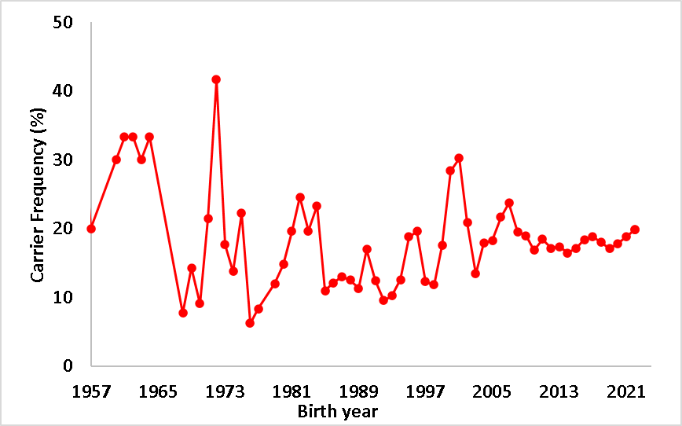
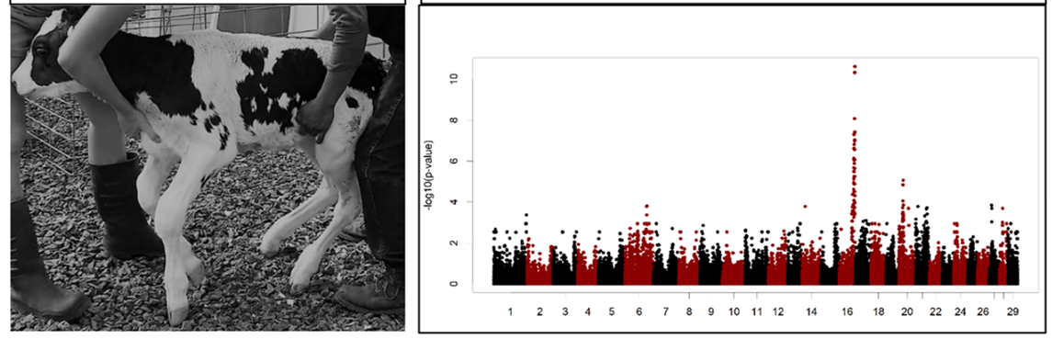
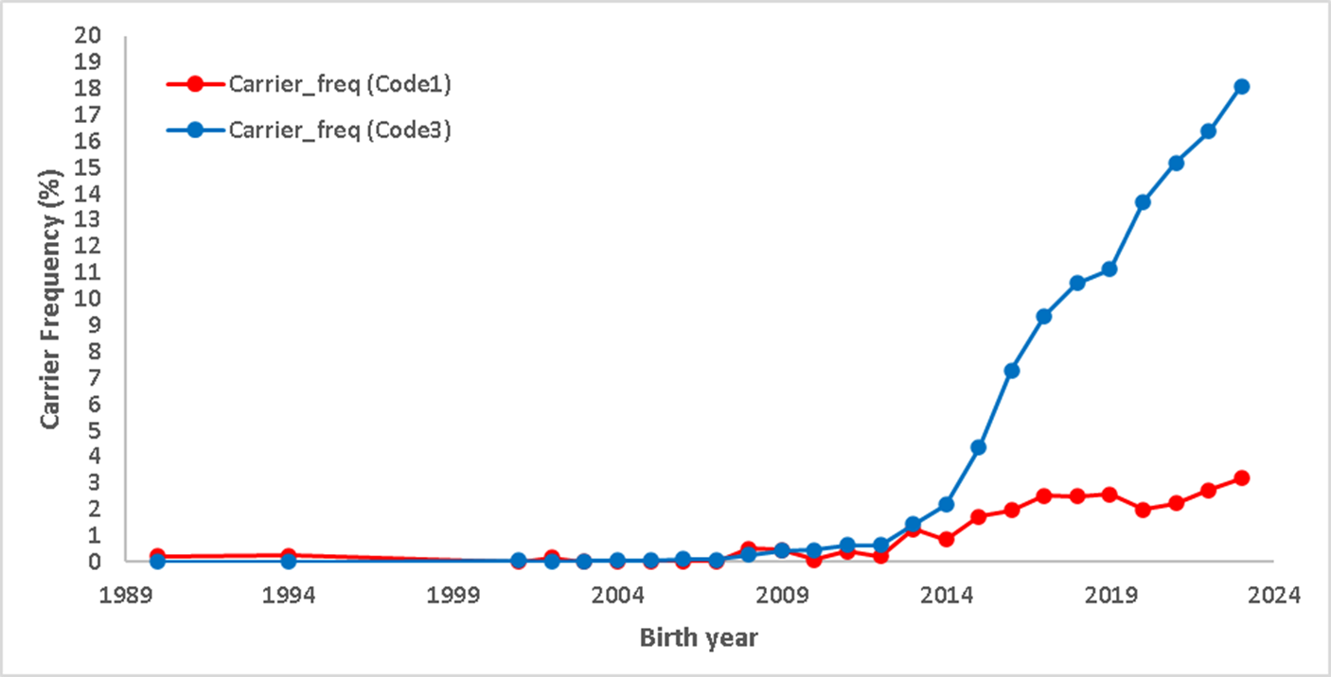
Haplotype inheritance and livability of recumbent Holstein calves
A. Al-Khudhair¹, P.M. VanRaden¹*, D.J. Null¹ M. Neupane,¹ and C.D. Dechow²
¹Animal Genomics and Improvement Laboratory, Agricultural Research Service, USDA, Beltsville, MD 20705-2350
2Pennsylvania State University, Department of Animal Science, University Park, PA 16802.
Abstract #8484
2023 ADSA Meeting
http://aipl.arsusda.gov
ABSTRACT
A recessive condition affecting calves’ ability to stand, termed recumbency, was reported in 2022. The identified haplotype on chromosome 16 traces back 13 generations via several very popular sires back to 1952. For 70 years, it has been one of the most common haplotypes in the Holstein population, but the observed number of homozygotes was only slightly less than expected in national data. A potential explanation was that a new mutation had occurred within that popular haplotype. Computer code to sort out the mutated from the original version of the cholesterol deficiency haplotype was improved and then applied to recumbency by requiring pedigree connections to a recent common ancestor of the affected calves. For 5.1 million genotyped Holsteins, haplotype codes included 0.01% homozygotes tracing only to that ancestor on both sides (code 2), 0.48% other homozygotes (code 4) tracing to that ancestor on both sides but also to other sires having the original version, 8.15% suspect carriers (code 3) where the normal or mutated status of the haplotype could not be determined, 2.09% sure carriers (code 1), and 89.27% noncarriers (code 0). Haplotype status for 558K calves matched to heifer livability records; those were analyzed without adjusting for birth year or herd incidence. Only 46 code 2 homozygotes had records and 52% of those died before 18 months at an average age of 1.7±1.6 months. That death rate may be underestimated if only healthier calves were genotyped. The death rate was only 4.2% for the 2,211 code 4 homozygotes and 2.4% for the code 0 noncarriers. Of the 5 oldest code 2 heifers that lived beyond 18 months, most had 3 or 4 lactations with good production, but one died at two years of age. Thus, calves that recover from recumbency can have normal, productive lives. Instead of identifying known or suspected homozygotes from genotypes and then checking phenotypes, a more proactive strategy would be to identify carrier’s mating and carefully monitor the resulting calves but that would require more effort. Different reporting methods or dominance effects may be needed to include recumbency and other partially lethal effects in selection and mating.
RESULTS
Confirming a recent mutation hypothesis in the HRB haplotype
The frequency trend of the HRB commonly existed haplotype in Holstein traced to the 1950s. The haplotype is one of the most common and the occurrence frequency averaged ~20% of the total population since the 1950s.
Known HRB haplotype has much less calf mortality than expected
Sequence variants with the highest concordance associated with the recumbency disorder (ARS-UCD1.2/bosTau9, region of (75,761,625 - end of chr16)).
RESULTS
Pedigree traced then sorted (mutant vs un-mutant haplotype) identifies the real carriers of HRB recessive gene.
Calf livability matched haplotype carrier status with old and new livability edits.
Heifer livability by HCD haplotype carrier status with old and new livability edits and pedigree tracing methods.
Calf livability by Recumbency haplotype carrier status with old and new livability. (*Genotype status:
0 = noncarrier, 1 = carrier, 2 = homozygous defect, 3 = suspect carrier, 4 = suspect homozygous
-4 = homozygous but lacking pedigree, 5 = not genotyped but has livability record.)
Dechow, C. D., E. Frye, and F. P. Maunsell. 2022. Identification of a putative haplotype associated with recumbency in Holstein calves. JDS Commun 3(6):412-415.
 |  | New hap test
 |  | Code 0 (%) | Code 1 (%) | Code 2 (%) | Code 3 (%) | Code 4 (%) | Total (%)
Old hap test | Code 0 (%) | 264666 (21.63) | 0 (0) | 0 (0) | 0 (0) | 0 (0) | 264666 (21.63)
 | Code 1 (%) | 374069 (30.57) | 106515 (8.71) | 0 (0) | 433674 (35.45) | 0 (0) | 914258 (74.73)
 | Code 2 (%) | 13351 (1.09) | 4784 (0.39) | 651 (0.05) | 0 (0) | 25780 (2.11) | 44566 (3.64)
 | Total (%) | 652086 (53.3) | 111299 (9.1) | 651 (0.05) | 433674 (35.45) | 25780 (2.11) | 1223490 (100)
Haplotype frequencies prediction for recumbent calves traced only to a common ancestor (ROYLANE SOCRA ROBUST-ET (HOUSA000064966739)). Older haplotype test method too often confused the normal and mutated versions of the original haplotype
STUDY OBJECTIVES
Revealing a potential genetic association for Holstein recumbency,
investigate this association.
On the haplotype level.
Inspecting the region for a possible recent mutation causing and/or associated with the recumbency disorder.
Validating penetrance from heifer livability data and its possibility of confounding the recumbency phenotype results.
Tracking such genetic disorders by utilizing pedigree data to track potential new mutations within existing haplotypes.
*Genotype code | Number |  | Livability (%) |  | Death age (mo) |  | Life (max=18 mo)
 | Old | New | Old | New | Old | New | Old | New
0 | 592,328 | 582,311 | 97.5 | 97.5 | 7.5 | 7.1 | 17.3 | 17.4
1 | 5,596 | 6,506 | 97.3 | 97.2 | 7.5 | 6.9 | 17.3 | 17.4
2 | 18 | 27 | 33.3 | 11.1 | 5.9 | 4.4 | 6.6 | 5.4
3 | 14,760 | 12,968 | 98.1 | 98.2 | 8.3 | 8.2 | 17.3 | 17.5
4 | 68 | 41 | 39.7 | 29.3 | 3.9 | 3.5 | 7.9 | 7.4
-4 | 147 | 74 | 95.2 | 94.6 | 8.9 | 6.9 | 16.8 | 16.8
5 | 5,116,059 | 5,116,059 | 95.6 | 95.6 | 6.7 | 5.7 | 17.1 | 17.2
 | Females |  | All males |  | Published males
 | N | % | N | % | N | %
Total | 4,931,321 | 100 | 391,960 | 100 | 285,276 | 100
Carrier | 848,701 | 17.21 | 65,558 | 16.73 | 48,538 | 17.01
Homozygous | 41,341 | 0.84 | 3,225 | 0.82 | 2,381 | 0.83
Expected homozygous | 43,573 | 0.88 | 3,318 | 0.85 | 2,490 | 0.87
Location | Type | Priority | Gene | Match | No match | G missing | Call total | Call rate % | Concordance %
79246884 | synonymous | low | KIF14 | 81 | 2 | 216 | 83 | 28 | 98
79636921 | missense/splice region | moderate | CACNA1S | 151 | 4 | 144 | 155 | 52 | 97
79733060 | synonymous | low | ENSBTAG00000046177 | 213 | 7 | 79 | 220 | 74 | 97
79613592 | missense | moderate | CACNA1S | 256 | 9 | 34 | 265 | 89 | 97
79733068 | missense | moderate | ENSBTAG00000046177 | 227 | 8 | 64 | 235 | 79 | 97
76107580 | missense | moderate | ZBTB41 | 275 | 10 | 14 | 285 | 95 | 96
79253161 | stop gained | high | KIF14 | 275 | 10 | 14 | 285 | 95 | 96
79910536 | synonymous | low | KLHL12 | 263 | 10 | 26 | 273 | 91 | 96
79120856 | missense | moderate | ZNF281 | 236 | 9 | 54 | 245 | 82 | 96
80127163 | synonymous | low | SYT2 | 232 | 9 | 58 | 241 | 81 | 96
76054628 | synonymous | low | ASPM | 282 | 11 | 6 | 293 | 98 | 96
76065369 | missense | moderate | ASPM | 282 | 11 | 6 | 293 | 98 | 96
Genotype code* | Number |  | Livability (%) |  | Death age (mo) |  | Life (max=18 mo)
 | Old | New | Old | New | Old | New | Old | New
0 | 558,362 | 548,507 | 97.6 | 97.6 | 7.9 | 7.1 | 17.3 | 17.4
1 | 16,360 | 16,074 | 96.8 | 96.7 | 6.9 | 6.2 | 17.1 | 17.2
2 | 46 | 43 | 47.8 | 44.2 | 1.7 | 1.5 | 7.7 | 8
3 | 35,942 | 35,162 | 96.8 | 96.8 | 7.5 | 6.8 | 17.1 | 17.3
4 | 2,211 | 2,145 | 95.8 | 95.7 | 7.3 | 6 | 16.9 | 17.1
-4
5 | 5,116,059 | 5,030,707 | 95.6 | 95.6 | 6.7 | 5.7 | 17.1 | 17.2
DATA & METHODS
The haplotype identified in recumbent calves by Dechow et al. (2022). The suspect haplotype traced back to a key ancestors identified from chip genotypes.
Homozygosity for all variants within the suspect region revealed using sequence data of common ancestor, affected (recumbent calf) and the sire of the affected calf .
To test the hypothesis of a recent mutation in the HRB haplotype, we restricted the haplotype using pedigree data to only those tracing to the recumbent calves’ common ancestor Robust as detected by Dechow et al. (2022).
Computer code to sort out mutated from original versions of haplotypes (VanRaden and Null, 2015) was improved, retested on the cholesterol deficiency haplotype, and then applied to recumbency.
Imputed genotypes that included 78,964 markers of 5,632,638 Holsteins were examined from April 2023 data. For both the HCD and HRB haplotypes, animal pedigrees were traced to help sort carriers of the mutated haplotype from animals that carry the (unmutated) original haplotype.
Heifer livability records (Neupane et al., 2022) for 5,728,980 calves were matched to haplotype status for both HCD and HRB resulting in 4,216,655 matched records.
The edited phenotype file had 4,154,954 matched heifer records after excluding 61,701 heifers.
Haplotype vs gene test analysis (old edit method vs. new edit method)
Using the Haplotype for Cholesterol Deficiency (HCD). New improved method identifies more HCD true carriers, confirmed by the HCD gene test.
Using Recumbency disorder gene test (from Selectsires company) confirming most of the haplotype test results.
 | Gene test code vs old method |  |  | Gene test code vs new method
Hap code | Not a carrier (col %) | Carrier (col %) | Total (%) | Not a carrier (col %) | Carrier (col %) | Total (%)
0 | 29838 (99.95) | 430 (55.20) | 30268 (98.81) | 29832 (99.93) | 71 (9.11) | 29903 (97.62)
1 | 4 (0.01) | 290 (37.23) | 294 (0.96) | 3 (0.01) | 458 (58.79) | 461 (1.5)
2 | 0 | 0 | 0 | 0 | 0 | 0
3 | 12 (0.04) | 59 (7.57) | 71 (0.23) | 19 (0.06) | 249 (31.96) | 268 (0.87)
4 | 0 | 0 | 0 | 0 | 1 | 1 (0)
Total (%) | 29854 (97.46) | 779 (2.54) | 30633 (100) | 29854 (97.46 ) | 779 (2.54) | 30633 (100)
CONCLUSIONS
Revised haplotype tracking methods were applied in this study that achieved greater precision in identifying undesired recessive inheritance.
Utilizing sequence data to narrow the search to a single mutation candidate.
Sorting haplotypes into the original version vs. those containing a new mutation.
Requiring pedigree relatedness to the key ancestor affected animal.
The new methods were even more essential for recumbency, where the original haplotype is much more common than the haplotype containing the new mutation.
Identification of harmful mutations and selection against them could improve fertility and reduce calf losses by $2 million per year.
 |  | Gene test results
 |  | # not carrier (%) | # carrier (%) | # recumbent (%) | Total (%)
Haplotype results | Code 0 | 675 (81.52) | 3 (0.36) | 0 (0) | 678 (81.88)
 | Code 1 | 0 (0) | 56 (6.76) | 0 (0) | 56 (6.76)
 | Code 2 | 0 (0) | 0 (0) | 2 (0.24) | 2 (0.24)
 | Code 3 | 67 (8.09) | 14 (1.69) | 0 (0) | 81 (9.78)
 | Code 4 | 3 (0.36) | 8 (0.97) | 0 (0) | 11 (1.33)
 | Total (%) | 745 (89.98) | 81 (9.78) | 2 (0.24) | 828 (100)
Tracing the recumbent calf's ancestor using pedigree data to a common bull born in 2008 (ROYLANE SOCRA ROBUST-ET).
The available genomic data of the HRB haplotype were then sorted for the recumbent animals to separate carriers of the mutated HRB haplotype for animals that carry the (unmutated) original HRB haplotype

