Slide 1
ANS 362 / 363 Lecture, U WI Paul VanRaden USDA, Animal Genomics and Improvement Laboratory Beltsville, MD, USA paul.vanraden@usda.gov
Talk title:
Animal breeding lessons and skills
are useful across many decades

Slide 2
Topics
Early training and how useful it was over the decades
Data collection and farm experience
Undergraduate coursework (U IL)
Graduate research projects (ISU)
Postdoc research (U WI)
Fellow graduate students
Other research more philosophical
Recent research on cloning

Slide 3
USDA PTAs calculated since 1926
Graves, R. R. 1926.
Transmitting ability of twenty-three Holstein-Friesian sires.
USDA Dept. Bull. 1372.
Daughter-dam comparison
Mean yield of daughters minus dam’s yield
Method used until 1962

Slide 4
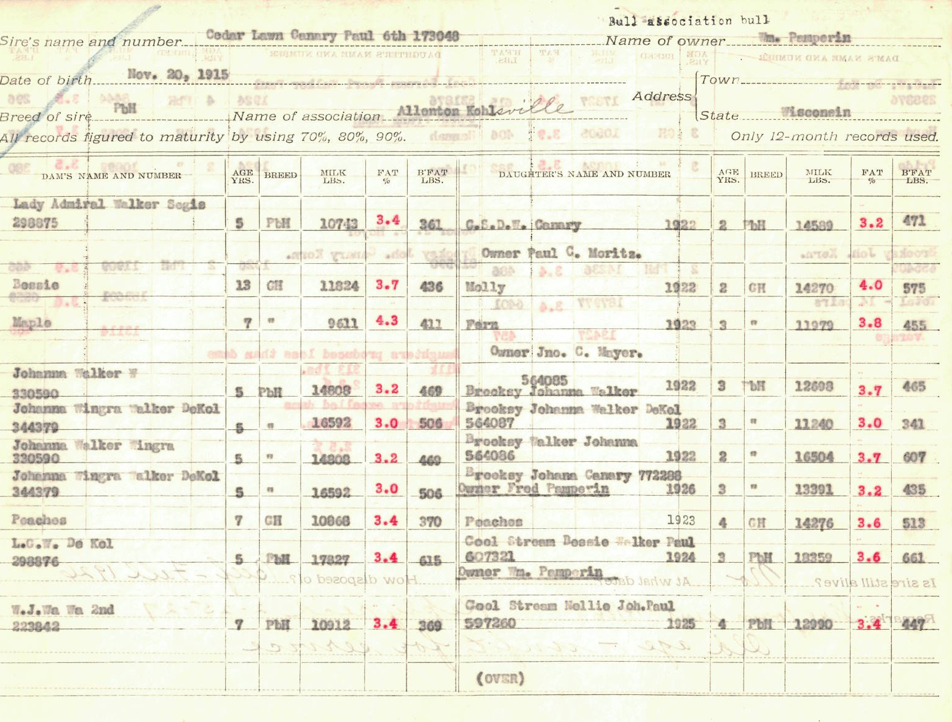
First USDA PTA sent to WI in 1926 (1 of the 23 bulls)
Cedar Lawn Canary Paul 6th
Born: Nov 20, 1915
Sold for beef in Fall, 1926
HO registration: 173048
Owned by: Wm. Pemperin
Bull Association: Allenton Kohlsville
The farm began in 1847 in the West Bend area. In 1992 they moved to Farmington at the crossroads of Cheeseville. They are a family dairy farm with 230 dairy cows.
George and Kathy Muth, current owners

Slide 5
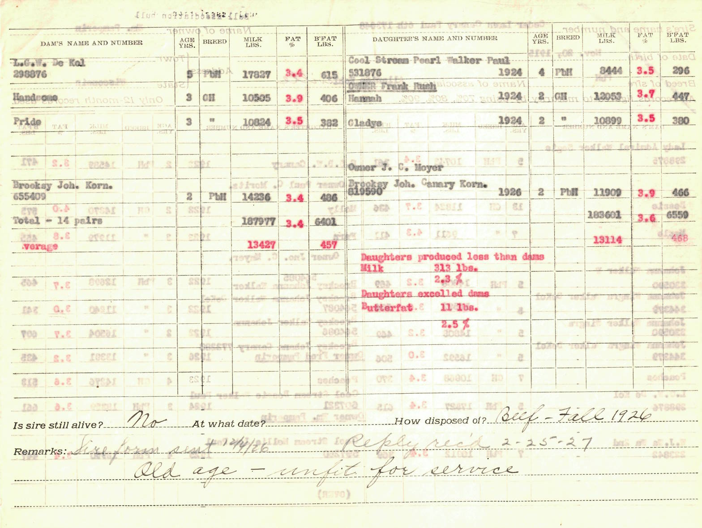
Page 2 of the first USDA PTA sent to WI in 1926
14 daughter - dam pairs
Daughters produced less than
dams for Milk but excelled
dams for Butterfat.
Bull PTA:
-313 lbs. Milk
+11 lbs. Butterfat
Sire form sent 12/4/1926
Owner replied 2-25-1927
Is sire still alive? No
Sire sold for: Old age – unfit
for service

Slide 6
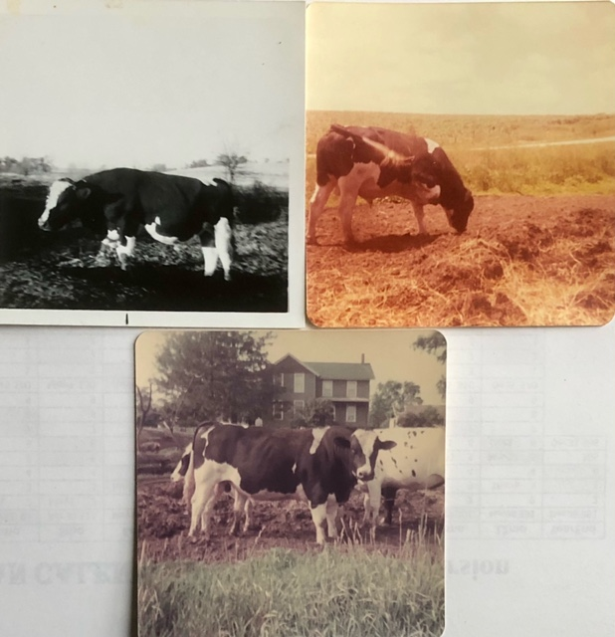
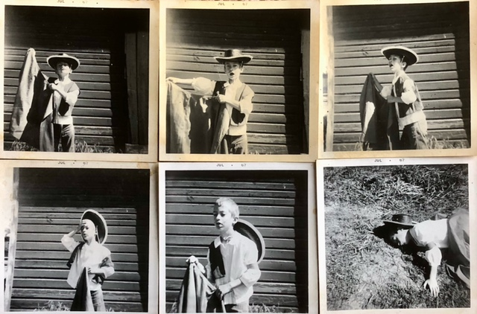
1967: Bulls are dangerous: Use AI instead
4-H photography project by sister Miriam (12 years old) and Paul (7)

Slide 7
Dairy Herd Improvement Association
1969 1st 4-H talk title: DHIA
Age 9
1976 1st job: DHI supervisor
Age 16
Trained in Urbana at the Illinois Dairy Records Processing Center
Retrained in 1977 to send records to Mid-States DHI in Ames, IA
1982-83 Shared office at Iowa State with Jay Mattison
He became CEO of NDHIA
Also Chair of the International Committee on Animal Recording (ICAR) 2017-2021
1988-2024 Improved genetic rankings using DHI data at USDA

Slide 8
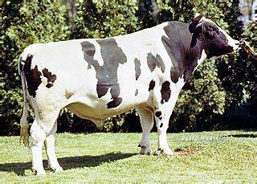
Impact of individual bulls
1980 undergrad term paper on bull Pawnee Farm Arlinda Chief:
“Only rarely does a bull come along… likely to have a tremendous influence on the breed” and hand-calculated impact of each bull
1988 with Holstein USA, automated the top ancestor list still published today
2011, with U IL, found a recessive mutation in Chief causing abortions (HH1)
Global benefit of extra milk from 14% Chief genes was $30 billion vs. $420 million cost of extra abortions
2024: Frequency of HH1 carriers decreased by selection from 4.2% in 2011 to 0.5% today

Slide 9
Lethal recessive defects: 10 years of success!
Haplotype | Carrier frequency (%) |  | Conception or death loss (%)
Year | 2012 | 2022 | 2012 | 2022
HH0 | 4.3 | 0.7 | 0.046 | 0.001
HH1 | 3.7 | 1.0 | 0.034 | 0.002
HH2 | 3.6 | 1.4 | 0.032 | 0.005
HH3 | 6.2 | 1.7 | 0.096 | 0.007
HH4 | 0.8 | 0.2 | 0.002 | 0.000
HH5 | 3.7 | 6.0 | 0.034 | 0.091
HH6 | 1.1 | 1.8 | 0.003 | 0.008
HCD | 6.2 | 0.8 | 0.090 | 0.006
Total | 32.8 | 20.1 | 0.352 | 0.153

Slide 10
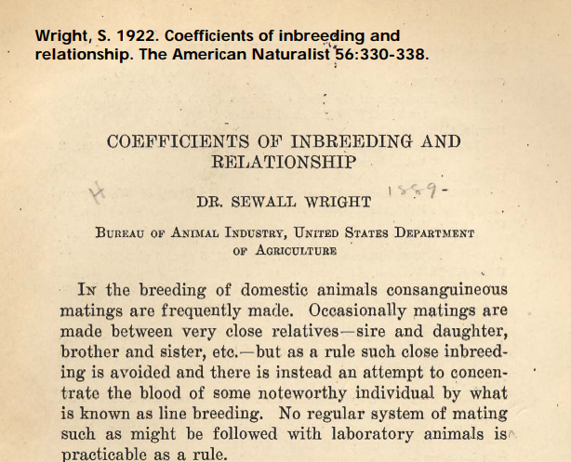
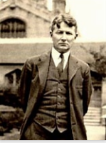
1922 pedigree relationship matrix – USDA

Slide 11
2008 genomic relationship matrix - USDA
Pages 1-3 of 1980 population genetics notes (Dairy Science 316):
Let gene content be coded as 0, 1, or 2 copies of an allele
Mean of gene content is twice allele frequency = 2p
Variance of gene content = 2p(1-p)
Genomic relationship matrix from 2008
Define Z_{ij} for locus i, animal j as the gene content – 2p_{i}
Subtract mean, divide by the sum of variances = ∑ 2p_{i}(1-p_{i})
Matrix G = Z Z’ / ∑ 2p_{i}(1-p_{i})

Slide 12
1984 journal paper (my first one)
Maximizing genetic gain under multiple-stage selection:
Choose animals with less mean but more variance
VanRaden, P.M., A E. Freeman, and M.F. Rothschild. 1984. J. Dairy Sci. 67:1761–1766.
C.R. Henderson said our conclusions were wrong
Published more papers on that topic over the decades:
Choose animals less inbred (2006), with rare favorable alleles (2014), or with more Mendelian Sampling variance (2019)

Slide 13
1984 reliability estimation
Establishing bounds on the accuracies of predictions of breeding value. Master’s Thesis, ISU
Similar projects:
Daughter equivalents in “Derivation, calculation, and use of national animal model information”, 1991
“Reliability of genomic predictions for North American Holstein bulls”, 2009
Interbull Genomic Reliability Working Group, member 2013-2024

Slide 14
1986 REML variance estimation programs
Computational strategies for estimation of variance components. PhD thesis, ISU
Fortran programs used for:
Angus carcass trait EPDs (1986-1997)
Holstein productive life heritability (1994)
Fertility and type heritabilities and correlations (2004, 2016)
Heifer livability and abortion h² (Neupane et al, 2021, 2023)
Sire model still useful for many millions of records

Slide 15
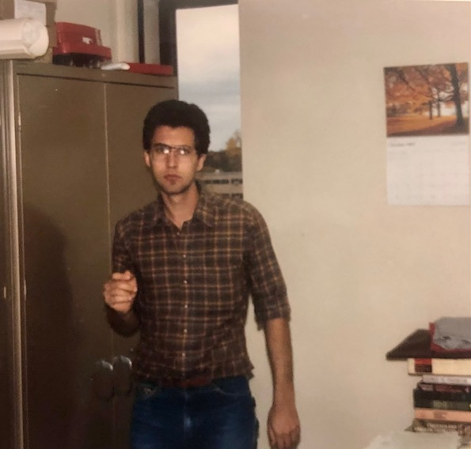
U WI postdoc Paul VanRaden 1987-88
Office on 4th floor An Sci
Red tapes are USDA PTAs
Project was HAUSA type PTAs
VAX computer retired
New code tested at IBM Research Center, Los Angeles
Photo by Georgios Banos
1st Interbull Center Director

Slide 16
“Cloud” computing, 1988
Holstein staff flew data to Madison twice per year
“On-time delivery of PTAs is more important than better accuracy” (Holstein CEO)
New model tested at IBM Research Center, Los Angeles
Research on memory sharing
Replaced by animal model of Ignacy Misztal in 1992 (U GA)

Slide 17
1987-2024 Least Cost Ration experiment
Least cost ration, every day for 37 years.
Costs $2.54 / day for food, drink, and snacks
Breakfast: 3-day rotation of cheapest cereals + whole milk
Lunch: every day a bologna and peanut butter sandwich
Dinner: 4-day rotation of macaroni, spaghetti, rice, noodles
Dessert: every day ice cream
Invented by me in 1987 at Kohl’s food store (Metro Market), Madison, WI
Prevents both starvation and obesity (100% successful so far)

Slide 18
Daily food cost actual US$ or adjusted for inflation
Available at http://www.paulvanraden.com/Nutrition.htm

Slide 19
2020-2023 Weekly body weight history

Slide 20
Cow size: First slide from my 1988 ADSA talk

Slide 21
Cow size: Conclusions from my 1988 ADSA talk
If a cow is bigger and gives more milk, that is good (profitable).
If a cow is bigger but does not give more milk, that is bad (unprofitable).
Relative emphasis should be 5 to -1 for production vs. body size.
Holstein Association should replace PTA Type with Body Size Composite (from U MN research).
[ADSA abstract presented in Edmonton, Alberta, Canada]
P.M. VanRaden, J Dairy Sci 71(Suppl. 1):238

Slide 22
Economic value of body size in Holsteins
1988: ADSA research suggested 5 to -1 emphasis
2000: Net Merit $ had 15 to -1 emphasis on yield : cow size
2018: Body size composite updated to body weight composite
Formula used data from 5 research herds (previously U MN)
2021: NM$ penalty now 5 to -1 on yield : cow size
2021: TPI includes small 29 to -1 penalty on cow size
2023: Canada still does not penalize large cows in their LPI index

Slide 23
Selection for more traits
26 traits had US genomic PTAs in 2009
13 new traits added in 2010-2021, mostly with low heritability and less data
Heifer and cow conception rates, cow livability, gestation length, mastitis, metritis, retained placenta, DA, ketosis, milk fever, early first calving, calf livability, and feed intake
Next new trait expected soon:
Milking speed
High reliability requires much data or high heritability

Slide 24
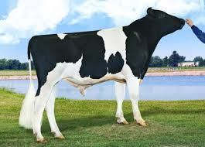
Genomic mating programs
Reduce inbreeding using genomic instead of pedigree relationships
Genomic relationship of each live female to each marketed bull
File contains 1 million females × 5,000 males
Genomic mating increases heifer calf value by
+$33 compared with pedigree mating (1.3% lower inbreeding)
+$78 compared with random mating (3.1% lower inbreeding)
Improves conception rates by avoiding recessive carrier matings

Slide 25
Relationship matrix with clones: Example
Holstein cow and her clone
Nelsons Estimate Liz
Nelsons Estimate Liz-2
Liz was Junior All-American Winter Yearling, 2001
Liz-2 was Junior Champion at World Dairy Expo in 2004
75 progeny of Liz, 20 of Liz-2
Photo © Frank Robinson, Lodi, CA, USA
Nauman, D. 2011. Commitment got Nelsons Pronto Liz across.
http://www.dairyagendatoday.com/News.aspx?nid=5557

Slide 26
Grand Champion in 2011, Clone beat her in 2013
Apple – 2011 World Dairy Expo
Apple-3 – 2013 World Dairy Expo
Photo by Nina Linton
Apple had 361 progeny.
Malcolm, D. 2019. KHW Regiment Apple-Red-ET – Everything and more. Photo by The Bullvine. Apple’s 9 clones added 325 more progeny.

Slide 27
Birth codes in USA data
Multiple birth codes:
4,762 pairs of natural identical twins (code 2 and verified by genotype)
1,776 split embryos (code 4)
530 nuclear transfer clones from embryos, calves, or adults (code 5)
From about 7 million animals
Code | Birth description
1 | Single
2 | Multiple birth (not from embryo transfer)
3 | Birth from embryo transfer
4 | Split embryo (artificially)
5 | Clone from nuclear transfer
6 | Embryo pedigree (implantation date stored as birth date)

Slide 28
Revised genetic evaluation model
Pedigree relationship matrix treated clones as full sibs but had >7,000 copies of another animal’s DNA
Store a source animal for each identical group
For progeny of clones, switch their sire or dam ID to source ID
Remove IDs of clones from the pedigree file
Keep a separate permanent environment effect for each clone
After computing the EBVs:
Copy the source EBV back to the clones
Report the original pedigree in the public formats

Slide 29
Benefits of the new model
A and G matrices match better
Genetic evaluations more precise for clones and progeny
Genomic evaluations now have identical polygenic effects
Identical EBVs in more trait groups such as type and calving
Combined progeny counts for cloned bulls instead of reporting (since 2008) the daughter count of the clone with the most
More exact pedigree inbreeding coefficients for descendants of clones
Improved ancestor discovery

Slide 30
Do clones (ETN) perform as expected?
Trait | Mean | Genetic SD | Clones | Effect | Effect/SD | Effect/Mean
Milk | 28,071 | 1134 | 472 | +18 | 0.0 | +0%
Fat | 1,077 | 50 | 467 | -8 | -0.2 | -1%
Protein | 871 | 30 | 467 | +7 | 0.2 | +1%
SCS (or SCC) | 200k | 0.28 | 460 | +0.34 | 1.2 | +27%
Productive life | 25 | 3.4 | 119 | -3.3 | -1.0 | -13%
Dtr. pregnancy rate | 27 | 2.8 | 354 | -5.0 | -1.8 | -19%
Heifer conc. rate | 45 | 2.6 | 37 | -5.5 | -2.1 | -12%
Cow conc. rate | 41 | 3.2 | 123 | -8.3 | -2.6 | -20%
Age at first calving | 831 | 2.1 | 115 | +17.0 | -8.1 | +2%
Cow livability | 97 | 3.2 | 423 | -7.3 | -2.3 | -8%

Slide 31
Conclusions about cloning
Genetic evaluations can account for identical animals:
Link progeny of clones to the source sire or dam
Remove clone copies from the pedigree before analysis
Restore clone IDs and copy EBVs from the source animal
Milk production was as expected but some other traits lower.
Many Holsteins may soon have clones in their pedigrees.
Cloning techniques also enable gene editing.
Models may need revision again for that technology.

Slide 32
Cloning DNA or ideas?
Dentine, M.R. 2003. “The future of animal genetics would be well served by hiring clones of Dr Ben.” National Dairy Genetics Workshop honoring Dr. Ben McDaniel. Raleigh, NC, p. 148.
Gretel Dentine was the first female dairy science professor at U WI (1985), then associate dean for research at CALS and executive director of the Wisconsin Agricultural Experiment Station.
Dr Ben was her major professor.

Slide 33
Some of my fellow grad students
Student | Later position | Country | Years
Bassam al-Safadi | Head, Biotechnology Research (govt) | Syria | 2018-
Sawsan Magid (al-Sharifi) | Minister of Agriculture (govt) | Iraq | 2004-5
M’Naouer Djemali | Director of National Gene Bank | Tunisia | 2006-12
Hiroshi Takahashi | Manager, Global Pig Farms | Japan | 2000-
Sompop Kassumma | Senior Officer, Livestock Dvlp (govt) | Thailand | 2002-
Jay Mattison | CEO of NDHIA and Chair of ICAR | USA | 2017-21
Jean Bertrand | Dean, Undergrad Studies, Clemson U | USA | 2021-
Mark Boggess | Director, US Meat Animal Res. Center | USA | 2018-
Georgios Banos | 1st Director, Interbull Centre | Sweden | 1992-99
Jack Dekkers | Distinguished Professor, Iowa State | USA | 2013-
Chuck Sattler | Vice President-Genetics, Select Sires | USA | 2007-
ISU
----
UWI

Slide 34
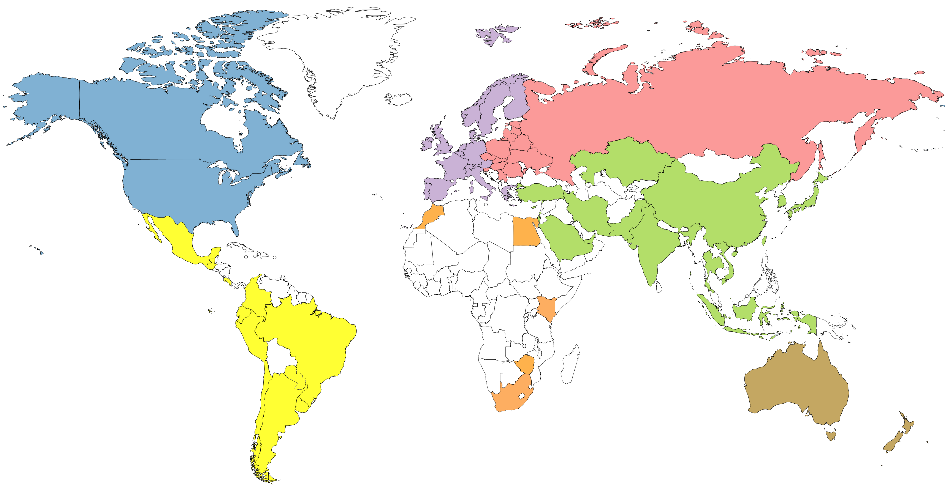
Genotype counts by region (June 2022)
4,974,462
68,684
447,423
420,230
159,563
20,660
67,465

Slide 35
Genetic progress (Holstein)

Slide 36
Predict 50 years of genetic progress (Cole, 2018)
Trait | 50-year progress | 2017 mean | 2067 mean
Milk (pounds) | +9,329 | 27,055 | 36,384
Fat (pounds) | +531 | 1,008 | 1,539
Protein (pounds) | +342 | 825 | 1,167
Productive life (months) | +65 | 26 | 91
Body size (pounds) | –230 | 1,500 | 1,230
Udder composite | +2.65 | 0 | 2.65
Daughter pregnancy rate (%) | +26 | 29 | 55
Cow conception rate (%) | +42 | 35 | 77
Heifer conception rate (%) | +21 | 57 | 78

Slide 37
Conclusions
Knowledge from college remains useful across decades
Genetics, economics, etc. will always be useful
Foreign students can also have big impacts
PTAs calculated continuously by USDA 1926-2013, then by CDCB
Genetic progress could be even faster over the next century

Slide 38
Acknowledgments and Disclaimers
Council on Dairy Cattle Breeding (CDCB) and its industry suppliers for data
Taxpayers for funding USDA-ARS-AGIL project 8042-31000-002-00, “Improving dairy animals by increasing accuracy of genomic prediction, evaluating new traits, and redefining selection goals”
AGIL staff for doing this research
Mention of trade names or commercial products in this presentation is solely for the purpose of providing specific information and does not imply recommendation or endorsement by USDA; USDA is an equal opportunity provider and employer

Slide 39
Hobby: Solutions to World Problems
Went to the library a lot (every day or weekend)
Picked a subject, studied until no material left to read
Got ideas beyond theirs
Decided someday to write a book “Solutions to World Problems”
In 1999 started a web site: paulvanraden.com

Slide 40
Instructions for WI talk
45 minutes, 8:50-9:40am in the ANS building.
Half of the students will be taking ANS 363 Principles of Animal Breeding, and the other half will be taking ANS 362 Veterinary Genetics.
ANS 363 is a classical course in Animal Breeding (breeding value estimation, selection techniques, inbreeding and hybrid vigor, crossbreeding systems).
ANS 362 covers the genetic basis for resistance to disease in livestock and companion animal species, including genetic defects, their discovery, diagnosis, and treatment.

