Slide 1
A. B. Chapman Lecture Paul VanRaden USDA, Animal Genomics and Improvement Laboratory Beltsville, MD, USA paul.vanraden@usda.gov
Title:
Improving progress across generations of cows, farmers, and scientists

Slide 2
Topics
Examples of university research with long-lasting benefits
Early training and how useful it was over the decades
Postdoc research (U WI)
Fellow graduate students
Other research more philosophical
Recent research on cloning
Genetic progress

Slide 3
“New” trait EFC added to Net Merit in 2021
A.B. Chapman & G.E. Dickerson. J. Animal Science, 1936
“The relation of age at first calving to butter-fat production in the first five lactations”
“based on the calving and production records of 253 Holstein cows from 40 herds in Wisconsin Dairy Herd Improvement Associations”
 | 1936 | 2021
Cows w/data | 253 | 34,353,878
Reliability | low | 70%
% of index | 0% | 2.1%
Abbreviation | AFC | EFC
Name | Age at first calving | Early first calving
Favorable Direction | Negative | Positive

Slide 4
Fertility records available 1936 and 2024
A.B. Chapman and L.E. Casida, 1936. J. Anim. Sci
“Length of service period in relation to productive and reproductive efficiency in dairy cows”
“efficiency of production and reproduction has been studied in the records of one commercial and four Wisconsin experiment station herds.”
Trait | Trt | Data since | Million records
Daughter Pregnancy Rate | DPR | 1960 | 91
Cow Conception Rate | CCR | 2000 | 37
Heifer Conception Rate | HCR | 2000 | 12
Sire Conception Rate | SCR | 2019 | 7

Slide 5
Chapman’s interests are still of great interest today
“Chapman continued his interest in Wright’s methods, especially inbreeding and selection theory, throughout his life.”
“Especially he was interested in the deleterious effects of inbreeding, as well as possible use of inbreeding for herd improvement after the model of hybrid maize.”
“A happy event in Chapman’s life was when his idol, Sewall Wright, decided to spend his retirement years in Madison. The Chapmans maintained happy and caring contacts with him…”
https://web.archive.org/web/20100610040307/http://www.secfac.wisc.edu/senate/2007/0205/1963(mem_res).pdf

Slide 6
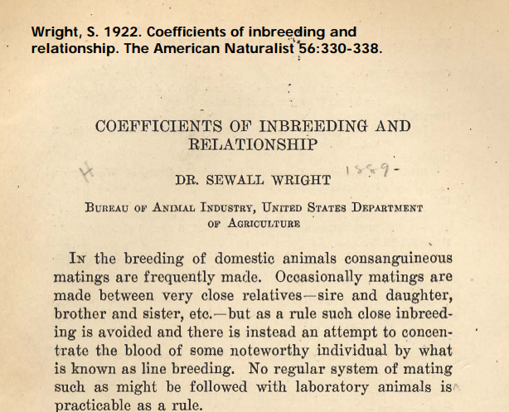
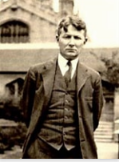
1922 pedigree relationship matrix – USDA

Slide 7
Sewall Wright – Biography and USDA research
Year | Research discoveries at USDA
1917 | Cattle color inheritance
1920 | Heritability (h²)
1920 | Livestock breeding (75-page book)
1921 | Systems of mating
1921 | Multiple regression accuracy (R²)
1921 | Effective population size
1921 | Correlation is not causation
1922 | Inbreeding coefficient (F)
1923 | Path coefficients
1925 | Computing relationships and F
Year | Biography | Location
1889 | Born | MA
1892 | Raised | Galesburg, IL
1911 | B.S. | Galesburg, IL
1912 | M.S. | U. IL, Urbana
1915 | PhD | Harvard U., MA
1916 | USDA | Beltsville, MD
1926 | Professor | Chicago, IL
1955 | Retired | Madison, WI
1988 | Died | Madison, WI

Slide 8
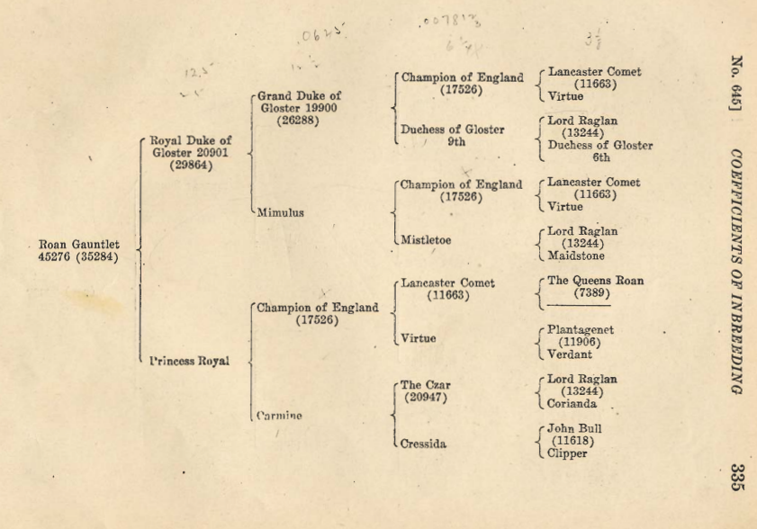
1922 Example pedigree: Shorthorns

Slide 9
Pedigree Relationship Matrix (1922 math)
 | PGS | PGD | MGS | MGD | Sire | Dam | Bull
Manfred | 1.053 | .090 | .090 | .105 | .571 | .098 | .334
Jezebel | .090 | 1.037 | .051 | .099 | .563 | .075 | .319
Teamster | .090 | .051 | 1.035 | .120 | .071 | .578 | .324
Dima | .105 | .099 | .120 | 1.042 | .102 | .581 | .342
O-Man | .571 | .563 | .071 | .102 | 1.045 | .086 | .566
Deva | .098 | .075 | .578 | .581 | .086 | 1.060 | .573
O-Style | .334 | .319 | .324 | .342 | .566 | .573 | 1.043

Slide 10
Genomic Relationship Matrix (2008 math)
 | PGS | PGD | MGS | MGD | Sire | Dam | Bull
Manfred | 1.201 | .058 | .050 | .093 | .609 | .054 | .344
Jezebel | .058 | 1.131 | .008 | .135 | .618 | .079 | .357
Teamster | .050 | .008 | 1.110 | .100 | .014 | .613 | .292
Dima | .093 | .135 | .100 | 1.139 | .131 | .610 | .401
O-Man | .609 | .618 | .014 | .131 | 1.166 | .080 | .626
Deva | .054 | .079 | .613 | .610 | .080 | 1.148 | .613
O-Style | .344 | .357 | .292 | .401 | .626 | .613 | 1.157

Slide 11
Difference (Genomic – Pedigree)
 | PGS | PGD | MGS | MGD | Sire | Dam | Bull
Manfred | .149 | -.032 | -.040 | -.012 | .038 | -.043 | .010
Jezebel | -.032 | .095 | -.043 | .036 | .055 | .004 | .038
Teamster | -.040 | -.043 | .075 | -.021 | -.057 | .035 | -.032
Dima | -.012 | .036 | -.021 | .097 | .029 | .029 | .059
O-Man | .038 | .055 | -.057 | .029 | .121 | -.006 | .060
Deva | -.043 | .004 | .035 | .029 | -.006 | .087 | .040
O-Style | .010 | .038 | -.032 | .059 | .060 | .040 | .114

Slide 12
2008 Derivation of genomic relationship matrix
Pages 1-3 of 1980 population genetics notes (U IL, Dairy Sci 316)
Let gene content be coded as 0, 1, or 2 copies of an allele
Mean of gene content is twice allele frequency = 2p
Variance of gene content = 2p(1-p)
Genomic relationship matrix algebra 2008
Define Z_{ij} for locus i, animal j as the gene content – 2p_{i}
Subtract mean, divide by the sum of variances = ∑ 2p_{i}(1-p_{i})
Matrix G = Z Z’ / ∑ 2p_{i}(1-p_{i})

Slide 13
Genomic relationship matrices: bovine vs. human
Simple quadratic :
G = Z Z’ / Σ 2p_{j}(1-p_{j})
Same math for each G_{ik}
Clones related by 1.0
Positive semi-definite
VanRaden 2008
5300 citations
Different math for G_{ii} vs. G_{ij}:
Divide Z_{ij} by sqrt [2p_{j}(1-p_{j})]
Diagonals G_{ii} get adjusted
Clones not related by 1.0
Negative eigenvalues
Yang et al 2010
4700 citations
https://www.nature.com/articles/ng.608

Slide 14
Yang et al (2010) math no longer used in GCTA
“To obtain a genome-wide relationship, we combine A_{ijk} for all of the SNPs using a common-sense weighting scheme,”
NO! Need to adjust off-diagonals by square root of 2 diagonals

Slide 15
Make the Yang (2010) matrix positive semi-definite
Let W be a diagonal matrix with ratios of the 2 formulas
W_{jj} = ∑_{i}(x_{ij} – 2p_{j})² / [x_{ij}² – (1 + 2p_{j})x_{ij} + 2p_{j}²]
Multiply all elements A_{jk} by square roots of those ratios
A_{adjusted} = W^{.5} (X-2P)’(X-2P) W^{.5}
Analogous relationship matrices
Henderson (1975) numerator matrix A = L D L’
Wright (1922) correlation matrix A_{corr} = W^{.5} A W^{.5}, where W_{ii} is 1 / diagonal A_{ii}

Slide 16
Single-step H matrix inverse - 2009
May 4-6 2009 meeting at UW - Madison:
Symposium on Statistical Genetics of Livestock for the Post-Genomic Era
May 11 email from Dave Johnson, LIC, NZL to Ignacy Misztal:
Good to meet you again last week. I have been thinking about your whole-population H matrix. It occurred to me, as I looked for something to do as I waited in LA airport, that H has a simple relatively sparse inverse. Namely H⁻¹ = A⁻¹ + {(0,0), (0,G⁻¹ – A₂₂⁻¹)}. Have you looked at this at all?

Slide 17
USA SNP list history
Year | Reference | Breeds | Added information | Markers (1000s) |  | HO Reliability%
 |  |  |  | Added | Total | Gain | Total
<2008 |  | All | Parent average |  | 0 |  | 27
2009 | VanRaden | HO | Chip genotypes (50K) | +38 | 38 | +23 | 50
2012 | Olson | 3 | More breeds (JE, BS) | +5 | 43 | +0 | 50
2013 | Wiggans | HO | Add HD markers (GHD) | +26, -8 | 61 | +0.5 | 67
2016 | Wiggans | HO | Add HD markers (GH2) | +16 | 77 | +1.5 | 68
2019 | VanRaden | HO | Add sequence SNPs | +2 | 79 | +1.2 | 69
2020 | Al-Khudhair | 5 | Add HD, other breeds | +5, -5 | 79 | +0 | 69

Slide 18
Benefits from selected markers and QTLs
Predict 2022 from 2019 PTAs
6,899 young Holstein bulls now proven
Compare 3 SNP densities
79K current SNP list
45K with ¼ of the HD SNPs
35K subset of 50K chip
~2% higher R² (79K vs. 45K)
Trait | 35K | 45K | 79K
 | Squared correlations (%)
Milk | 81.3 | 82.0 | 84.5
Fat | 84.3 | 84.7 | 86.2
Protein | 82.9 | 83.2 | 84.9

Slide 19
USDA PTAs calculated since 1926
Graves, R. R. 1926.
Transmitting ability of twenty-three Holstein-Friesian sires.
USDA Dept. Bull. 1372.
Daughter-dam comparison
Mean yield of daughters minus dam’s yield
Method used until 1962

Slide 20
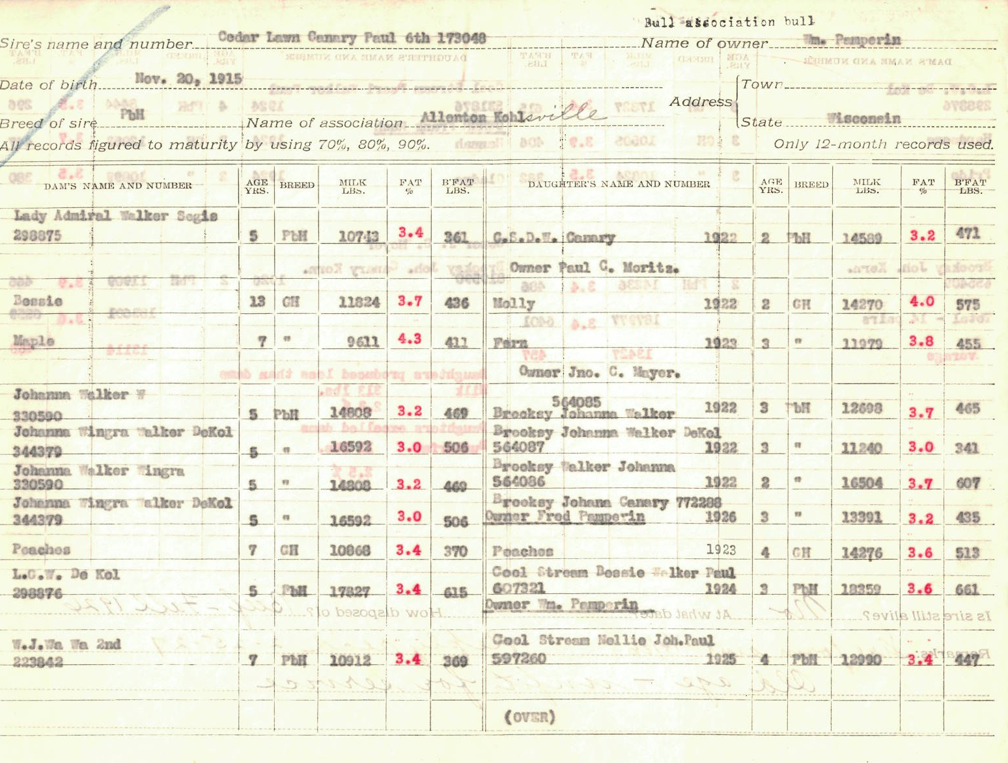
First USDA PTA sent to WI in 1926 (1 of the 23 bulls)
Cedar Lawn Canary Paul 6th
Born: Nov 20, 1915
Sold for beef in Fall, 1926
HO registration: 173048
Owned by: Wm. Pemperin
Bull Association: Allenton Kohlsville
The farm began in 1847 in the West Bend area. In 1992 they moved to Farmington at the crossroads of Cheeseville. They are a family dairy farm with 230 dairy cows.
George and Kathy Muth, current owners

Slide 21
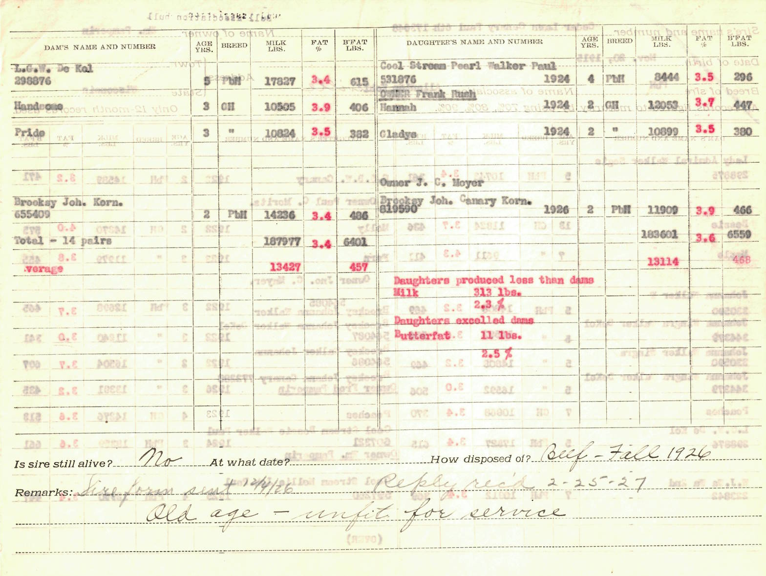
Page 2 of the first USDA PTA sent to WI in 1926
14 daughter - dam pairs
Daughters produced less than
dams for Milk but excelled
dams for Butterfat.
Bull PTA:
-313 lbs. Milk
+11 lbs. Butterfat
Sire form sent 12-4-1926
Owner replied 2-25-1927
Is sire still alive? No
Sire sold for: Old age – unfit
for service

Slide 22
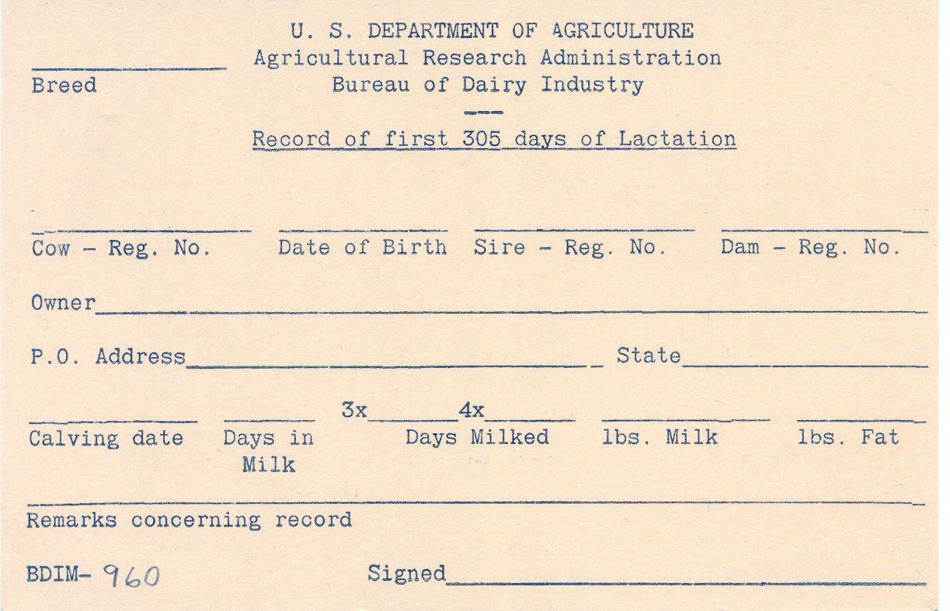
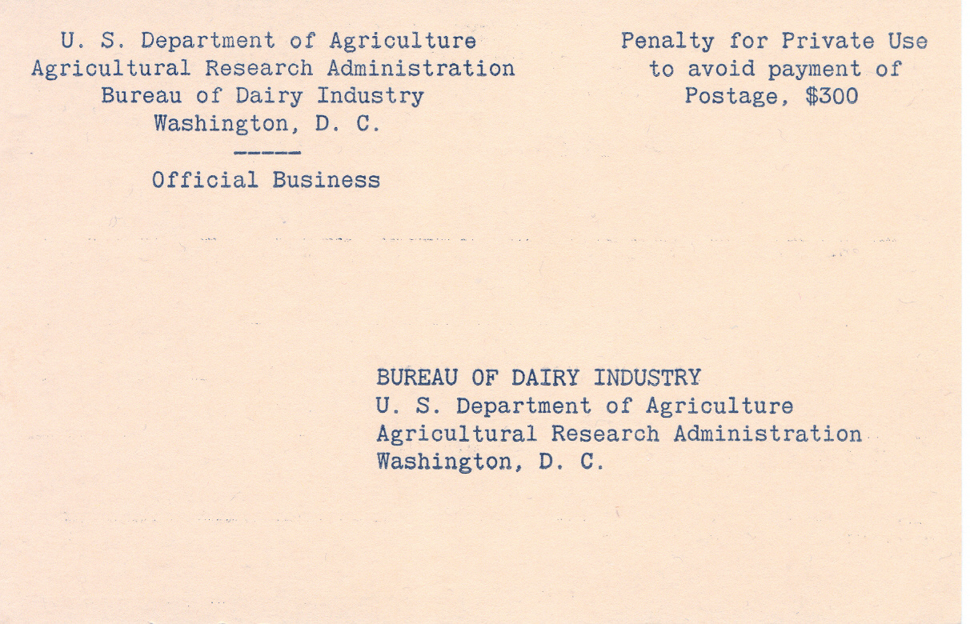
Postcards used to send the lactation records
Format 4 Postcard
(305-d lactation record)
BDIM – 960
Used in 1930s
Postage paid by USDA

Slide 23
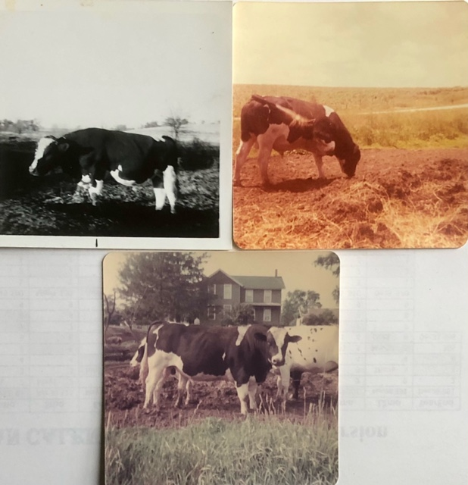
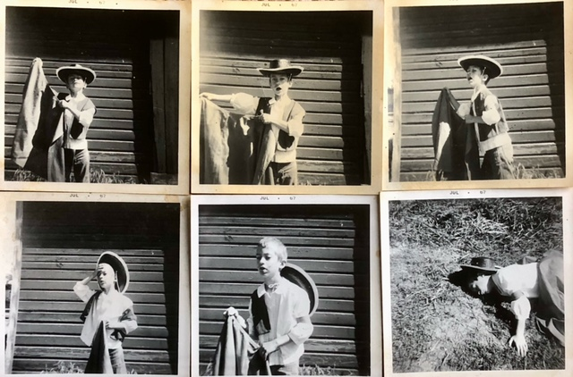
1967: Bulls are dangerous: Use AI instead
4-H photography project by sister Miriam (12 years old) and Paul (7)

Slide 24
Dairy Herd Improvement Association
1969 1st 4-H talk title: DHIA
Age 9
1976 1st job: DHI supervisor
Age 16
Trained in Urbana at the Illinois Dairy Records Processing Center
Retrained in 1977 to send records to Mid-States DHI in Ames, IA
1982-83 Shared office at Iowa State with Jay Mattison
He became CEO of NDHIA
Also Chair of the International Committee on Animal Recording (ICAR) 2017-2021
1988-2024 Improved genetic rankings using DHI data at USDA

Slide 25
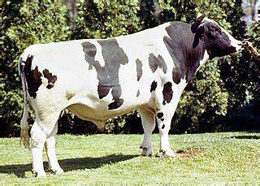
Impact of individual bulls
1980 undergrad term paper on bull Pawnee Farm Arlinda Chief:
“Only rarely does a bull come along… likely to have a tremendous influence on the breed” and I hand-calculated impact of each bull
1988 with Holstein USA, automated the top ancestor list still published
2011, with U IL, found a recessive mutation in Chief causing abortions (HH1)
Global benefit of extra milk from 14% Chief genes was $30 billion vs. $420 million cost of extra abortions
2024: Frequency of HH1 carriers decreased by selection from 4.2% in 2011 to 0.5% today

Slide 26
1984 journal paper (my first one)
Maximizing genetic gain under multiple-stage selection:
Choose animals with less mean but more variance
VanRaden, P.M., A E. Freeman, and M.F. Rothschild. 1984. J. Dairy Sci. 67:1761–1766.
C.R. Henderson said our conclusions were wrong
Published more papers on that topic over the decades:
Choose animals less inbred (2006), with rare favorable alleles (2014), or with more Mendelian Sampling variance (2019)

Slide 27
1984 reliability estimation
Establishing bounds on the accuracies of predictions of breeding value. Master’s Thesis, ISU
Similar projects:
Daughter equivalents in “Derivation, calculation, and use of national animal model information”, 1991
“Reliability of genomic predictions for North American Holstein bulls”, 2009
Interbull Genomic Reliability Working Group, member 2013-2024

Slide 28
1986 REML variance estimation programs
Computational strategies for estimation of variance components. PhD thesis, ISU
Fortran programs used for:
Angus carcass trait EPDs (1986-1997)
Holstein productive life heritability (1994)
Fertility and type heritabilities and correlations (2004, 2016)
Heifer livability and abortion h² (Neupane et al, 2021, 2023)
Sire model still useful for many millions of records

Slide 29
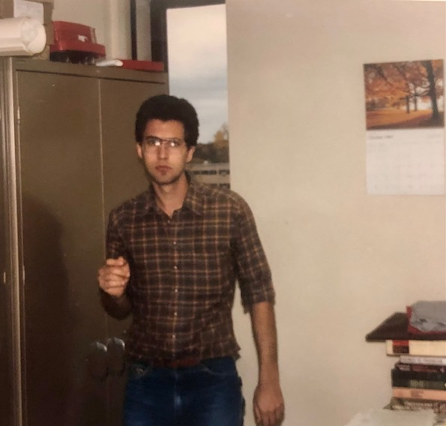
U WI postdoc Paul VanRaden 1987-88
Office on 4th floor An Sci
Red tapes are USDA PTAs
Project was HAUSA type PTAs
U WI VAX computer retired
Animal breeding and weather forecasting were the 2 biggest computer users
New code to run in Vermont
Photo by Georgios Banos

Slide 30
“Cloud” computing, 1988
Holstein staff flew data to Madison twice per year
“On-time delivery of PTAs is more important than better accuracy” (Holstein CEO)
MT sire model tested at IBM Research Center, Los Angeles
Research on memory sharing
Replaced by animal model of Ignacy Misztal in 1992 (U GA)

Slide 31
Some of my fellow grad students
Student | Later position | Country | Years
Bassam al-Safadi | Head, Biotechnology Research (govt) | Syria | 2018-
Sawsan Magid (al-Sharifi) | Minister of Agriculture (govt) | Iraq | 2004-5
M’Naouer Djemali | Director of National Gene Bank | Tunisia | 2006-12
Hiroshi Takahashi | Manager, Global Pig Farms | Japan | 2000-
Sompop Kassumma | Senior Officer, Livestock Dvlp (govt) | Thailand | 2002-
Jay Mattison | CEO of NDHIA and Chair of ICAR | USA | 2017-21
Jean Bertrand | Dean, Undergrad Studies, Clemson U | USA | 2021-
Mark Boggess | Director, US Meat Animal Res. Center | USA | 2018-
Georgios Banos | 1st Director, Interbull Centre | Sweden | 1992-99
Jack Dekkers | Distinguished Professor, Iowa State | USA | 2013-
Chuck Sattler | Vice President-Genetics, Select Sires | USA | 2007-
ISU
----
UWI

Slide 32
Cow size: First slide from my 1988 ADSA talk

Slide 33
Cow size: Conclusions from my 1988 ADSA talk
If a cow is bigger and gives more milk, that is good (profitable).
If a cow is bigger but does not give more milk, that is bad (unprofitable).
Relative emphasis should be 5 to -1 for production vs. body size.
Holstein Association should replace PTA Type with Body Size Composite (from U MN research).
[ADSA abstract presented in Edmonton, Alberta, Canada]
P.M. VanRaden, J Dairy Sci 71(Suppl. 1):238

Slide 34
Economic value of body size in Holsteins
1988: ADSA research suggested 5 to -1 emphasis
2000: Net Merit $ had 15 to -1 emphasis on yield : cow size
2018: Body size composite updated to body weight composite
Formula used data from 5 research herds (previously U MN)
2021: NM$ penalty now 5 to -1 on yield : cow size, also Residual Feed Intake (RFI)
2021: TPI includes small 29 to -1 penalty on cow size, some RFI
2023: Canada still does not penalize large cows in their LPI index

Slide 35
1987 Least Cost Ration experiment
Human least cost ration, every day for 37 years.
Invented by me in 1987 at Kohl’s food store (Metro Market), Madison, WI
Costs $2.54 / day for food, drink, and snacks
Breakfast: 3-day rotation of cheapest cereals + whole milk
Lunch: every day a bologna and peanut butter sandwich
Dinner: 4-day rotation of macaroni, spaghetti, rice, noodles
Dessert: every day ice cream
Prevents both starvation and obesity (100% successful so far)

Slide 36
Daily food cost actual US$ or adjusted for inflation
Available at http://www.paulvanraden.com/Nutrition.htm

Slide 37
2020-2023 Weekly body weight history

Slide 38
Relationship matrix with clones: Example
Holstein cow and her clone
Nelsons Estimate Liz
Nelsons Estimate Liz-2
Liz was Junior All-American Winter Yearling, 2001
Liz-2 was Junior Champion at World Dairy Expo in 2004
75 progeny of Liz, 20 of Liz-2
Photo © Frank Robinson, Lodi, CA, USA
Nauman, D. 2011. Commitment got Nelsons Pronto Liz across.
http://www.dairyagendatoday.com/News.aspx?nid=5557

Slide 39
Grand Champion in 2011, Clone beat her in 2013
Apple – 2011 World Dairy Expo
Apple-3 – 2013 World Dairy Expo
Photo by Nina Linton
Apple had 361 progeny.
Malcolm, D. 2019. KHW Regiment Apple-Red-ET – Everything and more. Photo by The Bullvine. Apple’s 9 clones added 325 more progeny.

Slide 40
Birth codes in USA data
Multiple birth codes:
4,762 pairs of natural identical twins (code 2 and verified by genotype)
1,776 split embryos (code 4)
530 nuclear transfer clones from embryos, calves, or adults (code 5)
From about 7 million animals
Code | Birth description
1 | Single
2 | Multiple birth (not from embryo transfer)
3 | Birth from embryo transfer
4 | Split embryo (artificially)
5 | Clone from nuclear transfer
6 | Embryo pedigree (implantation date stored as birth date)

Slide 41
Revised genetic evaluation model
Pedigree relationship matrix treated clones as full sibs but had >7,000 copies of another animal’s DNA
Store a source animal for each identical group
For progeny of clones, switch their sire or dam ID to source ID
Remove IDs of clones from the pedigree file
Keep a separate permanent environment effect for each clone
After computing the EBVs:
Copy the source EBV back to the clones
Report the original pedigree in the public formats

Slide 42
Benefits of the new model
A and G matrices match better
Genetic evaluations more precise for clones and progeny
Genomic evaluations now have identical polygenic effects
Identical EBVs in more trait groups such as type and calving
Combined progeny counts for cloned bulls instead of reporting (since 2008) the daughter count of the clone with the most
More exact pedigree inbreeding coefficients for descendants of clones
Improved ancestor discovery

Slide 43
Conclusions about cloning
Genetic evaluations can account for identical animals:
Link progeny of clones to the source sire or dam
Remove clone copies from the pedigree before analysis
Restore clone IDs and copy EBVs from the source animal
Milk production was as expected but some other traits lower.
Many Holsteins may soon have clones in their pedigrees.
Cloning techniques also enable gene editing.
Models may need revision again for that technology.

Slide 44
Cloning DNA or ideas?
Dentine, M.R. 2003. “The future of animal genetics would be well served by hiring clones of Dr Ben.” National Dairy Genetics Workshop honoring Dr. Ben McDaniel. Raleigh, NC, p. 148.
Gretel Dentine was the first female dairy science professor at U WI (1985), then associate dean for research at CALS and executive director of the Wisconsin Agricultural Experiment Station.
Dr Ben was her major professor.

Slide 45
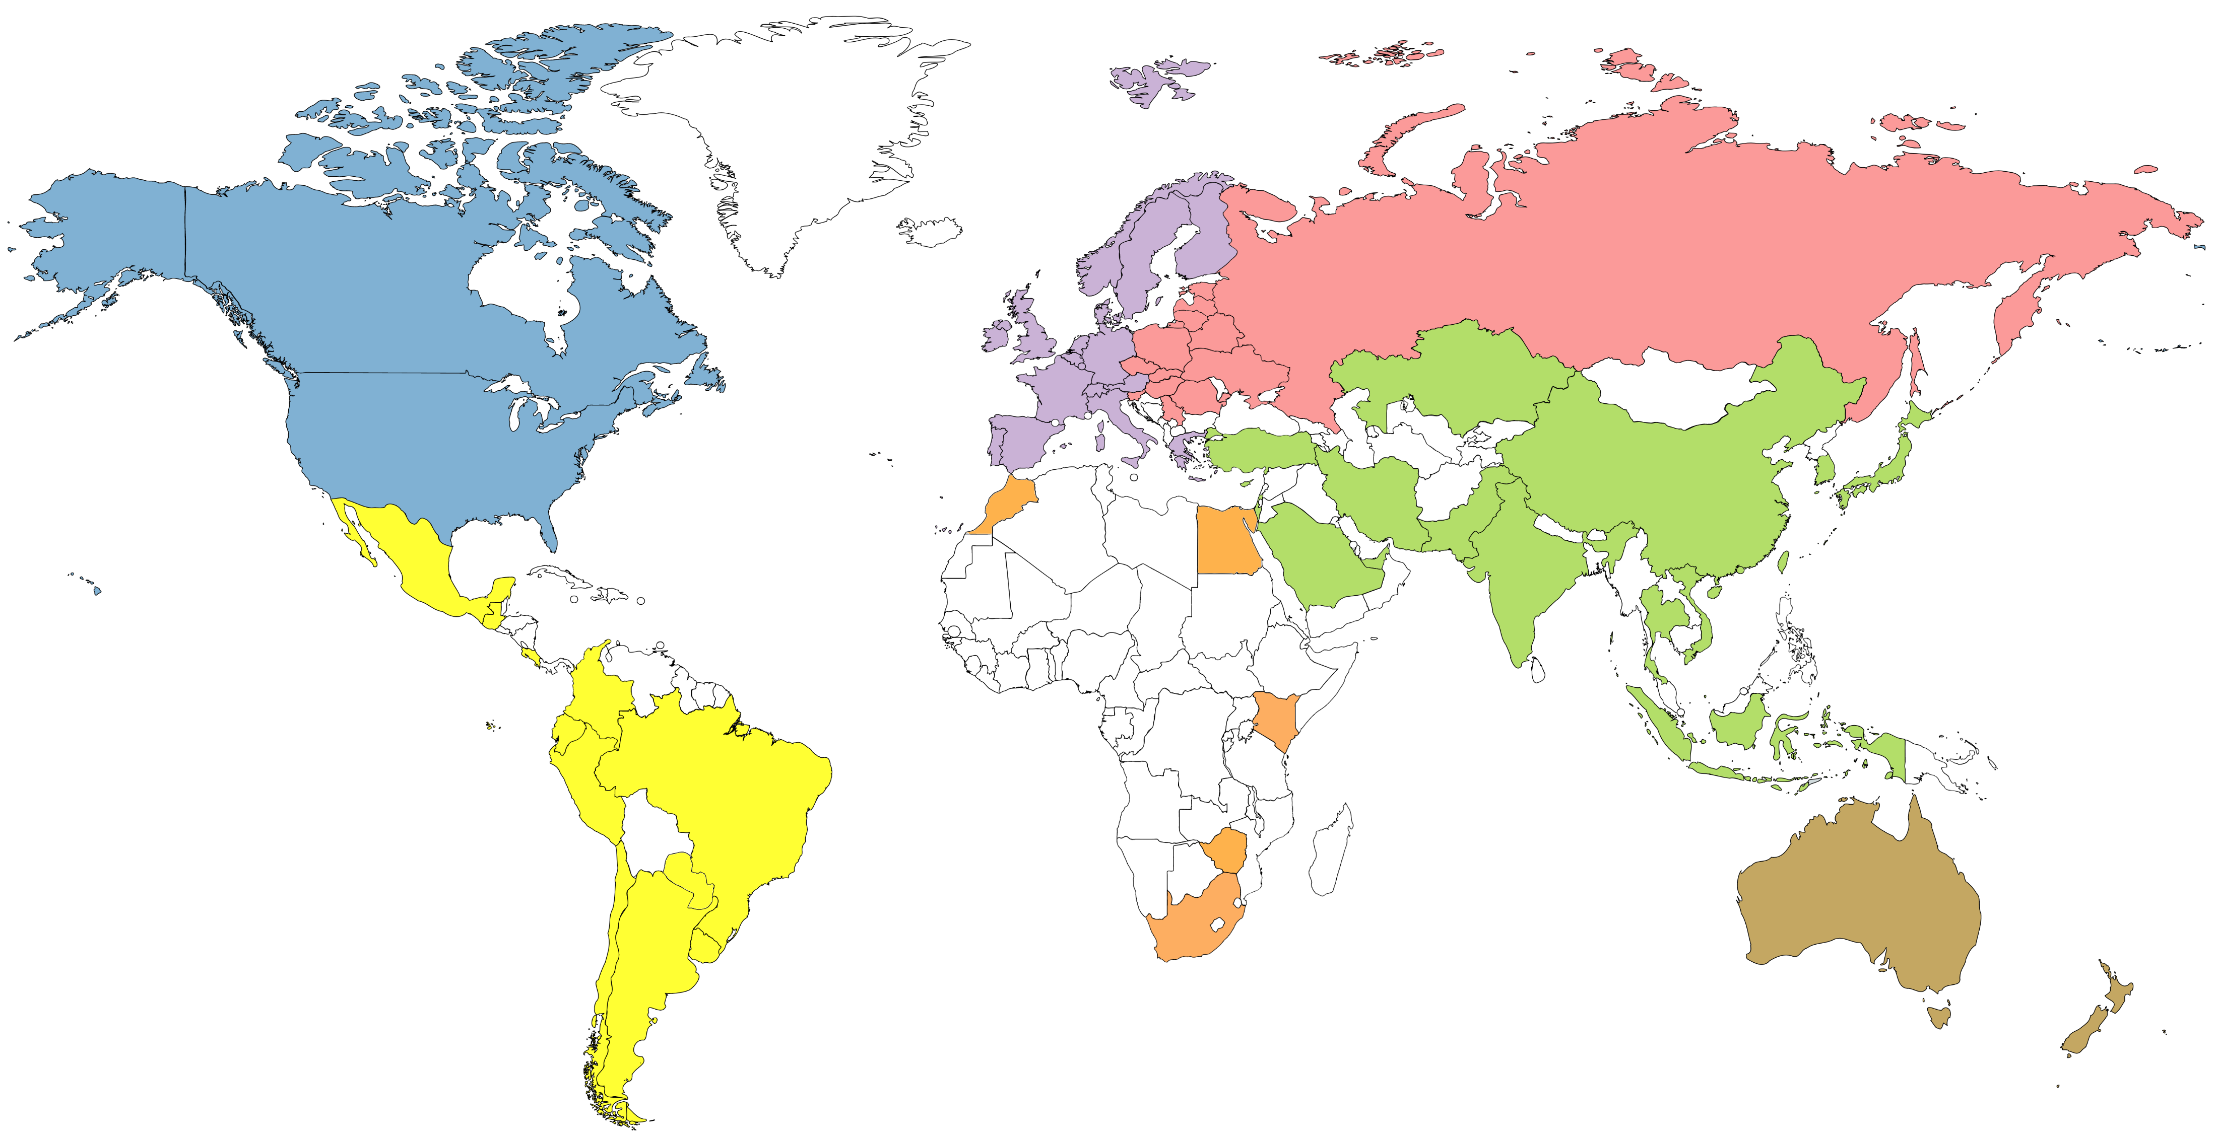
Genotype counts by region (June 2022)
4,974,462
68,684
447,423
420,230
159,563
20,660
67,465

Slide 46
Genetic progress (Holstein)

Slide 47
Predict 50 years of genetic progress (Cole, 2018)
Trait | 50-year progress | 2017 mean | 2067 mean
Milk (pounds) | +9,329 | 27,055 | 36,384
Fat (pounds) | +531 | 1,008 | 1,539
Protein (pounds) | +342 | 825 | 1,167
Productive life (months) | +65 | 26 | 91
Body size (pounds) | –230 | 1,500 | 1,230
Udder composite | +2.65 | 0 | 2.65
Daughter pregnancy rate (%) | +26 | 29 | 55
Cow conception rate (%) | +42 | 35 | 77
Heifer conception rate (%) | +21 | 57 | 78

Slide 48
Conclusions
Some traits we select for today were pioneered by Dr Chapman
Knowledge from college remains useful across decades
Genetics, economics, etc. will always be useful
Foreign students can also have big impacts
PTAs calculated continuously by USDA 1926-2013, then by CDCB
Genetic progress could be even faster over the next century with gene editing or transgenics

Slide 49
Acknowledgments and Disclaimers
Council on Dairy Cattle Breeding (CDCB) and its industry suppliers for data
Taxpayers for funding USDA-ARS-AGIL project 8042-31000-002-00, “Improving dairy animals by increasing accuracy of genomic prediction, evaluating new traits, and redefining selection goals”
AGIL staff for doing this research
Mention of trade names or commercial products in this presentation is solely for the purpose of providing specific information and does not imply recommendation or endorsement by USDA; USDA is an equal opportunity provider and employer

Slide 50
Instructions for talk
50 min plus questions and answers, the audience on-site will be faculty, postdocs, graduate students, and industry partners. We will also have a live stream of your presentation. I agree with you: a variety of interrelated topics sounds great.
The research seminar will be at 4 PM in the MSABD building, room 1111.
The lecture for undergrads will be at 8:50 AM in the ANS building.

