Slide 1
Breeding programs compared across countries, continents, and breeds
Paul M. VanRaden¹, Taylor M. McWhorter², Jose A. Carrillo², and Rodrigo R. Mota²
¹USDA Animal Genomics and Improvement Lab, Beltsville, MD
²Council on Dairy Cattle Breeding, Bowie, MD

Slide 2
Data and edits
December 2023 official data on USA scale.
Recent genotyped females born 2018-2023 from CDCB.
Breeds HOL and JER.
Proven bulls born 2016-2017 from Interbull.
Breeds HOL, JER, BSW, and RDC.
Milk-recorded daughters in ≥10 herds.
Evaluations for countries with at least 10 domestic proven bulls (DFS as 1 country).

Slide 3
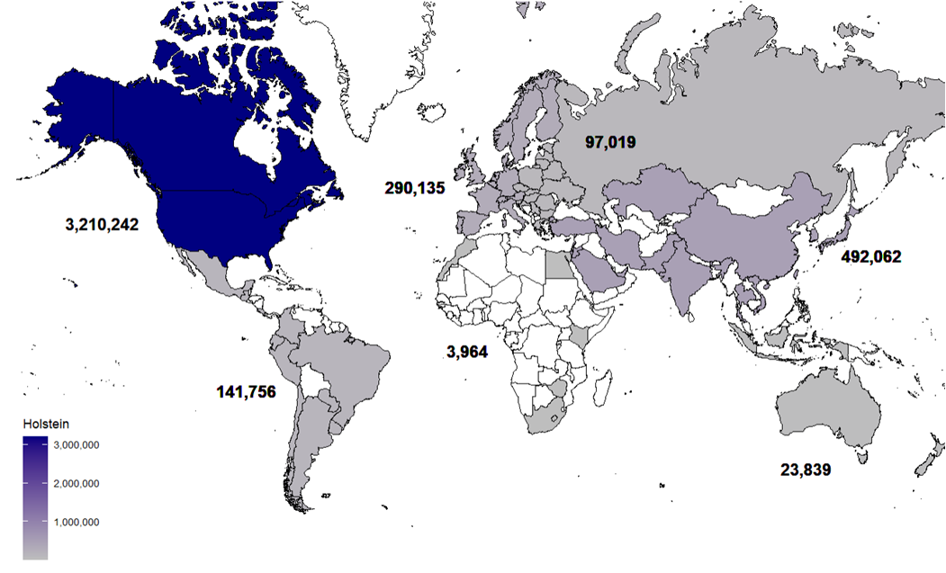
Recent female genotypes by continental region (Dec 2023)

Slide 4
Continental regions defined for genotypes
Continent | Countries
N. America | 2 | USA | CAN
L. America | 12 | ARG | BRA | CHL | COL | CRI | ECU | GTM | MEX | PER
 |  | PRI | PRY | URY
W. Europe | 17 | AUT | BEL | CHE | DEU | DNK | ESP | FIN | FRA | GBR
 |  | IRL | ITA | JEY | LUX | NLD | NOR | PRT | SWE
E. Europe | 17 | BUL | BLR | CYP | CZE | EST | GRC | HRV | HUN | LAT
 |  | LTU | POL | ROU | RUS | SRB | SVK | SVN | UKR
Africa | 5 | EGY | KEN | MAR | ZAF | ZWE
Asia | 13 | ARE | CHN | IND | ISR | JOR | JPN | KAZ | KOR | LBN
 |  | PKN | SAU | TUR | TWN
Oceania | 3 | AUS | IDN | NZL

Slide 5
Countries sending the most genotypes
Numbers of animals born in latest 5 years (both sexes, all breeds)
Countries with advanced breeding programs have large databases and accurate predictions
Many other countries have too little historical data to compute predictions
Country | Cows genotyped
United States | 3,571,054
Canada | 320,350
Saudi Arabia | 186,499
China | 160,558
Japan | 135,971
Italy | 114,501
Brazil | 102,000

Slide 6
Genotyped Holstein females: General stats
Net Merit averaged $480 in N. America and $211-381 in other continental regions.
Pedigree completeness ranged from average of 64.2% for Latin America to 86.1% for western Europe.
Pedigree inbreeding ranged from average of 8.7% for Africa and Oceania to 9.6% for North America.
Expected future inbreeding (EFI) had a small range from 9.0% in Oceania to 9.5% in North America.
Genomic future inbreeding (GFI) ranged from 9.4% to 10.4%.

Slide 7
Genotyped females by continent - Holsteins
Continent | Net Merit | Pedigree Completeness | Pedigree Inbreeding | EFI | GFI
 | ($) | (%) | (%) | (%) | (%)
North America | 480 | 84.2 | 9.6 | 9.5 | 10.4
Latin America | 335 | 64.2 | 9.1 | 9.4 | 9.9
Western Europe | 381 | 86.1 | 9.1 | 9.2 | 10.2
Eastern Europe | 370 | 74.5 | 8.8 | 9.2 | 9.7
Africa | 317 | 70.5 | 8.7 | 9.1 | 9.8
Asia | 366 | 76.5 | 8.8 | 9.2 | 9.7
Oceania | 211 | 75.2 | 8.7 | 9.0 | 9.4

Slide 8
Genotyped females by continent - Jerseys
Continent | Net Merit | Pedigree Completeness | Pedigree Inbreeding | EFI | GFI
 | ($) | (%) | (%) | (%) | (%)
North America | 304 | 87.9 | 8.9 | 9.0 | 7.7
Latin America | 75 | 57.3 | 8.5 | 8.7 | 7.0
Western Europe | 118 | 75.8 | 7.6 | 7.4 | 5.7
Eastern Europe | 284 | 79.4 | 7.8 | 8.0 | 6.2
Africa | 90 | 85.0 | 8.0 | 8.4 | 7.8
Asia | 41 | 74.6 | 8.1 | 8.6 | 7.1
Oceania | 1 | 63.9 | 8.1 | 8.1 | 7.1

Slide 9
Proven bulls: General stats
Pedigree completeness averaged 98% due to the Interbull exchange.
Holstein bulls had > 90% foreign sires in 7 of the 20 countries, but only 1% in NZL and 11% in USA. Averages were 43% foreign sires in Holsteins and Brown Swiss, 12% in Red Dairy Cattle, and 9% in Jersey.
Sire’s age at son’s birth averaged 2.2 to 2.9 years in 11 of the 20 countries for Holsteins, indicating rapid use of young sires. Other countries and breeds chose older sires of sons.
Proven bulls with genotypes used in USA reference population ranged from 0-100% and averaged 66% in Holsteins.

Slide 10
Comparing proven bulls of each breed by country
Proven bulls born 6-7 years ago with daughters in ≥ 10 herds
Variables and abbreviations defined:
Ped% Pedigree completeness back to 1980 (%)
G% Bulls with genotypes in the CDCB evaluation (%)
NM$ Net merit (average $ by country of ID)
EFI, GFI Future inbreeding using pedigree or genomic data
ForSire Bulls with a foreign sire (%)
SireGI Generation interval from sire to son (years)

Slide 11
Bull comparisons by country – Holsteins (+ Sim)
Country | Bulls | Daughters | Ped% | G%
USA | 1754 | 1085 | 100 | 99
DEA | 1005 | 348 | 97 | 0
DEU | 590 | 871 | 100 | 88
NLD | 444 | 1012 | 99 | 66
NZL | 444 | 811 | 99 | 1
CAN | 332 | 1125 | 100 | 100
JPN | 309 | 61 | 97 | 22
FRA | 282 | 1289 | 94 | 52
FRM | 194 | 591 | 92 | 0
ITA | 186 | 329 | 99 | 75
DFS | 162 | 1593 | 99 | 41
Country | Bulls | Daughters | Ped% | G%
CHE | 145 | 245 | 100 | 10
POL | 96 | 307 | 93 | 22
SVN | 82 | 107 | 91 | 1
ISR | 79 | 266 | 85 | 5
KOR | 71 | 36 | 94 | 0
AUS | 64 | 234 | 92 | 39
ESP | 60 | 185 | 97 | 42
GBR | 42 | 642 | 98 | 93
CZE | 23 | 473 | 100 | 78
LUX | 14 | 343 | 100 | 86
BEL | 13 | 476 | 99 | 85
Globe | 6412 | 771 | 98 | 54

Slide 12
Bull properties by country – Holsteins (+ Sim)
Cntry | NM$ | EFI | GFI | ForSire | SireGI
USA | 543 | 10.0 | 11.1 | 11 | 2.3
DEA | 202 | 1.1 | . | 38 | 4.1
DEU | 378 | 8.6 | 10.1 | 79 | 2.4
NLD | 326 | 7.8 | 9.8 | 58 | 3.0
NZL | -61 | 2.8 | 2.4 | 1 | 5.9
CAN | 479 | 10.0 | 11.3 | 65 | 2.2
JPN | 276 | 9.0 | 10.5 | 81 | 3.7
FRA | 257 | 8.0 | 10.1 | 79 | 2.6
FRM | 233 | 1.3 | . | 1 | 3.6
ITA | 315 | 7.6 | 10.7 | 90 | 2.8
DFS | 353 | 7.5 | 8.8 | 47 | 2.3
Cntry | NM$ | EFI | GFI | ForSire | SireGI
CHE | -23 | 5.0 | 9.3 | 50 | 4.0
POL | 274 | 8.2 | 10.2 | 100 | 2.9
SVN | 31 | 4.6 | 9.4 | 98 | 5.2
ISR | 269 | 5.5 | 3.2 | 29 | 4.9
KOR | 31 | 8.9 | . | 100 | 8.0
AUS | 125 | 8.3 | 9.9 | 70 | 3.5
ESP | 247 | 9.4 | 10.5 | 98 | 2.6
GBR | 267 | 7.3 | 8.1 | 74 | 4.4
CZE | 430 | 9.7 | 11.2 | 100 | 2.5
LUX | 442 | 9.0 | 10.6 | 100 | 2.6
BEL | 306 | 7.7 | 9.4 | 85 | 2.6
Globe | 324 | 7.0 | 10.7 | 43 | 3.2

Slide 13
Bull comparisons by country – Jerseys
Country | Bulls | Daughters | Ped% | G% | NM$ | EFI | GFI | ForSire | SireGI
USA | 359 | 594 | 95 | 100 | 279 | 9.1 | 7.4 | 4 | 3.1
NZL | 207 | 455 | 98 | 4 | -7 | 2.8 | 2.6 | 6 | 5.9
DFS | 56 | 941 | 99 | 63 | 326 | 4.9 | 3.1 | 7 | 2.4
AUS | 21 | 229 | 89 | 24 | -6 | 8.1 | 7.7 | 57 | 6.2
CAN | 19 | 176 | 100 | 100 | 69 | 8.4 | 8.1 | 47 | 2.5
Globe | 673 | 551 | 96 | 65 | 177 | 6.7 | 7.0 | 9 | 4.0

Slide 14
Bull comparisons by country – Brown Swiss
Country | Bulls | Daughters | Ped% | G% | NM$ | EFI | GFI | ForSire | SireGI
DEA | 157 | 213 | 96 | 93 | 436 | 5.4 | 6.3 | 37 | 4.4
CHE | 100 | 287 | 99 | 39 | 123 | 5.2 | 0.3 | 32 | 3.7
ITA | 57 | 116 | 99 | 93 | 289 | 6.2 | 6.8 | 63 | 3.8
USA | 49 | 130 | 99 | 100 | 223 | 7.8 | 7.5 | 39 | 4.3
FRA | 13 | 228 | 98 | 100 | 359 | 6.4 | 7.2 | 77 | 4.5
SVN | 12 | 54 | 98 | 50 | 226 | 5.6 | 6.1 | 92 | 4.9
Globe | 394 | 201 | 96 | 93 | 297 | 5.8 | 5.9 | 43 | 4.1

Slide 15
Bull comparisons by country – Red Dairy Cattle
Country | Bulls | Daughters | Ped% | G% | NM$ | EFI | GFI | ForSire | SireGI
DFS | 149 | 708 | 98 | 20 | 786 | 3.2 | 2.0 | 1 | 2.4
NOR | 92 | 1177 | 97 | 0 | 652 | 2.2 | . | 4 | 4.4
NZL | 27 | 56 | 95 | 0 | 438 | 2.1 | . | 33 | 8.3
CAN | 18 | 99 | 100 | 94 | 412 | 7.3 | 5.8 | 33 | 5.3
AUS | 15 | 90 | 76 | 0 | 432 | 3.2 | . | 60 | 6.5
GBR | 11 | 147 | 83 | 64 | 57 | 6.1 | 4.2 | 27 | 9.4
USA | 7 | 94 | 97 | 100 | 129 | 7.6 | 5.6 | 43 | 6.6
Globe | 329 | 676 | 96 | 19 | 638 | 3.2 | 3.7 | 12 | 4.1

Slide 16
Conclusions
Foreign HOL bulls and genotyped females are highly related to the USA reference population, except ISR (3.2%) and NZL (2.4%) bulls.
HOL genetic merit was higher in North America than in all other continental regions but varied more in other breeds.
Breeders in many countries are choosing genomic predictions from USA.
Predictions for foreign animals should be almost as accurate as for domestic animals, but genetic correlations are unknown in many new markets.

Slide 17
Acknowledgments
CDCB staff and industry cooperators for data
Interbull for data on bulls
AGIL staff and USDA funding of project 8042-31000-113-000-D, “Improving Dairy Animals by Increasing Accuracy of Genomic Prediction, Evaluating New Traits, and Redefining Selection Goals”

