Slide 1
Genetic and genomic evaluations of milking speed and duration from automated milk recording
J.R. O’Connell¹, J.L. Hutchison², A.M. Miles², S. Toghiani²,
P.M. VanRaden², and R.F. Fourdraine³
¹University of Maryland School of Medicine, Baltimore, MD
²USDA Animal Genomics and Improvement Lab, Beltsville, MD
³Dairy Records Management Systems, Raleigh, NC

Slide 2
Introduction
Many milking systems now record milk produced, time taken, and electronic ID of each milking for each cow
Genomic predictions possible with recent data from large herds
Different edits and trait definitions may affect heritability
Possible new trait to include in selection index
USA Brown Swiss already developed milking speed (MSPD) as a genetic trait (Wiggans et al., 2006)
Interbull provides multi-trait across-country evaluations (MACE) from 15 others that routinely evaluate MSPD

Slide 3
Data and edits
Records from 2022 to 2024 from Dairy Records Management Systems
165 herds, 9 different equipment manufacturers (OEM), and 47,833 complete lactations of 43,788 cows, including 12,237 genotyped cows
Milking speed (MSPD) was defined as milk yield divided by duration (DUR) for each individual milking:
averages across 305-d lactation using data for all parities or first parity (P1) only, all days or DHI test days (TD) only, and defined as MSPD or DUR

Slide 4
Model and variance estimation
The genetic model for lactation records included milking frequency, parity, equipment manufacturer, herd-year, genetic groups, and permanent environment
The pedigree relationship matrix included 319,721 animals with records or descendants with records plus 99 million other animals
Preliminary variances estimated from an earlier subset of 23,201 MSPD records
Both Gibbs sampling and REML gave very similar results
PTA correlations were based on 756 Holstein bulls with reliability (REL) for MSPD > 50%

Slide 5
Average all milkings or only test days?
Heritability was 37% for all days vs. 28% from TD-only
Residual variance was 51% higher for TD-only vs. all 305 days
Genetic correlation was 0.97 using all days vs. TD-only
PTA correlation unfavorable with somatic cell score but slightly favorable with milk yield and Net Merit $
Statistic | All milkings | Test day avg
Heritability | 37% | 28%
Error variance | 1.10 | 1.67
PTA reliability (proven bulls) | 67% | 64%
Corr with SCS | 0.39 | 0.43
Corr with milk | 0.14 | 0.16
Corr with Net Merit $ | 0.08 | 0.06

Slide 6
Use all parities (1 to 5) or 1st parity only?
Heritability was 45% with all parities or 41% in parity 1
Repeatability of 76% in all- parity model
Genetic correlation was 0.92 suggesting 1st and all parities are measuring nearly the same trait
Decided to use all parities to improve reliability
Statistic | All parities | 1st parity
Heritability | 45% | 41%
Error variance | 26% | 59%
Permanent environment variance | 31%
Repeatability | 76%

Slide 7
Correlations of MSPD and DUR
Heritability for DUR was higher than MSPD at 44% across all parities and 48% for parity 1
Genetic correlation of DUR with MSPD was -0.81 and phenotypic correlation was -0.52
DUR penalizes high producers for milking longer whereas MSPD avoids that and was chosen as the trait
Also, positive MSPD PTAs are favorable, whereas negative DUR PTAs would be favorable

Slide 8
Genetic and genomic PTAs
Stage of lactation effects were removed as fixed effects before averaging the residuals into lactation records
Allows easier modelling of part-lactation records
Genomic PTAs derived from deregressed pedigree model PTAs
For young animals, MSPD predictions averaged 47% REL
Compared to ~70% REL for most other traits or 27% REL for residual feed intake
PTAs had SD of 0.23 pounds/minute and range -1.1 to +1.4

Slide 9
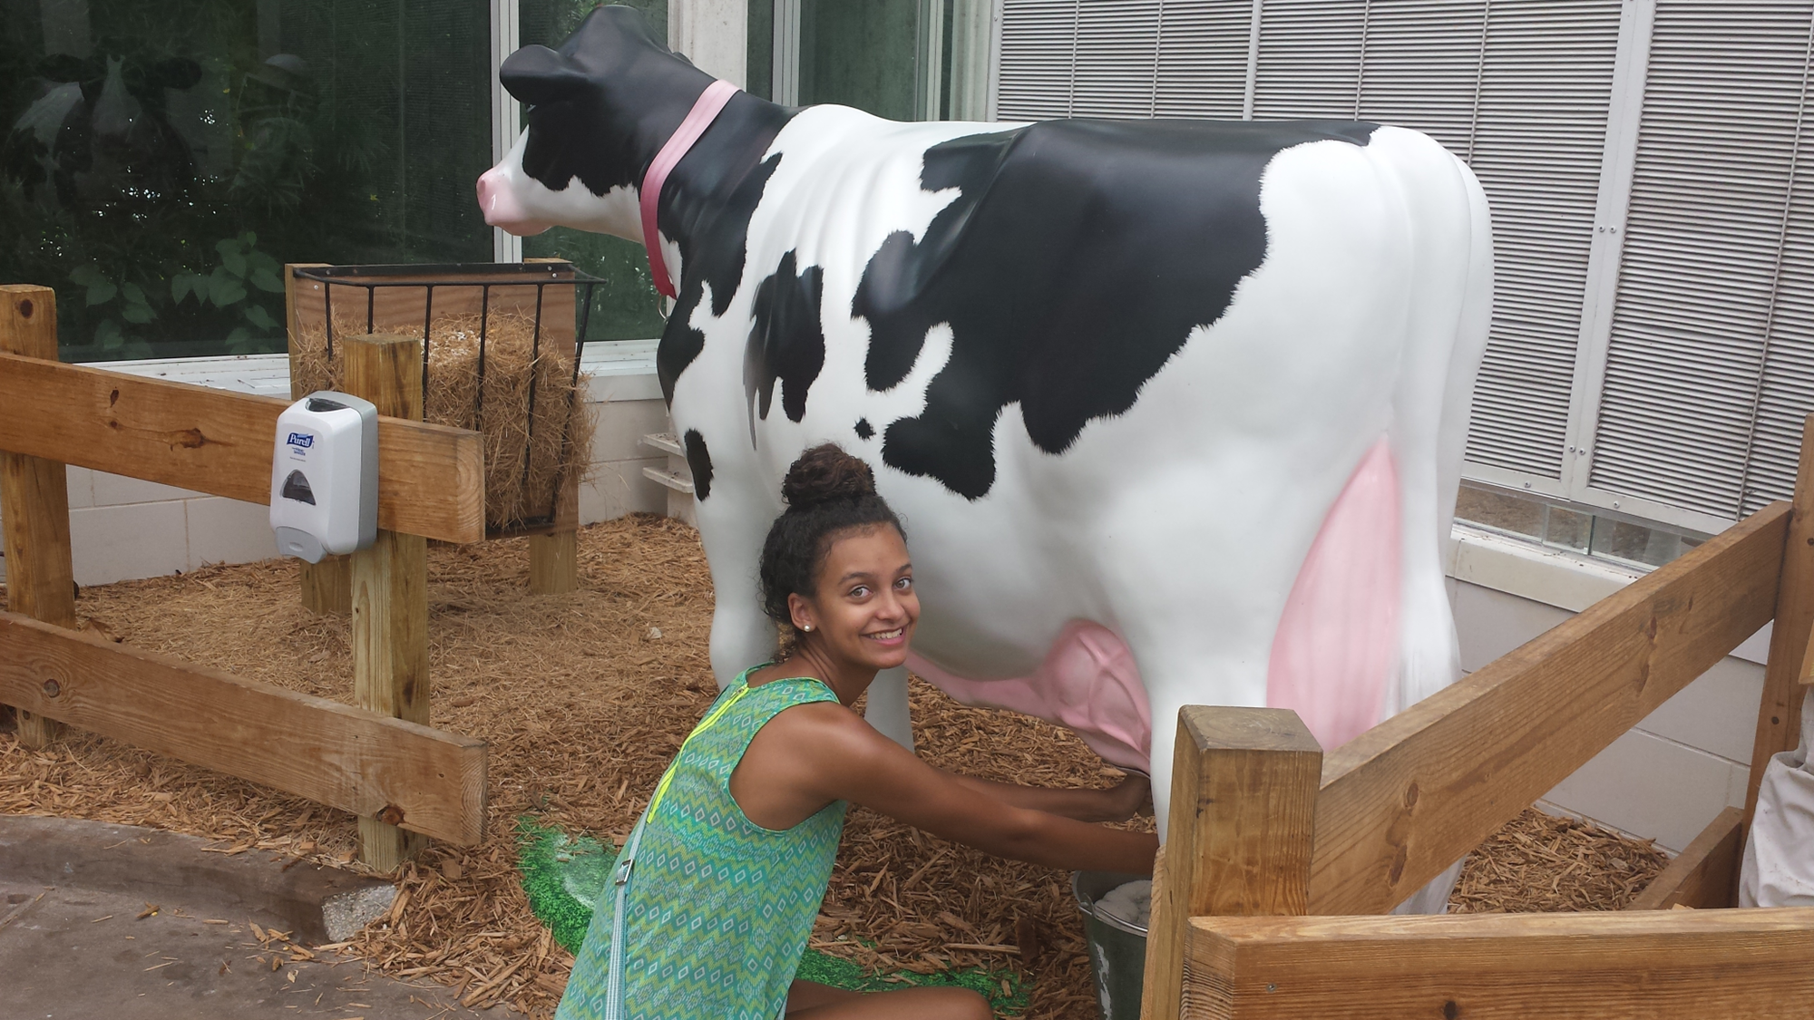
Economics
Benefits from faster milking may be 10 times larger with robotic than manual attachment because robots cannot move on to the next cow until the current cow finishes
Relative emphasis might be 3% of index with robots but only 0.3% with manual attachment
15 countries submit MSPD to Interbull but only 5 include MSPD in their national selection index
Genetic correlations among countries are about 0.85 but most data is reported by owner to type classifier

Slide 10
Conclusions
Milking speeds recorded by on-farm equipment are very useful but routine data flow is a key hurdle
Heritability and repeatability are high across lactations, especially when averaging all milkings within a lactation
Genomic predictions for MSPD are feasible and could have significant economic impact for producers

Slide 11
Next steps
Incorporate partial lactation records and explore data from robotic milking systems
Update genetic and genomic prediction methodology and results
CDCB is targeting delivery of this new trait in December 2024
Routine data flow is a key hurdle
PARITY
DIM
BREED
OEM
Many factors influence quantitative MSPD measurements

Slide 12
Acknowledgments
Pedigree and genotype data were available to the authors from _ under USDA Agricultural Research Service Material Transfer Research Agreement #58-8042-8-007
Special thanks to Dairy Records Management Systems (DRMS) for their research collaboration and supplying MSPD phenotypic data
AGIL staff and USDA funding of project 8042-31000-113-000-D, “Improving Dairy Animals by Increasing Accuracy of Genomic Prediction, Evaluating New Traits, and Redefining Selection Goals”

