Slide 1
Transforming agriculture: genomic selection
Paul VanRaden
USDA, Agricultural Research Service, Animal Genomics and Improvement Laboratory, Beltsville, MD
Email: paul.vanraden@usda.gov

Slide 2
Introduction
DNA can be read very affordably
Chips developed after human genome project
Transferable to almost all species
Cows were second species in 2007, customized in Beltsville
Cow reference genome since 2019 also from Beltsville
Now most genetic research and selection reads DNA directly
In past century, genetic research used mainly pedigrees
Using math derived for cows in 1922 in Beltsville

Slide 3
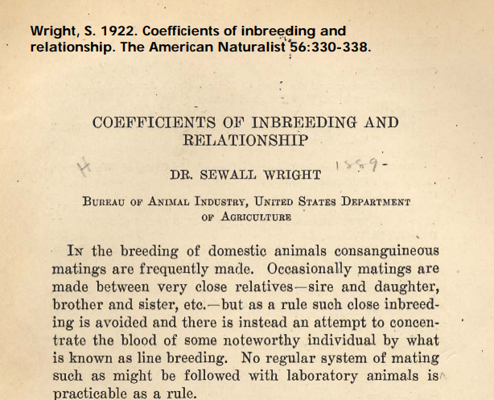
Pedigree relationship matrix – 100 years!

Slide 4
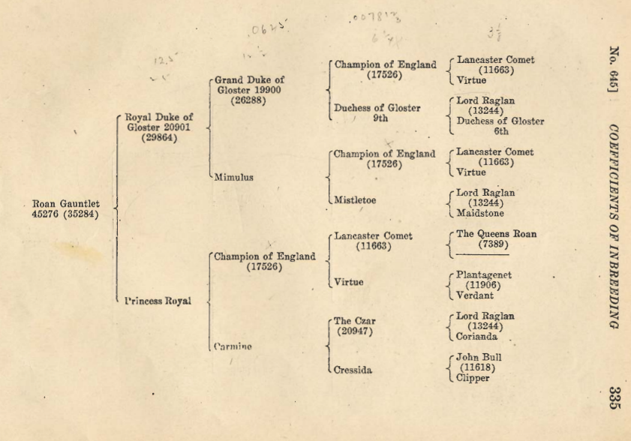
1922 example pedigree: Milking Shorthorns

Slide 5
Pedigree Relationship Matrix (1922)
 | PGS | PGD | MGS | MGD | Sire | Dam | Bull
Manfred | 1.053 | .090 | .090 | .105 | .571 | .098 | .334
Jezebel | .090 | 1.037 | .051 | .099 | .563 | .075 | .319
Teamster | .090 | .051 | 1.035 | .120 | .071 | .578 | .324
Dima | .105 | .099 | .120 | 1.042 | .102 | .581 | .342
O-Man | .571 | .563 | .071 | .102 | 1.045 | .086 | .566
Deva | .098 | .075 | .578 | .581 | .086 | 1.060 | .573
O-Style | .334 | .319 | .324 | .342 | .566 | .573 | 1.043

Slide 6
Genomic Relationship Matrix (2008)
 | PGS | PGD | MGS | MGD | Sire | Dam | Bull
Manfred | 1.201 | .058 | .050 | .093 | .609 | .054 | .344
Jezebel | .058 | 1.131 | .008 | .135 | .618 | .079 | .357
Teamster | .050 | .008 | 1.110 | .100 | .014 | .613 | .292
Dima | .093 | .135 | .100 | 1.139 | .131 | .610 | .401
O-Man | .609 | .618 | .014 | .131 | 1.166 | .080 | .626
Deva | .054 | .079 | .613 | .610 | .080 | 1.148 | .613
O-Style | .344 | .357 | .292 | .401 | .626 | .613 | 1.157

Slide 7
Difference (Genomic – Pedigree)
 | PGS | PGD | MGS | MGD | Sire | Dam | Bull
Manfred | .149 | -.032 | -.040 | -.012 | .038 | -.043 | .010
Jezebel | -.032 | .095 | -.043 | .036 | .055 | .004 | .038
Teamster | -.040 | -.043 | .075 | -.021 | -.057 | .035 | -.032
Dima | -.012 | .036 | -.021 | .097 | .029 | .029 | .059
O-Man | .038 | .055 | -.057 | .029 | .121 | -.006 | .060
Deva | -.043 | .004 | .035 | .029 | -.006 | .087 | .040
O-Style | .010 | .038 | -.032 | .059 | .060 | .040 | .114

Slide 8
Genomic selection requires:
DNA from many individual animals or plants
Genotypes for many variants per individual
Phenotypes from many individuals
Quality control of the data
Statistical methods to convert data into predictions
Breeders convinced that the predictions will work
Investment to continue collecting data

Slide 9
Progress made since 2008
Progress in stability and reliability of dairy cattle predictions
Expansion in number of variants tested
Additional traits tested and new uses for genotyping
Growth in numbers genotyped worldwide and in other species
Extra genetic progress worth about $4 billion in dairy cattle in the first decade! (Published by ARS National Program Leaders, Beltsville, MD)

Slide 10
Sources of DNA 2008-2018
Source | 2008 | 2010 | 2018 | 2008 | 2010 | 2018
 | % | % | % | N | N | N
Tissue (ear) | 0 | <1 | 81 | 0 | 100 | 579,255
Hair roots | 0 | 82 | 14 | 0 | 22,550 | 102,229
Blood | 10 | 5 | 2 | 623 | 1,375 | 14,656
Embryos | 0 | 0 | 1 | 0 | 0 | 6,188
Nasal swab | 0 | 12 | <1 | 0 | 3,300 | 656
Semen | 90 | <1 | <1 | 5,285 | 200 | 319
Unknown | 0 | 0 | 2 | 0 | 0 | 17,048

Slide 11
Potential for embryo genotyping
15,000 embryos already genotyped
Change selection strategies if technology improves and costs decline
Genotype before instead of after pregnancy
Demand for embryo genotyping could be more than for calves
Could genotype 20 million embryos/year instead of 4 million calves
May be difficult to automate … requires switching to embryo transfer instead of artificial insemination

Slide 12
Numbers of variants tested in cattle
Year | Variants | Data source
<1995 | 0 | Only pedigrees and phenotypes
2003 | 367 | RFLP markers, not implemented
2008 | 50,000 | 50K SNP chip
2010 | 777,000 | High-density chip
2015 2019 | 39,700,000 63,000,000 | Whole genome sequencing (1000 Bull Genomes Project)
Future | Epigenetic | External control of gene function

Slide 13
Chip history (37 chips + sequence)

Slide 14
Genetic progress (Holstein)

Slide 15
Predict 50 years of genetic progress (Cole, 2018)
Trait | 50-year progress | 2017 mean | 2067 mean
Milk (pounds) | +9,329 | 27,055 | 36,384
Fat (pounds) | +531 | 1,008 | 1,539
Protein (pounds) | +342 | 825 | 1,167
Productive life (months) | +65 | 26 | 91
Body size (pounds) | –230 | 1,500 | 1,230
Udder composite | +2.65 | 0 | 2.65
Daughter pregnancy rate (%) | +26 | 29 | 55
Cow conception rate (%) | +42 | 35 | 77
Heifer conception rate (%) | +21 | 57 | 78

Slide 16
Selection for more traits
26 traits had US genomic PTAs in 2009
10 new traits added in 2010-2021, mostly with low heritability and less data
Heifer and cow conception rates, cow livability, gestation length, mastitis, metritis, retained placenta, DA, ketosis, milk fever, early first calving, calf livability, and feed intake
Next new trait expected soon:
Milking speed
High genomic reliability requires:
Large reference populations, historical databases, or high heritability

Slide 17
Genomic mating programs
Reduce inbreeding using genomic instead of pedigree relationships
Genomic relationship of each live female to each marketed bull
File contains 1 million females × 5,000 males
Genomic mating increases heifer calf value by
+$33 compared with pedigree mating (1.3% lower inbreeding)
+$78 compared with random mating (3.1% lower inbreeding)
Also improves conception rates by avoiding recessive carrier matings
Also reduces inbreeding of bull calves, promoting faster growth

Slide 18
Genetic and genomic milestones
Year | Researchers | Discovery/Development
1865 | Mendel | Inherited traits of peas
1900 | Bateson and others | Rediscovery of Mendel’s laws
1905 | Spillman (USDA) | Horned/polled (Mendelian trait in cattle)
1922 | Wright (USDA) | Pedigree relationship matrix
1953 | Watson, Crick | Structure of DNA
1974 | Norman (USDA), Henderson (1976) | Use of pedigree relationships in PTAs
2001 | Lander | Sequence of human genome
2007 | Illumina, USDA, and others | Development of SNP chip for cattle
2009 | Elsik (NIH and USDA funding) | Sequence of cattle genome
2009 | USDA and many others | Genomic methods, official predictions

Slide 19
Compare largest 2 DNA databases (July 2 2015)
 | 23andMe | CDCB/USDA
Genotypes | ~950,000 | 1,000,000
Countries | 55 | 48
Genotyping cost | $99 | $37 to $135
Species | Human | Cattle
Generations of data | Few | Many
Prediction reliability | Low | High
Reference: http://genomemag.com/davies-23andme/#.VdY722zosY1
Web sites: https://www.23andme.com/
https://www.cdcb.us/
https://www.ars.usda.gov/northeast-area/beltsville-md-barc/beltsville-agricultural-research-center/agil/aip/

Slide 20
Human genotyping and sequencing (2024)
Technology | Database | People genotyped | Variants genotyped
High-density (HD) SNP chip | Ancestry.com | ~25 million | 700,000
 | 23andMe | ~15 million | 700,000
Whole genome sequence | TopMed (U. Michigan) | 160,000 | 840 million
 | Illumina | 600,000 | 500 million
HD imputed to sequence | NIH, Bethesda, MD | 58 million | 300 million
Total raw data = 600,000 people × 40× coverage × 2.7 billion genome length) = 65 million GB

Slide 21
Genotyping in other livestock
Poultry: Several million per year, Aviagen, Scotland, 2022
Aviagen Group genomics lab further strengthens genetic selection
Beef: ~ 1 million total, American Angus, 2021
Trends in genetic diversity and the effect of inbreeding in American Angus cattle under genomic selection | Genetics Selection Evolution
Swine: 400,000 total, Pig Improvement Corporation, 2019

Slide 22
Genomic selection in other species: Example in peas
Genomic methods from dairy cattle are now used for many species
Example: Roorkiwal et al. (2016) Front. Plant Sci. 7:1666
3,000 markers for 315 elite lines of chickpeas in India
Tested several statistical methods developed for dairy cattle such as the genomic relationship matrix
“… study establishes the necessary resources for deployment of genomic selection in chickpea breeding”

Slide 23
Summary
The DNA predictions implemented in 2009 have improved rapidly
Adjustments were needed to remove biases, give breeders confidence
Accuracy improved as datasets expanded, more traits were included
Many new uses such as pedigree discovery and genomic mating
Future predictions will use more gene tests discovered from sequence data and more international genotypes
Methods developed for dairy cattle are now used for beef, swine, poultry, honeybees, humans, trees, corn, alfalfa, soybeans, and even peas
Mendel would be pleased

Slide 24
Acknowledgments and Disclaimers
Council on Dairy Cattle Breeding (CDCB) and its industry suppliers for data
Taxpayers for funding USDA-ARS-AGIL project 8042-31000-002-00, “Improving dairy animals by increasing accuracy of genomic prediction, evaluating new traits, and redefining selection goals”
AGIL staff for doing this research
Mention of trade names or commercial products in this presentation is solely for the purpose of providing specific information and does not imply recommendation or endorsement by USDA; USDA is an equal opportunity provider and employer

Slide 25
Instructions
highlight local Beltsville research
and its broader impacts (in this case, interaction with CDCB).
Typically, this looks like 15-18 minute talks from each speaker,
followed by about 15-20 minutes of questions/discussion

