Slide 1
High-throughput Genotyping of Vegetable Crops for Germplasm Conservation
Joanne A. Labate
Molecular Biologist and Acting Curator for Seed Crops
Plant Genetic Resources Unit
USDA, Agricultural Research Service
Geneva, NY 14456 USA
joanne.labate@ars.usda.gov

Slide 2
Plant Genetic Resources Unit (PGRU), Geneva, NY
conserves 29 genera of seed crops and wild relatives
mission is to acquire, maintain, characterize, and distribute plant genetic resources
Major holdings:
Genus
Allium
Apium
Asparagus
Brassica
Cucurbita
Fagopyrum
Physalis
Raphanus
Solanum
Number of accessions
1,144
243
158
2,157
839
255
168
715
6,600

Slide 3
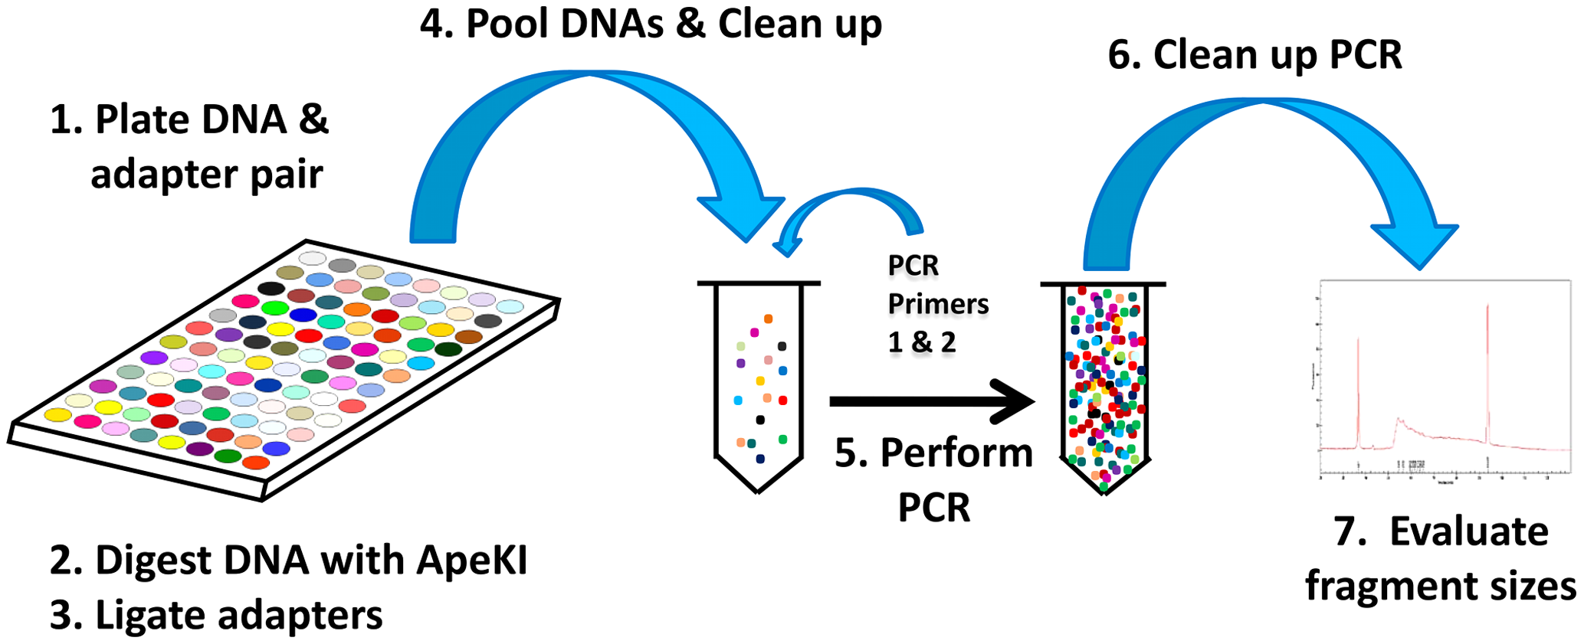
Genotyping-by-sequencing (Elshire et al. 2011)
$21.57 per DNA sample for library construction and sequencing 96-well plate
simultaneous marker discovery and genotyping reduces ascertainment bias
does not require a reference genome
Fig. 2 from PLoS ONE 6(5): e19379

Slide 4
Plant Genetic Resources Unit (PGRU), Geneva, NY
conserves 29 genera of seed crops and wild relatives
Major collections:
Genus
Allium*
Apium
Asparagus
Brassica*
Cucurbita*
Fagopyrum
Physalis*
Raphanus*
Solanum*
*bold indicates a sample was GBS genotyped
Number of accessions
1,144
243
158
2,157
839
255
168
715
6,600

Slide 5
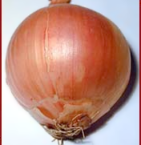
Allium cepa (onion)
highly consumed in the U.S., production dollar value ranks third among vegetables
an ancient, globally widespread crop, thousands of onion cultivars have been developed to fit diverse environments and dietary preferences
costly to breed/conserve due to its biennial habit and requirements for cross-pollination
molecular genetic markers, which can increase the efficiency of breeding, are difficult to develop due to onion’s large (16GB) genome size.
GBS discovered 70,000 single nucleotide polymorphism (SNP) markers using doubled-haploid lines as controls
after filtering for high quality and expected segregation ratios, 701 of the SNPs were mapped in an F2 population
results indicated that GBS is a promising technology for marker development in onion, raw data collected for 95 PGRU accessions in replicate
Labate, J.A., M.J. Havey, S.E. Mitchell, K. Hyma and J.C. Glaubitz. 2016. Genotyping-by-sequencing an onion (Allium cepa) mapping population. 2nd Combined National Onion Assoc/National Allium Research Conference, Nov. 30 – Dec. 3, 2016, Savannah, GA

Slide 6
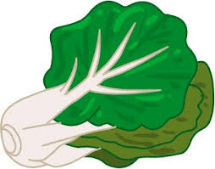
Brassica rapa (Asian greens)
very diverse in its usage, consumed as a raw or cooked leafy green (mizuna, Chinese cabbage, bok choy), a spice or condiment (sarson), a root vegetable also used as animal fodder (turnip), or a cooking oil (oilseed rape).
genetic relationships among morphotypes are not well understood but a deeper understanding would be beneficial for crop conservation and improvement
sampled B. rapa that originated from across the globe and included ten various morphotypes for GBS
333 accessions x 18,272 SNPs; supported the genetic distinction of morphotypes but also indicated differences between the same types based on geographic origins
most inclusive dataset to date, understanding of these relationships will inform future breeding and scientific work in B. rapa
Bird, K.A., H. An, E. Gazave, M.A. Gore, J.C. Pires, L.D. Robertson and J.A. Labate. 2017. Population structure and phylogenetic relationships in a diverse panel of Brassica rapa L. Frontiers in Plant Science (submitted)

Slide 7
Physalis philadelphica (tomatillo or husk-tomato)
originated in Central Mexico, widely cultivated in Guatemala and Mexico, primarily consumed as relishes or sauces (green salsa), Latino cuisine represents a rapidly growing niche market in USA
considered an underutilized species by the Food and Agriculture Organization (FAO)
breeding for size, disease resistance, mechanical harvest would be desirable
previous studies of tomatillo populations have shown them to be closely related to each other
GBS of 125 accessions, multiple plants per accession, scored 77,340 SNPs in 179 samples
AMOVA results, absence of isolation-by-distance and lack of clustering pattern related to geographical origin supported these earlier studies
identified 86 pairs of accessions that were quantitatively differentiated from each other, graphical representations of qualitative divergence among 125 genotyped accessions, confimed homozygosity of new inbred lines
Labate, J.A. and L.D. Robertson. 2015. Nucleotide diversity estimates of tomatillo (Physalis philadelphica) accessions including nine new inbred lines. Mol. Breeding 35:106

Slide 8
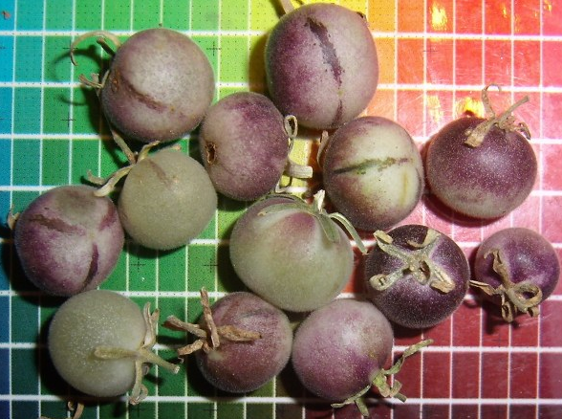
Solanum spp. (wild tomato)
Solanum peruvianum sensu lato (s.l.) was reclassified into four separate species; reproductive barriers among the species are incomplete
GBS yielded 14,043 SNPs x 46 sampled plants; estimated isolation-by-distance, pairwise genetic distances and clustering
strong support for IBD, more pronounced between interspecific pairs
Eriopersicon and Arcanum species groups were genetically distinct except for S. huaylasense which showed 50% membership proportions in each group
S. peruvianum and S. corneliomuelleri were not significantly differentiated from each other
Many thousands of SNP markers were identified that could potentially be used to distinguish pairs of species, including S. peruvianum versus S. corneliomuelleri. Diagnostic markers will be valuable for delimiting morphologically similar and interfertile species in germplasm management.
Labate, J.A., L.D. Robertson, S.R. Strickler and L.A. Mueller. 2014. Genetic structure of the four wild tomato species in the Solanum peruvianum s.l. species complex. Genome 57:169-180

Slide 9
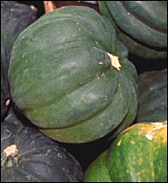
Cucurbita maxima (winter squash)
traditionally been valued for its good storage properties bestowed by its thick, hard skin; provides a wide range of nutrients
consumer demand has been steadily rising during recent decades
naturally occurring cucurbatacins (tetracyclic triterpenes) have been used in pest control and also exhibit anti-inflammatory and anticancer activities
improvement has focused on fruit size & shape, non-bitter fruits, deep orange fruit color (high pro-vitamin A), earliness, bush habit, insect and disease resistance
core sets based on morphological diversity (95 accessions) and geographical diversity (95 accessions, 38 countries), 165 total accessions, 285 plants were genotyped using GBS
collaborating with CucCAP project
Umesh K. Reddy, W. Virginia. State Univ.; Mary Hausbeck and Safa Alzohairy, Michigan State Univ.

Slide 10
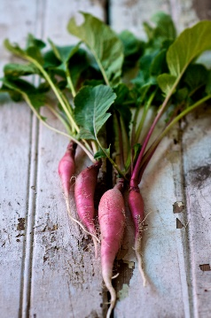
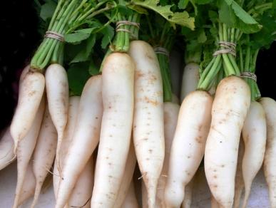
Raphanus sativus (radish)
represents 2% of total global vegetable production (7 million tons/year)
consumed as root vegetable (hypocotyl + true root), leafy vegetable, sprouts, seeds or as seed pods; used as cover crop or forage crop
ancient crop native to the Eastern Mediterranean and Eastern Asia; may have experienced multiple domestication events
consumer preferences are regionally based, resulting in morphological diversity combined with adaptation to local conditions
rich source of vitamin A, vitamin C, minerals and carbohydrates; improvement has focused on size and shape
core set based on weighted geographical sampling (35 countries, 152 accessions); 5 plants per acc. were genotyped using GBS
collaborating with Institute of Vegetables and Flowers, Chinese Academy of Agricultural Sciences, Beijing, China (recent germplasm exchange added 23 radish accessions)

Slide 11
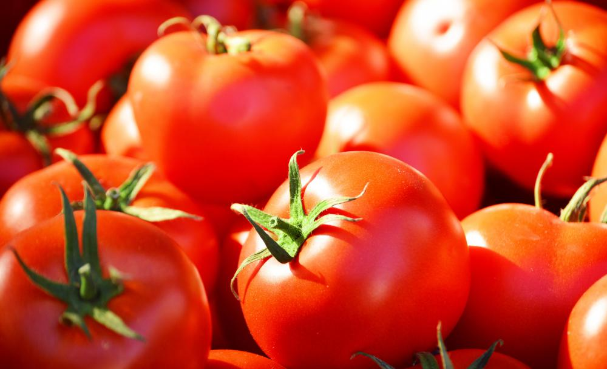
Solanum lycopersicum (cultivated tomato)
highly consumed in the U.S. in both fresh and processed forms $2.7 billion commercial value in USA in 2015 (high value, high risk crop)
breeding has emphasized crosses with wild relatives due to narrow genetic base, ease of crossing, production demands based on growing conditions & market niche, susceptibility to pests and diseases, vulnerability to abiotic factors.
USA consumers ask for more flavorful, colorful, and heirloom types available year-round; these will still require the resistances, shelf-life and durability of standard supermarket varieties
185 accession PGRU core set based on geographical origins, centers of diversity, fruit shape, SolCAP heirlooms, commercially important varieties or breeding lines 1930s – 1990s
assayed two 96-well plates of DNA samples using GBS

Slide 12
tomato fruit diversity
tomato products diversity
tomato traits: disease resistance, drought tolerance

Slide 13
Tomato diversity panel for GBS, 190 DNA samples
home garden, fresh market, vintage, geodiversity, landraces from primary and secondary centers of diversity, fruit shape diversity, ornamental, processing, breeding lines, expired PVPs, private companies and public breeding programs
many with disease resistance
eight San Marzano accessions – important commercial variety
one Solanum pimpinellifolium sample

Slide 14
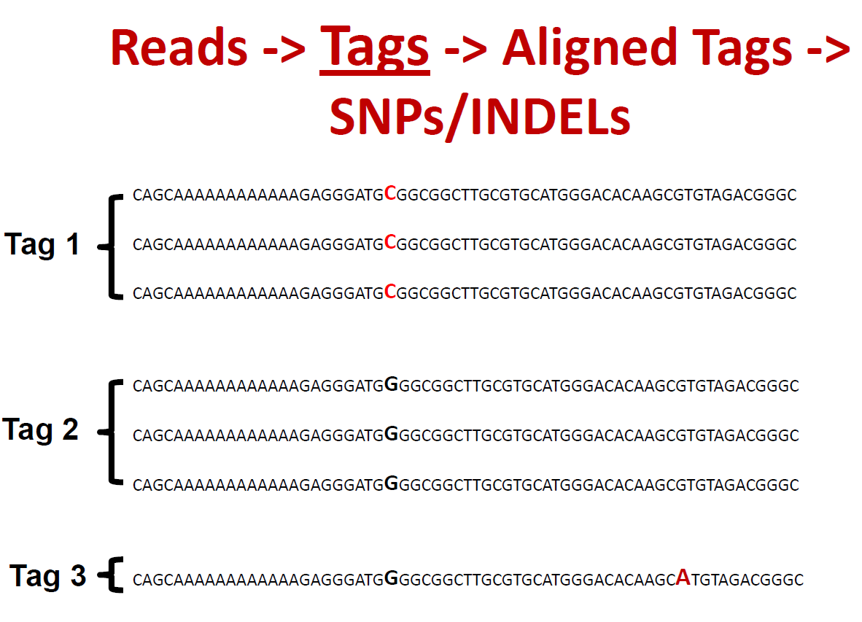
GBS terminology – what is defined as an allele?
source: Institute for Genomic Diversity, Cornell University

Slide 15
TASSEL 3.0 bioinformatics pipeline for SNP calling
190 tomato DNA samples
793,000 aligned tags
35,603 raw SNPs
> 400,000,000
high quality reads,
64 nucleotides each
quality filters: max-alleles 2, minGQ 98, remove-indels, minimum count 19 (at least 10% of DNAs scored), at least three observations of an allele (minimum allele frequency = 0.01)
3,713 mapped, high quality SNP sites in 190 DNA samples

Slide 16
Summary of tomato GBS data
3,713 SNPs in 190 DNA samples
missing data = 0.33 in this 1.41 × 10⁶ diploid genotypes data points
average heterozygosity = 0.08
heterozygosity range 0.03 (PI 505317, Mataverde, cultivar from Colombia 1986) to 0.28 (PI 128586, Chile 1938)
S. pimpinellifolium heterozygosity = 0.19
Allele summary:
N 0.33
T 0.21
A 0.20
G 0.09
C 0.08
R 0.02
Y 0.02
K 0.01
M 0.01
W 0.008
S 0.002

Slide 17
Number of sites
Proportion heterozygous

Slide 18
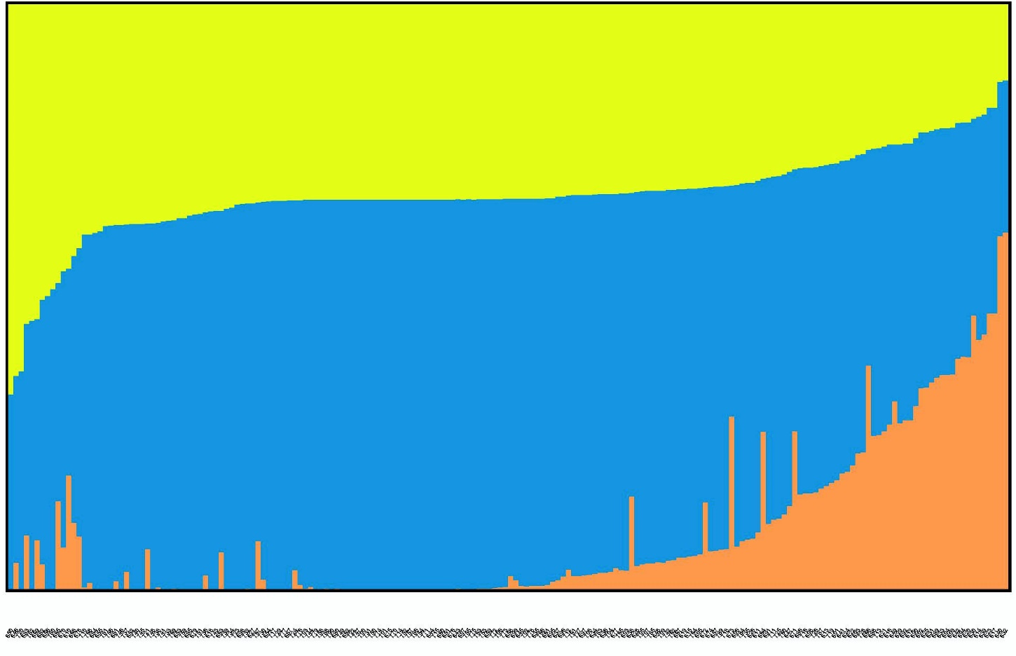
Population Structure k = 3 groups (3,713 SNPs x 190 plants)
S. pimpinellifolium
pear, ellipsoid from Italy
Peru, Panama
Chile, Ecuador, Nicaragua, Italy

Slide 19
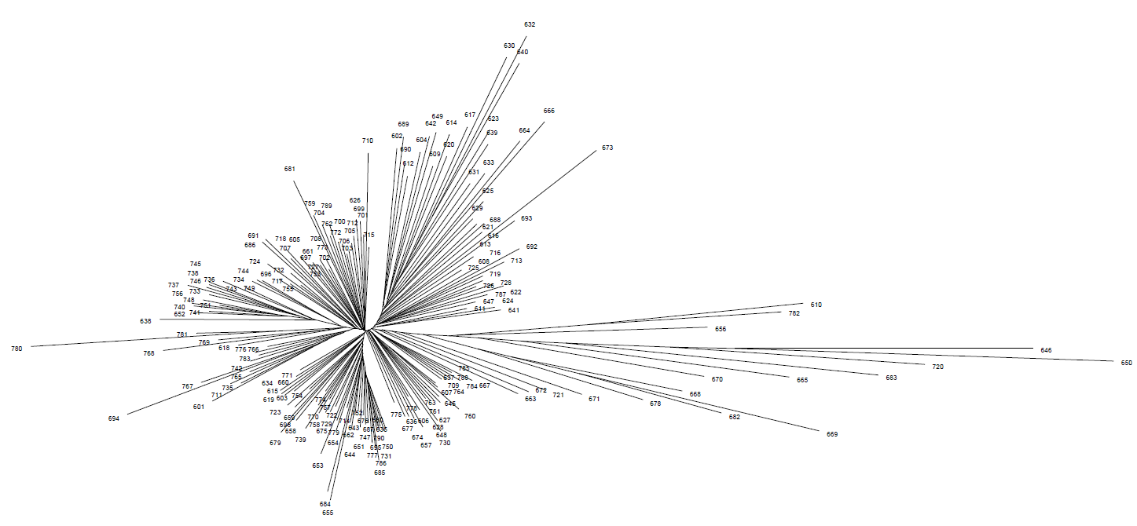
Neighbor-joining tree graphed using SplitsTree (3,713 SNPs x 190 plants)
Italy
Italy
Italy
Italy
France
Taiwan
VFNT cherry
Italy
Ecuador
Ecuador
Colombia
Peru
Nicaragua
Chile
S. pimpinellifolium
Ecuador
Ecuador

Slide 20
Neighbor-joining bifurcating tree with bootstrap values
(3,713 SNPs x 190 plants)
85% support split from root

Slide 21
Neighbor-joining bifurcating tree with bootstrap values
(3,713 SNPs x 190 plants)
low support for groups to the right of this split with one notable exception
85% support split from root

Slide 22
Neighbor-joining tree root with high bootstrap support for root
85%
Italy
Ecuador
Peru
S. pimpinellifolium

Slide 23
Neighbor-joining tree with bootstrap values
Neighbor-joining tree showed 92% bootstrap support for processing types
92%
741 Tioga*
652 M82
740 DNAP-9*
756 UC-82B
748 Sun1643*
638 T533
746 71-75*
737 Castlerock*
745 Ramsay*
738 Moran 3053*
733 Allure*
743 Mystro*
736 Peto 460
630 LYC2406
Bold indicates processing type
*Plant Variety Protection – intellectual property protected

Slide 24
Neighbor-joining tree showed 95% bootstrap support for four of eight San Marzano accessions
95%
785 San Marzano, Italy
790 Pomodoro San Marzano-Lampadina, Italy
786 San Marzano, Spain
667 San Marzano, Argentina
These were dispersed throughout the NJ tree:
784 San Marzano, South Africa
San Marzano, United States (selected for resistance to heat sterility)
San Marzano, Hungary
Pink San Marzano, United States

Slide 25
Neighbor-joining tree results
Only other clusters with >90% bootstrap support were 4 pairs of accessions:
669, 682 both from Ecuador
651, 762 LA0330, Burbank
606, 778 Costoluto Genovese, Pomodoro Superselezione di Marmande
694, 767 Manalucie, Venus (FL and NC experiment stations)

Slide 26
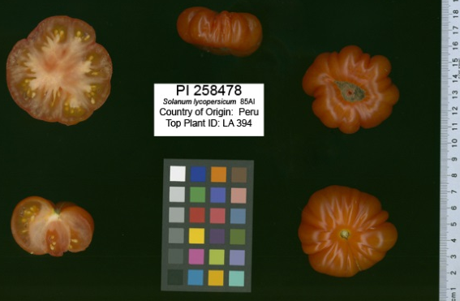
Example fruit from a landrace accession closely related to wild tomato

Slide 27
Conclusions GBS
tomato
not extensive genetic distinction among types: ornamental, processing, breeders lines, home gardening etc
PVP varieties were closely related to each other, shared UC-82 pedigree
traditional view is that cultivated tomato germplasm is not rich source of new variation
outlier accessions: VFNT cherry, Italian accessions, landraces could provide novel alleles for crop improvement
support for a “genuine” San Marzano, four additional San Marzano accessions were not closely related
GBS has been a valuable technique to apply to vegetable germplasm collections, with or without a reference genome

Slide 28
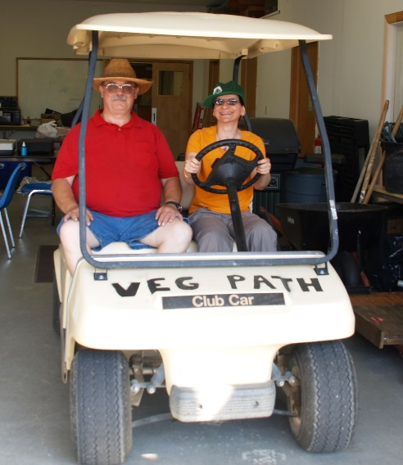
Thank you!
PGRU Technical support
Susan Sheffer Paul Kisly
Sherri Tennies
Greg Noden
Nancy Consolie
Jackson Bartell
Mike Morabito
L.D. Robertson, Seed Crops Curator, USDA-ARS, PGRU
S. Mitchell, K. Hyma, R. Bukowski, J. Glaubitz, E. Gazave, M.A. Gore, S.R. Strickler, L.A. Mueller, Cornell University
M.J. Havey, USDA-ARS, Vegetable Crops Research Unit
K. Bird, H. An, J.C. Pires, University of Missouri
Funded by CRIS Project No. 1910-21000-024-00D

