Slide 1
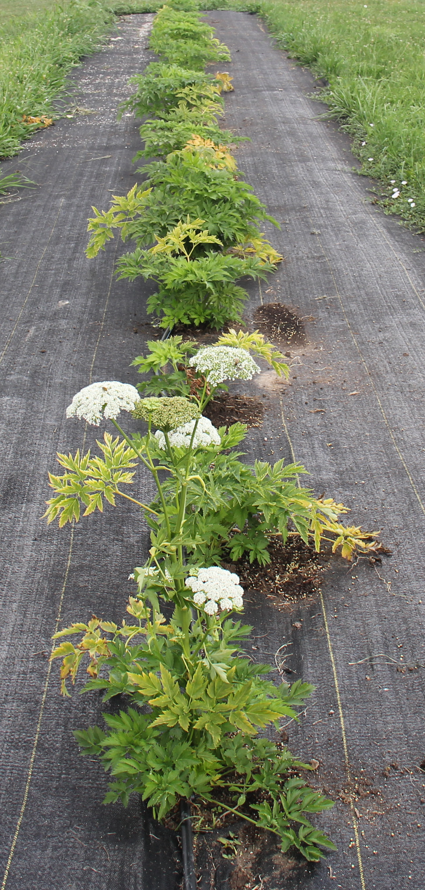
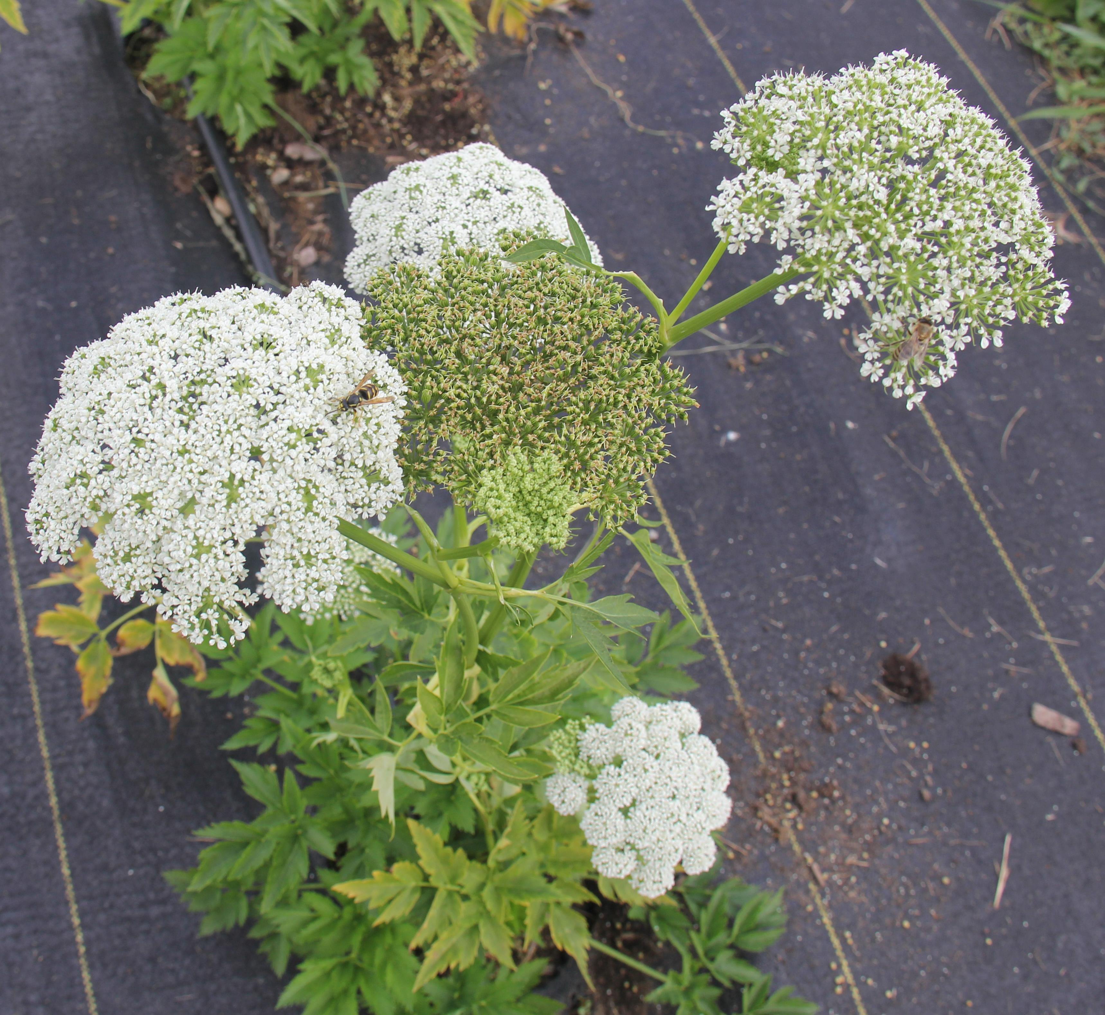
PGRU vegetable crop germplasm
maintain, regenerate, back up
distribute
acquire
characterize
outreach
Korean pig celery
Joanne Labate, USDA Plant Genetic Resources Unit, Geneva, NY. August 25, 2020

Slide 2
Maintenance
12,707 accessions of tomato, onion, radish, winter squash, cabbage, cauliflower, broccoli, other cole crops, celery, tomatillo, asparagus and other vegetables and their wild relatives.
Three expired PVPs added in 2019 (two radish, one cauliflower).
2020 regenerations (reduced 50%):
171 plots for annual and 1st yr biennial accessions
50 plots for 2nd yr biennial accessions
40 accessions (25 onion, 15 winter squash) distributed to cooperators
10 short-day onion cultivars not currently in the collection are being regenerated
rescued sample of perennial Korean celery, also known as Korean pig plant (Dystaenia takesimana) is being regenerated in 2020 so that it can be added to the germplasm collection. This is a rare species endemic to an island in South Korea. Animal forage and also as an ingredient to add flavor to soups.
501 samples backed up in 2019 at NLGRP, including cole crops, buckwheat, mustard, onion, radish, tomato and winter squash.

Slide 5
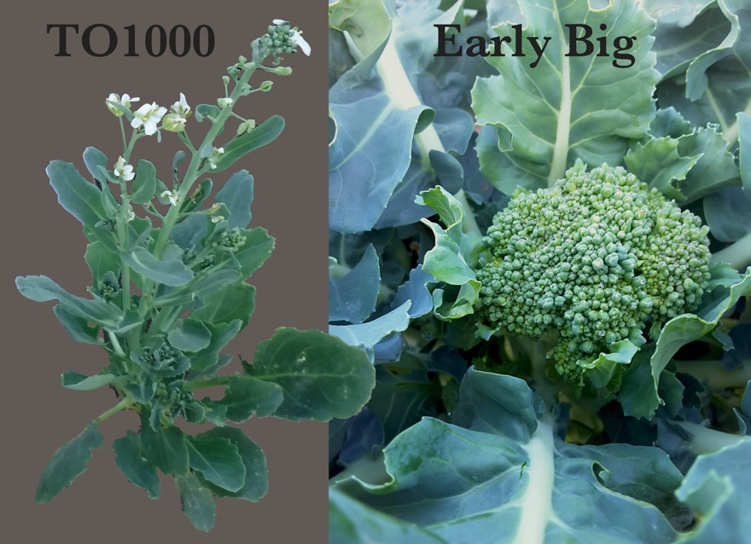
Acquisition
PGRU has acquired a broccoli x Chinese kale mapping population consisting of 175 inbred lines. Lines are fully characterized using 1,881 DNA markers. Allocations of five seeds per each line will be available to requestors. The population is valuable as a research and teaching tool. Relatively short time from sowing seed to flowering means that a research project can be completed within several months. Studies of this population will contribute to the knowledge needed for the continued successful breeding of superior vegetable varieties.
Stansell, Z., Farnham, M., Björkman T. 2019. Complex horticultural quality traits in broccoli are illuminated by evaluation of the immortal BolTBDH mapping population. Frontiers in Plant Science. 10: 1104, doi: 10.3389/fpls.2019.01104

Slide 6
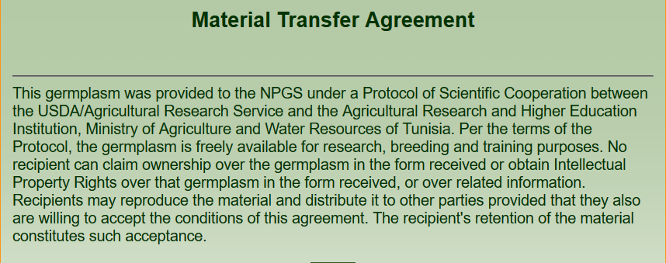
Planned acquisitions:
Onion (Mutschler) DH, dwarf scape, synthetic populations, high Brix, low pungency
Tomato (Mutschler) ‘Campbell 1943’, insect resistance lines
Industrial hemp

Slide 7
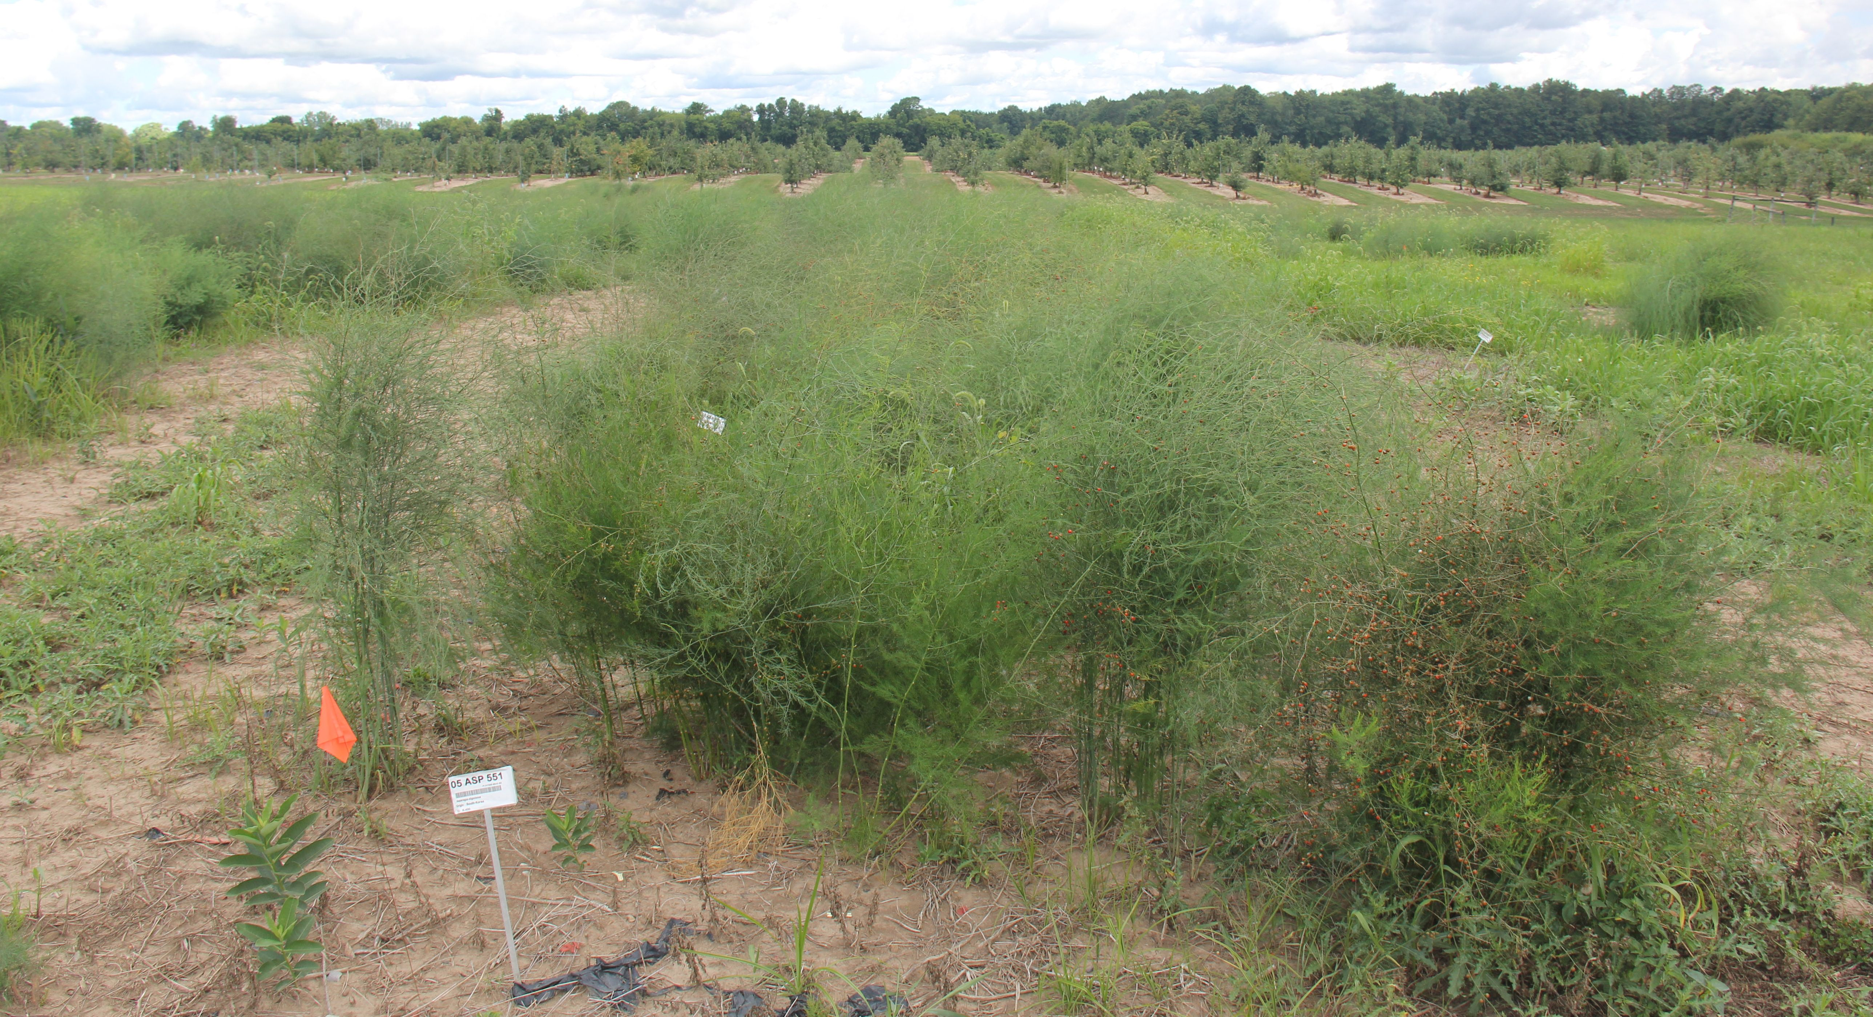
Characterize
field characterizations are on hold during pandemic
Asparagus conservation and research:
regenerate and increase the PGRU asparagus collection
99 distinct accessions held as seed, field collections, or in greenhouse
identified highest priority accessions to increase in 2021

Slide 8
Characterize
Two studies planned involving asparagus germplasm (on hold):
evaluate seed germination and synchronicity among several seed treatments
genotyping-by-sequencing:
population structure, genetic diversity, and domestication footprints across NPGS, commercial, and contributor germplasm. Evaluate asparagus pedigree lineages and putative bottleneck events during the development of modern elite germplasm. Collaborators: A. Harkess (Hudson-Alpha), J. Leebens-Mack (University of Georgia), N. Stone, M. Roose (UC Riverside)

Slide 9
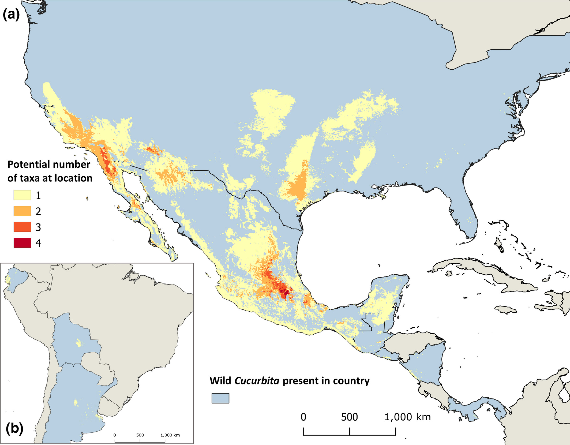
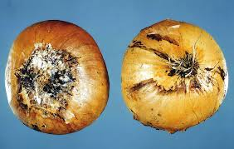
Characterize
895 onion SNPs including 284 mapped SNPs were published
- Labate, J.A., J.C. Glaubitz, and M.J. Havey. 2020. Genotyping by sequencing
for SNP marker development in onion. Genome (in press).
- onion pseudoreference genome (https://doi.org/10.5061/dryad.6wwpzgmwg)
- raw genotyping-by-sequencing reads (49 Gbases from 380 DNA samples)
Taxonomy and distributions of the wild relatives of the cultivated species of pumpkins, squashes, and gourds (Cucurbita L.) were analyzed. Ranges of all 16 currently known wild taxa in the genus were modelled and their conservation status was assessed. Khoury et al. Plants, People, Planet. 2019;00:1–15. https ://doi.org/10.1002/ppp3.10085.
Fusarium basal rot resistance in onion seedlings and bulbs (Cramer)

Slide 10
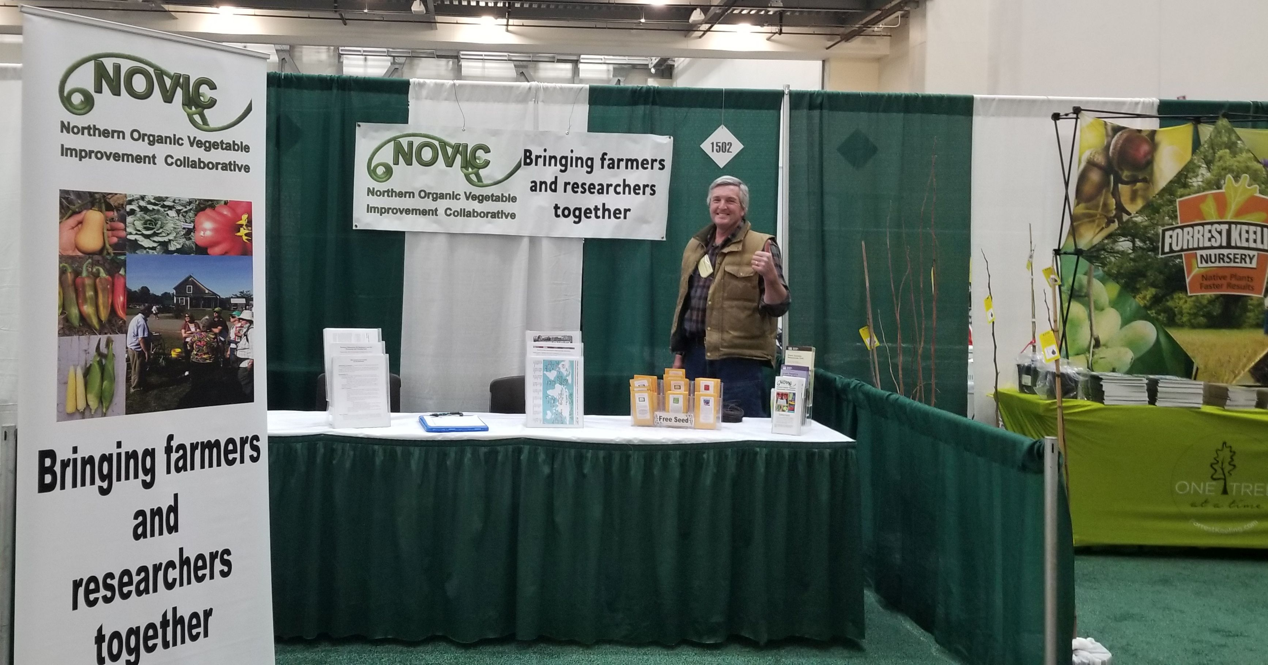
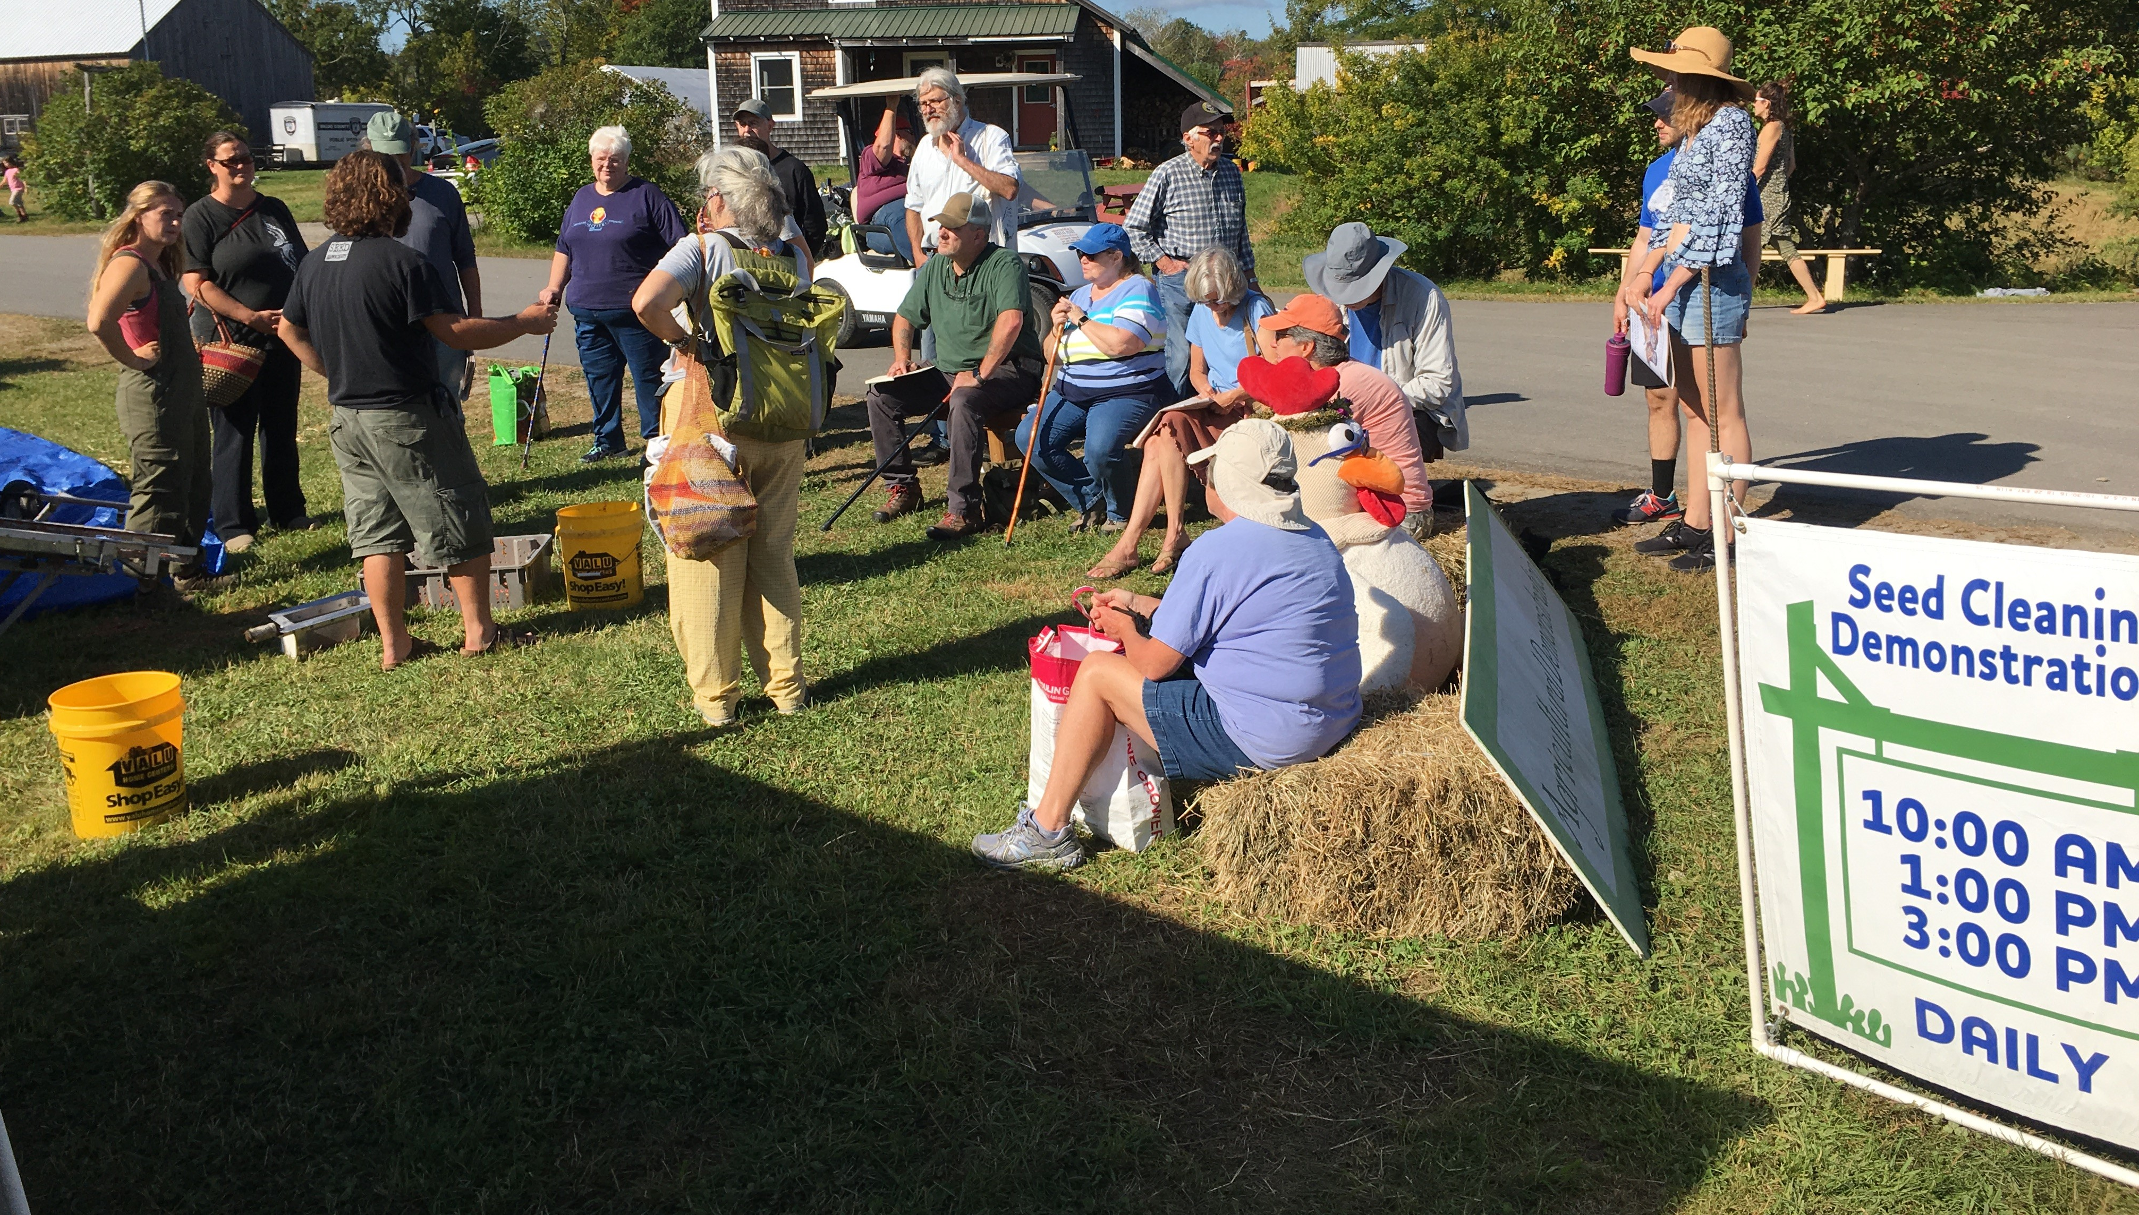
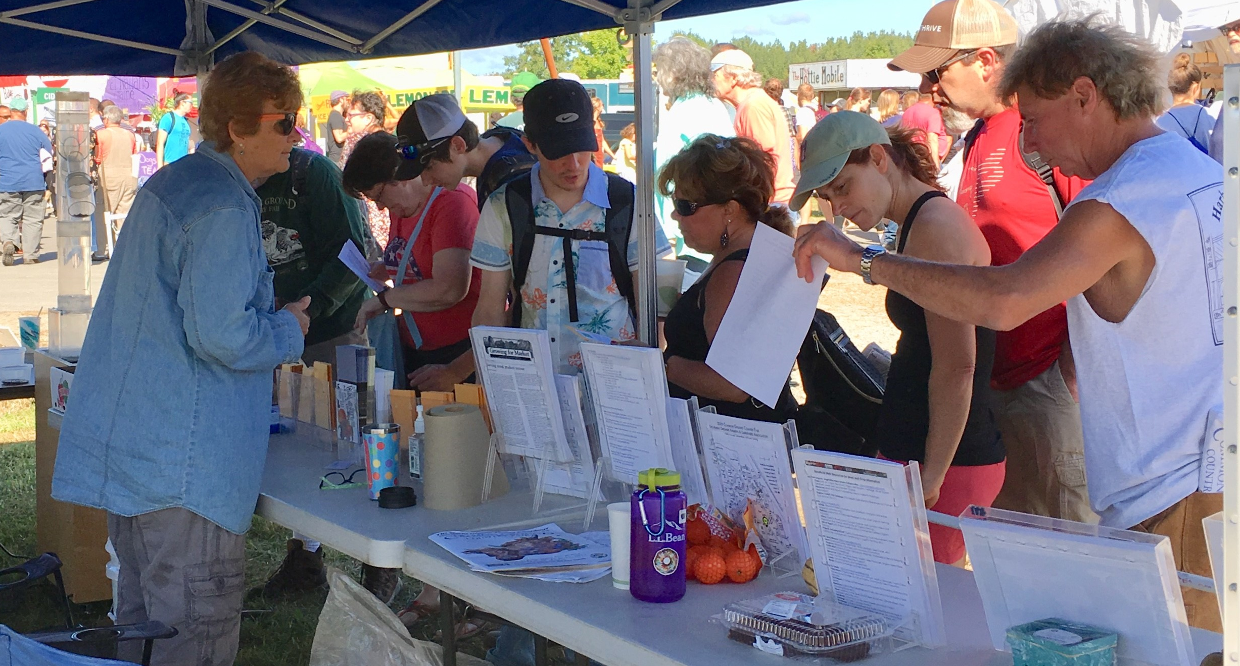
Outreach, NOVIC3
Sept. 21, 2019 Cornell Univ PLBR 4060 tour 35 students from Science & Society: Stories of (Agri)Culture class, and Alliance for Science group from International Programs CALS. Distributed seed of tomato, pepper, squash, sweet corn, handouts origins of crops, seed saving, NOVIC brochures Sept. 20-22, 2019 Common Ground Country Fair, Unity, ME tomato, squash, snap peas, cucumber seed, ~60,000 attendees, >635 visitors to our booth, demos on wet and dry seed processing, handouts including NOVIC brochures, seed saving techniques, equipment, organic web resources Nov. 7, 2019 Cornell Univ PLSCS 3170 Seed Science and Technology biennial field trip 7 undergraduate students – NOVIC brochures, seed saving literature, crop origins maps, vegetable seed samples Dec. 10-12, 2019 Great Lakes Expo, Grand Rapids, MI >4,000 attendees, distributed vegetable seed samples and handouts including NOVIC brochures, seed saving techniques, equipment, organic web resources Jan. 17-19, 2020 NOFA-NY, Syracuse, NY 800 registrants, distributed vegetable seed samples and handouts including NOVIC brochures, seed saving techniques, equipment, organic web resources Feb. 13-15, 2020, Ohio Ecological Food and Farm Association, Dayton, OH >1,100 attendees distributed vegetable seed samples and handouts including NOVIC brochures, seed saving techniques, equipment, organic web resources
Great Lakes Expo, MI
Common Ground Fair, ME

