Slide 1
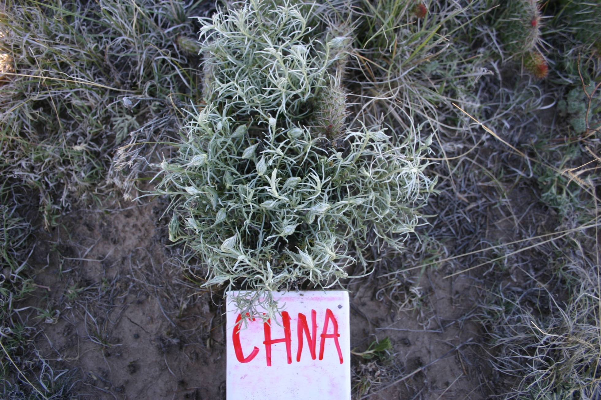
SHRUBS
Ericameria nauseosus ERNA
rubber rabbitbrush
ERNA

Slide 2
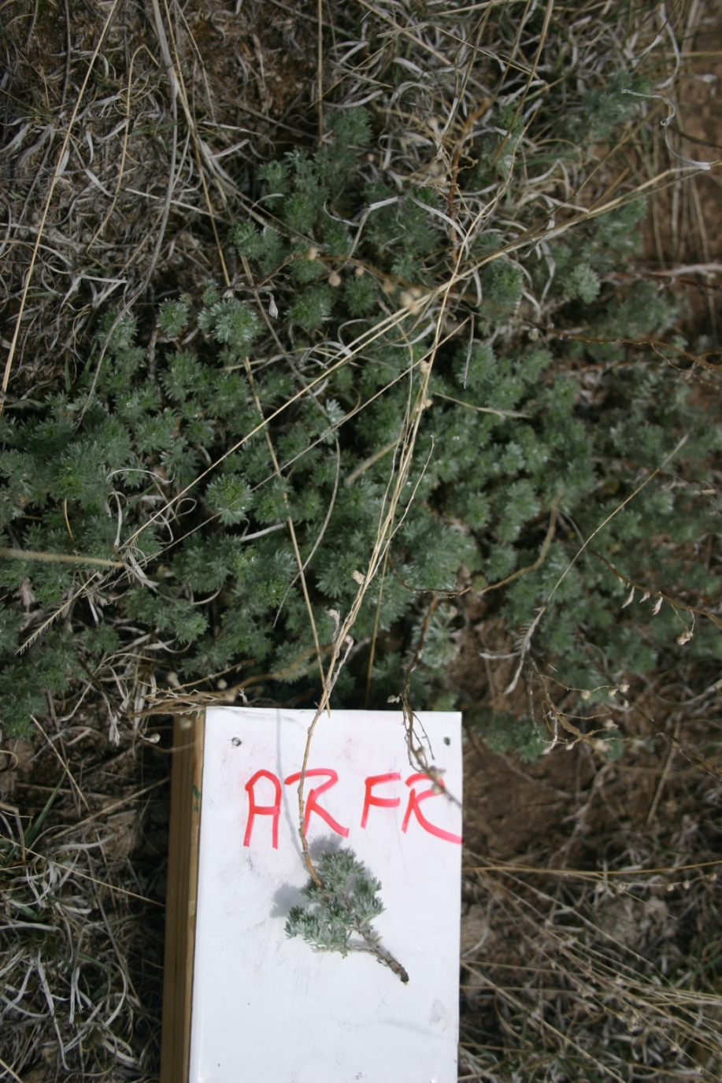
SUBSHRUBS
Artimisia frigida
fringed sagewort
Notes:
Sage smell

Slide 3
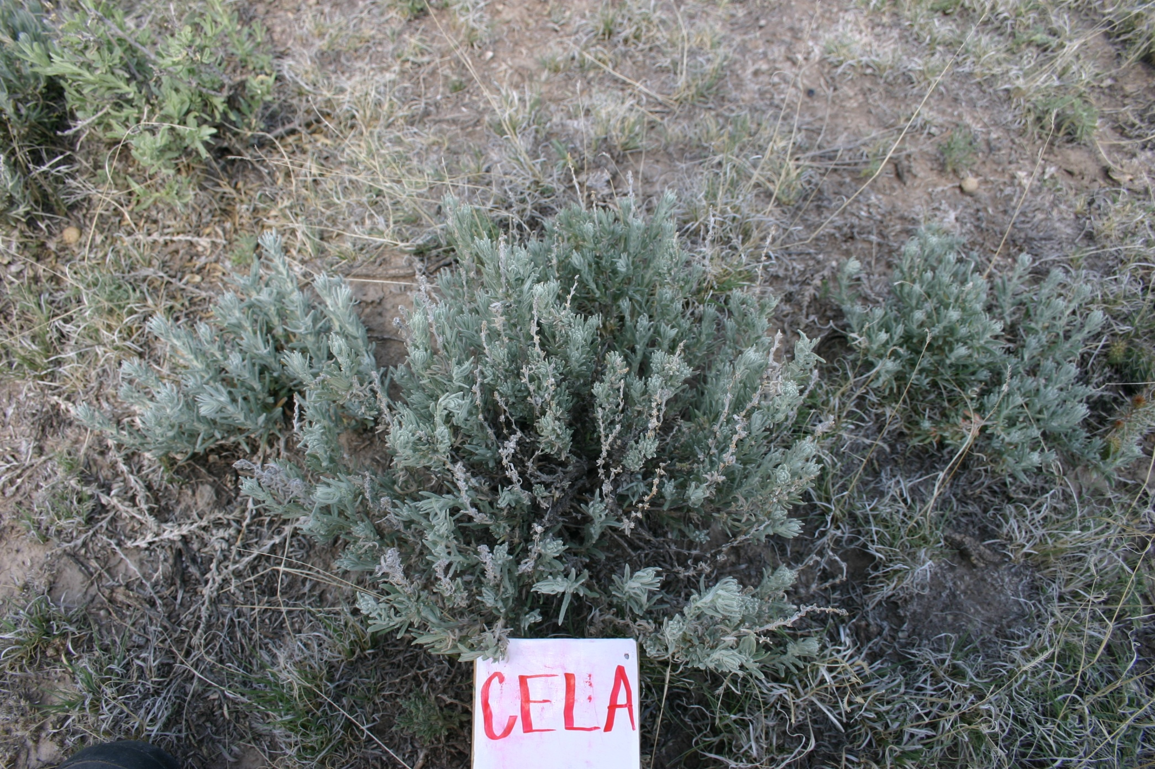
SUBSHRUBS
Krascheninnikovia lanata
common winter fat
KRLA

Slide 4
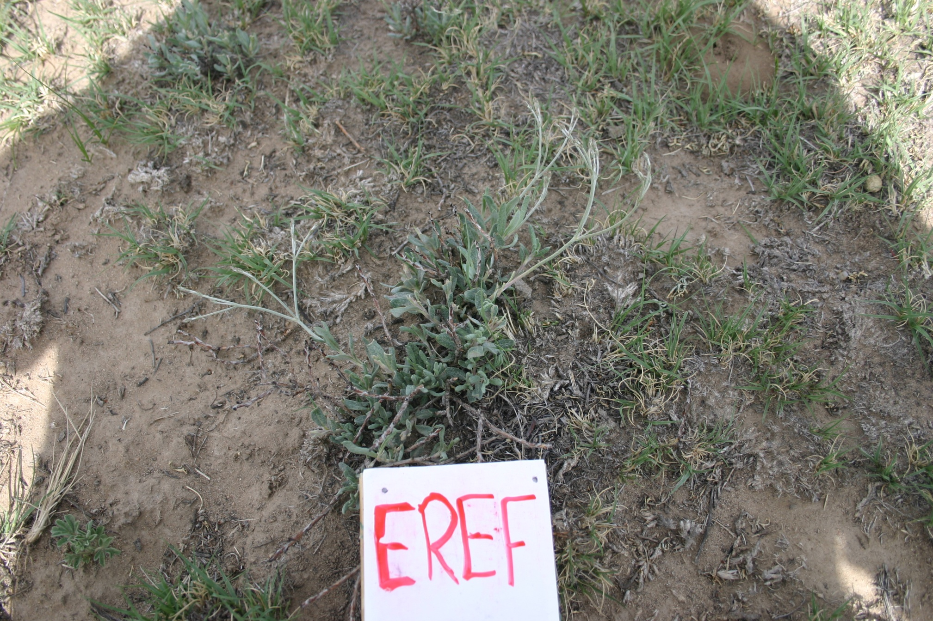
SUBSHRUBS
Eriogonum effusum
spreading buckwheat
Notes:
Stems will turn red

Slide 5
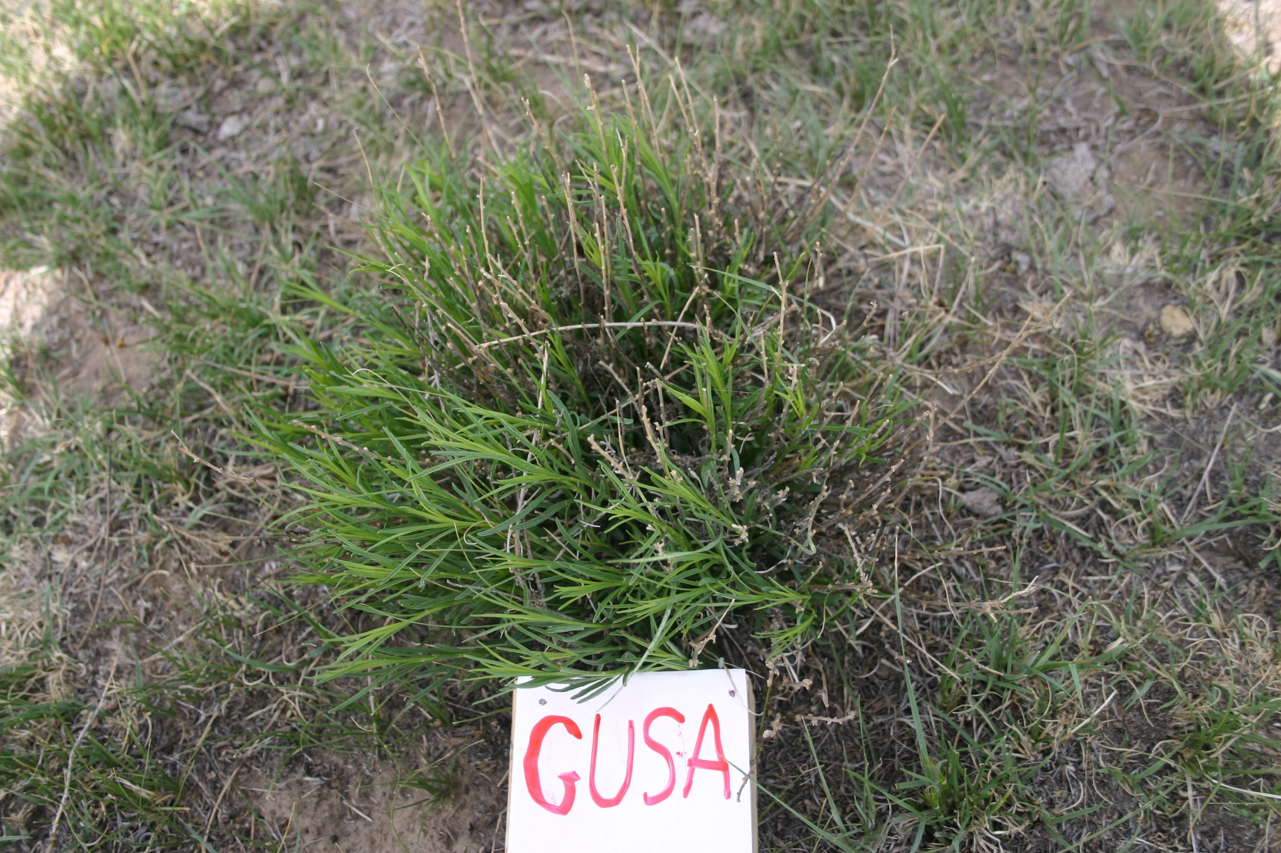
SUBSHRUBS
Gutierrezia sarathrae
broom snakeweed

Slide 6
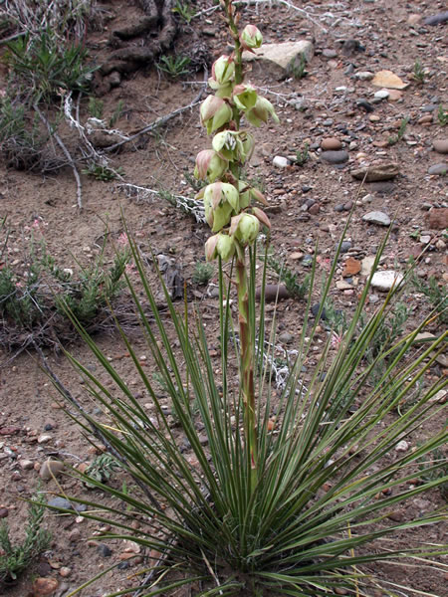
SHRUBS
Yucca glauca
small soapweed
ARFI
Notes:
Only found in one pasture at CPER (20SE?)

