Slide 1
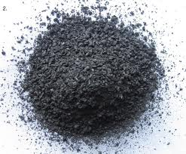
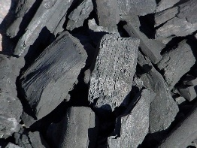


Biochar: Overcoming Historical Hurdles
Kurt A. Spokas
Research Soil Scientist
United State Department of Agriculture – Agricultural Research Service St. Paul, MN USA
ISMOM 15 - Soil Interfaces For Sustainable Development (July 5-10, 2015)
McGill University Montreal, Canada

Slide 2

Google ScholarTM
Biochar “Explosion”
* Number of returned items within each year from Google ScholarTM search. Not solely peer-reviewed manuscripts.

Slide 3
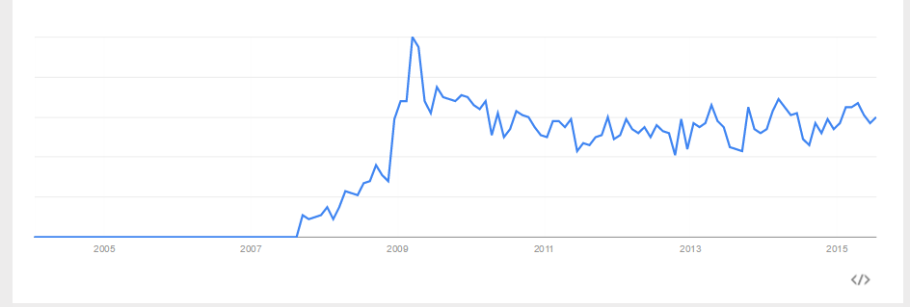
GoogleTM
Search Volume
Relative Search Volume
2005 2007 2009 2011 2013 2015
* Number of returned items within each year from Google ScholarTM search. Not solely peer-reviewed manuscripts.

Slide 4
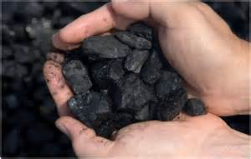


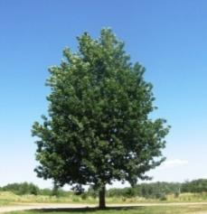
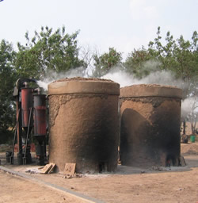
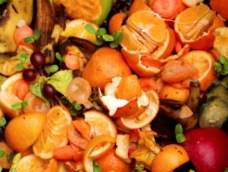
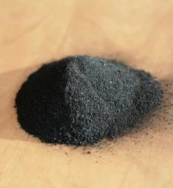
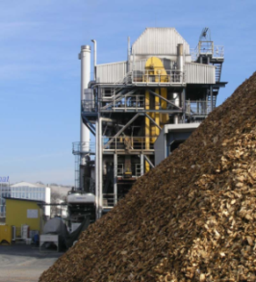
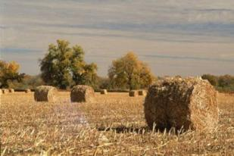
Biochar Definition
Biochar is black carbon that is produced for
carbon sequestration
Pyrolysis
Biomass Materials
Recalcitrant carbon form
(black carbon)
(>50 to 1,000,000 yrs?)
Easily degradable
(0-5 yrs)

Slide 5


“Biochar” History
-- One of the materials with the longest history of scientific research….
"Those who don't know history are destined to repeat it.“
-E. Burke

Slide 6
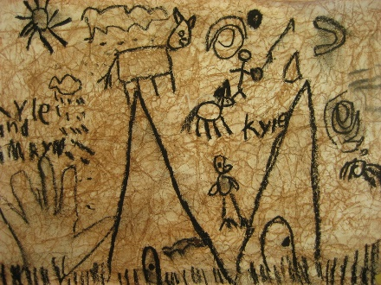
Biochar
Use in Ancient Civilizations
Charcoal Cave Drawings
~30,000 BC

Slide 7
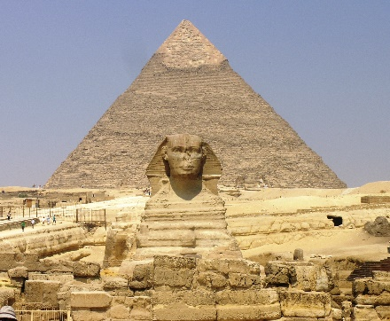
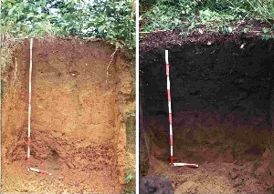
Biochar
Use in Ancient Civilizations
Charcoal Cave Drawings
~30,000 BC
Egyptians -
Embalming
antimicrobial properties of wood vinegar
Potential soil improver (?)

Slide 8
Biochar
Use in Ancient Civilizations
Charcoal Cave Drawings
~30,000 BC
Egyptians -
Embalming
antimicrobial properties of wood vinegar
Fuel/Energy -
3000-4000 BC
Water Filtration -
3000-4000 BC

Slide 9

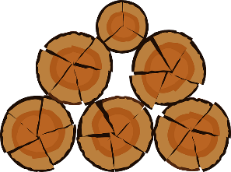
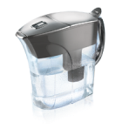
Ancient Civilizations
Charcoal Cave Drawings
~30,000 BC
Pencils
Egyptians -
Embalming
Potential soil improver
Chemical Source
Bioenergy
Fuel/Energy -
3000-4000 BC
But still in use today….
Charcoal production
(15th century)
Water Filtration -
3000-4000 BC
Activated charcoal filtration

Slide 10
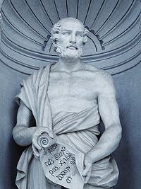
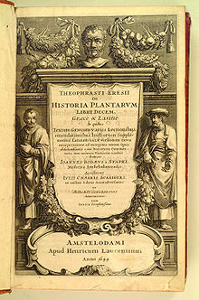
Ancient Greeks
Theophrastus – “Enquiry into plants”
~ 350-290 BC
Charcoal primarily for energy and silver mining :
“Worst woods mentioned in the oak, since it contains most mineral matter (ash) and the wood of older trees is inferior to younger trees, and for the same reason charcoal from really old trees is especially bad.”
Good charcoal source –
  “…if the wood contains a large amount of moisture after drying..”
Pigment for pottery; metal working; and energy – no direct mention of soils

Slide 11
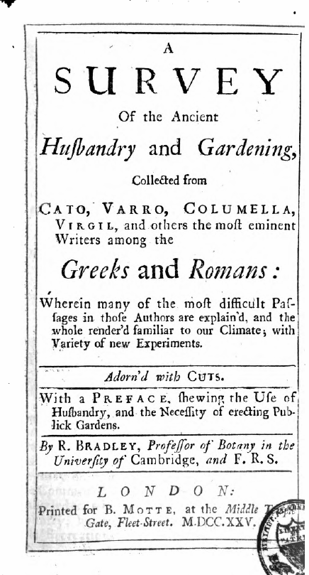
Ancient Romans
Direct mention of agricultural use.
In burned vegetables “…there are abundance of the salts of vegetables, so they must greatly contribute to enrich the land”
Major use to “open stiff lands”
However,
  1. “Keeping such mixtures wet”
  2. “Must be used sparingly”
    3. “Only sprinkled on the ground just prior to harrow”
“A Survey Of The Ancient Husbandry And Gardening, Collected From Cato, Varro, Columella, Virgil, And Others The Most Eminent Writers Among The Greeks And Romans” (Bradley, 1725)

Slide 12
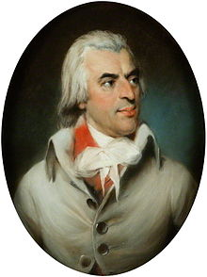
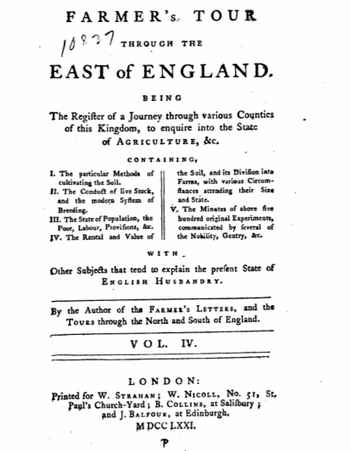
Arthur Young (1770)
Applied:
    Coal ash
    Charcoal
    Peat ash
    Bone char
Occasional yield improvements
Conclusions mirrored hypotheses of the ancient Roman philosophers –
Composed of plant nutrients = must be good for plants
Young, A. (1771). The farmer's tour through the east of England: being the register of a journey through various counties of this kingdom, to enquire into the state of agriculture, &c. containing, I. The particular methods of cultivating the soil; II. The conduct of live stock, and the modern system of breeding; III. The state of the population, the poor, labour, provisions, &c.; IV. The rental and value of the soil, and its division into farms, with various circumstances attending their size and state; V. The minutes of ... (Vol. 4). Printed for W. Strahan.

Slide 13
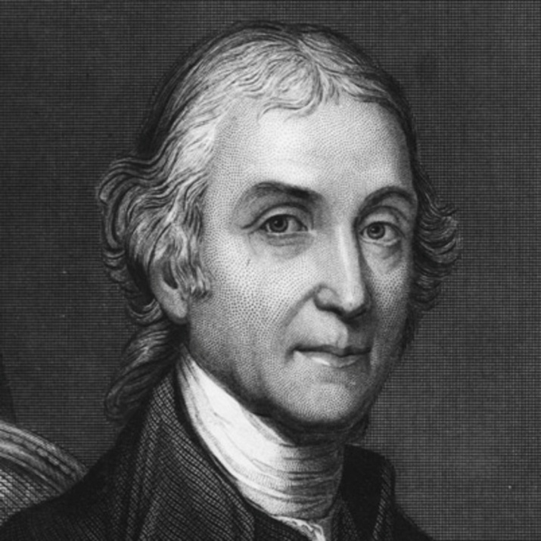
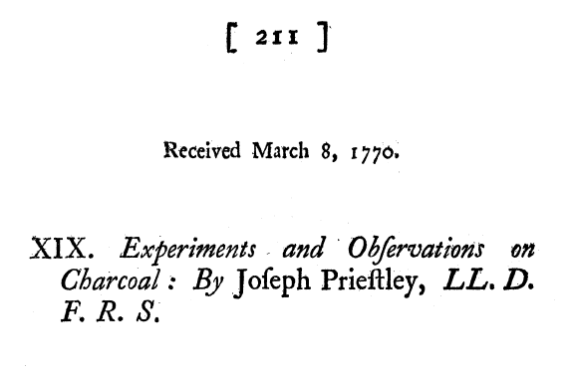
1700’s
Scientific research still in its infancy
Joseph Priestley
Properties of charcoal, primarily focused on electrical conductivity and gunpowder production
Electrical properties of charcoal
  Significant differences in electrical conductivity between similar pieces of wood charred within the same batch
  Alters REDOX conditions
    (although not known yet)

Slide 14
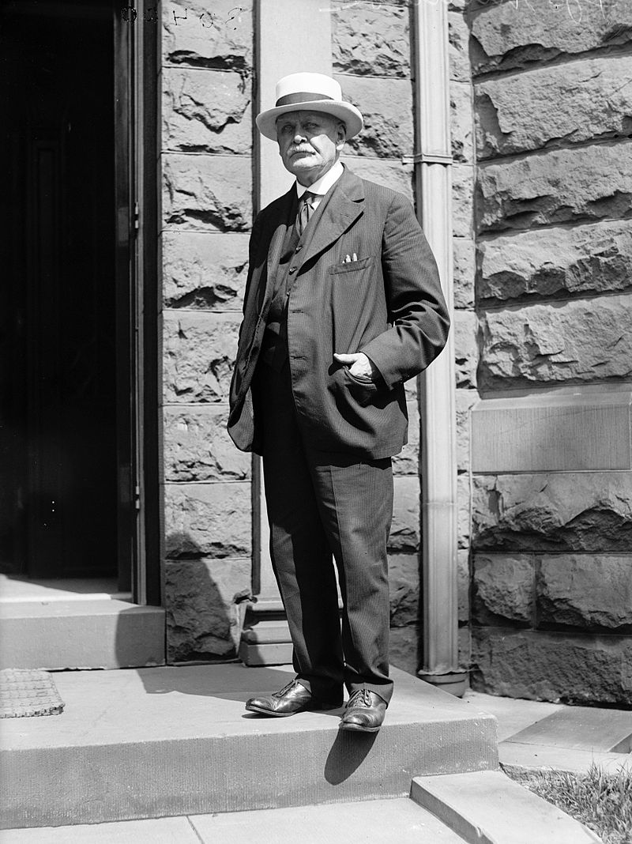
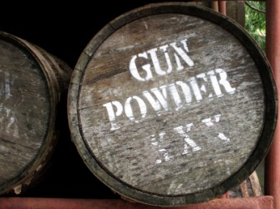
Biochar Research – Modern History
1800
1900
2000
Gunpowder Years (1810 – 1920’s)
  Charles E Munroe (1885)
  "Gunpowder is such a nervous and sensitive spirit, that in almost every process of manufacture; it changes under our hands as the weather changes.“
Overall gunpowder reaction:
6 KNO₃ + C₇H₄O —> 3 K₂CO₃ + CO₂ + 6 CO + 2 H₂O + 2 N₂
Nitrate
Charcoal

Slide 15
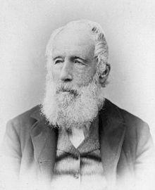
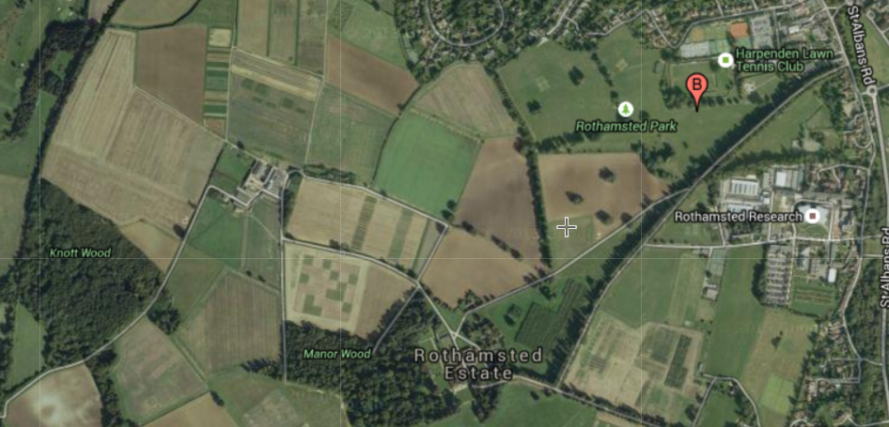
1800’s
Scientific research still in its infancy
Artificial manures for agriculture:
  Sir John Lawes
  “Father of inorganic fertilizer industry”
  Rothamsted Ag Research Plots in the UK
  One treatment examined was charcoal
Peat charcoal (unknown application rate) increased turnip yields, compared to the control plots
Google Earth View

Slide 16

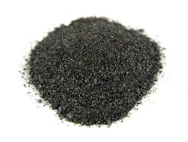
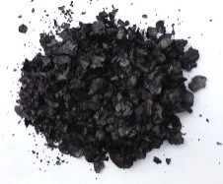
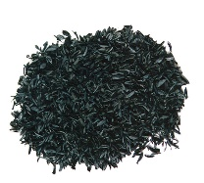
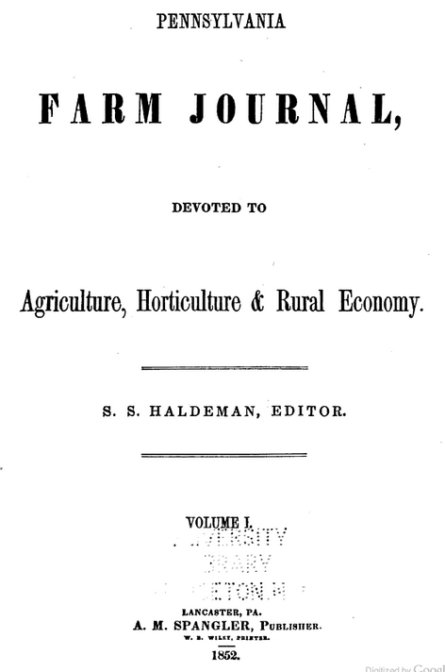
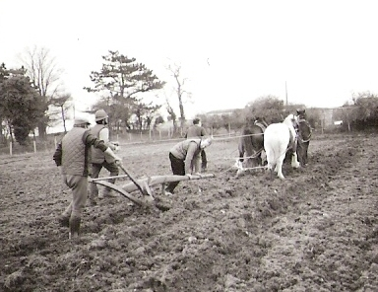
“The use of charcoal (biochar) as a fertilizer is not a new thing, but only in the last few years that agriculturists have taken notice of it.”
Editorial in the 1St volume of the
Pennsylvania Farm Journal
(Haldeman, 1852)

Slide 17
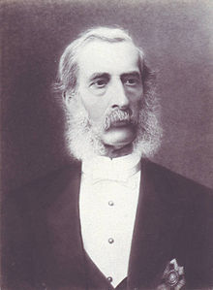
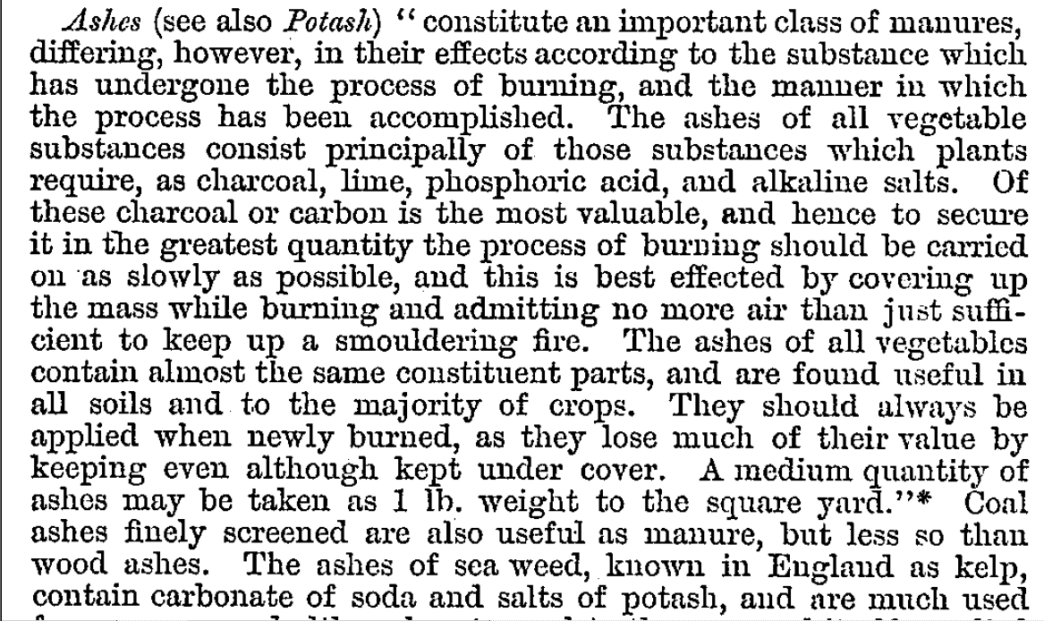
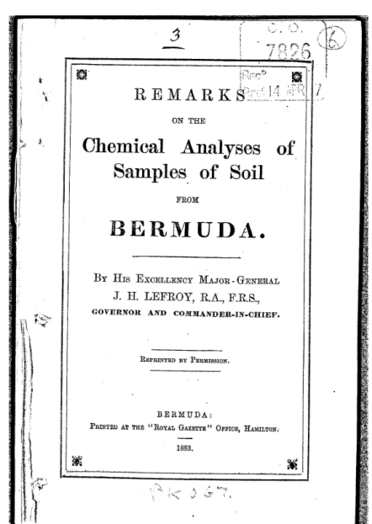
Sir John Henry LeFroy
1 lb per sq yd = 5000 lb/ac
(5500 kg/ha)
(LeFroy, 1883)

Slide 18
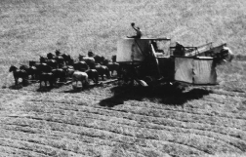
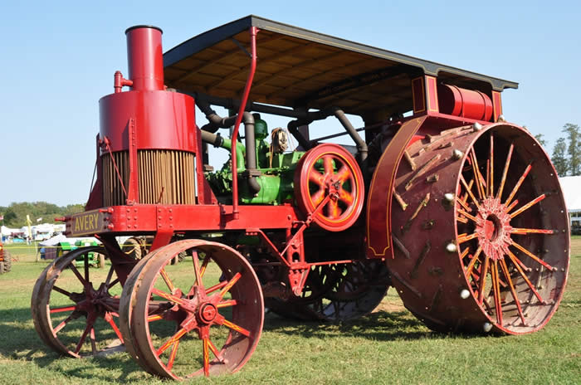
Documented Uses
  Improving yields (peat charcoal)
    Oats – 2-fold increases reported
    Grasses - improved growth & color
    Potatoes – Improved yield 2-fold
    Corn – near doubling of yield
  Increasing soil temperature
    Earlier crop germination/emergence (1730)
  Charcoal mixed with manures
    “Improved fertilization action” (1834)
  Reducing plant pathogens
    Particularly for potatoes, peach trees
    “One handful of charcoal with each seed” (1834)
  US Patents in the 1850’s for
  “Antiseptic fertilizer”

Slide 19
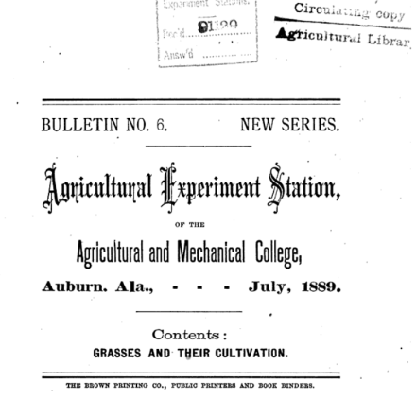
“If compost or stable manure is applied it is best with charcoal” -- “hold nutrients (ammonia) until plant needs it…” (p. 151)
Additional reports during this time period of the need for additional fertilizer to be applied with charcoal
  “Nutrient Bandit” ?

Slide 20
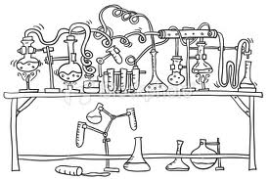
Biochar Research History
1800
1900
2000
1900’s:
  Discovery of charcoal activation
    > Steam activation (Ostreijko, 1900)
    > Chemical activation (Bayer, 1915)
    Took over 4000 years from discovery of sorption processes by charcoal before optimization.

Slide 21
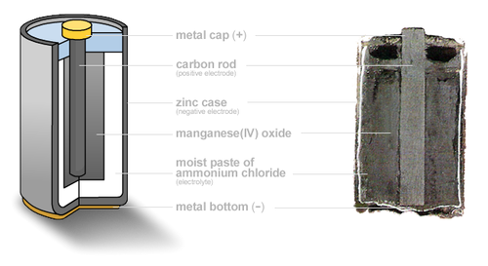
Biochar Research History
1800
1900
2000
1900’s:
  Carl Gassner –
  Development of dry cell battery –
  catalyst for metal cations: Zn, Fe, Al,…

Slide 22
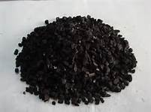
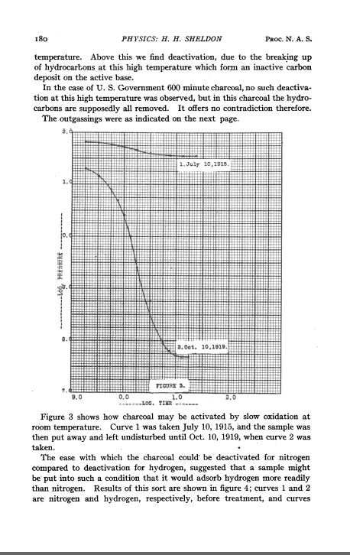
1920
- Surface modification of charcoal
- Ambient conditions
Water vapor (humidity)
  - Three fold increase in N₂ sorption
      4 yrs of laboratory storage (Sheldon, 1920)
    - Linked to increase in surface carboxyl acid groups
Charcoal’s adsorption behavior is a function of how charcoal is stored, treated and conditioned (activation) (Rideal and Wright, 1925; Adams et al., 1988)

Slide 23
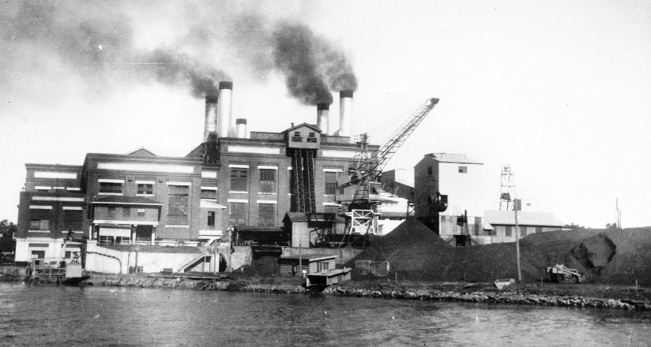
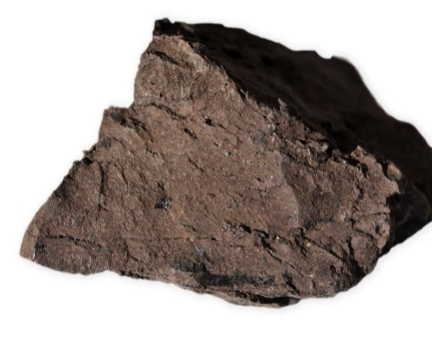
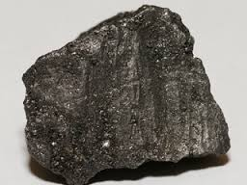
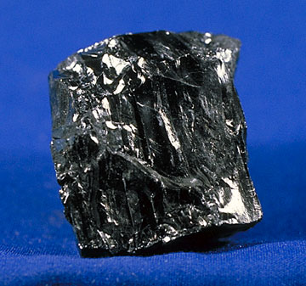
Coal
  Coal was promoted as an agricultural fertilizer (Lieske 1929, 1931)
  Due to the stimulation of fungi and bacteria
  High volatile matter (VM) coals
Stimulate microbial activity more than low VM coals
“Peat is better than graphite”
  Continues into present →
  ArcTech (Virigina; USA)
  Actosol® Humic Acid Fertilizer
  (extracted from coal)

Slide 24

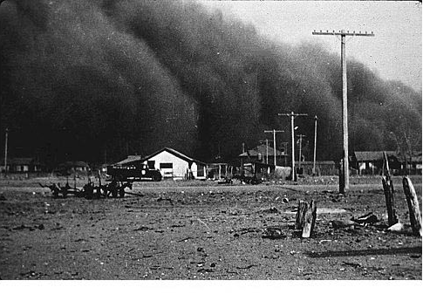
Lieske (1930’s)
  Due to the stimulation of fungi and bacteria
  Coal was promoted as an agricultural fertilizer (Lieske 1929, 1931)
  High volatile matter (VM) coals
Stimulate microbial activity more than low VM coals
Peat is better than graphite
  Great Depression
  – Why apply coal when you can’t even afford food ?

Slide 25
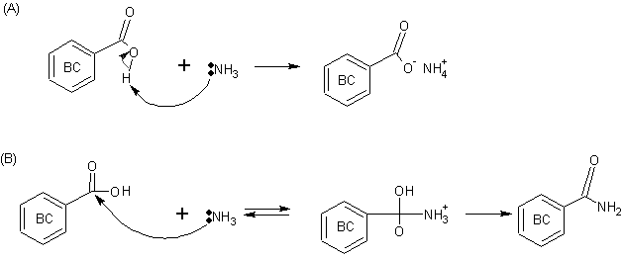
Biochar Research History
1800
1900
2000
1920-1950’s
  Focus on use of charcoal in analytical methodology
    Observed disappearance of N-forms (interference)
      [e.g., Harper 1924; Burrell and Phillips 1925; Gibson and Nutman 1960; Scholl et al. 1974]

Slide 26

Biochar Research History
1800
1900
2000
1920-1950’s
  Focus on use of charcoal in analytical methodology
    Observed disappearance of N-forms (interference)
      [e.g., Harper 1924; Burrell and Phillips 1925; Gibson and Nutman 1960; Scholl et al. 1974]
“Nutrient Bandit”

Slide 27
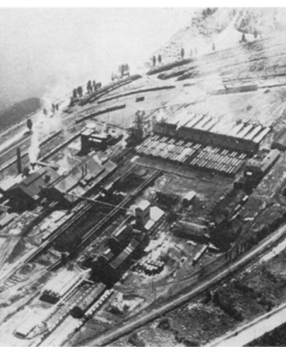
Used biomass for energy and chemical needs (1800-1920)
Wood Distillation Plants
Smil, Vaclav. Energies: An Illustrated Guide to the Biosphere and Civilization. The MIT Press: Cambridge, MA, 1999

Slide 28
Microbial Degradation of Biochar
Over a 100 year history of research
  Potter (1908)
    Initial observation of fungi degradation of lignite coal
  Galle (1910)
    First isolated pure cultures of bacteria that degrade coal

Slide 29
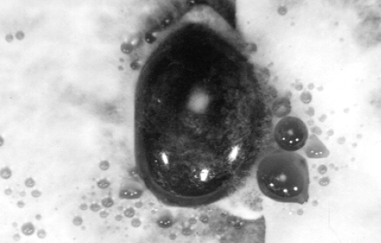
Fakoussa (1981)
  “Liquefaction” of coal by microbes
    Formation of colored liquids
Cohen and Gabriele (1982)
  Wood-decaying fungi (white-rot and brown-rot) on coal form black liquid droplets

Slide 30
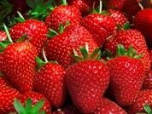

Biochar Research History
1800
1900
2000
1960’s→
Actions of charcoal linked to sorptive properties
  Turner (1955)
    Positive yield improvements due to sorption of plant “putrids”
  Weatherhead et al. (1978)
    Plant chemical inhibitors (auxin and cytokinin) sorbed by charcoal
  Majumber et al. (1959)
    Charcoal has insecticidal effects
  Krishnakumari et al. (1962)
    Loss of activity with storage
  Hitz et al. (1953)
    Used activated charcoal for strawberry seedling protection from herbicides

Slide 31





Biochar Research History
1800
1900
2000
1985-Current
– Biochar Renaissance
Wim Sombroek

Slide 32


Historic Hurdles
“On stiff clay soils it will produce an increase of vegetation, but not sufficient to pay the expense of the manure (charcoal).”
Maryland State Agricultural Society (1822) p. 410
Economic of applying charcoal on large scale.

Slide 33

The Cultivator (1849): Improvement of the Soil
“…using charcoal as a fertilizer depends on circumstances.”
“…cost (of charcoal) in many situations is probably too great to admit its profitable use as an ordinary manure.”

Slide 34
“Peat charcoal alone does not appear to be of value as a manure commensurate with its cost, and it will be necessary to reduce the cost of the manufacture of this article very considerably, before any extensive applications of it..”
Durden, E.H. (1849)

Slide 35


“Peat charcoal alone does not appear to be of value as a manure commensurate with its cost, and it will be necessary to reduce the cost of the manufacture of this article very considerably, before any extensive applications of it..”
Durden, E.H. (1849)

Slide 36


What has changed?
1849
Farmers ≈69% of labor force
1 farmer supports 2 people
$ 0.75 USD per bushel for corn
Today
Farmers <2% of labor force
1 farmer supports >100 people
$4.28 USD per bushel for corn
$188.88 USD metric ton [04Jul2015]
$1.00 in 1914 had the same buying power as $22.57 in 2012 [$16.92 /bu]

Slide 37



































Biochar Industry
The use of trade, firm, or corporation names in this presentation is for the information and convenience of the reader. Such use does not constitute an official endorsement or approval by the United States Department of Agriculture or the Agricultural Research Service of any product or service to the exclusion of others that may be suitable.

Slide 38



We are at a point where the pendulum is swinging away from fossil fuels and back to biomass as our source of energy
1800’s – 1900’s
2000’s →
1900 – 2000’s
Wood Distillation
(pyrolysis)
Ag. Residues (?)
Fossil Fuels

Slide 39




We need to understand biochar’s mechanisms to fully utilize the chemical, physical, and microbial properties of biochar to obtain the anticipated function.
  In other words, to optimize for a particular use or “designer biochar”(Novak, 2009)

Slide 40

Observation:
Eyes can be fooled.

Slide 41


Acknowledgements
Technician
Martin duSaire
Visiting Post-docs
Xiurong Lin (China)
Tae Jun Lim (S. Korea)
Beatriz Gámiz (Spain)
Students
Eric Nooker
Ed Colosky
Laura Colosky
Rena Weis
Lee Yang
Kate Hall
Visiting Students from Brazil
Risely Ferraz Almeida
Rose L.M. Tavares
Andres Thomazini
Elton Blancho

Slide 42


James Bradley – Sustainable Harvesting
..where they have grub’d up the woods, and sown wheat; but I cannot help at every opportunity, when I have occasion to mention the cutting down of woods, to reminder the reader, to take care at the same time, to plant when he cuts down; for without, I am sure England will soon be out of stock of timber.
“A Survey Of The Ancient Husbandry And Gardening, Collected From Cato, Varro, Columella, Virgil, And Others The Most Eminent Writers Among The Greeks And Romans” (Bradley, 1725)

