Slide 1
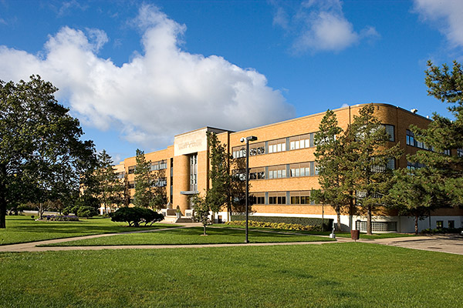
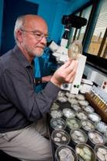
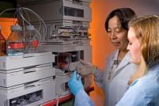
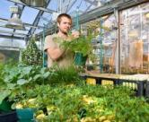
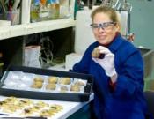
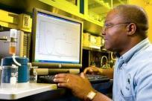
Where Innovation
Is
Nothing New
ARS – Affecting our Lives Outside of 8-5
Where Innovation is Nothing New

Slide 2
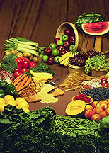
“The Agricultural Research Service of the USDA has been one of our greatest sources of assistance and has unfailingly and generously answered all sorts of technical questions from food to plastic bowls.”
Mastering the Art of French Cooking. Julia Child, et.al.

Slide 3
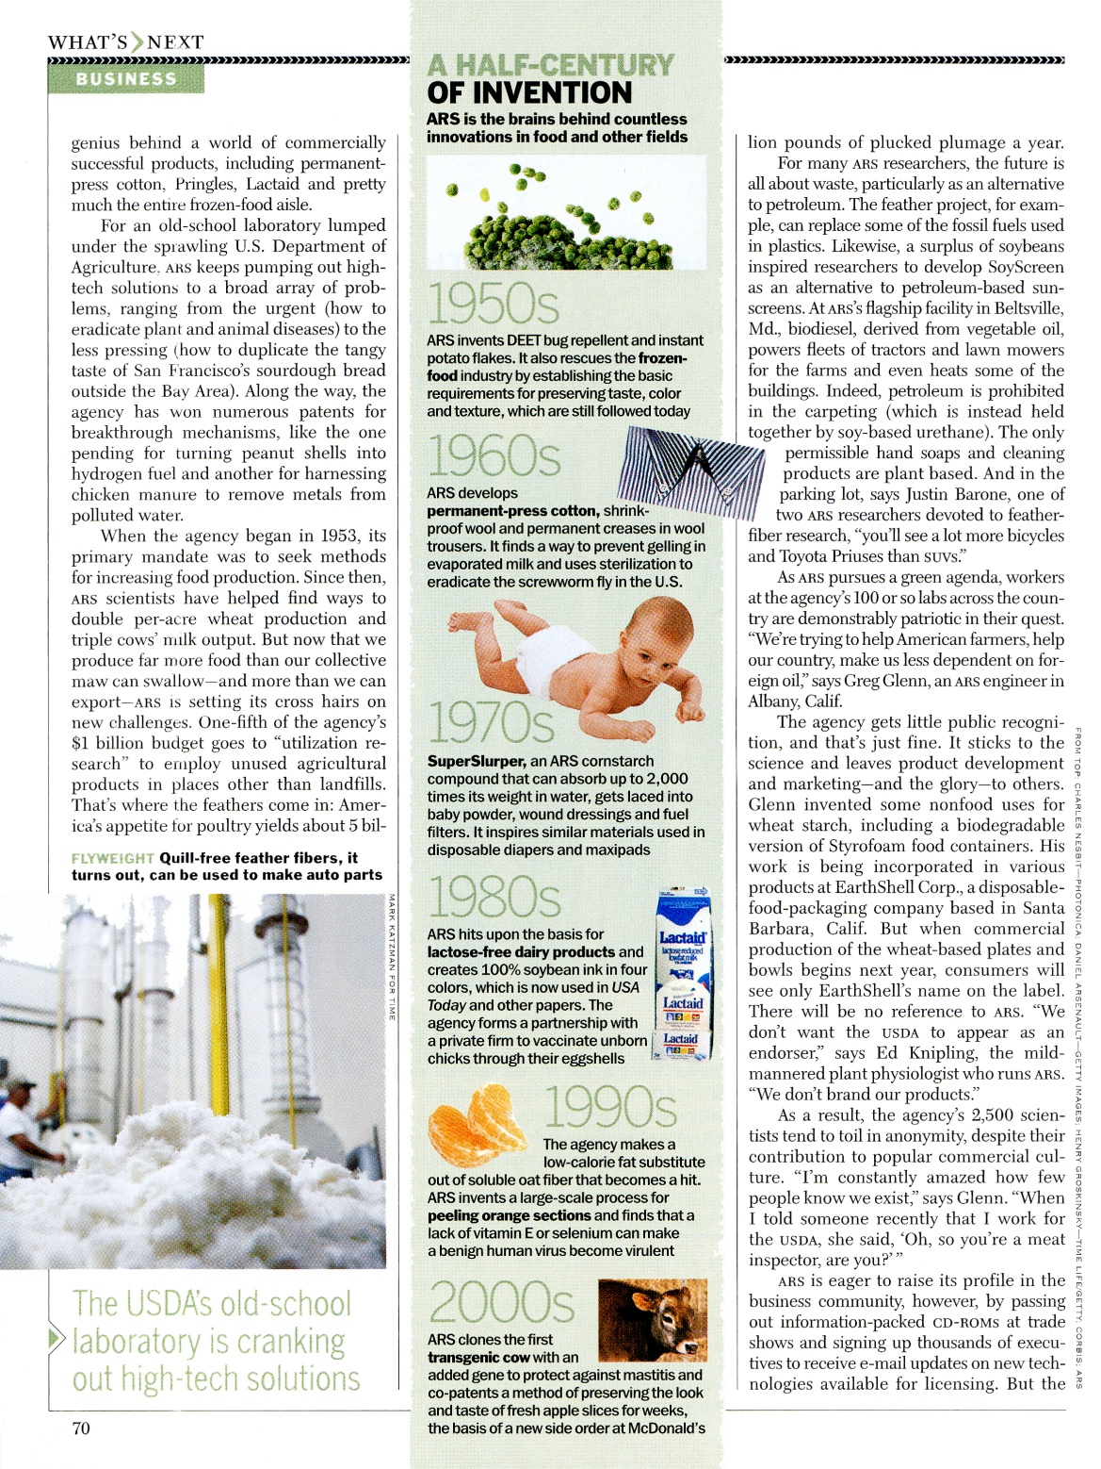
“…one of the most wide-ranging and innovative laboratories anywhere on the planet.”
“…the genius behind a world of commercially successful products, including permanent-press cotton, Pringles, Lactaid and pretty much most of the frozen-food aisle.”
Time Magazine, Oct. 11, 2004
“Where the best ideas take wing”
Notes:
1941 – developed submerged liquid fermentation process for penicillin production
1944 – ARS developed ‘epoxidation’ reactions, which enabled the production of flexible vinyl plastics
1950 – ARS developed commercially-viable process for producing dextrans (from sugar beet pulpand sugar cane). Used to produce synthetic blood plasma for the Korean War
1950 – developed commercially-viable process for making xanthan gum, an edible food thickener made by fermentation
1954 – developed DEET mosquito repellant
1976 – patented SuperSlurper, a co-polymer of starch that absorbs over 100 times its weight in water. Started superabsorbent industry

Slide 4
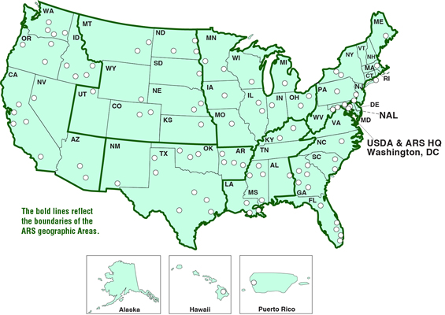

Slide 5
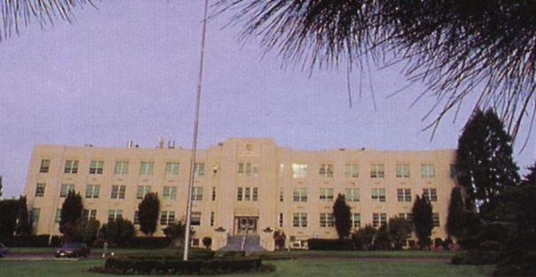
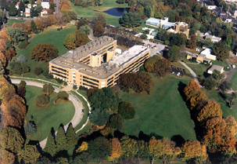
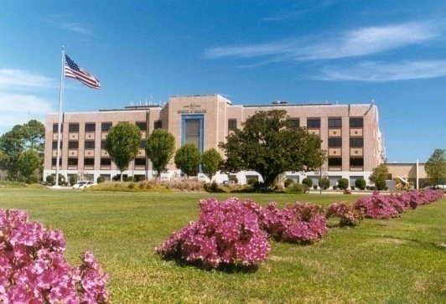
Since 1940 the four regional research centers have provided the major portion of ARS’s capability for research and development of technology to increase the use of agricultural products and thereby enhance the economic viability and competitiveness of U.S. agriculture.
Agricultural Adjustment Act, ‘38
ERRC
WRRC
NCAUR
SRRC

Slide 6
USDA Research Timeline
1862- USDA Created
1869- First analysis of food published – corn
1873 –Navel oranges introduced into California – from Brazil
1902 – First plant methodically bred for disease resistance
1923 – Commercial hybrid seed corn developed
1941 – Mass production of penicillin
1946 – Technique to produce high-quality frozen orange juice
1950 – Dextran and Xanthan gum developed
1953 – ARS created
1954 – Instant potato flakes developed
1955 – Roma tomato released
1962 – Permanent press creases in wool slacks
1965 - Permanent-press cotton textile developed
1976 – Super Slurper developed
1987 – First 100% soy-based ink
1990 – Oatrim fat replacer
1993 – Paper from chicken feathers
2000 – Nutrim soluble oat fiber nutraceutical
2005 – Edible coating to keep sliced apples fresh
2006 – cotton wound dressing for patients with chronic wounds
2012 – Saved the French Quarter from Formosan termites, Hardiness Zone Map

Slide 7
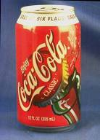
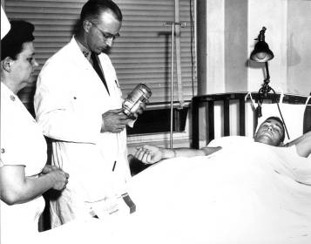
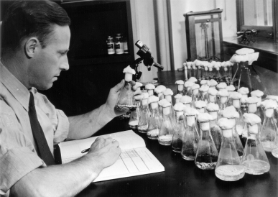

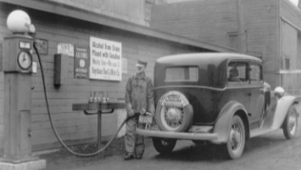
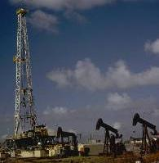
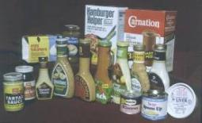
Historical Research Results
HFCS
Penicillin
Dextran
Alcohol Research
Xanthan Gum

Slide 8
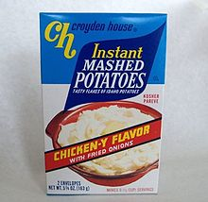
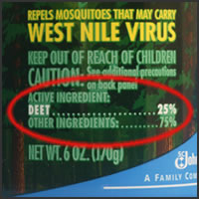
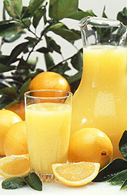
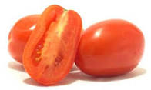
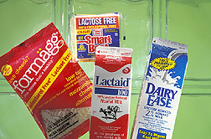
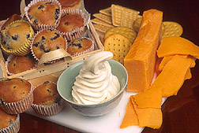
Deet
Frozen Orange Juice
Instant Mashed Potatoes
Low-fat foods-Fantesk
Roma Tomatoes
Lactose-free Milk

Slide 9
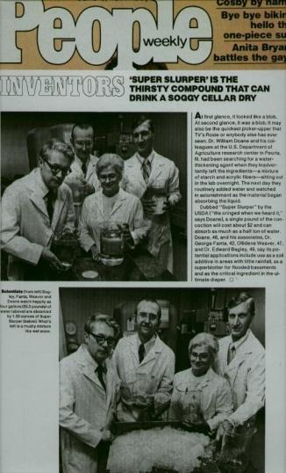
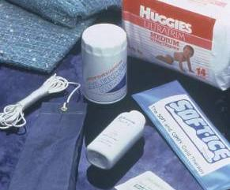
“Super Slurper”
SuperAbsorbent
Material
Starch That Slurps
“Super Slurper”
SuperAbsorbent
Material
Starch is the main constituent of grain flours, and the most plentiful starch is cornstarch. Although most of the products from corn milling go into food and feed, 4.5 billion pounds of starch are annually produced, largely for nonfood purposes. Of this amount, 3.5 billion pounds are used in the paperboard, paper, and related industries, where starch serves both as an adhesive and a coating.
And new uses for cornstarch continue to surprise us. For example, when ARS scientists married starch to a synthetic chemical, they managed to create a product so thirsty, it could absorb hundreds of times its own weigh in water.
Someone called it Super Slurper, and the name stuck.
After patents were secured in 1976, Super Slurper started popping up all over the marketplace. The absorbent compound, which can slurp up to 2,000 times its weight in water, is used as an electrical conductor in batteries. You can find it in fuel filters, baby powders, and wound dressings and disposable diapers.

Slide 10
But what have you done for us lately?

Slide 11

Biodegradable Soy-based Hydraulic Fluid
Exclusively licensed to Agrilube/Bunge, 2006
Test with the National Park Service

Slide 12
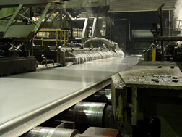
Biobased Metalworking Fluid
In aluminum rolling mill operations like this one, Alcoa, Inc., tested ARS’s
new biobased metalworking
fluid and preferred it to the petroleum-based lubricants. As a result, ARS–developed bio-based fluids are now used routinely at Alcoa’s Reno, NV, mill.

Slide 13
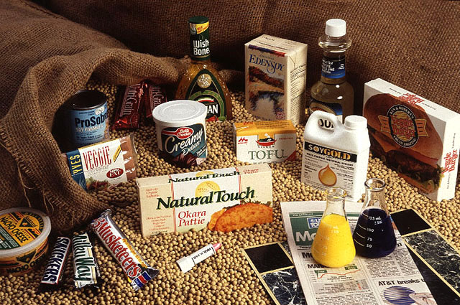
Soybean Oil Based Inks
NCAUR scientists developed a way to make printing inks, previously a petroleum-based product, from 100 percent soy oil which have characteristics that either meet or exceed industry standards for product functionality. Two patents were awarded to ARS for news ink and sheetfed and heatset ink technologies, with licensing having been executed or in process for these technologies.
Notes:
Epoxy resins from sugar, peanut-stuffing for packaging and plastics from cornstarch, 100-percent soybean printing ink, and industrial lubricants from oilseeds all resulted from ARS research.
An example is wheat-starch-based resin for making plastic cutlery. ARS licensed this technology to Midwest Grain of Kansas who produces and sells the resin LCI Industries in Hazelhurst, MS where blind workers mold the final product for U.S. troops.

Slide 14
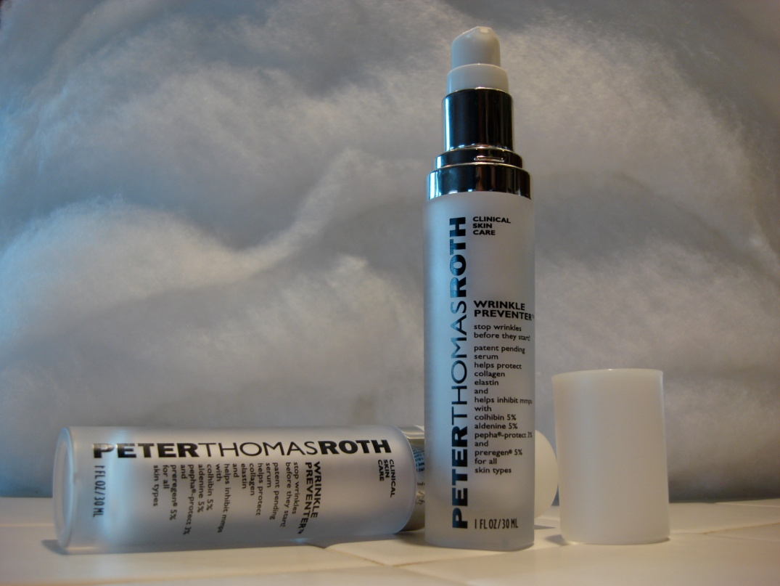
SoyScreen
An all-natural sunscreen and antioxidant for skin and hair care applications. Vegetable oil is enzymatically converted with botanical extracts through a “green” manufacturing process with low ecological impact. Licensed to iSoy Technologies.

Slide 15
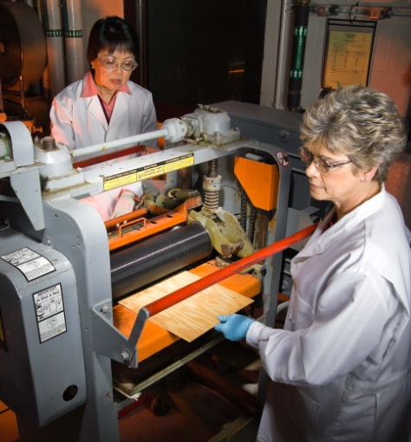
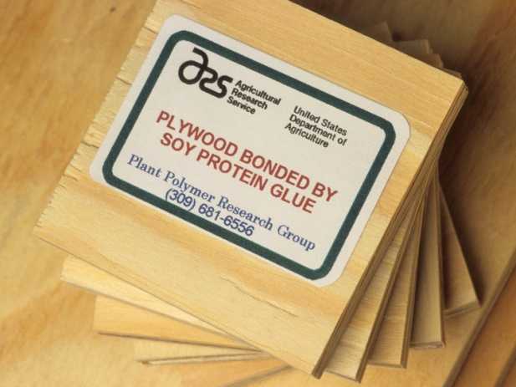
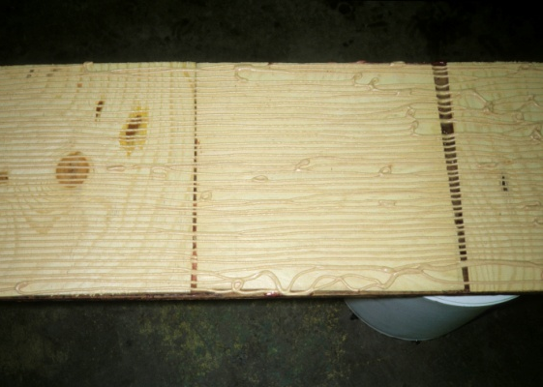
Soybean Protein-Based Plywood Adhesive
A soybean protein-based plywood glue designed for foam extrusion. Soybean flour replaced spray-dried animal blood, the industry’s protein extender, is cheaper than the industry glue but is just as strong and has eliminated health concerns about handling animal blood. Commercially used by Georgia Pacific
Notes:
Health concerns are related to the risk posed by disease pathogens that may be present in animal blood that could adversely affect mill workers.

Slide 16
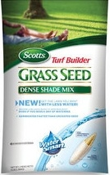
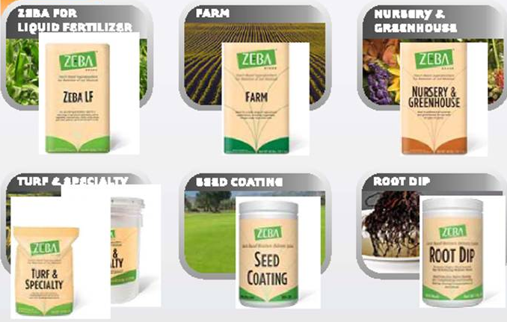
Second Generation Superabsorbent
Based on original superabsorbent technology incorporating new agricultural application and manufacturing methods. Helps growers achieve higher yield and better quality with less water. Absorbent Technologies, Inc. (ATI) has developed its own patents and maintains ongoing relationships with USDA researchers. Zeba products, from ATI, are targeted toward the turf, nursery, and home and garden markets. The technology is also in Scotts products.

Slide 17
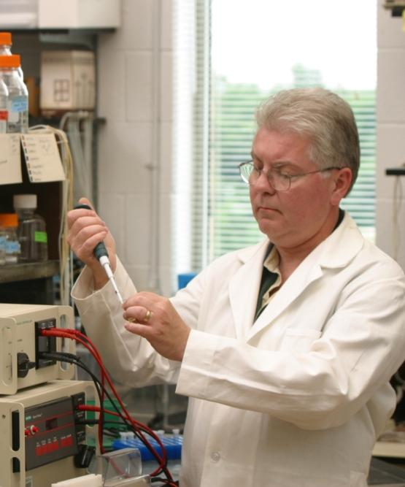
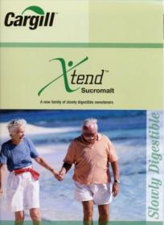
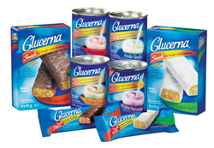
Low Glycemic Index Sweetener
ARS-developed technology for polysaccharide synthesis and enzymatic modification
Cargill developed the commercial product
Provides food and beverage customers a natural and slow release carbohydrate syrup.
Syrup is 70% as sweet as sucrose

Slide 18
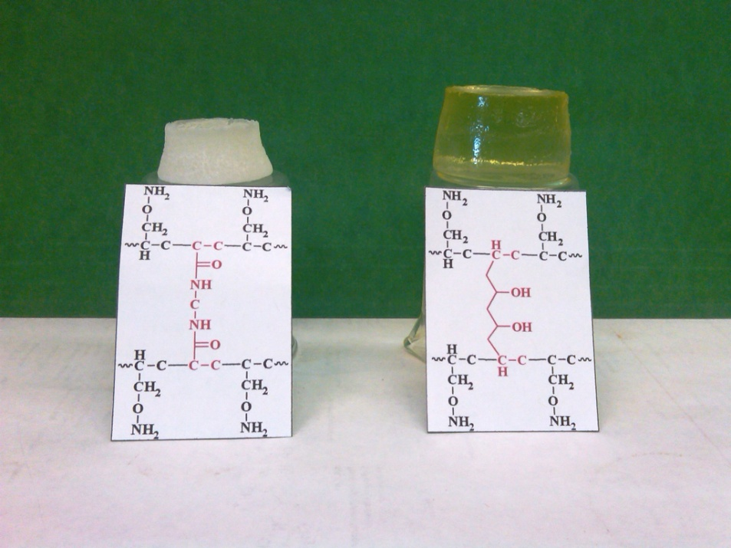
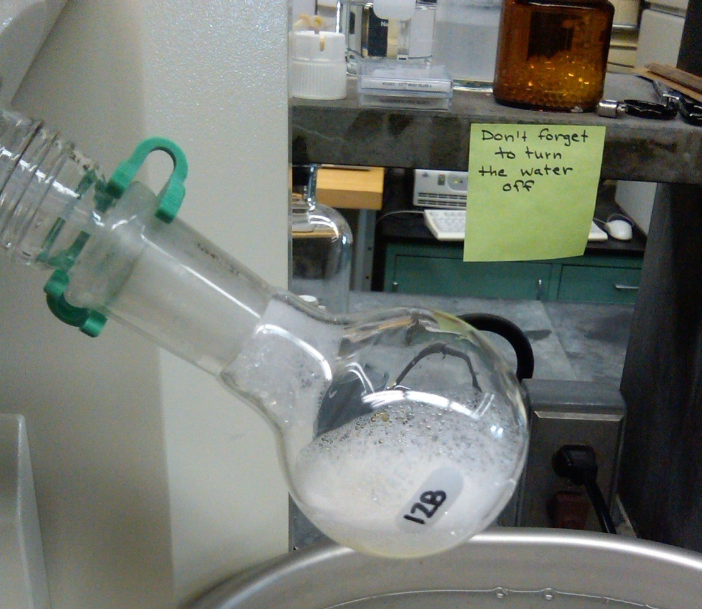
Specialty Chemicals and Monomers
Develop commercially viable biocatalytic and chemical processes that enable the production of specialty chemicals and monomers from agriculture.
Polyacrylic sugar gels
Wound dressing, Contact lenses
Disposable diapers, Antigen biosensors
Sugar-based “green” detergents
Green detergents from sugars and lipid
Tailored properties
Two patents. Interest from Dow.

Slide 19
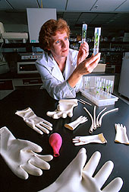
Guayule Latex
Guayule is a rubber-producing southwestern desert shrub. ARS scientists in Albany, CA discovered that guayule latex is hypoallergenic and suitable for the manufacture of high-value and life-saving medical products.

Slide 20
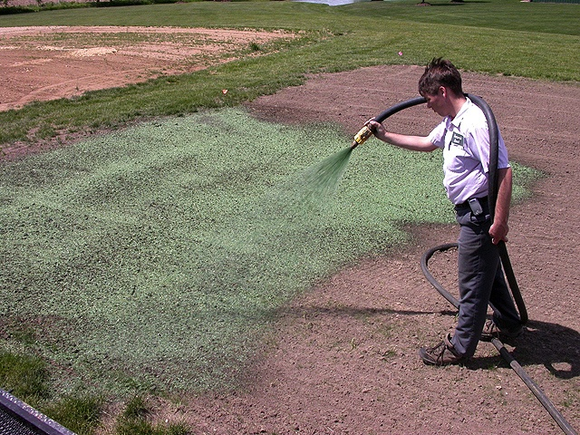
Cotton Gin Hydromulch
ARS researchers at Lubbock, TX, worked with an industrial partner to convert cotton gin byproducts into a high performance hydromulch for the ‘green’ industry. The hydromulch minimizes soil erosion while promoting grass seed establishment and returns revenue to cotton producers and ginners.

Slide 21
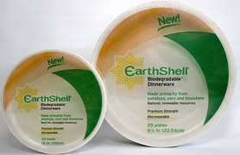
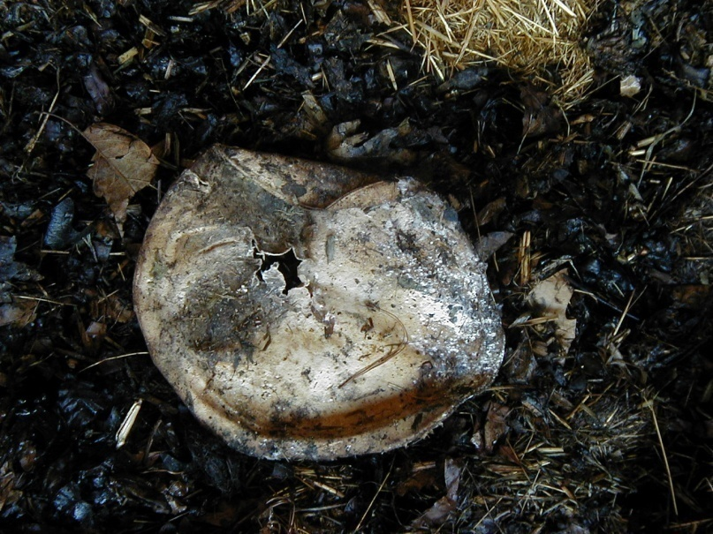
Compostable Food
Service Products
Starch/fiber composite materials made into compostable food service products. Sold in over 900 retail stores. Market potential is $8 billion
Rapid (~35 da): Bowls, cups, plates, trays
Notes:
Starch/fiber composite materials made into compostable food service products. Sold in over 900 retail stores. Market potential is $8 billion

Slide 22

ARS and the 2014 World Cup
Soccer’s elite playing at three Brazilian stadiums during the 2014 FIFA World Cup were running, kicking and sliding across turfgrass developed by ARS scientists in collaboration with University of Georgia colleagues

Slide 23
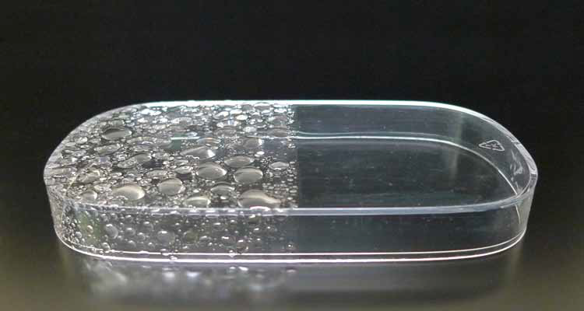
Nanoparticle Coating
Rainwater pounding on the glass windows of an office or a home is less likely to bead up and reduce visibility. Unique because it is “rain-ready” in about 1 minute.

Slide 24
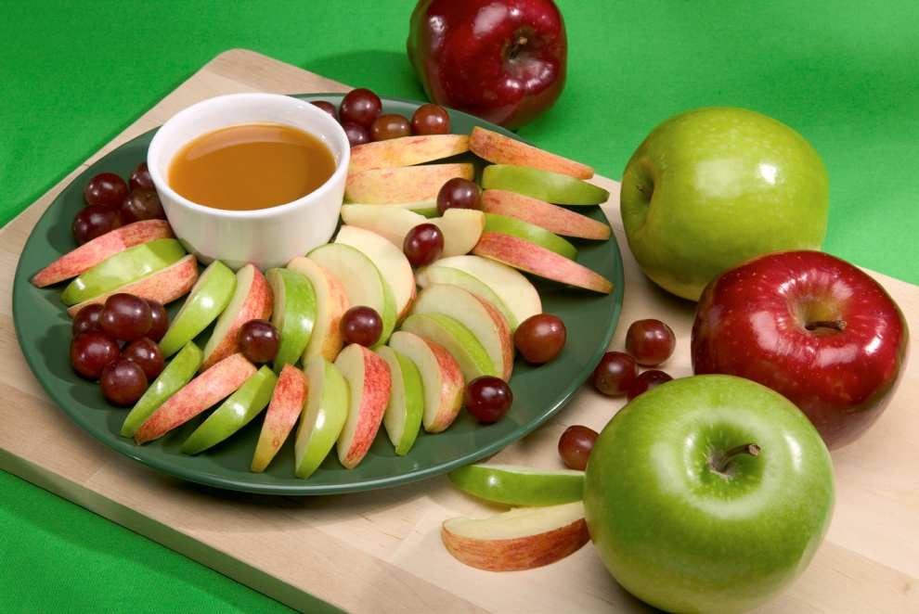
Fresh Cut Fruit Coating
Revolutionized the industry
Helps prevent fresh cut fruits and vegetables from browning
Special blend of vitamins, salt and minerals
NatureSeal® sold commercially to over 350 processors worldwide
Extends the shelf life of sliced fruit for up to 28 days under refrigeration
Apples then 19 different produce items including sliced avocados
McDonalds, Burger King, Wendy’s Subway, 84% of supermarkets
National School Lunch Program thru USDA’s sliced apple program

Slide 25
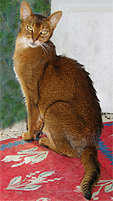
Kitty Litter
100% biodegradeable
DDGs – spent grains from ethanol
More environmentally friendly than clay-based litters
Higher value for DDGs than animal feed
Highly absorbent, forms strong clumps that don’t crumble when scooped, significant odor control

Slide 26


Temporary Fire-retardant Coating
June 9 – July 23, 2012 – 12 wildfires burned simultaneously in CO. consuming 244,000 acres, destroying 600 homes and killing 6.
The 2011 Bastrop wildfire, worst in TX history, burned 32,000 acres, destroyed 1,691 homes and killed 2
Experimental gel might offer better, more affordable protection against wildfire than other fire-retardant gels
Sodium bentonite clay, cornstarch and water
Protect wood-based siding up to 30 minutes – long enough to save a house.
Just rinse it off after the fire.

Slide 27
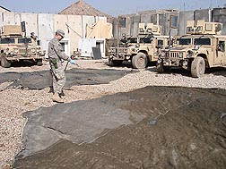
Insect-Protective Gear
USDA-DOD initiative – Deployed Warfighter Protection Research Program – ARS Gainesville, FL
Evaluating insecticides, application equipment, and treating military tents, camouflaged screening and sun awnings with long-lasting residual pesticides
Reduce mosquito and sand fly populations
Tests conducted in Iraq to control mosquitoes.
Material was still successful after 300 days post treatment
Additional test in Kenya to control sand flies
Joint program to create effective barriers and gear that help shield deployed soldiers from disease-causing insects.

Slide 28
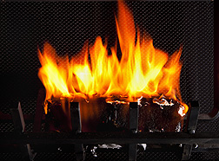
Fire Logs from Lawn Clippings
Tons of grass clippings in landfills
Ecofriendly
Burn brightly and evenly
20-60% clippings, 40-80% plant derived waxes or oils

Slide 29
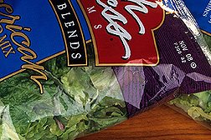
Market Lighting Affects Nutrients
Look for packages that have greater exposure to light.
Overall more nutritionally dense
Affected the leaves’ photosynthetic system
Significant increases in carotenoids, Vitamins C, E, K, and B9 or folate

Slide 30
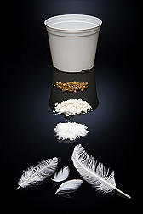
Biodegradeable Pots
Chicken Feathers
About 4 billion pounds of chicken feathers are generated each year
Feathers and quill fibers used in car parts
Feather-derived plastic can be molded like other petroleum-based plastics
Degrade over variable amounts of time, 1-5 years

Slide 31

Widespread crop improvements
Other everyday items you might
not connect with agriculture
Likely buying a product of ARS
research every time you shop
What isn’t to be found on any
store shelf is the Agricultural
Research Service brand name

Slide 32

Federally funded agriculture research has been so successful in finding solutions to farmers’ problems and providing what consumers need that for every dollar spent, $1.35 is returned to the taxpayer.

Slide 33
“I know of nothing so pleasant to the mind, as the discovery of anything which is at once new and valuable – nothing which so lightens and sweetens toil, as the hopeful pursuit of such discovery. And how vast, and how varied a field is agriculture, for such discovery.
Abraham Lincoln, September 30, 1859

Slide 34









Leading America towards a better future
through agricultural research and
information.

