Slide 1
Reconciling: Travel Documents
Created by:
Jessica Wernimont
Rudy Fuchs
Updated 2023

Slide 2
CATS: Recommended Entries Short Data Entry - Travel
For travel, it is best to use the Short data - Travel Doc Type. It is recommended to use a 3 entry system to track travel.
Entry 1 – Authorization
Entry 2 – De-Authorization
Entry 3 – Voucher
Those who use this method to track travel have very few issues when it comes to reconciling and loss of funds due to unnecessary open travel obligations.

Slide 3
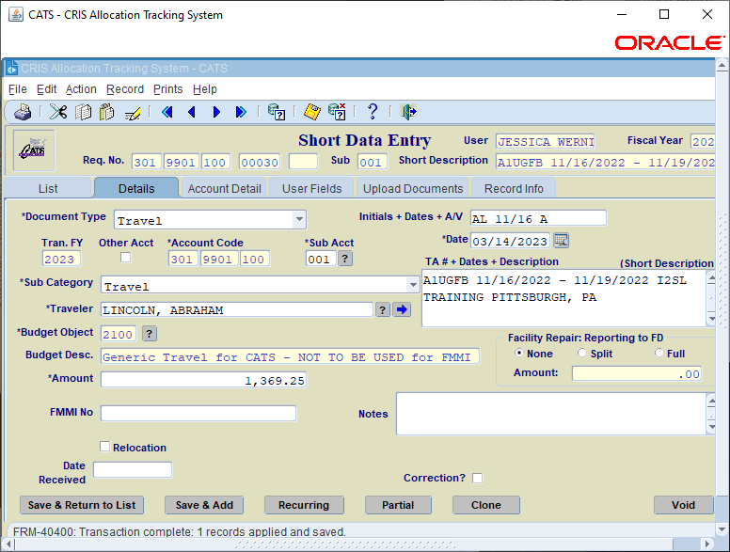
CATS: Recommended Entries Short Data Entry - Travel
Go to Action > Short Data Entry > Select “Add”
Entry 1:
Doc Field: Traveler initials, begin date of trip (4 digits) and A (for Authorization)
Note: This action will allow for travel to be organized on the SOF and will provide support to fund holders on official travel costs.
Sub Category: Travel
Traveler: Last Name, First Name
Details: TA# (obtained from travel system), Dates of Travel, and Destination.
Note: This information will show on the SOF
BOC: 2100 – Generic Travel for CATS
Amount: Dollar amount of the authorization

Slide 4
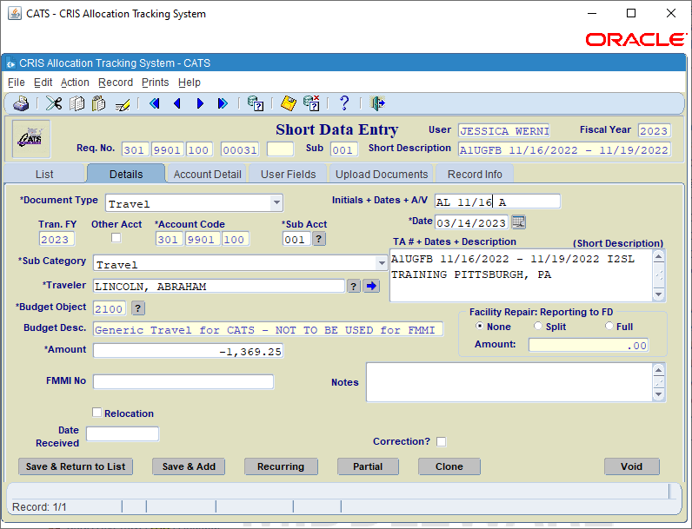
CATS: Recommended Entries Short Data Entry - Travel
Utilize the “Clone” feature and adjust 1 field:
Entry 2:
Amount: Change the dollar amount of the entry to the credit of the authorization.
Note: This action will cause a credit to the original obligation. At this stage, the net cost of the travel will be $0.00 to the SOF.

Slide 5
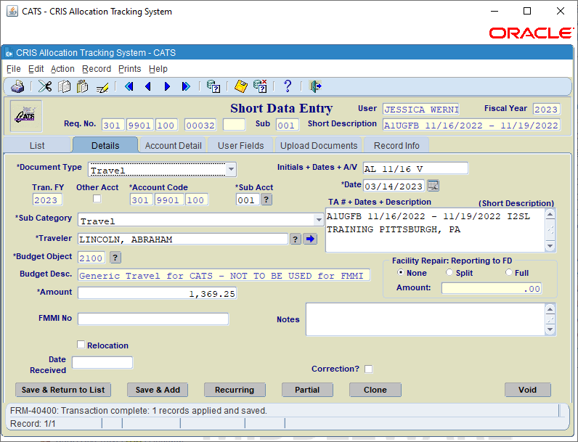
CATS: Recommended Entries Short Data Entry - Travel
Utilize the “Clone” feature and adjust 2 fields:
Entry 3:
Doc Field: Traveler initials, begin date of trip (4 digits) and V (for Voucher)
Amount: Change the dollar amount of the entry to full dollar amount of the authorization.
Note: This action will create the commitment of the full amount. At this stage, the net cost of the travel will be the authorized amount.
Example: $ 1,369.25 - $1,369.25 + $1,329.25 = $1,369.25
Once the voucher is completed in Concur, only the 3rd entry will have to be adjusted.
NOTE: If travel is cancelled, the third entry should be adjusted to $0.00 and the Short Description changed to “CANCELLED”

Slide 6
CATS: Recommended Entries Short Data Entry - Travel
3 Entries seems like a hassle, why should you do it this way?
Flexibility while reconciling. You can sort by Doc Number and it puts everything in order by Initials, Dates, and puts the Authorizations first.

Slide 7
CATS: Recommended Entries Short Data Entry - Travel
Less room for human error. If someone else enters these into CATS, there are no calculations needed. Whatever is on the voucher should be on the V line in CATS
If the travel is cancelled, without having the unreconciled entries in CATS, how would you know to follow up if the De-Authorization does not show up?
If a Fund Holder is looking for extra money, most of the time they are only looking at the Unreconciled Transactions for things they can cancel.
If a voucher has not been processed yet, the unreconciled transactions are your reminder to follow up.
If you want to know what the final price of a trip was, you can easily tell by looking at the amount of the V record.
Un-liquidation Report is cleaner on open travel – less to report.

Slide 8
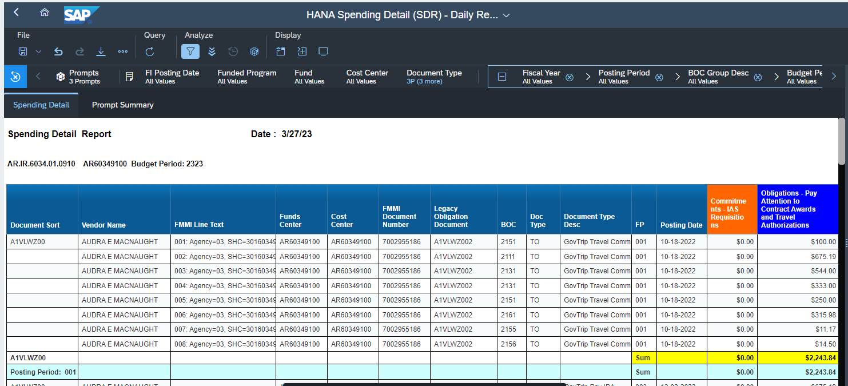
HANA Spending Detail Report
Pull the HANA Spending Detail Report
Travel is listed in order of the TA number (Document Sort Number).
Obligation Column = Travel Authorization
Expenditure Column = Travel Voucher

Slide 9
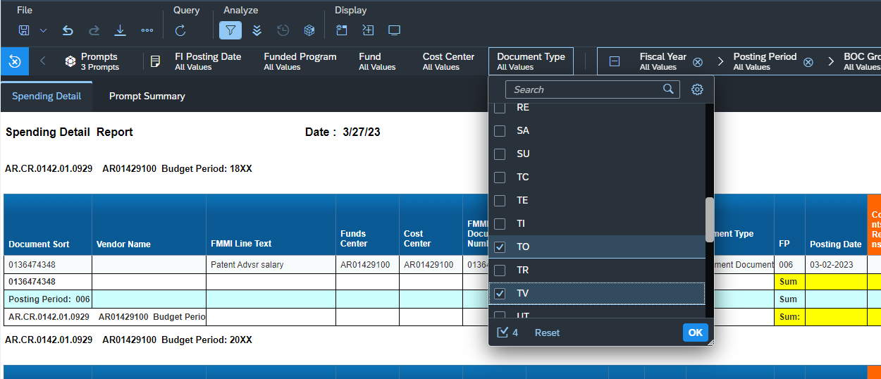
HANA – SDR Advanced Filtering
To filter the SDR on just Travel transactions, filter on Document Type:
TO: GovTrip Travel Commitment
TV: GovTrip Reimbursable ()
3P: GovTrip Pay IBA (Personal travel card reimbursement)
4P: GovTrip Pay CBA (Central billed Account reimbursement)

Slide 10
HANA SDR 3 Types of travel scenarios
Authorization only hitting this month.
You can tell this example due to the fact that the only doc type showing is TO and the total amount is in the Obligations column
Reconcile only the Authorization entry in CATS

Slide 11
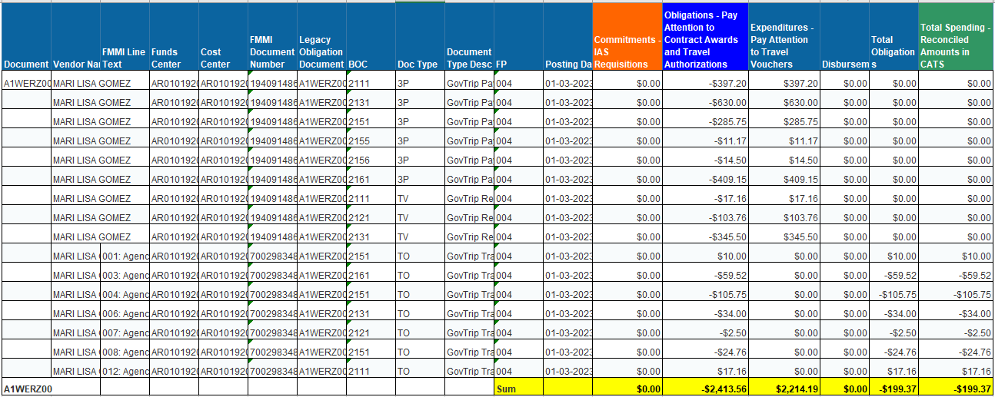
HANA SDR 3 Types of travel scenarios
Authorization was reconciled in a previous month, voucher was processed this month.
You can tell this example due to the fact that the doc types show credits (-) to the TO and positive (+) TV, 3P, and/or 4P. The amounts in the Obligations column is the Authorization reversing itself and the amount in the Expenditure column is the total amount of the voucher.
Reconcile the Credit Authorization and the Voucher.
The difference is shown in the Total Spending column.

Slide 12
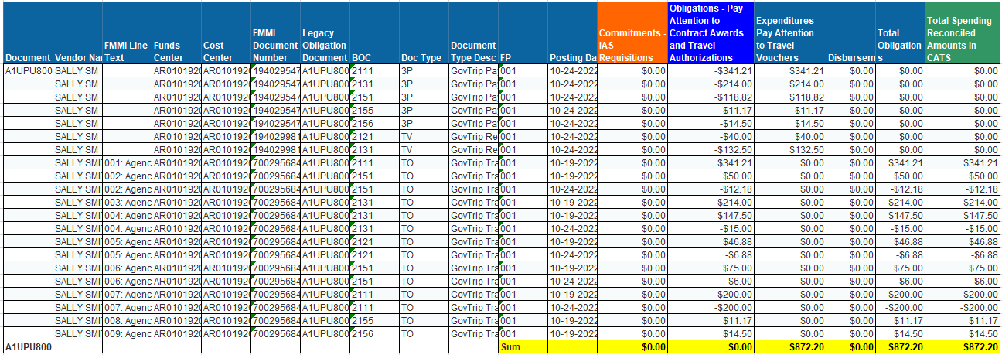
HANA SDR 3 Types of travel scenarios
Authorization and Voucher were processed in the same month.
You can tell this example due to the fact that the doc types show TO, TV, 3P, and/or 4P.
The amounts in the Obligations column is zero (Auth + De-Auth) and the amount in the Expenditure column is the total amount of the voucher.
Reconcile both Authorization Entries and the Voucher Entry.
The difference is shown in the Total Spending column.

Slide 13
Questions?
Contact your servicing Budget Staff Members.

