Slide 1
Foodomics
James Harnly
Food Composition and Methods Development Lab, Beltsville Human Nutrition Research Center, Agriculture Research Service,
US Department of Agriculture, Beltsville, MD
Beltsville Human Nutrition Research enter
Beltsville, MD, September 9, 2018

Slide 2
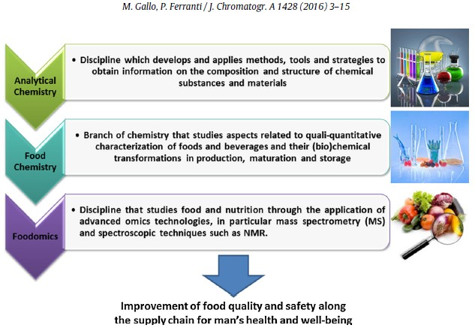
Definition

Slide 3
Further
Food is a highly complex mixture and, with such complexity, its definition cannot be based only on preselected components.
Capozzi & Bordoni, Genes Nutr, 8:1–4 (2013).
The methodologies of food analysis have greatly evolved over the past 100 years, from solution chemistry to the modern instrumental platforms. Today, integrated analytical approaches allow the chemical composition of a food to define a ‘food fingerprint’ that is valuable to assess nutritional value, safety and quality, authenticity and security. This comprehensive strategy, defined as foodomics, includes emerging work areas such as food chemistry, phytochemistry, advanced analytical techniques, biosensors and bioinformatics. Gallo & Feranti, J Chromatogr A, 1428:3–15 (2016).
There are hundreds of thousands of foods, each with tens of thousands of components, each with the potential to impact human health. Harnly, OSQR Research Plan (2018).

Slide 4
Further Direction
Food is a highly complex mixture and, with such complexity, its definition cannot be based only on preselected components.
Capozzi & Bordoni, Genes Nutr, 8:1–4 (2013).
The methodologies of food analysis have greatly evolved over the past 100 years, from solution chemistry to the modern instrumental platforms. Today, integrated analytical approaches allow the chemical composition of a food to define a ‘food fingerprint’ that is valuable to assess nutritional value, safety and quality, authenticity and security. This comprehensive strategy, defined as foodomics, includes emerging work areas such as food chemistry, phytochemistry, advanced analytical techniques, biosensors and bioinformatics. Gallo & Feranti, J Chromatogr A, 1428:3–15 (2016).
There are hundreds of thousands of foods, each with tens of thousands of components, each with the potential to impact human health. Harnly, OSQR Research Plan (2018).

Slide 5
FCMDL Integrated Food History
Developed comprehensive method for flavonoids in foods.
In line with USDA directives
Collaborated with Office of Dietary Supplements Analytical methods and reference materials (AMRM)
Flavonoids known to be environmental compounds Can they be used for authentication? YES!
Pattern recognition (chemometrics)
Discriminate between classes of foods and botanicals What compounds are responsible for discrimination
Loadings and multivariate ANOVA Metabolomics
Result:
Metabolite Fingerprinting
Food patterns to identify/classify whole food or plant Metabolomics
Detect, identify, and quantify food or plant components

Slide 6
Analytical Protocol
Sample
FIHRMS
Genetic Analysis
DNA
Sequencing
Fingerprints
ANOVA
Variance Table
Targeted Analysis
Targeted Analyses
Select Representative Samples
PCA
Metabolomics
Identify Compounds
Score Plot
Sample Classification
Loading Plot
ID Discriminating Ions
Library
ID All Ions
Quantify Compounds?
Quantify Compounds
Metabolite Fingerprinting
Metabolomics, Targeted Analyses, Genetics

Slide 7
Metabolite Fingerprinting
High throughput qualitative screening of the metabolic composition of an organism or tissue with the primary aim of sample comparison and discrimination analysis. Generally no attempt is initially made to identify the metabolites present. All steps from sample preparation, separation, and detection should be rapid and as simple as is feasible.*
* Hall, RD. New Phytologist 169:453-468 (2006).

Slide 8
Metabolomics
Inventory of small molecules (fats/lipidomics)
Ultra high performance liquid chromatography- high resolution accurate mass/tandem mass spectrometry (UHPLC-HRAM/MS^{n})
Ion masses to 4 decimal places
Exact chemical formulas
On-line search for putative identification of molecules
Positive identification with authentic standards
Quantification of compounds
Identification is very time consuming
Evaluation of metabolic pathways

Slide 9
Similarity of Foods and Botanicals
Terminology: Similarity, same food, authentication, phyto- equivalence, or taxonomic exactness. The inverse is contamination or adulteration
Perspective: These are all the same problem and best addressed with the same approach: non-targeted metabolite fingerprinting with chemometric analysis.
Non-targeted methods: Information is limited to the composition of the reference materials. No target compounds, no target adulterants. As comprehensive as possible. Usually a form of metabolite fingerprinting.
Every data point is used; none are arbitrarily discarded.

Slide 10
Conceptually, Authentication is Simple
Authentication is a “Sesame Street Question”
Peter Scholl, FDA
Which one is different?
Or, rephrased:
Is this one,
, the same as the others?

Slide 11
Conceptually, Authentication is Simple ☺
Build a model with reference samples.
Set statistical limits (how much deviation from the model will be tolerated).
Then, compare the “test” sample to the model.
The Hard Part:
Specifying and collecting reference samples for the model that will encompass as many naturally occurring sources of variation as possible.
Specifying a method that will encompass as many of the specific botanical features/properties as possible – non-targeted chromatographic and spectral fingerprints.

Slide 12
Non-Targeted Methods: Chromatographic and Spectral Fingerprints
Fingerprints come from:
direct analysis of solids,
direct analysis of extracts (no separation), or
chromatograms of extracts.
Fingerprints are complex chromatograms or spectra.
Fingerprints require statistical or chemometric analysis to extract information.
Any chromatographic or spectroscopic method can be used.
Solid Sample
Solid Sample
Extract
Solid
Separation
Direct
Chromatograms
Spectra
Fingerprints

Slide 13
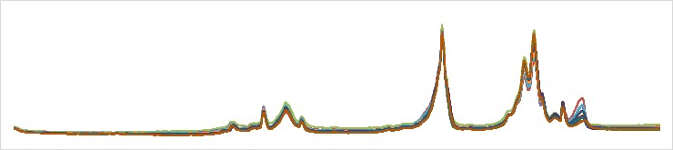
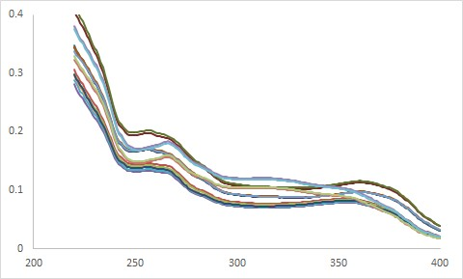

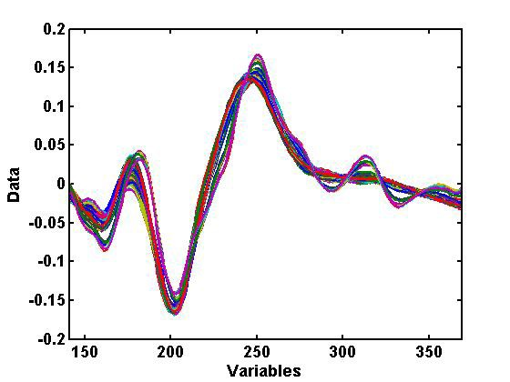
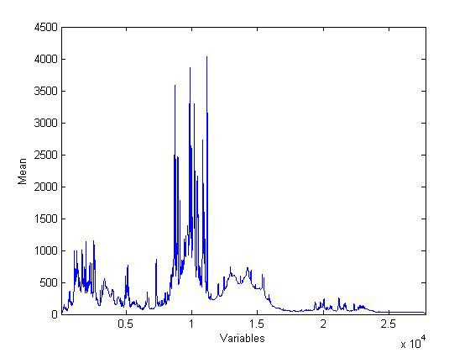
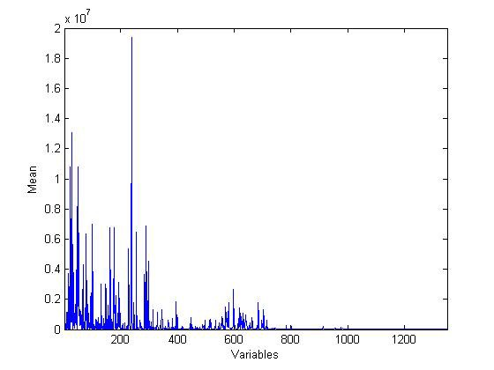
Do These Fingerprints Match?
Chromatogram-Any Detector
UV
NIR
NMR
FIMS

Slide 14
Do These Fingerprints Match?
Chemometric Methods!
Approachª | Method | Supervision | Classes
Exploratory | PCA^{b} | None | None
Class Modeling (soft modeling) | SIMCA^{b} (multi-PCA) | ID classes | 2 or more
One-Class Modeling | PCA | ID 1 class | 1
Classification | PLS-DA^{b} | ID classes | 2 or more
(hard modeling)
a
Richard G. Brereton, Chemometrics for Pattern Recognition, John Wiley & Sons, West Sussex, UK, 2009, ISBN 978-0-470-98725-4
PCA - Principal Component Analysis, SIMCA - Soft independent modeling of class analogy, PLS-DA – Partial Least Squares-Discriminant Analysis.
b

Slide 15
Characterization of Maca
(USDA, Gaia Herbs, Am Bot Council, & Sturt University*)
Lepidium meyenii Walpers but possibly Lepidium peruvanium
Chacon.
Native to Peru above 4,000 m, cultivated by Incas, still grown in Peru, and now cultivated in China.
Used as a staple food component and as a dietary supplement.
Improves energy, mood, fertility, sexual drive, and decreases anxiety.
# | ID | Sample | Physical | Source
43 | pP | Peruvian, processed | powder, gelatinized | Gaia
15 | uP | Peruvian, un-processed | tuber, raw | Meissner*
8 | uC | Chinese, un-processed | tuber, raw | Gaia
* Prof. Henry Meissner, Faculty of Health Studies, Charles Sturt University & Therapeutic Research, TTD International Pty Ltd, Elanora, QLD 4221, Australia

Slide 16
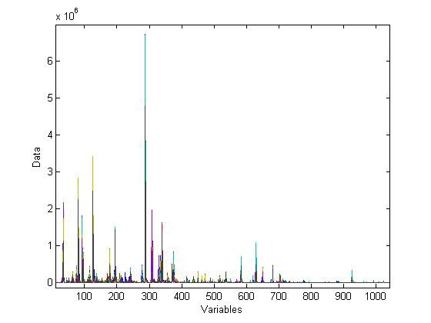
FIHRMS Fingerprints of Maca (Lepidium meyenii)
66 spectra overlaid

Slide 17
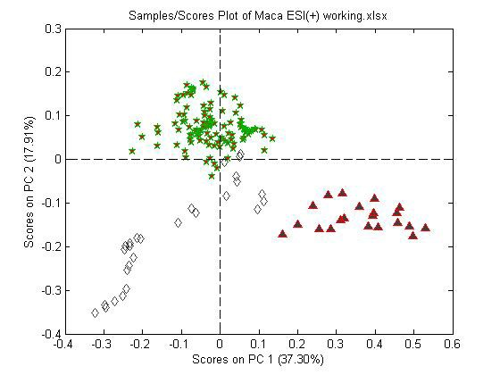
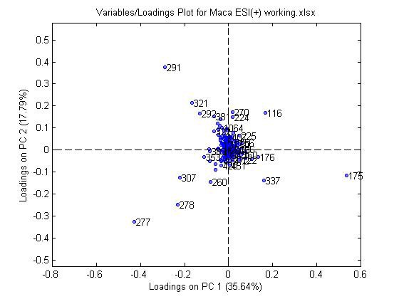
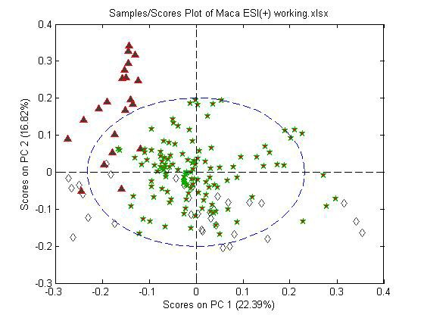
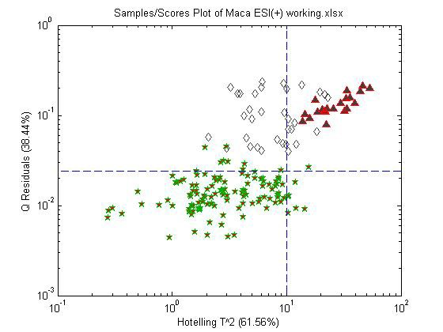
PCA/One-Class Modeling: Maca
pP
PCA
Score Plot
PCA
Loadings Plot
uP
uC
One-Class Model
PCA Score Plot
One-Class Model
Residuals Plot
uC
uP
uC
pP
95% Confidence Limit
(95% Confidence Limit
95% Confidence Limit
uP
pP

Slide 18
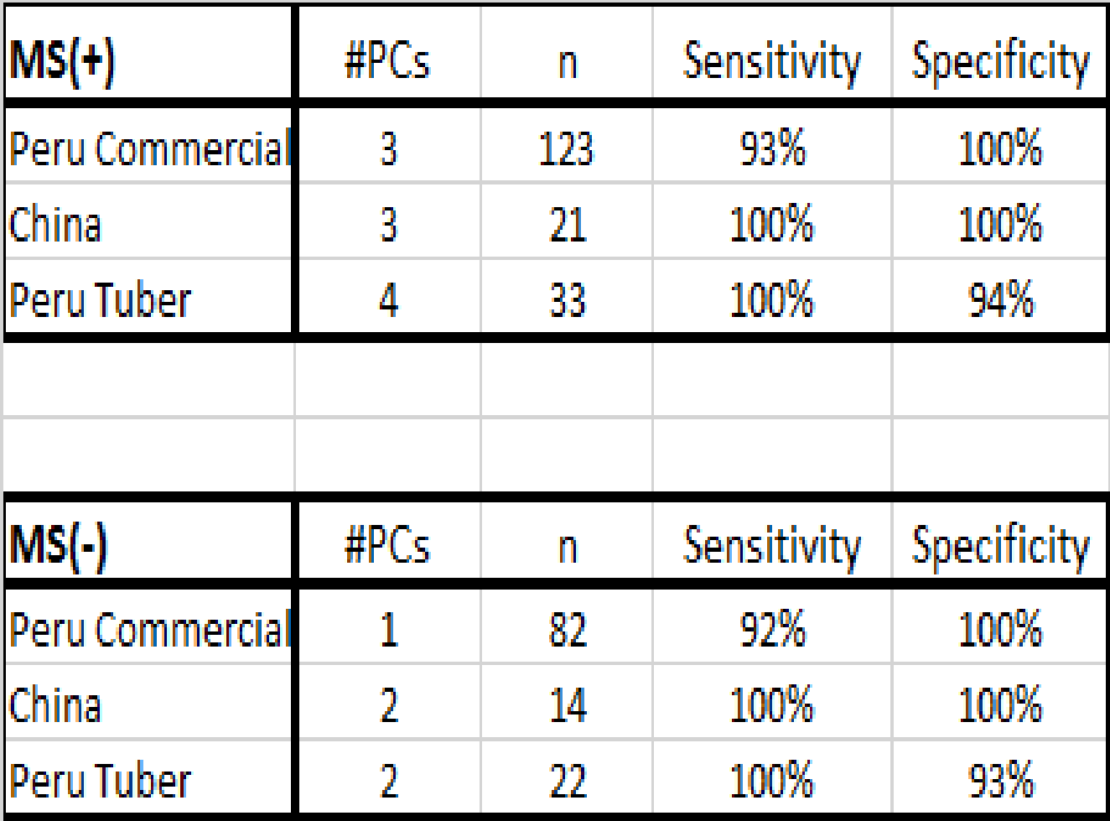

Sensitivity and Specificity of One Class Modeling Sensitivity = % true samples identified as true Specificity = % false samples identified as false
pP
uC
uP
pP
uC
uP

Slide 19


One-Class Modeling
Hotelling T² and Q Statistics
Linear, 1D model (1 PC) fit to bivariate data: (*) authentic samples
(mean-centered)
Hotelling T² statistic – Multivariate analog to Student’s t value in univariate statistics. Characterizes the variance within the model.

Slide 20
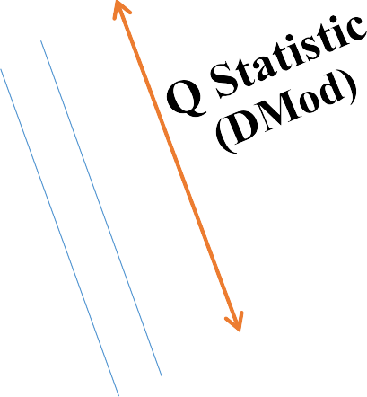


Class Modeling
Hotelling T² and Q Statistics
Linear model (1 PC) fit to bivariate data: (*) authentic samples (*) test samples
Hotelling T² statistic – Multivariate analog to Student’s t value in univariate statistics. Characterizes the variance within the model. Q Statistic – Characterizes the variance outside the model. No equivalent in univariate statistics.

Slide 21
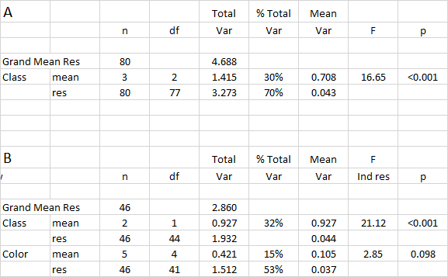

Pooled Analysis of Variance (pANOVA) for FIHRMS Fingerprints of Maca
All Samples
 | Colored Tubers |  |  | F
0.10

Slide 22
PCA Score Plot of FIHRMS Fingerprints of Maca
pP
uC
uP

Slide 23
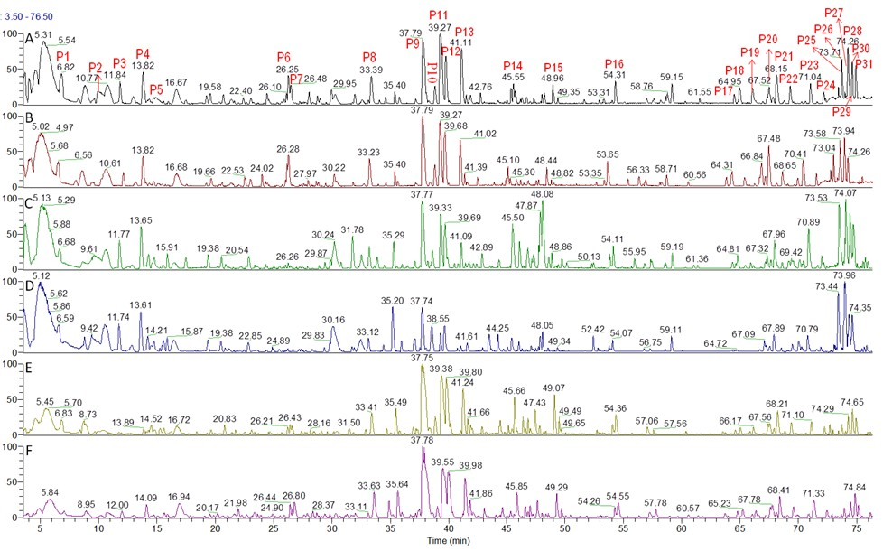
Metabolomic Profiles: MS(+)
pP
pP uC
uC uP
uP

Slide 24
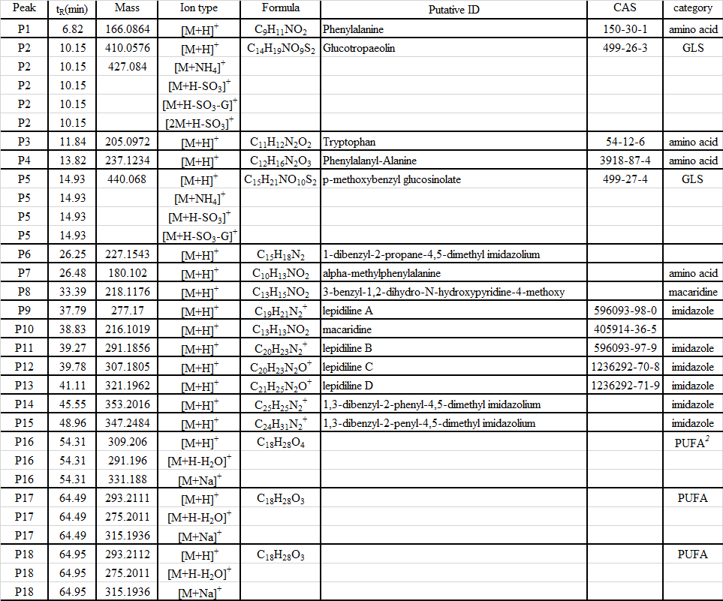
Maca Library: MS(+)

Slide 25
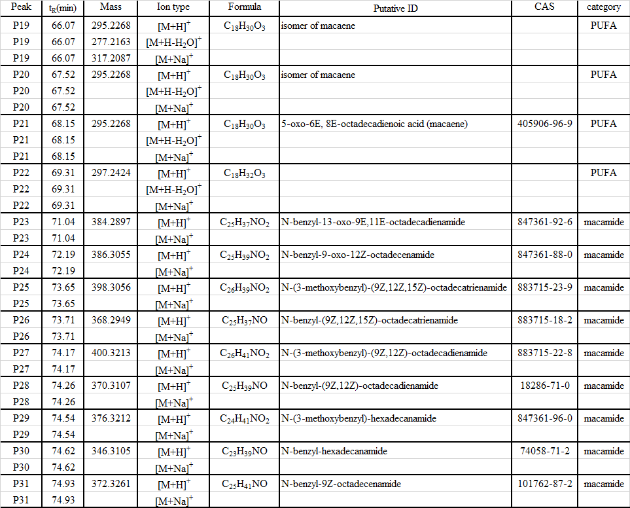
Maca Library: MS(+) cont’d

Slide 26
Loadings for PCA Scores Plot of FIHRMS Fingerprints of Maca
lepidiline B
arginine
Lepidiline A

Slide 27
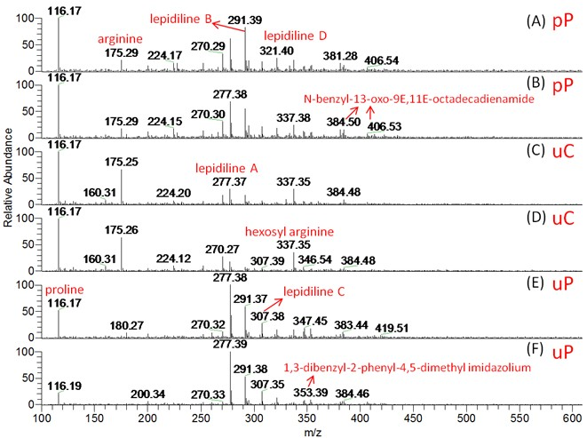
ID of Masses in FIHRMS Fingerprints: MS(+)

Slide 28
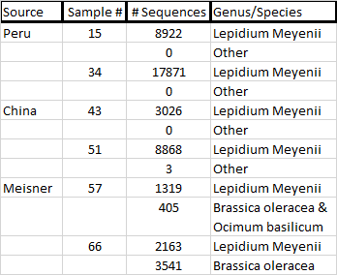
DNA Next Generation Sequencing
pP
uC
uP

Slide 29
Analysis of Wheat Samples*
Free Air CO₂ Enrichment (FACE) Adaptive Cropping Systems Laboratory
Cutivar
Sample Line CO₂ Level Yield
5a-d | 5 | Ambient | 100%
5e-h | 5 | Elevated | 106%
6a-d | 6 | Ambient | 100%
6e-h | 6 | Elevated | 141%
*Bunce, Agronomy 7:20-26 (2017)

Slide 30
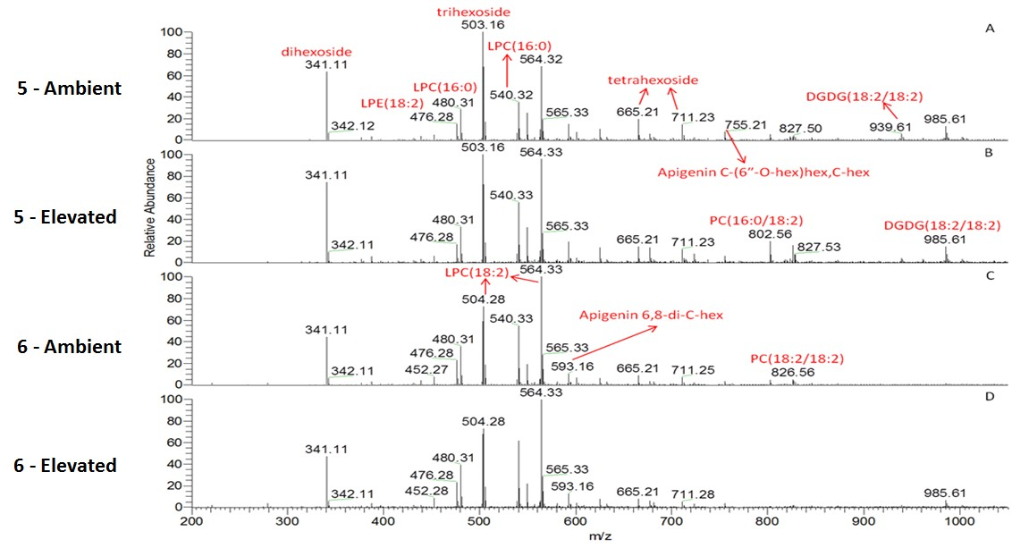
Metabolite Fingerprints (MS-)
Flow Injection Total Ion Counts

Slide 31
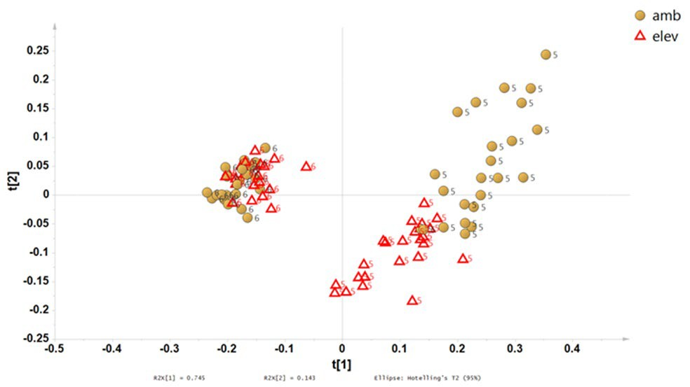
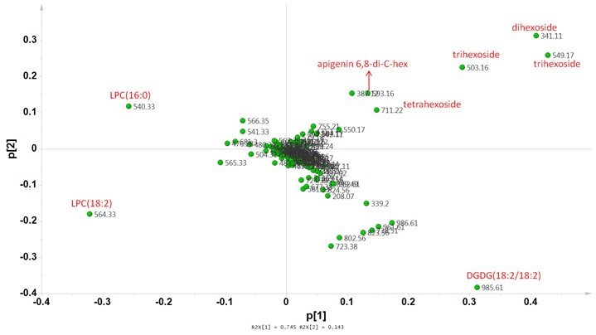
Spectral Fingerprints MS(-) PCA Score Plot & Loadings
PCA Scores Plot
PCA Loadings Plot

Slide 32
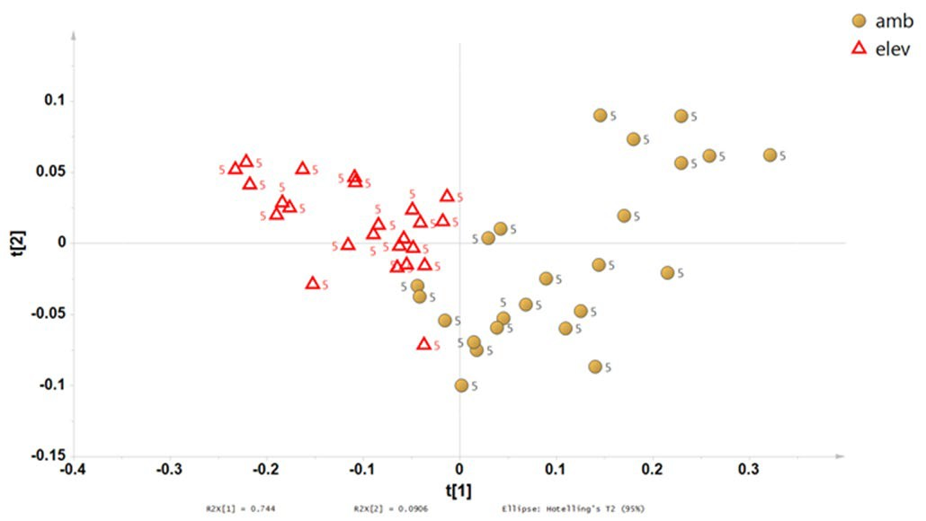
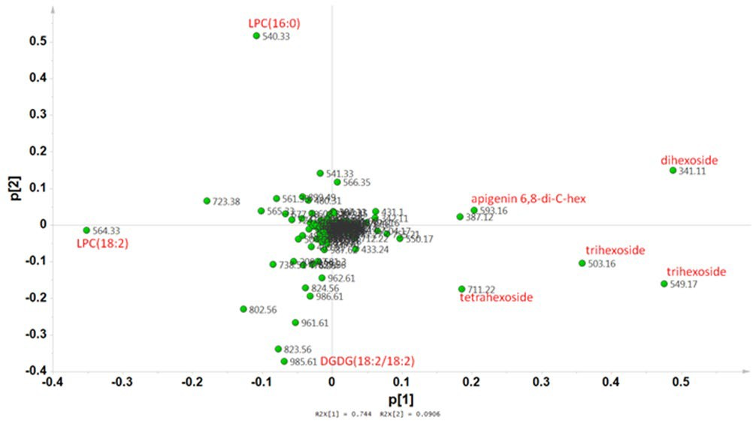
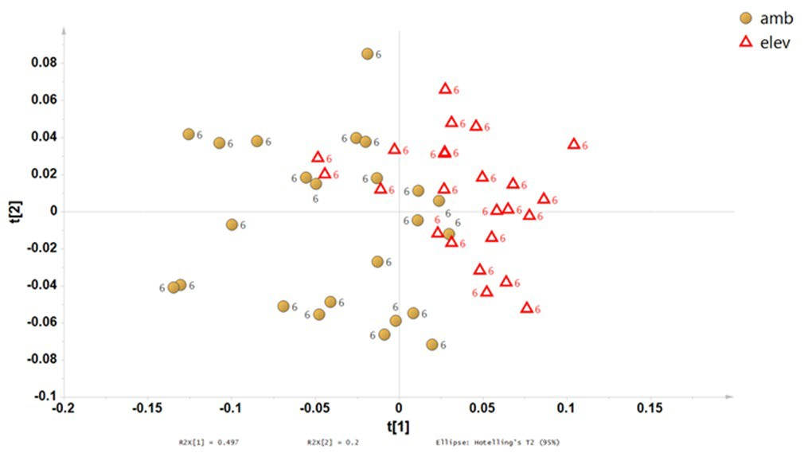
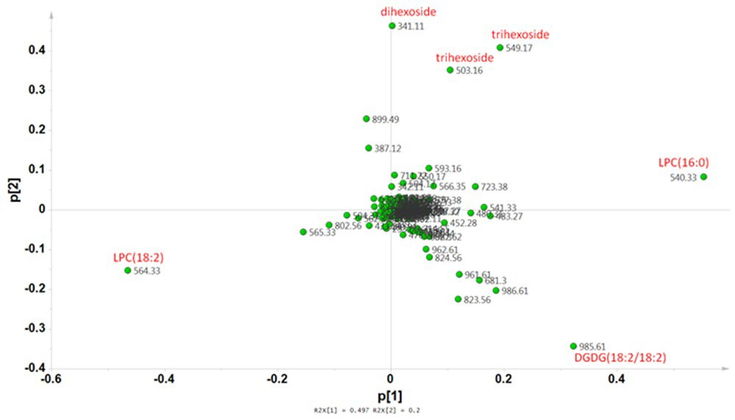
Spectral Fingerprints MS(-): Lines 5 and 6 Separately
PCA Score Plot & Loadings:
PCA Line 5
PCA Loadings Line 5
PCA Line 6
PCA Loadings Line 6

Slide 33
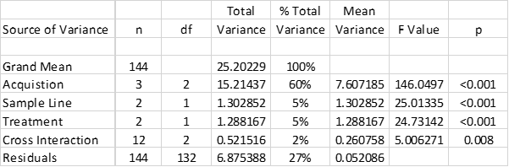
Spectral Fingerprints MS(-)
Pooled Multivariate ANOVA

Slide 34
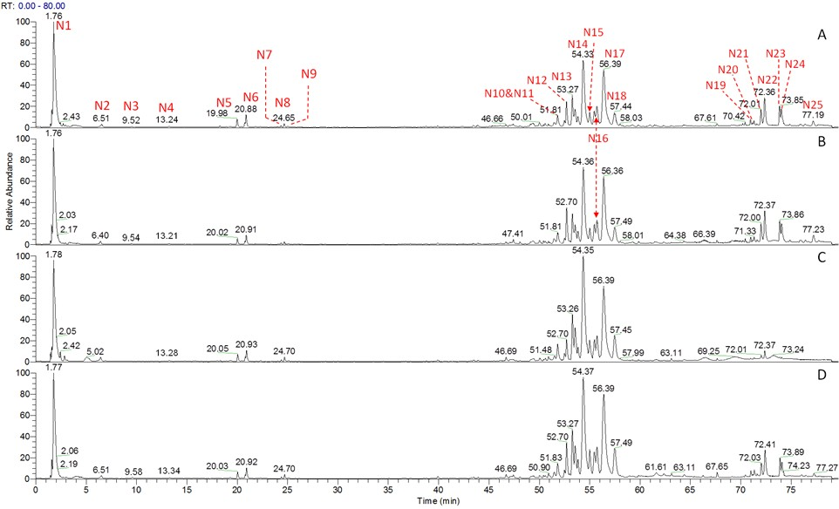
Metabolomics: UHPLC-DAD-HRAM/MS^{n}
MS(-) Total ion Counts
5 - Ambient
5 - Elevated
6 - Ambient
6 - Elevated

Slide 35
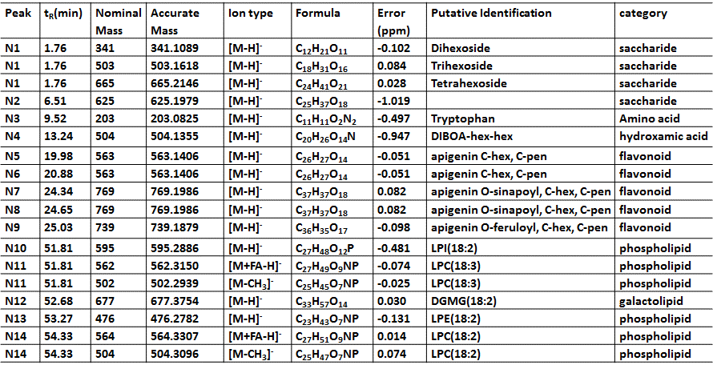
Maca Metabolomics Library MS(-)

Slide 36
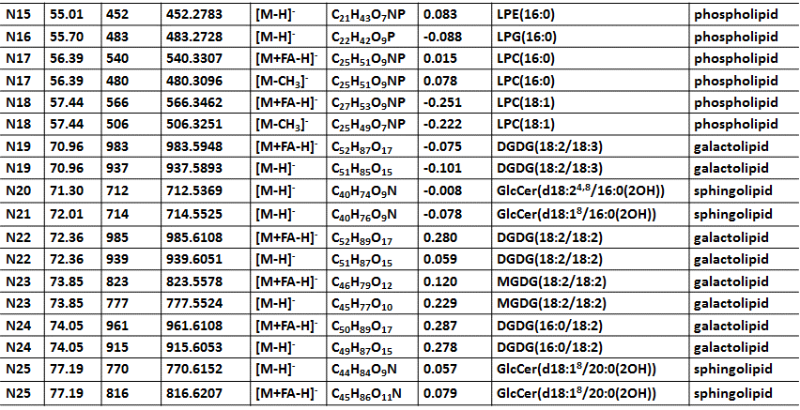
Maca Metabolomics Library MS(-) cont’d

Slide 37
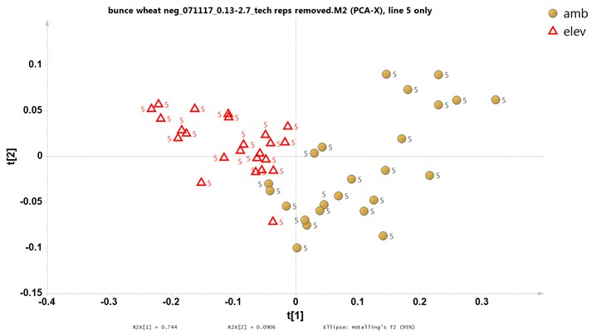

Spectral Fingerprints MS(-)
PCA Score Plot & Loadings: Peak Identification

Slide 38
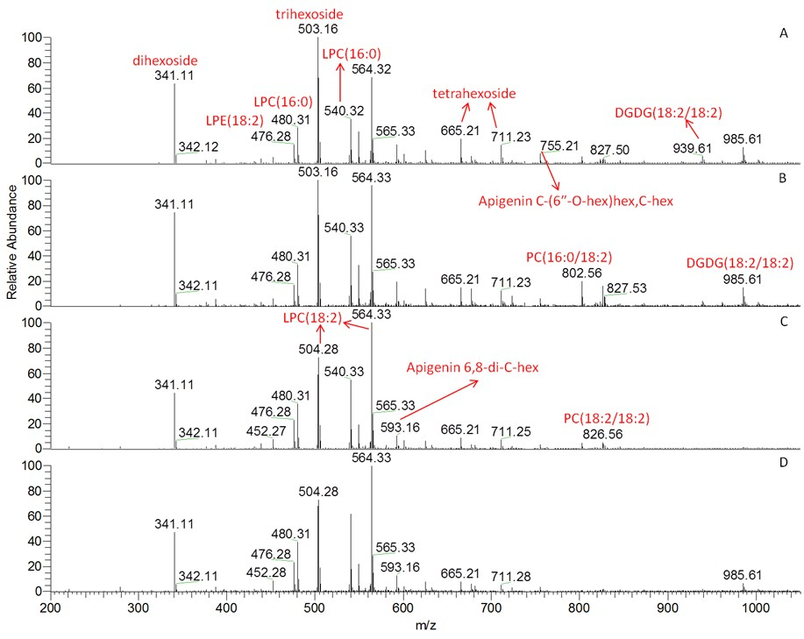
Spectral Fingerprints (MS-)
Peaks Identification
5 - Ambient
- Elevated
- Ambient
6 - Elevated

Slide 39
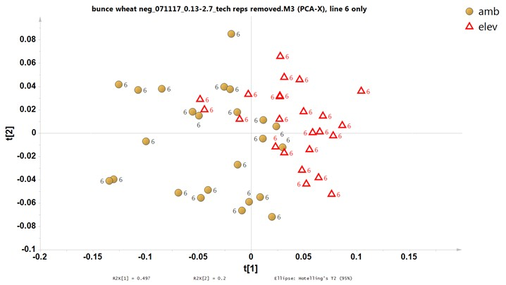

Spectral Fingerprints MS(-)
PCA Score Plot & Loadings: Peak Identification

Slide 40
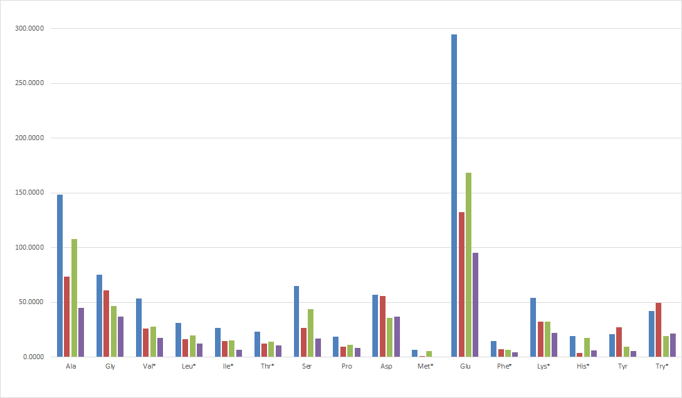
Targeted Analysis: Amino Acid Profiles
Free Amino Acids
Line 5 Amb
Line 5 Elev
Line 6 Amb
Line 6 Elev
*essential amino acid
*essential amino acid

Slide 41
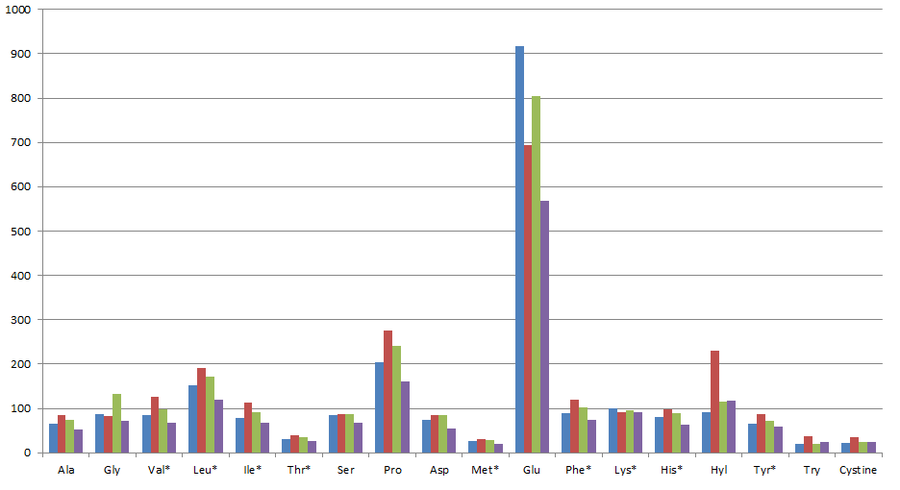
Targeted Analysis: Amino Acid Profiles
Amino Acids after Protein Hydrolysis
Line 5 Amb
Line 5 Elev
Line 6 Amb
Line 6 Elev
*essential amino acid

Slide 42
North American Dry Beans of Middle American Ancestry CAP Grant Study: 308 genotypes of beans representing 8 market classes from two races were grown in 7 locations.*
Race Market Class Durango Great Northern
Pink Pinto Small Red
Mesoamerica Black Navy
Small White Tan
Locations:
Colorado Idaho Michigan North Dakota Nebraska Puerto Rico Washington
Researchers:
Colorado State University Michigan State University North Dakota State University University of Nebraska
USDA, ARS
Baylor College of Medicine, Houston, TX
Grain Legume Genetics & Physiology Research Center, Prosser, WA Red River Valley Agricultural Research Center, Fargo ND
Tropical Agricultural Research Station, Mayaguez, PR
* McClean et al., Crop Science 57:1-16 92017)

Slide 43

Do These Fingerprints Match?
Chromatogram-Any Detector
UV
NIR
NMR
FIMS

Slide 44
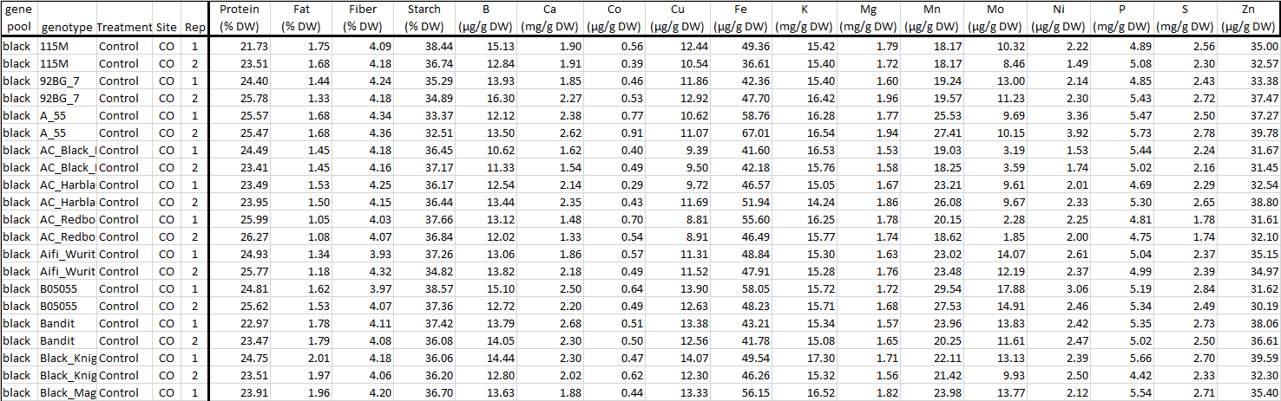
Do These Fingerprints Match?
Do These Data Files Match?

Slide 45
Sample Comparison: Nutrients Analyzed
Primary | Macro | Micro
Metabolites | Elements | Elements
Protein | Calcium | Boron
Lipids | Magnesium | Cobalt
Starch | Phosphorous | Copper
Fiber | Sulfur | Potassium Iron Manganese Molybdenum Nickel Zinc

Slide 46
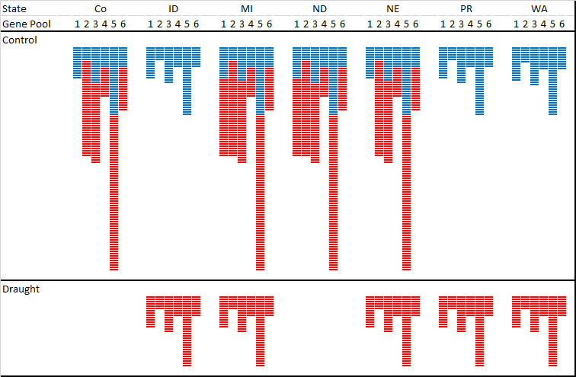
Sample Comparison
Total: 2 races, 8 market classes, 308 genotypes, 7 locations
Market Class
Control
Genotype
Drought

Slide 47
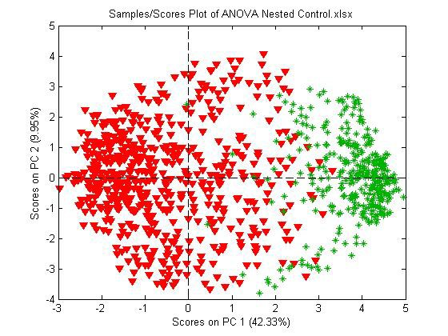
ANOVA-PCA Score Plot: Nutrients
No Classification - Labeled by Race
Mesoamerican
▼ Durango

Slide 48
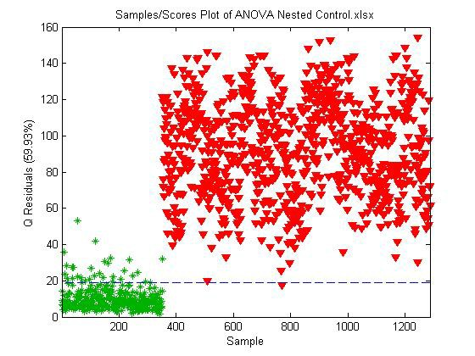
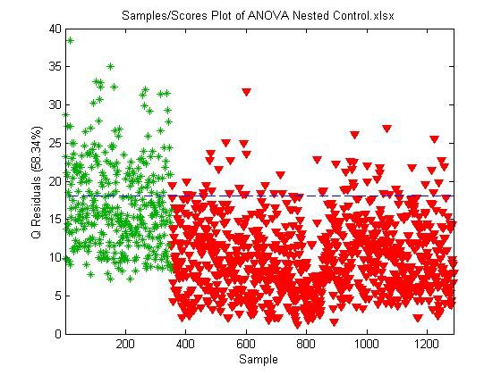
SIMCA: Nutrients
Modeled by Race – Labeled by Race
Mesoamerican
▼ Durango
95% Confidence Limit

Slide 49
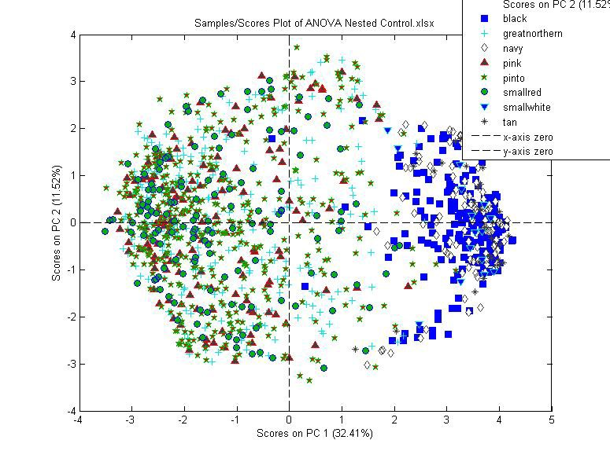
North American Dry Beans of Middle American Ancestry ANOVA-PCA of control samples, labeled by market class

Slide 50
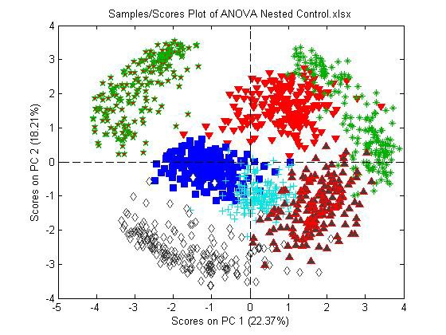
North American Dry Beans of Middle American Ancestry ANOVA-PCA of control samples, labeled by state
ID
CO
WA
MI
PR
ND
NE

Slide 51
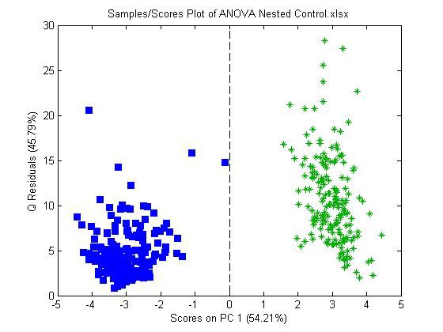
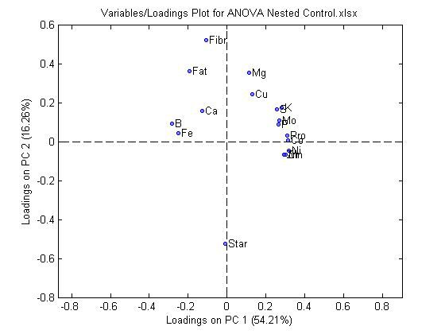
ANOVA-PCA Score Plot & Loadings: ID vs MI
PCA Score Plot
MI
ID
Loadings

Slide 52
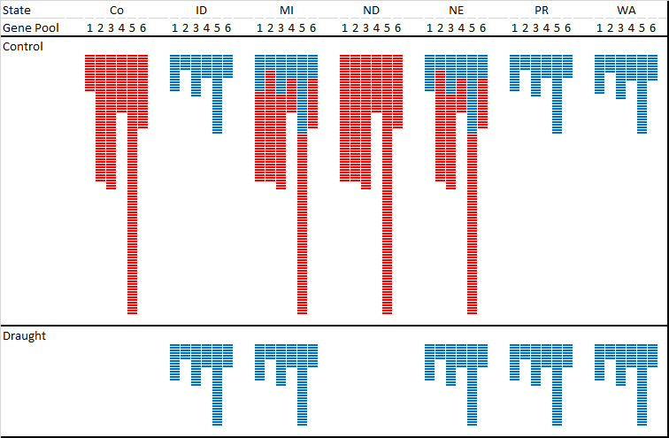
Sample Comparison: Water Stress
6 market classes, 130 genotypes, 5 locations
Market Class
Control
pe y
not
e
G
Genotype
Drought

Slide 53
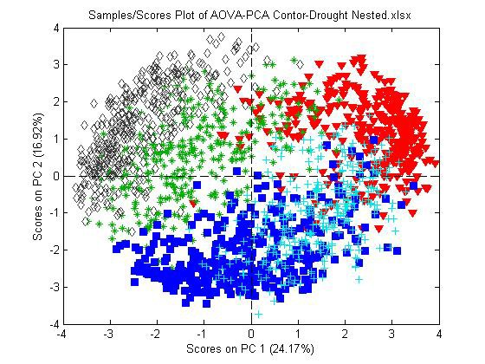
North American Dry Beans of Middle American Ancestry ANOVA-PCA of control & drought samples, labeled by state
NE
WA
ID
PR
MI

Slide 54
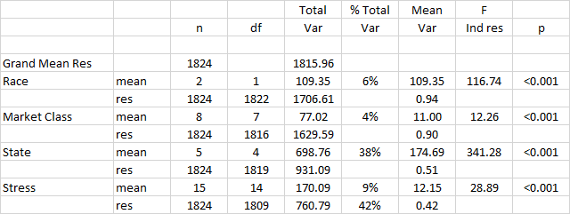
North American Dry Beans of Middle American Ancestry Pooled multivariate ANOVA

Slide 55
Growth and Yield Measurements
Days to flower Days to maturity Plant height Lodging
No impact on Modeling
Growth habit
100 seed weight Seed yield
No data for North Dakota

Slide 56
Garlic Feeding Study
17 Subjects Crossover study
C0 Control baseline urine C3 Control 3 hr urine
G0 Garlic baseline urine G3 Garlic 3 hr urine
Samples analyzed by Metabolon Isolated 637 peaks
Identified 337 compounds
0 hours
3 hours
0 hours
3 hours

Slide 57
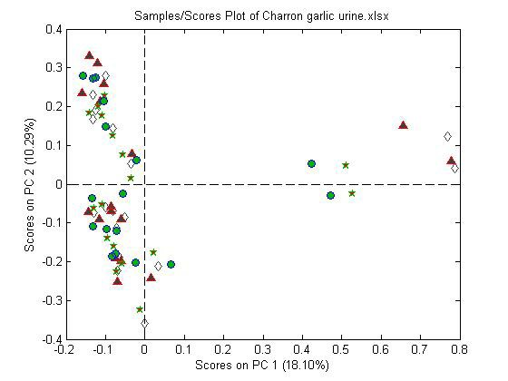
PCA: All samples, labeled wrt subject

Slide 58
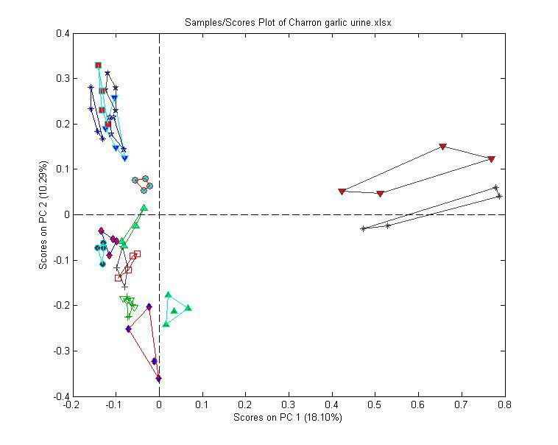
PCA: All samples, labeled wrt subject
Connected border points

Slide 59
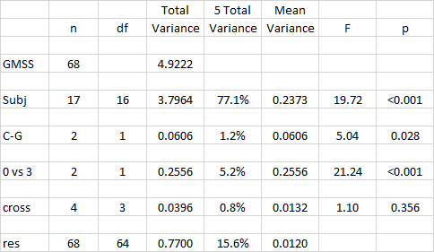
Pooled multivariate ANOVA (pmANOVA)

Slide 60

PCA: Subject residuals, labeled wrt treatment
Separation of baselines and 3 hr
G0
C0
C3
G3

Slide 61

PCA: Subject residuals, 3 hr (C3 VS G3)
Separation of 3 hour control and garlic
C3
G3

Slide 62
Loadings: Subject residuals
8.00E-01
7.00E-01
C3 vs G3 (garlic)
6.00E-01
5.00E-01
4.00E-01
3.00E-01
C0 vs C3 (meal)
2.00E-01
1.00E-01
0.00E+00
0
100
200
300
400
500
600
700
-1.00E-01
-2.00E-01

Slide 63



Loadings: G3 vs C3
8.00E-01
N-acetylalliin (220.0638)
Isoalliin (220.0638)
X - 12107
7.00E-01
200
150
100
50
0
6.00E-01
BL
Control
3h
BL
Garlic
3h
5.00E-01
Urine
X-12119 (212.0638)
4.00E-01
3.00E-01
2.00E-01
1.00E-01
0.00E+00
0
100
200
300
400
500
600
700
-1.00E-01
-2.00E-01

Slide 64


Simultaneous ID of Families of Flavonoids
Based on Spectra of 146 Compounds
UV-Vis Spectra
PCA

Slide 65

Step-Wise ID of Families of Flavonoids
Conventional Approach
Step-Wise Approach
Identify anthocyanins
Identify flavanals and flavanones
Identify flavones, flavonols, and hydroxycinnamic acid derivatives

Slide 66

Flavonoids in Blueberries
Final Identification by HRAM/MS
In-House Database of >5500 Phenolic Compounds
Flavones/Flavonols/Hydroxycinnamic Acid Derivatives
Flavanals/Flavanones Anthocyanidins

Slide 67
Summary
Need:
speed of metabolite fingerprinting, detail of metabolomics
Fingerprinting:
classification of samples statistics of separation of clusters
analysis of variance for experimental factors identification of key compounds
Metabolomics:
identification/quantification of compounds
library of compounds - exact masses, formulas, CCSs Identification/quantification of fingerprints/loadings
Genetics:
identification of samples
identification of associated fungi and bacteria Metadata:
Need as much metadata as possible

Slide 68
Acknowledgements
Funding:
USDA Agricultural Research Service
Office of Dietary Supplements at the National Institutes of Health
USDA, FCMDL
Dr. Pei Chen
Dr. Jianghao Sun
Dr. Ping Geng
Dr. Mengliang Zhang
Dr. Devanand Luthria
Dr. Craig Byrdwell

