Slide 1

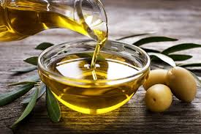
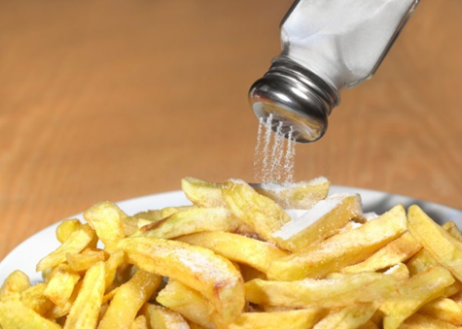
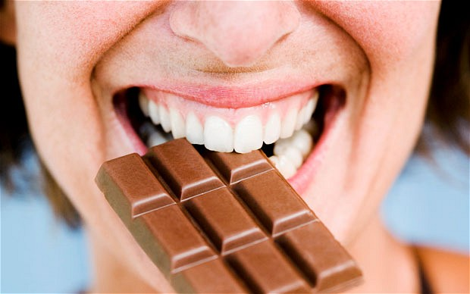
A Sampler of Sensory Nutrition Work at Monell
Paul Wise
Monell Chemical Senses Center 2019

Slide 2
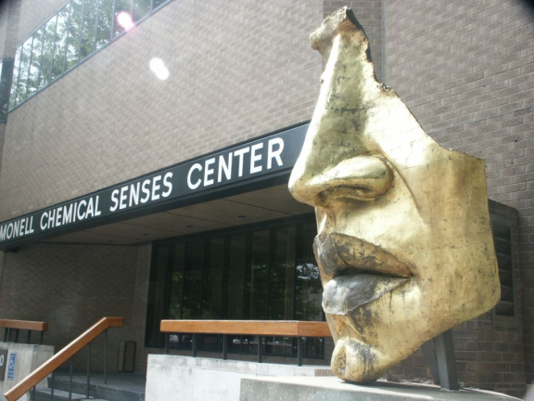
Monell Chemical Senses Center
Center for Basic and Translational Research
in the Chemical Senses
Notes:
~25 PIs in diverse areas of the Chemical Senses
Including taste, smell and roles in health and disease
~125 Employees
~60 PhD level
My home for past 2.5 yrs

Slide 3
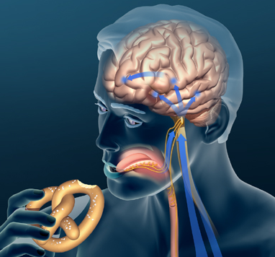
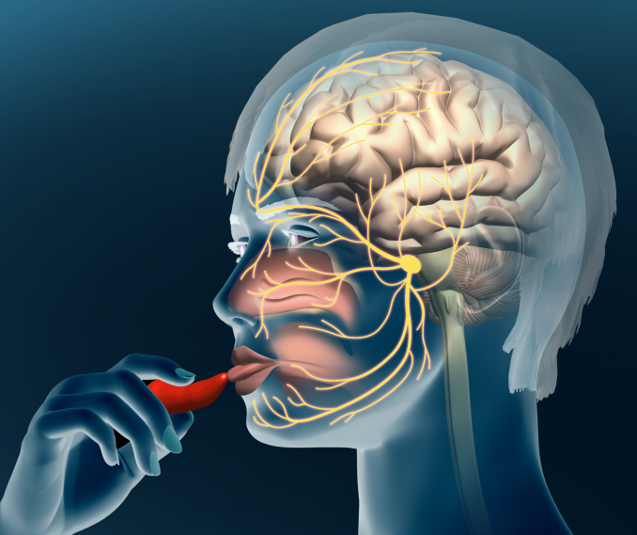
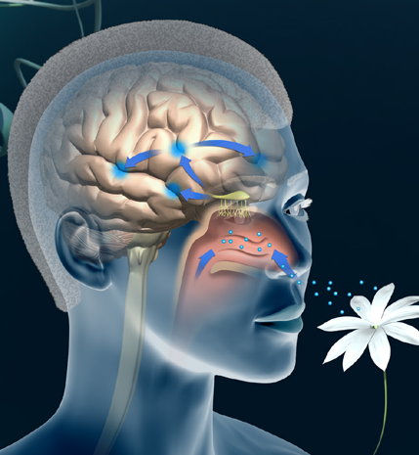
Taste: Sweet, sour, salty, bitter, savory (fatty? starchy? mineral?)
Somatosensation: Chemesthesis, texture, temperature
Smell: Most of flavor

Slide 4
Sensory Nutrition at Monell
How does chemosensory perception affect food choice?
How does food choice affect chemosensory perception?
Role of GI chemoreceptors in digestion and metabolism
How to make foods/drugs with health benefits more acceptable (bitter reduction, enhancement of saltiness and sweetness)

Slide 5
Overview: Some of what we do
Genetic contributions to individual differences in flavor perception (bitter)
Blocking bitterness (drugs/foods)
Pungency of olive oil in the throat, and what it tells us about potential benefits (if we have time/interest)

Slide 6
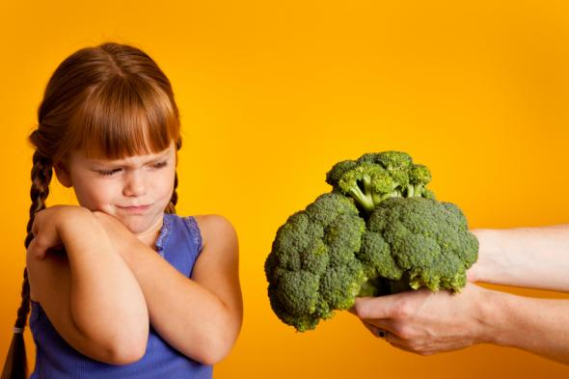
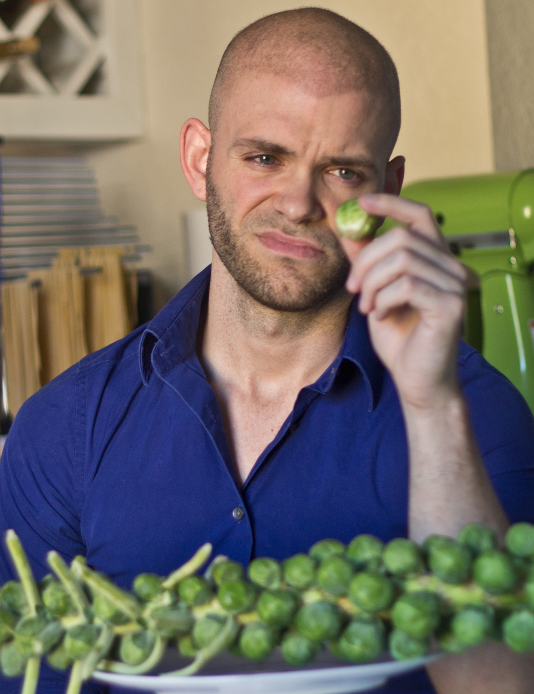
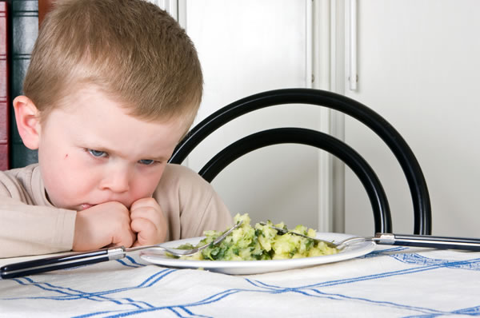
Many people taste a variety of nutritious vegetables as bitter, which contributes to rejection

Slide 7
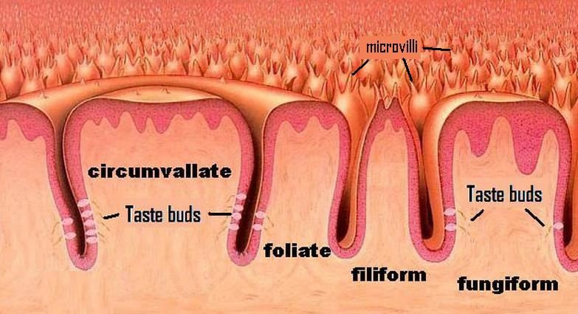
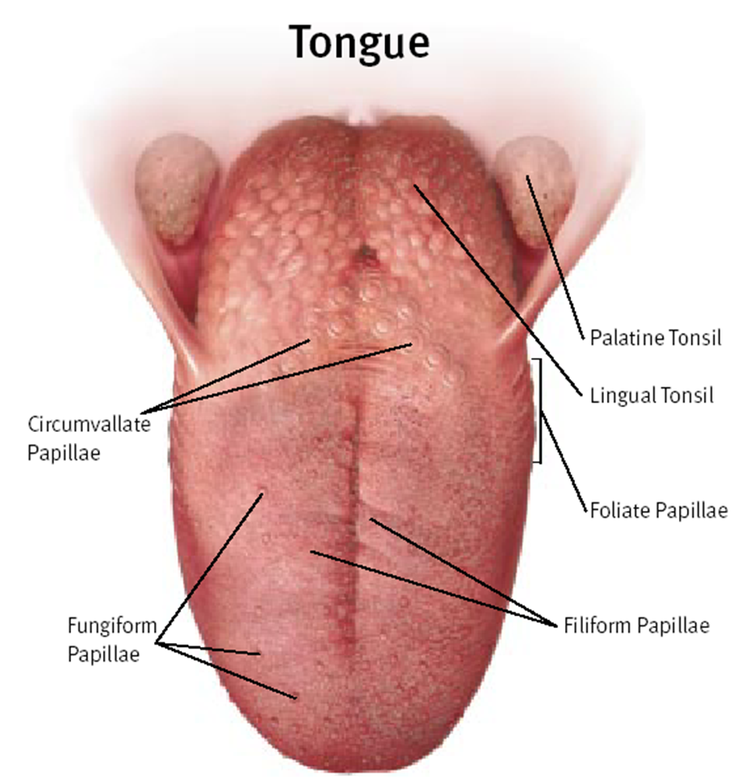
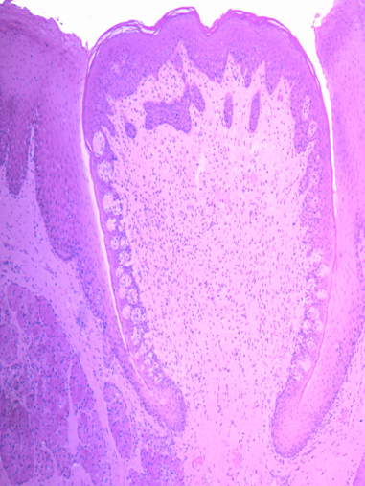
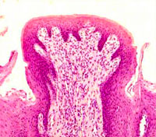
The tongue
Circumvallate
Papillae
www.newtonsapple.org.uk
Foliate
Papilae
Fungiform
Papillae
Filiform
Papillae
http://www.proprofs.com/flashcards/story.php?title=histology-block-3
Smith and Margolskee, 2001
Circumvallate
Fungiform
medcell.med.yale.edu

Slide 8
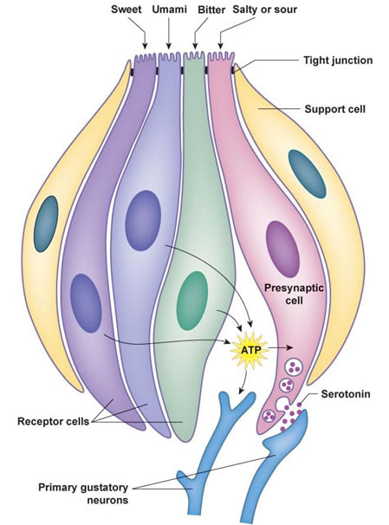
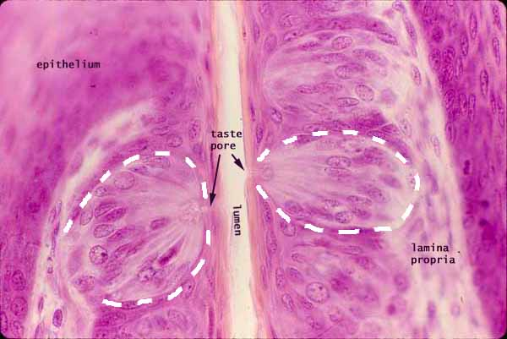
Taste buds
Support cells
(type I)
Presynaptic
cells
(type III)
Receptor
cells
(type II)
http://www.proprofs.com/flashcards/story.php?title=histology-block-3
Gustatory
neurons

Slide 9
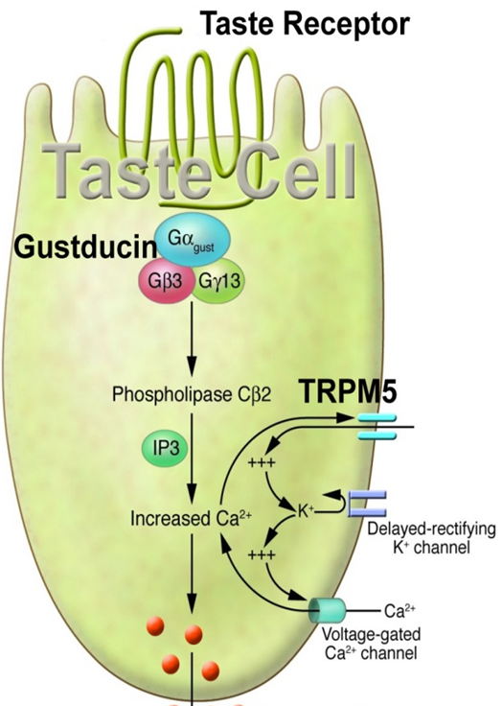
Transduction: Second messenger cascade
Receptor protein paired w/ G-protein. Subunits released upon binding
G-protein sub-units interact w/ enzymes, start chemical reactions
Calcium goes up (internal stores)
Ca2+ opens additional ion channels positive ions rush in
Cell depolarizes, releases messenger molecules outside
ATP

Slide 10
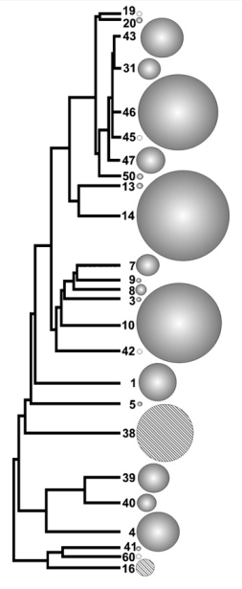
Selectivity of the 25 human bitter taste receptors
Bitterness of grapefruit juice
β-glucosides, salicin
Saccharin and Ace-K
Behrens and Meyerhof 2013 Seminars in Cell & Developmental Biology 24 215–221
Notes:
The TAS2R38 recognizes many compounds belonging to the class of isothiocyanates 16 salic (acetylsalicylic acid—the active ingredient
in aspirin).
. On the other hand,
TAS2R16 specializes in the so-called glucopyranosides—which
include substances that contain cyanide—such as those found in bitter almonds.
in (such as amygdalin
in bitter almonds or linamarin in manioc.
Even a single dose of one milligram of cyanide
per kilogram of body weight is lethal for most
mammals. A slight change in the genes for the
TAS2R16 receptor must have had a signiﬁ cant
inﬂ uence on feeding behavior, survival chances
and the spread of the human species vSigns of positive selection were also found for
TAS2R16
encoding a receptor for
βglucopyranosides.
Its ancestral allele associated with lower sensitivity to
β
-glucopyranosides
is under positive selection only in central Africa, while the evolutionarily derived allele
associated with an increased sensitivity is under positive selection in the rest of the world. It
is suggested that the global pattern of allelic variation of the
TAS2R16
gene depends on
selective pressures of protection against malaria in Africa and protection against toxins in
malaria-free zones
Almost all people who live outside of Africa have a super-sensitive version of the gene. About 15% of people in Africa have a less sensitive version. Why? Because some of the same compounds can be metabolized to fight malaria.

Slide 11
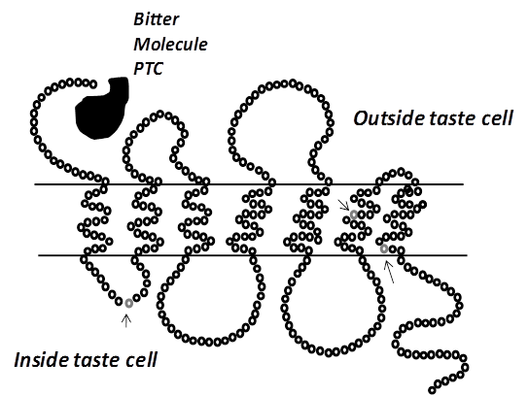
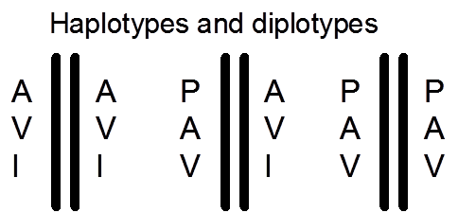
V262A
I296V
A49P
“Non-taster”
“Taster”
“Super-taster”

Slide 12
Intensity
[PTC] M
Bufe et al 2005

Slide 13
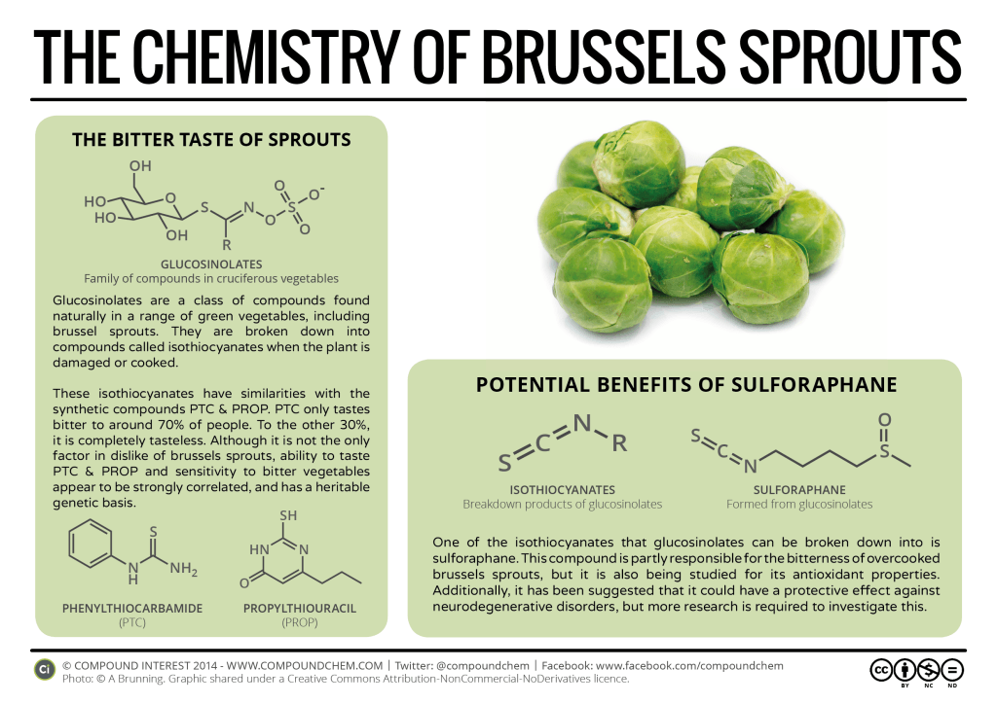

Slide 14

Glucosinolate-Containing
Vegetables
NonGlucosinolate-Containing
Vegetables

Slide 15
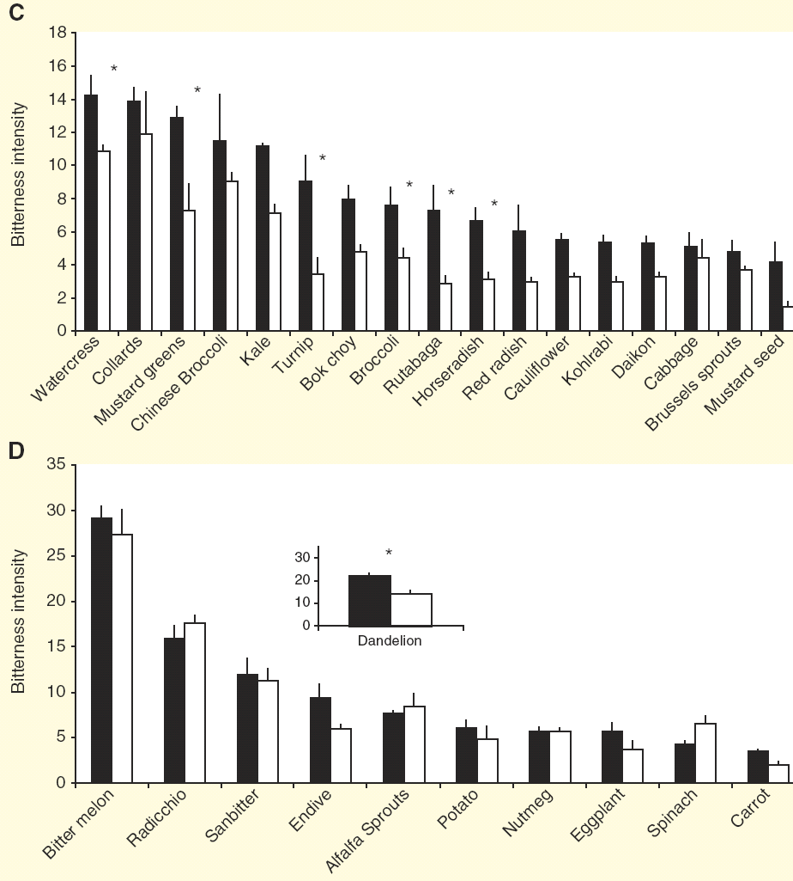
Responses to Individual Vegetables By Genotype of Subjects
Sandell and Breslin, Current Biology (2006) 16: 792-794

Slide 16
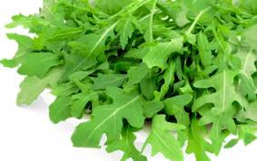
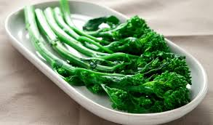
Interim conclusion:
Genetic differences in bitter taste receptors are associated with individual differences in bitter perception, even in some complex foods
But, practically speaking, what can we do about bitterness?

Slide 17
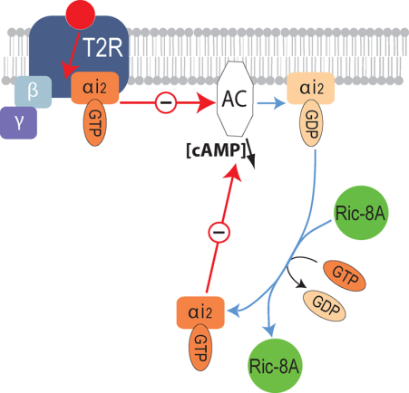
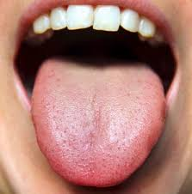
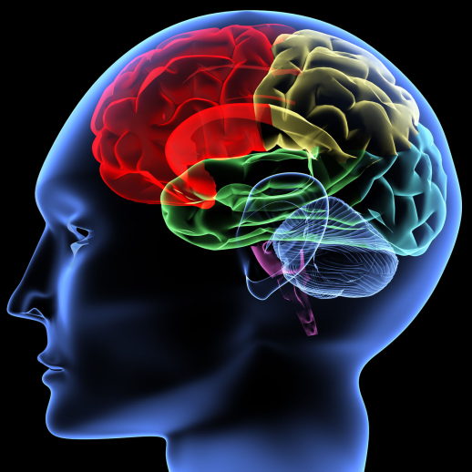
Basic strategies for blocking bitterness
Biophysical: bind bitter compounds, but break down after swallowing (e.g., lipids and cyclodextrins). [Coupland and Hayes (2014) Pharm Res 31:2921 – 2939.]
Peripheral: Block the response of the bitter receptor(s) (e.g., sodium).
Central: Reduce the perception of bitterness using sensations that interact with bitterness in the brain (sweet taste, aroma).
Peripheral
(at the tongue)
Central
(in the brain)

Slide 18
Na+ suppresses bitterness
Percent Bitterness Suppression
Keast and Breslin Pharmaceut. Res. 2002
Notes:
USA 3500 mg per day, IOM suggests 2300 mg/day (1500 mg for those with risk for hypertension).

Slide 19
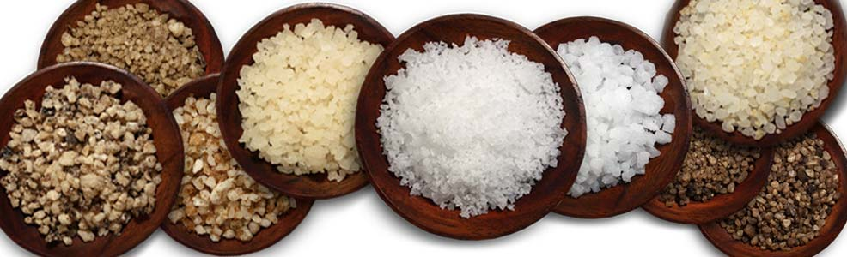
Using a peripheral interaction:
Blocking bitter in broth
Point 1: Demonstration that Na+ blocks bitterness
Point 2: It’s not the saltiness, it’s the Na+

Slide 20
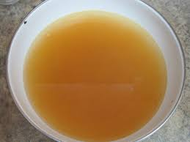
Sensory Experiments:
Very low Na+ broth, warm
  Experiment 1, chicken flavor only
  Experiment 2, chicken flavor plus savory ingredients
Three salt conditions
  No added salt
  128 mM NaCl
  171 mM KCl
Four levels of L-tryptophan (model bitter)
Healthy adults rated saltiness and bitterness
Notes:
USA 3500 mg per day, IOM suggests 2300 mg/day (1500 mg for those with risk for hypertension).

Slide 21
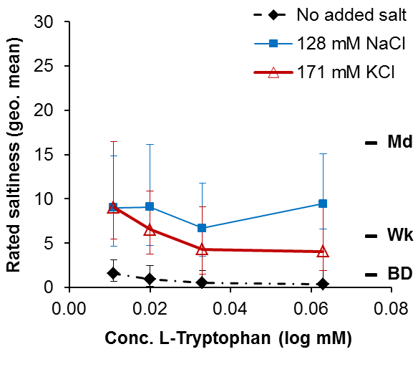
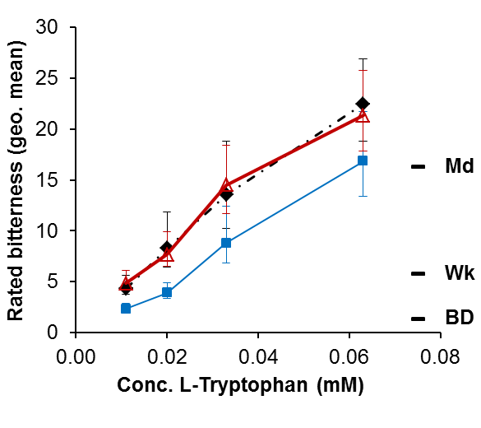
Experiment 1: Just chicken flavor
Concentration of L-tryptophan (mM)
Saltiness: [KCl = NaCl] > No salt
Bitterness: [KCl = No salt] > NaCl
Wise, Damani, Breslin, submitted
Notes:
USA 3500 mg per day, IOM suggests 2300 mg/day (1500 mg for those with risk for hypertension).

Slide 22
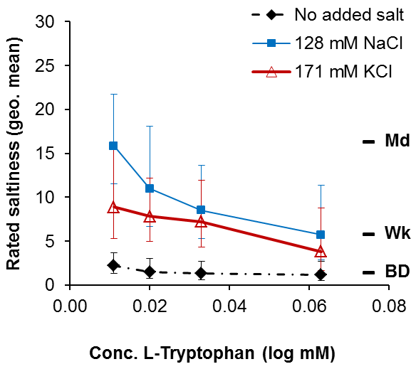
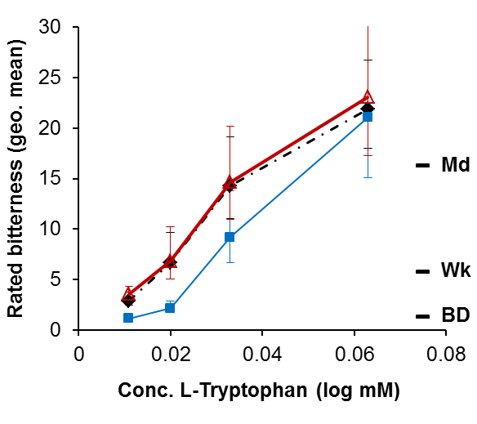
Experiment 2: Chicken + savory
Concentration of L-tryptophan (mM)
Saltiness: [KCl = NaCl] > No salt
Bitterness: [KCl = No salt] > NaCl
Wise, Damani, Breslin, submitted
Notes:
USA 3500 mg per day, IOM suggests 2300 mg/day (1500 mg for those with risk for hypertension).

Slide 23
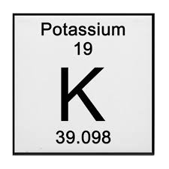
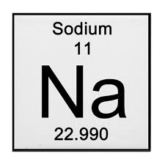
Interim conclusions:
KCl imparts saltiness to simple model foods, but does not block bitterness like sodium does.
KCl can replace saltiness in reduced Na+ foods, but cannot replace other important sensory benefits
Supports the proposition that sodium blocks bitterness, but not salty taste (peripheral effect)

Slide 24
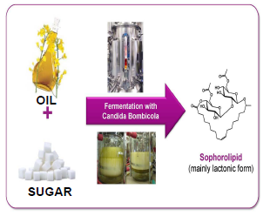
Possible example of biophysical action: Sophorolipids (bio-surfactant from fermentation of waste oil)

Slide 25
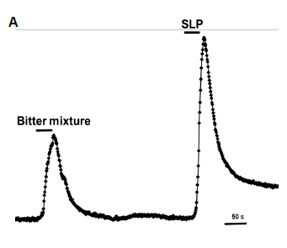
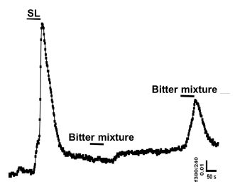
Sophorolipids block bitter responses in cultured human taste cells
Human taste cells
respond to SLP and a bitter cocktail
But after SLP, cells no longer respond
to bitter cocktail

Slide 26
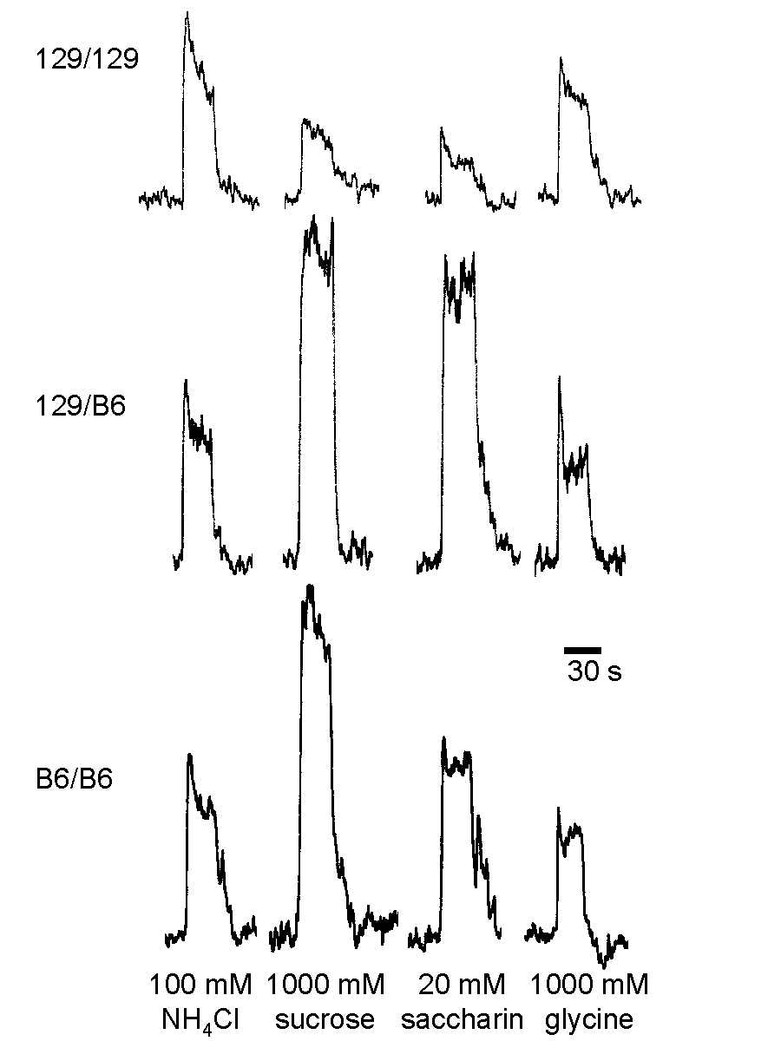
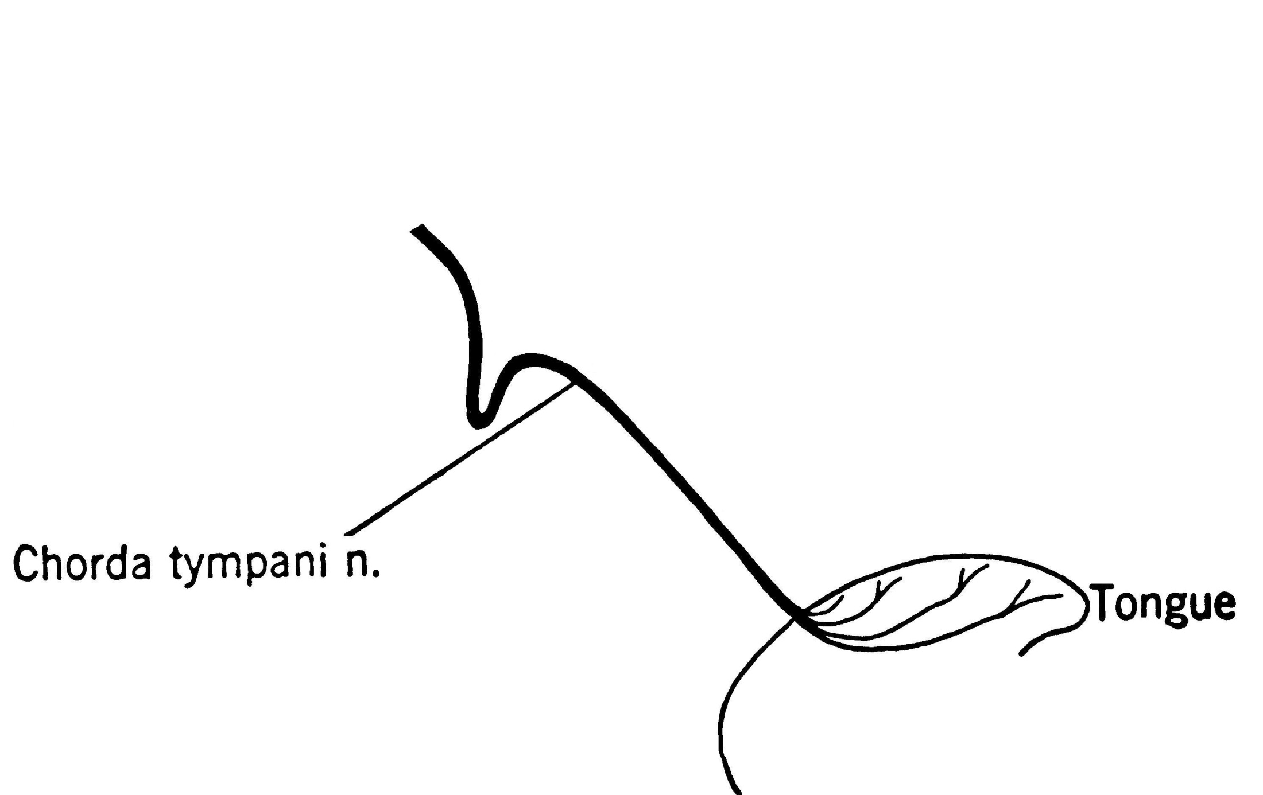
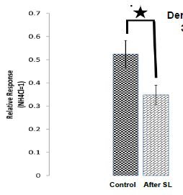
Sophorolipids block responses in mouse taste nerve to denatonium
Taste solution
Notes:
Amiloride-sensitivity of salt taste responses has been demonstrated in electrophysiological experiments.
Lingual application of taste solutions evokes activity in the chorda tympani gustatory nerve.

Slide 27
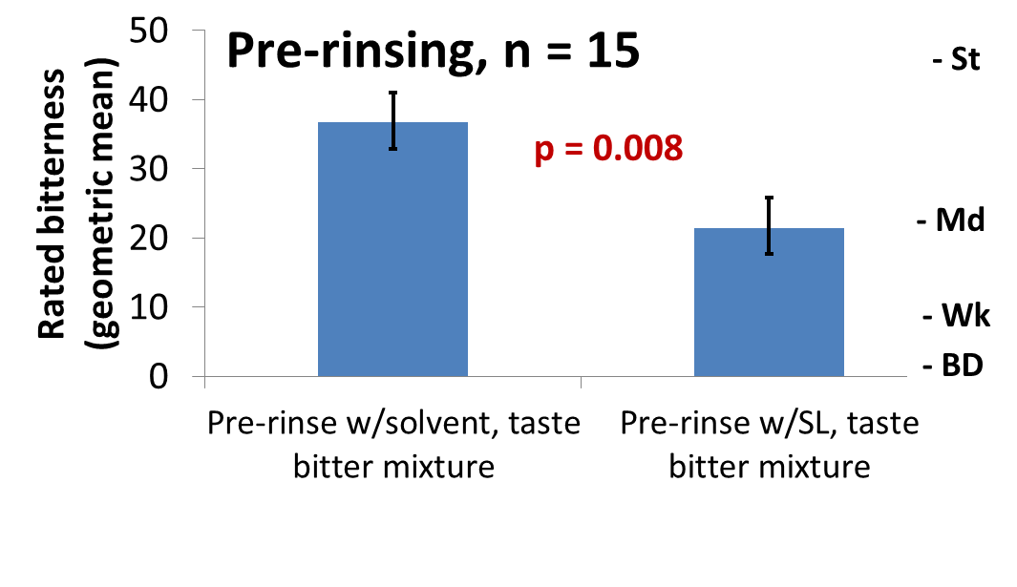
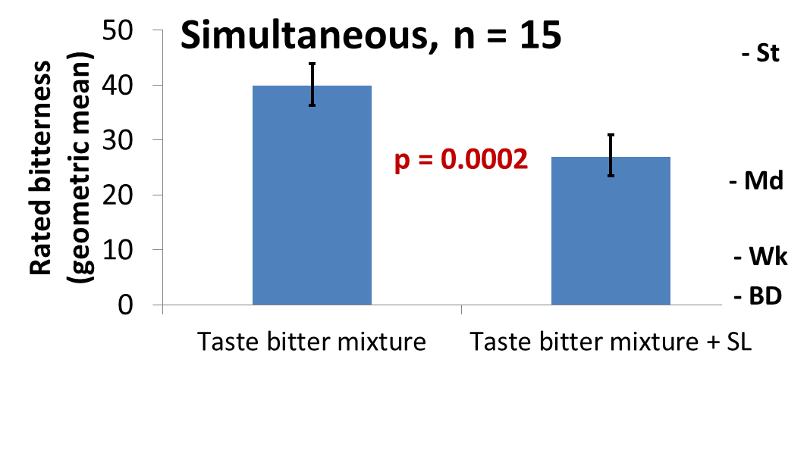
Sophorolipids block bitterness for people

Slide 28
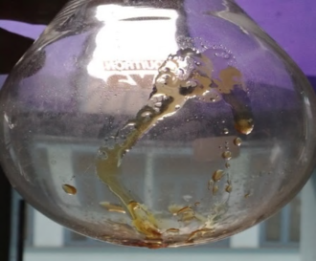
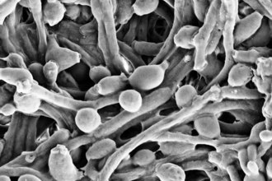
Interim conclusions:
SLPs block the responses to bitter compounds
  human taste cells
  mouse taste nerve
  people
SLPs seems to block the responses to a wide range of bitter compounds, suggestive of non-specific mechanism of action
Working on actual compounds of interest (e.g., anti-malarial drugs, HIV meds)

Slide 29
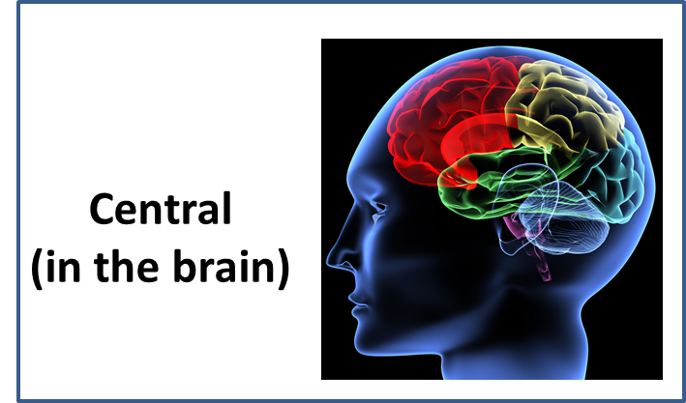
Using Central Interactions: Sweet-smelling aromas can enhance sweetness and suppress bitterness

Slide 30
fMRI shows that brain areas associated with flavor respond more strongly to NaCl + bacon odor than to NaCl + air (or NaCl + Strawberry)
Air+
Low
NaCl
Air+
Hi
NaCl
Bc.+
Low
NaCl
Bc.+
Hi
NaCl
St.+
Low
NaCl
St.+
Hi
NaCl
Contrast: [NaCl+odor]-NaCl
Seo et al. (2013). Human Brain Mapping 34, 62–76.

Slide 31
A smoky odor enhances salt and umami intensity
clean air
*p<0.05
vs. clean air
Increasing
Smoky
odor
Expected taste from
a smoky aroma
water
(no taste)
sucrose
NaCl
SOA
(bitter)
citric
acid
(sour)
msg/imp
(umami)
Isogai and Wise, unpublished

Slide 32
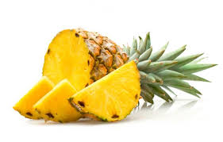
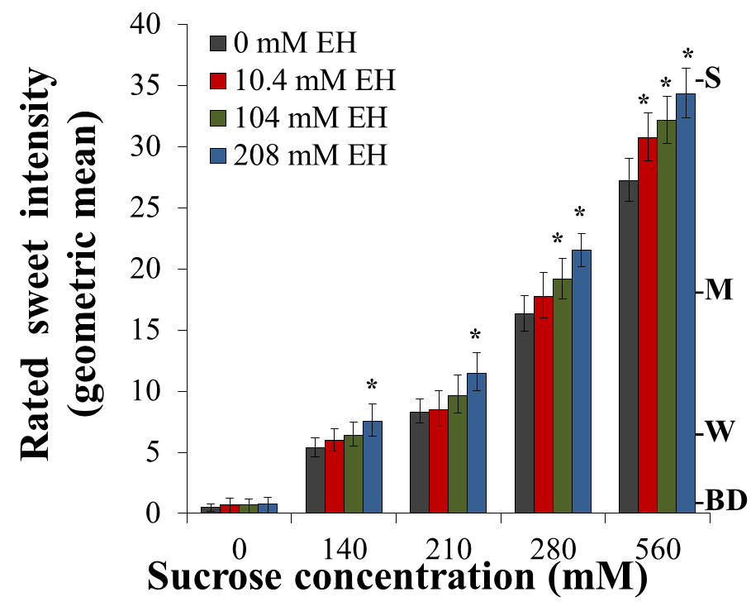
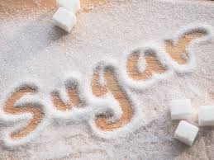
A “sweet” aroma enhanced sweetness
Ethyl hexanoate (“pineapple”)
+
Isogai and Wise, 2016. Chem. Senses

Slide 33
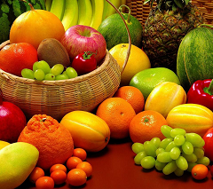

An experiment on how “sweet” aromas affect bitter taste
We measured the effect of adding the fruity ester ethyl hexanoate (EH) and vanillin (vanilla odor) on the rated bitterness of sucrose octaacetate

Slide 34
Both EH and vanillin suppressed the rated bitterness of SOA relative to a clean air blank (by about 20%)
Notes:
Talk about onsets, not timing? Not sure now what that note means

Slide 35
Interim conclusions
Smells can modulate the perceived intensities of tastes, consistent descriptions in taste terminology
Odors can suppress the perceived intensity of tastes, including an unpleasant bitter taste

Slide 36

Chemesthesis: Chemical Feel
Cooling
Warmth
Itch
Stinging
Burning
Tingling

Slide 37
To be felt, chemicals must stimulate nerve endings
Dusts/
Xenobiotics
(acyl-homoserine
lactones)
Chemical Stimuli
Epithelium
ATP

Slide 38

Transduction: Converting chemical stimuli into the electro-chemical signals used by the brain
Nerve cell membrane

Slide 39

TRP-V1 (VR1) is the receptor for capsaicin
2+
Ca
Na
+
TRP-V1 (VR1)
2+
Ca
Na
+
Voltage-gated
ion channels

Slide 40

TRP-V1 (VR1) is the receptor for capsaicin
, protons (pH<6.8)
or T>42ºC
2+
Ca
Na
+
TRP-V1 (VR1)
2+
Ca
Na
+
Voltage-gated
ion channels
2+
Ca
Na
+

Slide 41
TRP-V1 (VR1) is the receptor for capsaicin
, protons (pH<6.8)
or T>42ºC
2+
Ca
Na
+
TRP-V1 (VR1)
2+
Ca
Na
+
Voltage-gated
ion channels
2+
Ca
Na
+
Depolarization
initiates action
potentials

Slide 42

Several TRP channels participate in chemesthesis

Slide 43

Ibuprofen
“Irritates the throat”

Slide 44


Slide 45
Throat stinging compound:
(-)-decarbomethoxy-dialdehydic ligstroside aglycone
Oleocanthal
(oleo = olive; canth = sting; al = aldehyde)
Beauchamp et al., Nature: 2005

Slide 46
Synthesized oleocanthal falls on same concentration-intensity function as extra virgin olive oils
Synthetic oleocanthal
Beauchamp et al., Nature: 2005

Slide 47


MZ vs. DZ Twins: A Classic Design
Identical (monozygotic, or MZ) twins) have virtually 100% of their genes in common
Fraternal (dizygotic, or DZ) twins are no more closely related than any other pair of siblings (assumed to have about 50% of their genes in common)

Slide 48





Slide 49


Slide 50
Conclusions
Genetic contributions to individual differences, helps us understand underlying mechanisms, segment consumers
Blocking bitterness (drugs/foods), various ways to go about it, with some success
  Peripheral (at the receptors): Example Na+
  Biophysical (some lipids): Possible example, sophorolipids
  Central (in the brain): Sweet taste (which we didn’t discuss), aroma
Pungency of olive oil in the throat predicts content of a natural NSAID

