Slide 1
Improvements in validating predictions and solving multi-trait genomic models
Paul VanRaden¹ and Andres Legarra²
¹ USDA, Agricultural Research Service, Animal Genomics and Improvement Laboratory, Beltsville, MD, USA, paul.vanraden@usda.gov
² Council on Dairy Cattle Breeding, Bowie, MD, USA

Slide 2
Previous trip to Finland: 2006
2006 Interbull meeting in Kuopio had a session “Developments in international genetic evaluation.” I chaired it and the speakers included:
  Esa Mäntysaari: variance components for the new Denmark-Finland-Sweden (DFS) test day model
  Martin Lidauer: modeling the combined DFS data
  Jukka Pösö: experiences with DFS data, and
  Kjell Johansson: the new DFS udder health EBVs.
I remember it because my flight was cancelled and I missed the first meeting day before that session.

Slide 3
Topics
Multitrait models and unknown parent groups (UPG)
  Benefits from MT are largest with more missing data
  Combine newly measured traits with correlated old traits
  Estimate UPG trends from correlated response to old traits
  Examples for USA fertility traits
Validation research: continuing with ideas from Esa
  Need for new genomic validation

Slide 4
Topic 1: MT modeling of fertility as example
Reporting only traditional pedigree-based evaluations (before testing ssGBLUP) and starting with most difficult set of traits
Fertility traits models and algorithms are complex because:
  Low heritability with different lactation weights and data pattern for each trait
  Correlated, negative genetic trends caused by selection for yield
  Correlations might change (natural mating vs. AI; hormonal treatments; heat detection)
  Latest UPG also unstable because heifer fertility arrives before cow fertility

Slide 5
Fertility traits
Focus is on CCR and DPR with high genetic correlation of 0.86
Goal: Estimate 40 years of missing UPGs for CCR from only DPR data
Advice from U GA: Truncate the first 40 years of data!
Excellent advice, but MT UPG with missing traits is still a useful, general issue to solve.
Trait | Name | Recorded since:
CCR | Cow Conception Rate | 2000
HCR | Heifer Conception Rate | 2000
DPR | Daughter Pregnancy Rate | 1960
EFC | Early First Calving | 1960

Slide 6
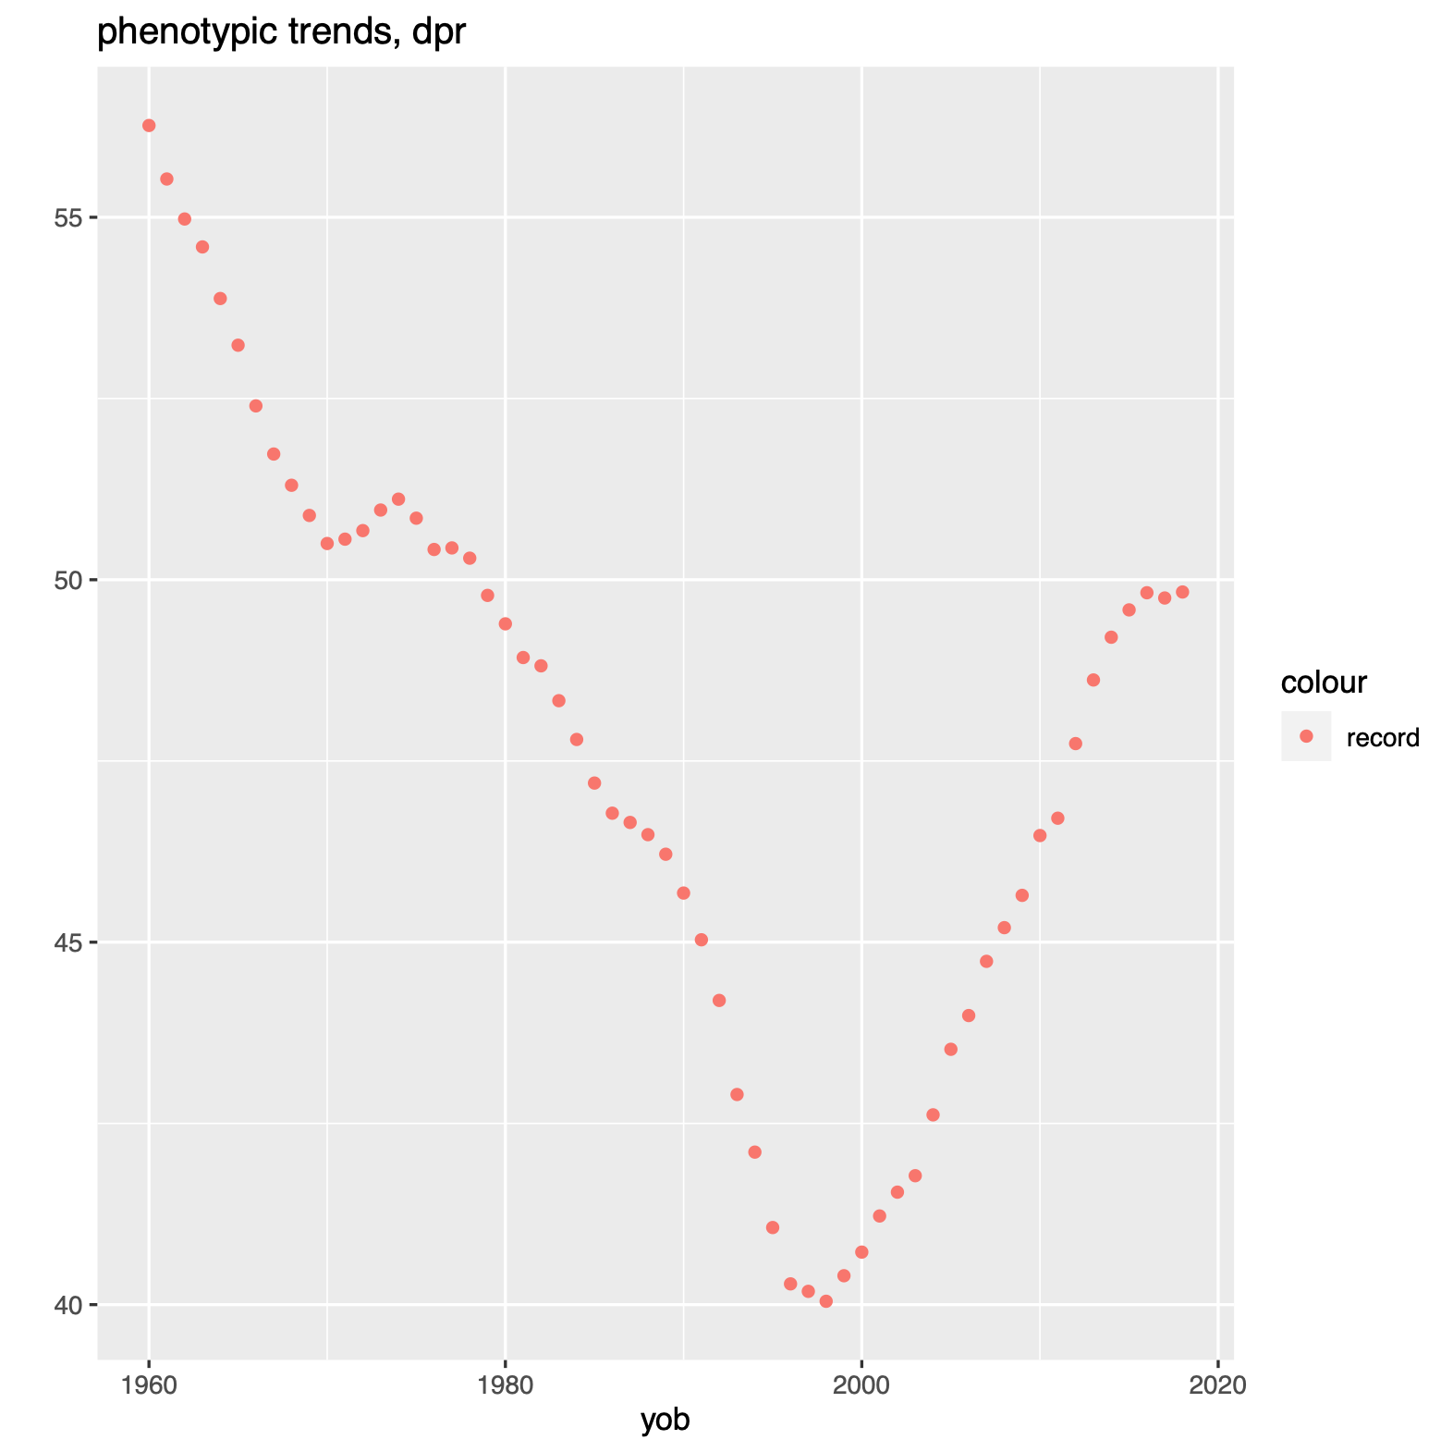
Phenotypic trend for DPR of Holsteins
21-day pregnancy rate averaged:
  57% in 1960
  40% in 1998
  50% for cows born in 2020
Selection index included:
  Milk yield since 1935
  Longevity since 1994
  Fertility since 2003

Slide 7
MT models and UPGs for missing traits
Masuda et al (2022 JDS) Invited review: Unknown-parent groups and metafounders in single-step genomic BLUP.
  MT models were never mentioned
  Most software packages never tested such unbalanced trait patterns
VanRaden et al (2014 JDS) Comparison of single-trait to multi-trait national evaluations for yield, health, and fertility.
  Tested 6-trait model with milk, fat, protein, PL, and DPR since 1960 plus SCS since 1982
  Tested 3-trait fertility model but with poor convergence and forced early UPG for CCR and HCR to have no trend, causing bias in DPR trend.

Slide 8
UPG solving strategies
Use full rank A⁻¹ or singular A⁻ with UPGs included?
  Define genetic base in advance (Iowa State strategy) or after converging to any base (Cornell strategy)
  Converging to anywhere usually faster than to predefined base
Apply trait genetic covariance matrix T also to UPGs (A⁻ ⊗ T)?
  Missing UPG solutions have data via T, even if treated as fixed
  Measured traits contribute to solutions for missing trait UPGs
Include UPG in the EBV or as separate contribution? (Affects convergence)

Slide 9
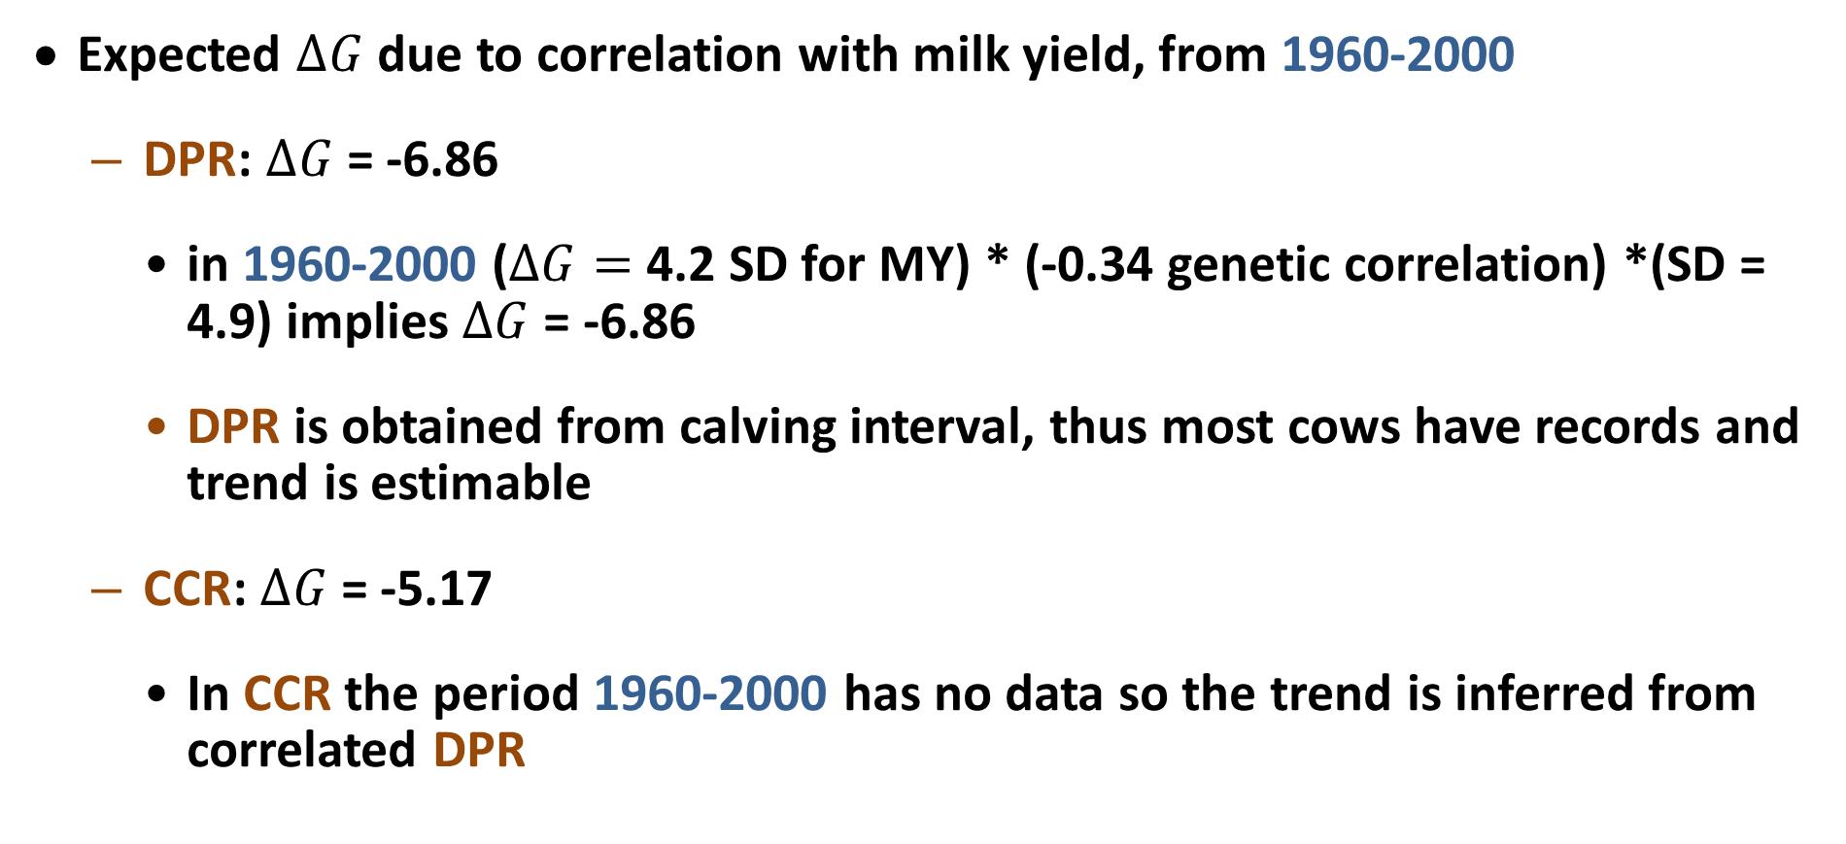
Observed and expected genetic trends
Expected $∆G$ due to correlation with milk yield, from 1960-2000
  DPR: $∆G$= -6.86
    in 1960-2000 ($∆G=$ 4.2 SD for MY) * (-0.34 genetic correlation) *(SD = 4.9) implies $∆G$= -6.86
    DPR is obtained from calving interval, thus most cows have records and trend is estimable
  CCR: $∆G$= -5.17
    In CCR the period 1960-2000 has no data so the trend is inferred from correlated DPR

Slide 10
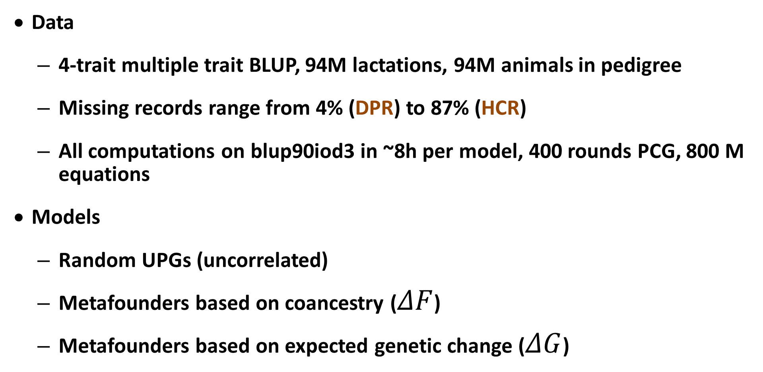
Fertility data and models tested
Data
  4-trait multiple trait BLUP, 94M lactations, 94M animals in pedigree
  Missing records range from 4% (DPR) to 87% (HCR)
  All computations on blup90iod3 in ~8h per model, 400 rounds PCG, 800 M equations
Models
  Random UPGs (uncorrelated)
  Metafounders based on coancestry ($ΔF$)
  Metafounders based on expected genetic change ($ΔG$)

Slide 11
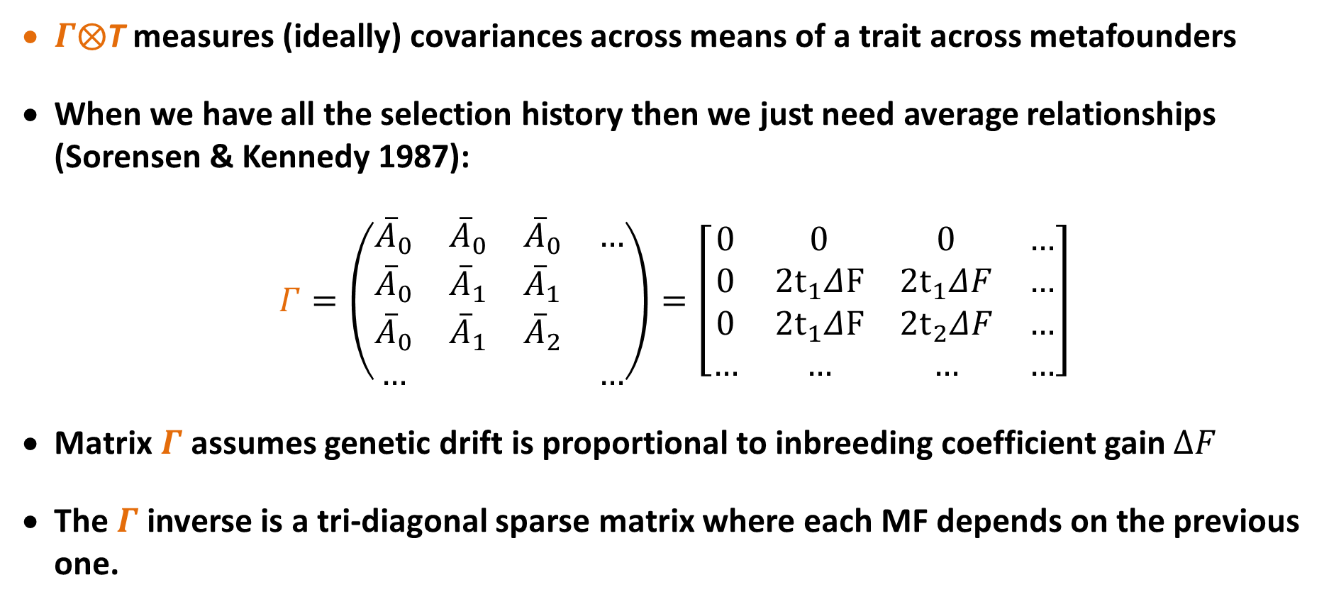
Metafounder model
$Γ⨂$T measures (ideally) covariances across means of a trait across metafounders
When we have all the selection history then we just need average relationships (Sorensen & Kennedy 1987):
$$Γ=\left(\begin{matrix}{\overline{A}}_{0} & {\overline{A}}_{0} & {\overline{A}}_{0} & … \\ {\overline{A}}_{0} & {\overline{A}}_{1} & {\overline{A}}_{1} & \\ {\overline{A}}_{0} & {\overline{A}}_{1} & {\overline{A}}_{2} & \\ … & & & …\end{matrix}\right)=\left[\begin{matrix}0 & 0 & 0 & … \\ 0 & 2t_{1}ΔF & 2t_{1}ΔF & … \\ 0 & 2t_{1}ΔF & 2t_{2}ΔF & … \\ … & … & … & …\end{matrix}\right]$$
Matrix $Γ$assumes genetic drift is proportional to inbreeding coefficient gain $∆F$
The $Γ$inverse is a tri-diagonal sparse matrix where each MF depends on the previous one.

Slide 12
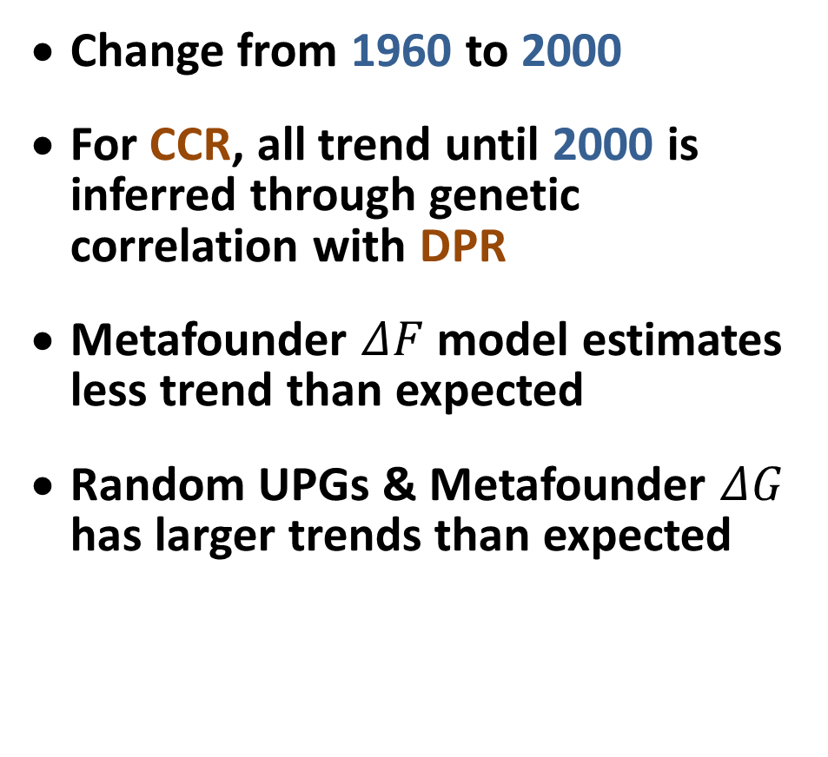
Genetic and phenotypic trends for fertility
Change from 1960 to 2000
For CCR, all trend until 2000 is inferred through genetic correlation with DPR
Metafounder $ΔF$ model estimates less trend than expected
Random UPGs & Metafounder $ΔG$ has larger trends than expected
Trend | DPR | CCR
Phenotypic | -16
Expected genetic | -6.9 | -5.2
Random UPG | -9.0 | -9.0
MF_DeltaF_1 | -4.0 | -5.3
MF_DeltaF_2 | -5.2 | -5.3
MF_DeltaG | -8.7 | -7.6

Slide 13
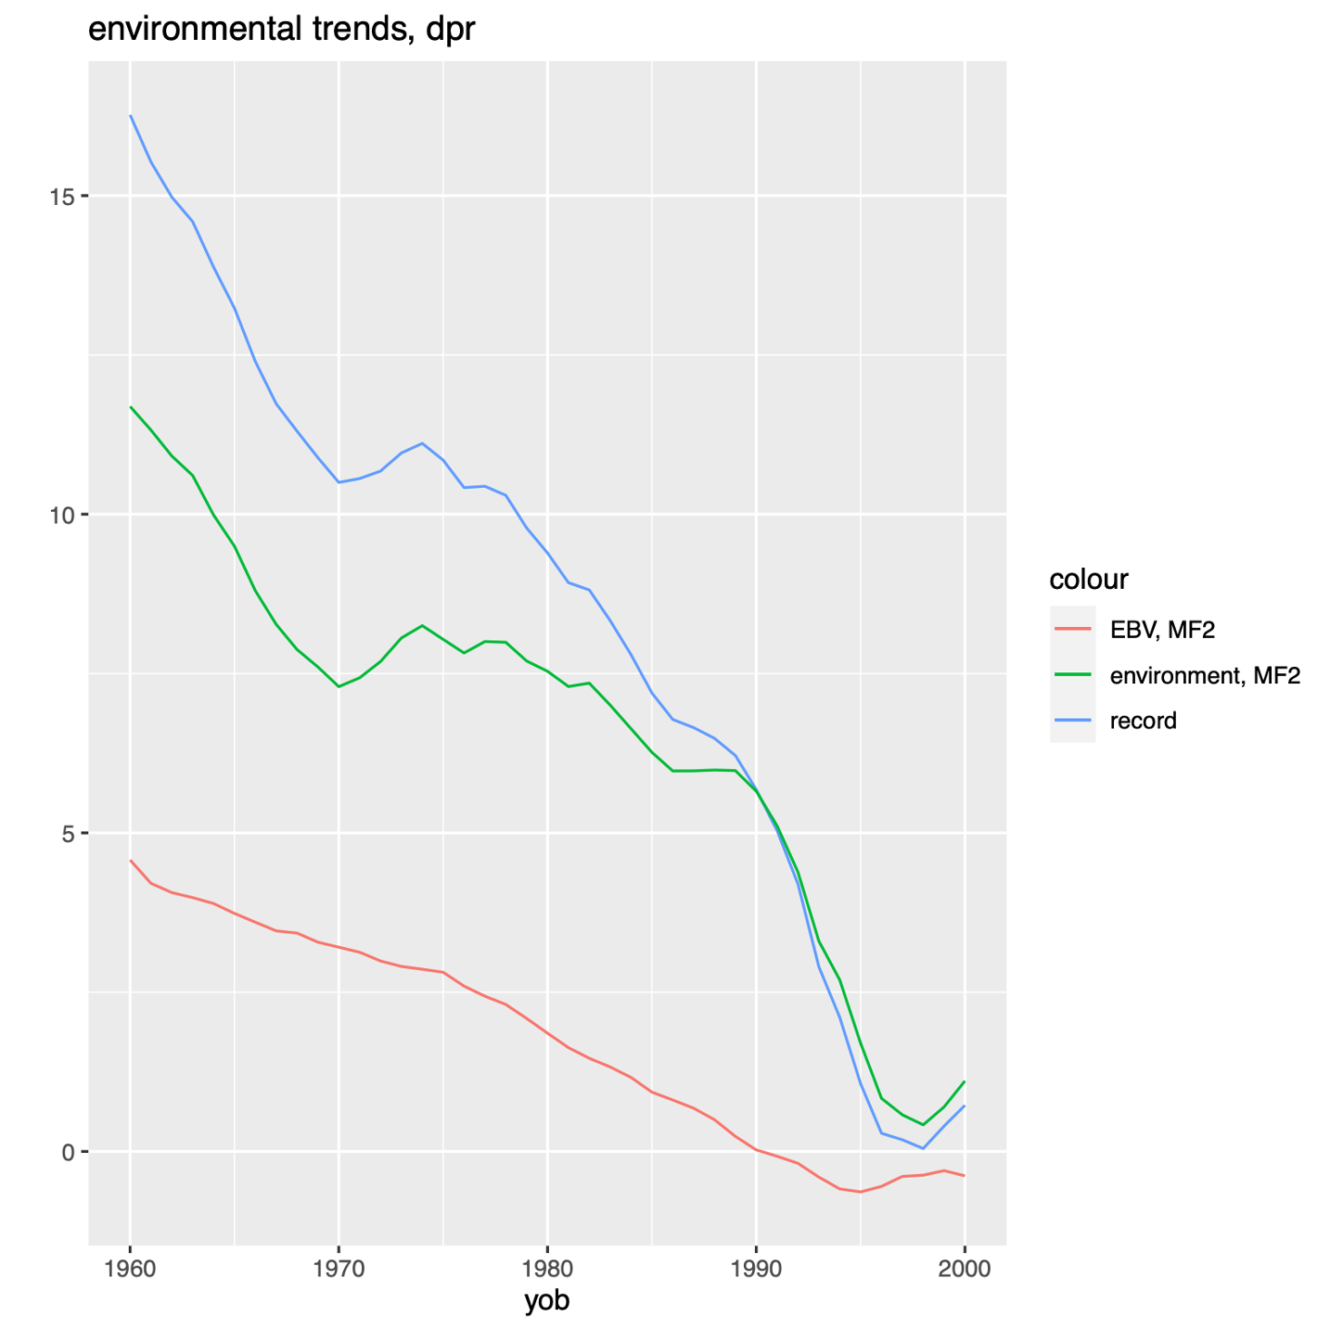
Past environmental vs. genetic trend - DPR
For years 1960-2000, the negative phenotypic trend for DPR is split by MF 𝛥F model into:
  69% environmental trend
  31% genetic trend
Random UPG model (not shown):
  44% environmental trend
  56% genetic trend
Phenotype
environment
genetic

Slide 14
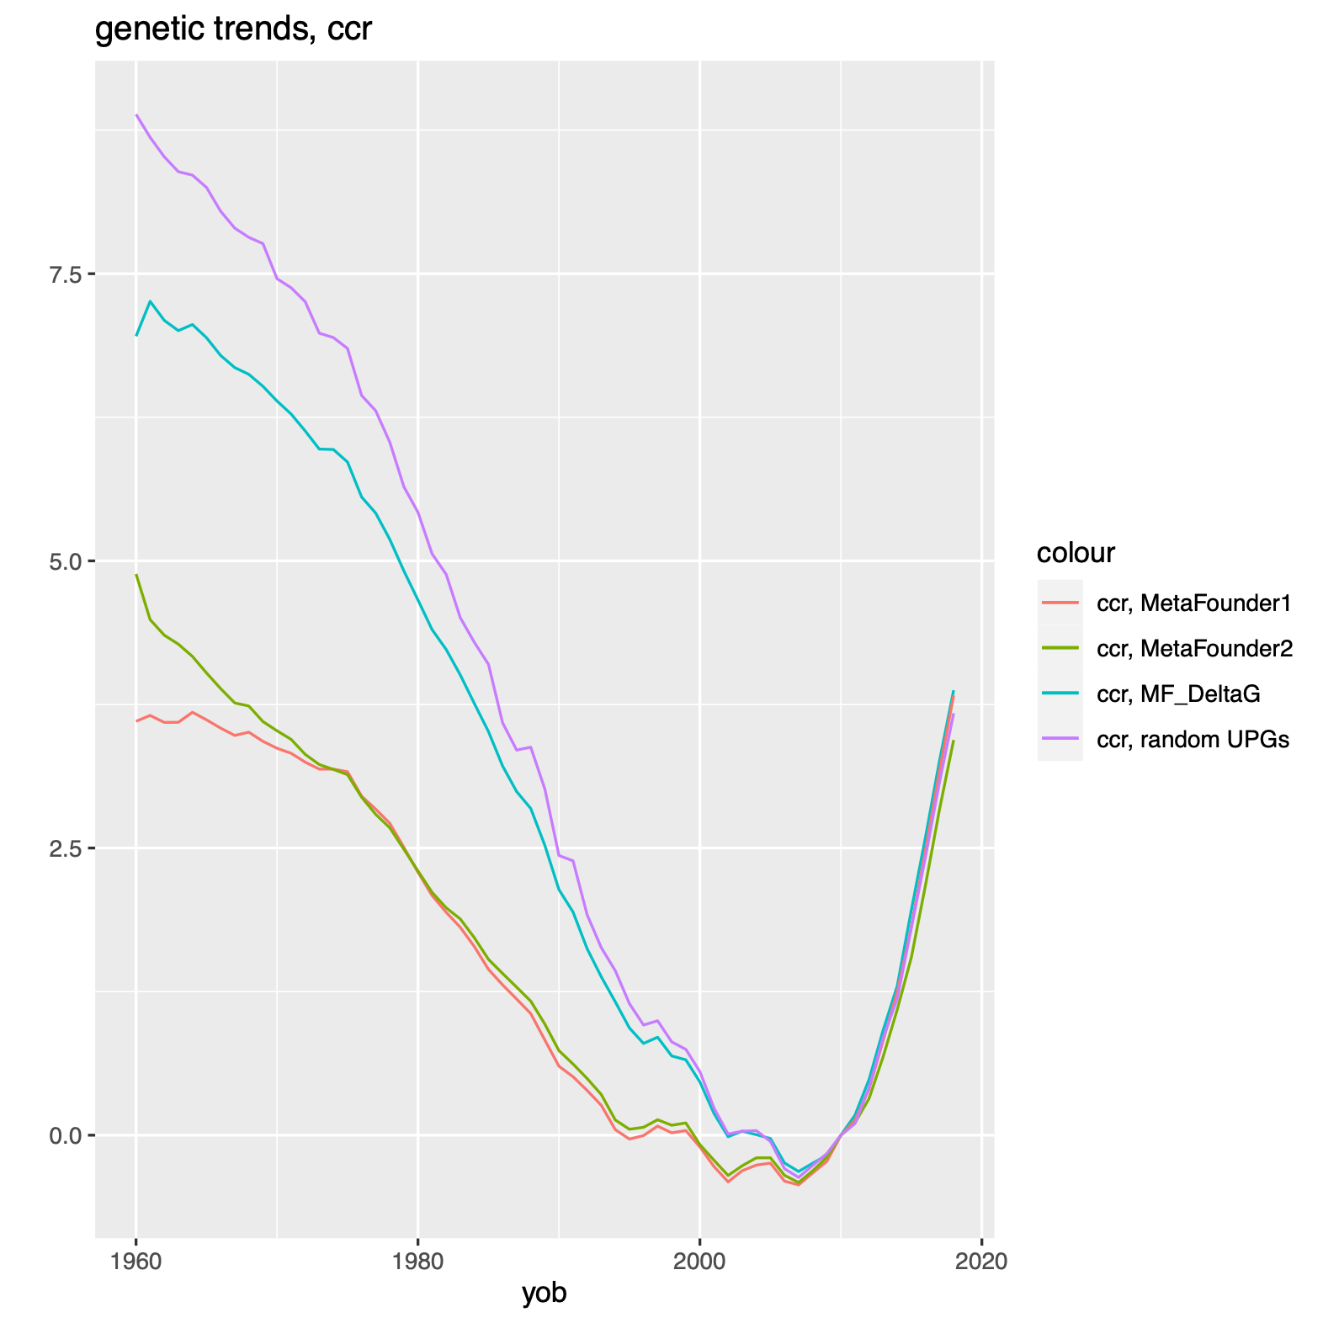
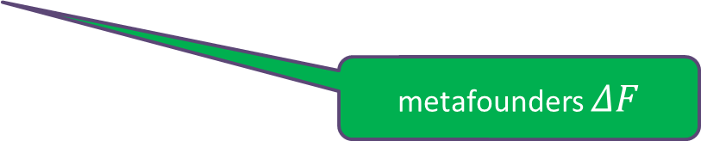
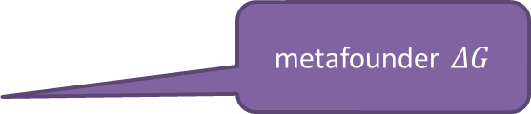
UPG effects on genetic trend for CCR
CCR trend pattern similar to DPR trend, as expected
Random UPG estimated most trend for CCR
MF 𝛥𝐺 also estimated more trend than expected
MF 𝛥F estimated less trend than expected
random UPG
metafounder $ΔG$
metafounders $ΔF$

Slide 15
Topic 2: Need for new genomic validation
Problem:
  Validation bulls are a pre-selected subset of bulls born
  Analysis of new data must account for previous selection
  But the new data should be independent of previous data
Solution:
  Compute final GEBVs including new and truncated data
  Then deregress to isolate the new vs. truncated data

Slide 16
Progress
Genomic validation software revised by Pete Sullivan
  February: Predict (deregressed) GEBV instead of EBV or DYD
  Feb Workshop reports from (DEU, NLD, USA, CAN)
  March, August: Allow B1 > 1.2, pass/fail/hiSE, easier use
Studied other options for genomic deregression and weighting
Reviewed trend validation tests I, II, and III
Simulation results of Judith Himmelbauer (Zuchtdata, Austria)

Slide 17
Small data validation (from Feb): USA Guernsey
Trait | Bulls | B1 | S.E.(B1) | R² GEBV | R² PA | Pass / Fail
Milk | 19 | 0.92 | 0.22 | 51 | 36 | Pass
Fat | 19 | 0.51 | 0.18 | 32 | 34 | Fail
Protein | 19 | 0.77 | 0.25 | 36 | 26 | Pass
SCS | 18 | 1.48 | 0.43 | 42 | 19 | Fail
Longevity | 7 | 0.52 | 0.52 | 37 | 5 | Pass
DPR (int) | 19 | 0.62 | 0.62 | 18 | 30 | Fail
Mota — Interbull Workshop - Feb 2023

Slide 18
USA summary from February Workshop
Larger breeds and more heritable traits had more stable results
Smaller breeds and less heritable traits are hard to validate. Tests often fail:
  B₁ more or less than expected from S.E., which may be underestimated.
  Upper biological limit of 1.2 should allow for S.E. of B₁
  R² of parent average may exceed GEBV with small sample sizes
Mota — Interbull Workshop - Feb 2023

Slide 19
Retest with new deregression – HOL milk
Deregression was too small
Compared EDCdif / (EDCtotal + k) to previous EDCdif / (EDCdif + k)
Example: applied to USA HOL milk, same table as VanRaden (2021)
B1 is further from 1.0 with larger S.E., but t-tests are similar
Model R² more similar to DYD R²
DYD ignores genomic selection
Dep. |  | t-test |  | R²
Var. | B1 | B1 | B0 | Resid | Model
DYD | 1.027 | 1.9 | −14.4 | 0.10 | 59
DRPo | 0.990 | −0.9 | −16.5 | 0.02 | 69
DRPn | 0.985 | −1.1 | −16.7 | 0.03 | 60
GEBV | 0.992 | −0.8 | −16.3 | 0.02 | 72

Slide 20
Possible weight revision
Deregression formula was revised and new weighting option was considered
y = Xb + Zu + e
Solve to obtain b^ and u^, the observed residuals e^ can be computed as:
e^ = y - Xb^ - Zu^
y could be weighted by Var(e^) including PEV, but MME use only Var(e).
Choice probably makes little difference since young bull REL very similar.
Simulation could verify if Var(e) is more precise than Var(e^).

Slide 21
LR regression
Predict later published GEBV from earlier published GEBV
  Simple to use without deregression, weights, or precomputed REL
  Similar to Verify program used for all EBVs since 2002
  Klei et al. (2002 Interbull Bulletin) used REL to compute expected change
  GVerify is applied to GEBVs to check consistency from 4 months earlier
Can apply Verify to 4-year instead of 4-month truncated EBVs (TMACE)
Use a series of truncation times to get smaller S.E. in small populations

Slide 22
Status of trend tests I, II, and III
Test I: Difference of first vs. all lactation genetic trends
  Still useful for repeated records models with single EBV
Test II: Difference in DYD across time
  Few people get DYD for difficult traits or single-step models
Test III: Trend in 2nd crop daughters by year of birth
  Less useful because few proven bulls are returned for years of service
  Instead, check trends for young bulls as they add daughters?
  Make math more precise using regression instead of year counts?

Slide 23
Status of genomic validation
Revised gebvtest.py is ready:
  Uses later GEBV or deregressed GEBV instead of later DYD or deregressed EBV as dependent variable (better for ssGBLUP)
Future options for genomic validation:
  Add regression on age to test if genetic trend in young bulls changes when they later add daughter records
  Add other regressions such as for PA or inbreeding
  Estimate S.E. for R² by bootstrapping (Legarra et al, 2014)

Slide 24
Current and future validation options
Tests I, II, and III check for bias in proven bull genetic trend
Test IV checks for stability of EBV variance (MS)
Genomic validation checks if young bull GEBV match later DYD
Future options for genomic validation:
  Use later GEBV or deregressed GEBV instead of later DYD or deregressed EBV as dependent variable (better for ssGBLUP)
  Add regression on age to test if genetic trend in young bulls changes when they later add daughter records
  Add other regressions such as for PA or inbreeding

Slide 25
Simulation results
Himmelbauer et al., 2023. Comparison of different validation methods for single-step genomic evaluations based on a simulated cattle population. J. Dairy Sci. (August)
Genomic pre-selection biases tests of DYD or deregressed EBV
Tests of GEBV and dGEBV do account for selection
Most tests identify direction but not size of true bias
Use cows instead of bulls to validate small populations?
  Similar to using foreign bulls to validate domestic math
  YD of cows still predict well due to less selection

Slide 26
Validation summary and questions
The working group did a lot of work.
Do new tests produce too many FAILing grades (use 0.8 to 1.2)?
Should all GEBV tests now use the revised instead of previous software?
Any other revisions needed this year?
Mäntysaari et al. (2010) “Interbull validation test for genomic evaluations” is the most highly rated Interbull Bulletin paper of all time (191 citations). Happy retirement to Esa!

Slide 27


Acknowledgments
Interbull Validation Working Group
  Esa Mäntysaari (chair emeritus), Pete Sullivan, Raphael Mrode, Zengting Liu
CDCB staff (Rodrigo Mota) for testing
CDCB industry cooperators for data
AGIL staff and USDA funding of project 8042-31000-113-000-D, “Improving Dairy Animals by Increasing Accuracy of Genomic Prediction, Evaluating New Traits, and Redefining Selection Goals”

