Slide 1
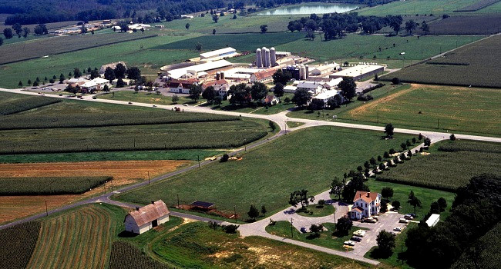
Beltsville dairy
breeding experiments
1912-2024
Paul VanRaden
USDA, Agricultural Research Service, Animal Genomics and Improvement Laboratory, Beltsville, MD
Email: paul.vanraden@usda.gov
Project web site: USDA-ARS-AGIL

Slide 2



ANIMAL GENOMICS & IMPROVEMENT LAB (AGIL)
1
Accelerating Genetic Improvement of Ruminants Through Enhanced Genome Assembly, Annotation, and Selection
2
Improving Dairy Cow Feed Efficiency and Environmental Sustainability Using Genomics and Novel Technologies to Identify Physiological Contributions and Adaptations
3
Increasing Accuracy of Genomic Prediction, Developing Algorithms, Selecting Markers, and Evaluating New Traits to Improve Dairy Cattle
(AIPL)

Slide 3
Breeding experiments at BARC 1912-2024
Extreme inbreeding (HO, GU) 1912-1949
  Separate slides at:
  https://www.ars.usda.gov/ARSUSERFILES/80420530/PRESENTATIONS/2002/INBRED.PPT
Four-breed crosses (HO, JE, GU, and 22 RD imported from DNK) 1939-1954
Feed efficiency of different breeds (AY, BS, HO) 1957-1969
Selection for milk yield vs. net merit (HO) 1970-1983
Transgenic cows (JE) that resist mastitis 2000-2005
High vs. low residual feed intake (HO) 2018-2024

Slide 4
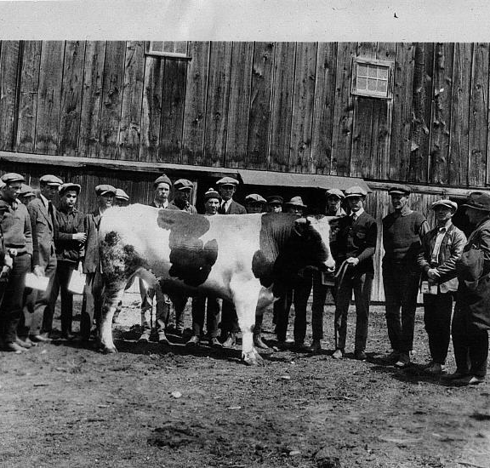
Development of progeny testing programs
Beltsville and other ARS field stations obtained sons of the best DHI proven sires.
Loaned the young bulls to farmers who agree to test the daughters and provide their DHI data.
More than 1,200 young bulls were loaned by 1956.
>75% of those bulls’ daughters averaged higher yield than the dams

Slide 5
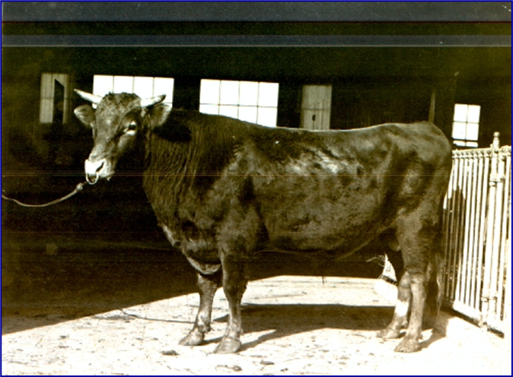
Extreme inbreeding 1912-1949
Dairy breeding program modelled after hybrid corn.
Foundation Guernsey sire (Prince Billy) imported from the Isle of Guernsey in 1910
  Guernsey line died due to lethal recessive and Brucellosis epidemic
Foundation Holstein sire (Lad 11th) purchased from Minnesota in 1912
  Holstein birth weights decreased from 37 kg to 29 kg
  Milk yield decreased by 7% and fat yield by 17% with inbreeding levels near 50%
“Continued inbreeding of whole herds, however, is almost certain to be disastrous.”

Slide 6
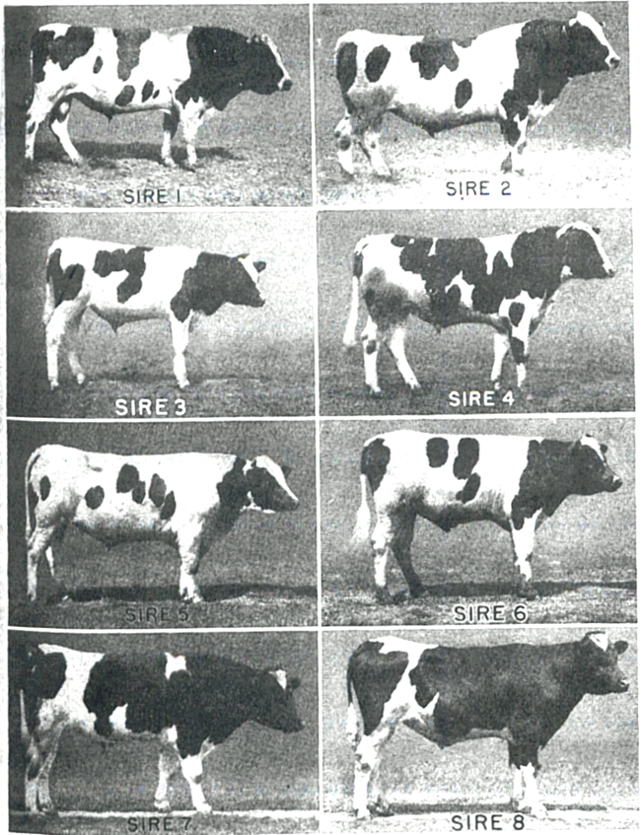
Experimental design
8 consecutive generations of mating sires to their daughters, and dams to their sons
  8 herd sires used at Beltsville 1912-1949 are shown on right
  Each more inbred than the last
Highest inbreeding coefficients ever obtained in dairy cattle (maximum F = 75.1%)

Slide 7
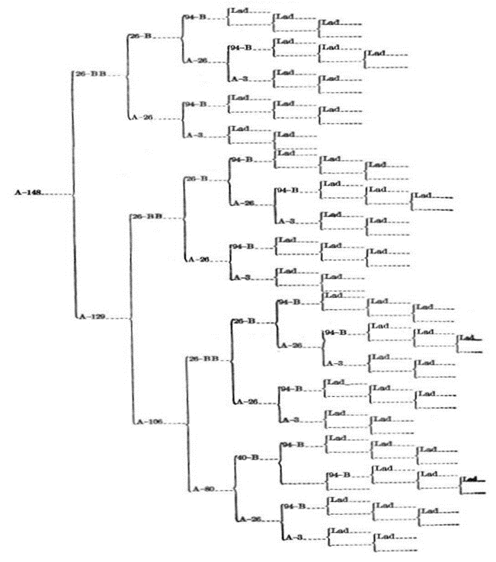
Example of extreme inbreeding
Pedigree for Holstein cow A-148
Sire 1 (Lad) from Minnesota appears 50 times in her pedigree
64.6% inbreeding coefficient

Slide 8
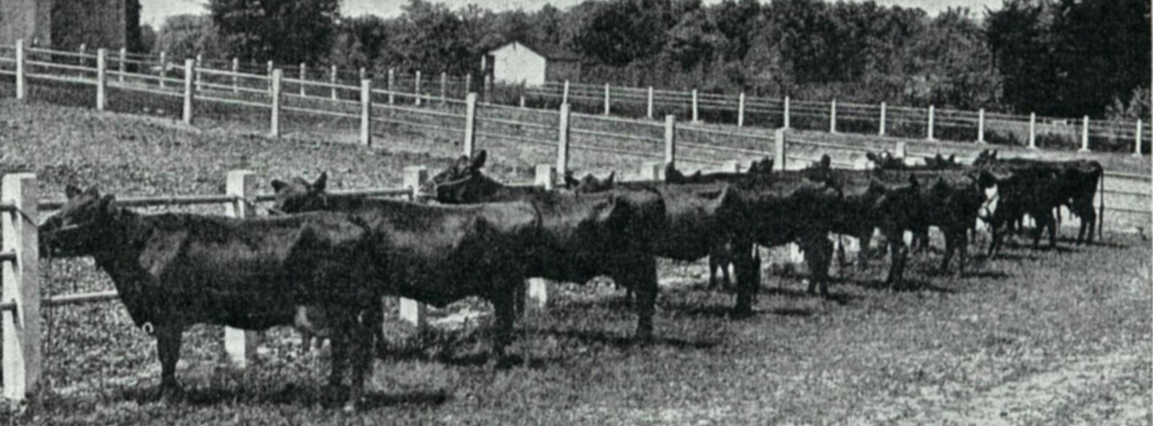
3-way crosses: Jersey × Red Dane × Holstein (42 cows)
USDA Yearbook of Agriculture 1947
From USDA research herd at Beltsville, MD
Butterfat yield of three breed crosses was greater than from their F₁ crossbred dams.
Three breed crosses averaged 14,927 pounds of milk and 641 pounds of butterfat as 2-year-olds in 1947.
Notes:
6660kg milk
290kg fat
No predictions based on f1 daus:dam so don’t know whether this can be attributed to ‘hybrid vigor’
This group was heavy on the Red Dane sire
These were 3 breed crosses, so more hybrid vigor should be maintained (~85% in 3 breed rotations),
as opposed to rotating only 2 breeds (~65% in 2 breed rotations)

Slide 9
Review of USDA crossbreeding 1939-1954
“When production-proved sires are used for crossbreeding in a 3- or 4-breed rotation, a big increase in milk and butterfat production can be expected in the first cross, and slight increases in subsequent crosses” Fohrman et al., 1954, USDA Tech. Bull. 1074 (127 pages)
  Results from 55 foundation purebred cows, 55 2-breed crosses, 58 3-breed crosses, and 23 4-breed crosses.
  Statistical comparisons used the daughter-dam method, not contemporary purebred Holsteins.
Touchberry (1992) said “Few things in the entire history of dairy cattle breeding have evoked such a heated response as… the publications of Fohrman.”

Slide 10
Feed efficiency of different breeds 1957-1969
57 Ayrshire, 68 Brown Swiss, and 57 Holstein cows
“Holsteins were more efficient than Brown Swiss, with Ayrshires intermediate.”
“High positive relation between efficiency and various measures of production and income, and uniformly negative relations between efficiency and mean body weight, gain in weight, and four measures of body size.”
Dickinson, F.N., B.T. McDaniel, R.E. McDowell. 1969. Comparative efficiency of feed utilization during first lactation of Ayrshire, Brown Swiss, and Holstein cows. J. Dairy Sci., 52:489-497

Slide 11
Selection for milk only vs net merit (163 cows)
1969-1983: Merit defined as fat-corrected milk yield, percent daughters culled in first lactation, and udder conformation of daughters.
No significant difference in overall profit between the 2 lines.
  Balaine, D.S., R.E. Pearson, and R.H. Miller. 1981. Profit Functions in Dairy Cattle and Effect of Measures of Efficiency and Prices. [Origin of Net Merit formula]
  Miller, R.H., R.E. Pearson, M.F. Rothschild, and L.A. Fulton. 1981. Comparison of Single and Multiple-Trait selected Sires. Response in Mastitis Traits, - ScienceDirect
  Rothschild, M.F., R.H. Miller, and R.E. Pearson. 1983. Reproductive Performance from Daughters of Single and Multiple Trait Selected Sires - ScienceDirect
  Pearson, R. E., R. H. Miller, J. W. Smith, L. A. Fulton, M. F. Rothschild, D. S. Balaine, and E. M. Coffey. 1981. Single and multiple trait sire selection. First lactation milk yield and composition, conformation, feed intake, efficiency, and net income. J. Dairy Sci. 64:77.

Slide 12
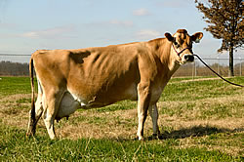
Mastitis resistant cows 2000-2005
Produced 3 transgenic Jersey cows.
Transgenic cows secreting over 3 μg of lysostaphin/ mL of milk are protected against mastitis caused by Staphylococcus aureus.
Our results indicate that genetic engineering can provide a viable tool for enhancing resistance to disease and improve the well-being of livestock.
Wall, Robert J., Anne M Powell, Max J Paape, David E Kerr, Douglas D Bannerman, Vernon G Pursel, Kevin D Wells, Neil Talbot & Harold W Hawk. 2005. Genetically enhanced cows resist intramammary Staphylococcus aureus infection. Nature Biotechnology 23:445–451.

Slide 13
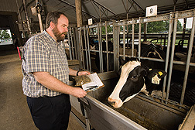
High vs. low residual feed intake (RFI)
2018-2024: Cows with high PTA for RFI mated to high RFI sires, and low RFI cows mated to low RFI sires
Beltsville was only USA research station measuring heifer RFI (226 heifers):
  Connor, E. E., J. L. Hutchison, C. P. Van Tassell, and J. B. Cole. 2019. Defining the optimal period length and stage of growth or lactation to estimate residual feed intake in dairy cows. J Dairy Sci. 102:6131–6143.
  Except for ST Genetics: 2014-present, >7,000 heifers in Ohio
Beltsville was only USA research station measuring methane until 2023.
BDI (Bureau of Dairy Industry) is herd prefix since 1912.

Slide 14
Regional Research Project history
S-49 summary: “Probably the greatest benefit of any regional project is that it provides the participants an opportunity each year to assemble at one station and exchange ideas, approaches, and procedures. Such communication invariably leads to a stronger total research effort.” (White et al., 1976)
  White, J. M., R. H. Miller, and C. J. Wilcox. 1976. Review of Regional Project S-49-Genetic Methods of Improving Dairy Cattle for the South. J. Dairy Sci. 60:473-481.
  Blake R W, B T McDaniel, R E Pearson, R E McDowell, C J Wilcox. 1986. Genetic methods of improving dairy cattle for the south: a review and prospects from Regional Project S-49. J Dairy Sci 69(4):1098-109.
NC-2 summary:
  Kelm, S. C., A. E. Freeman, and NC-2 Technical Committee. 2000. Direct and Correlated Responses to Selection for Milk Yield: Results and Conclusions of Regional Project NC-2, "Improvement of Dairy Cattle through Breeding, with Emphasis on Selection” J. Dairy Sci. 60:473-481.

