Slide 1
U MD LeClerg Lecture:
Local selection experiments and global impacts of university genetics training
Paul VanRaden
USDA, Agricultural Research Service, Animal Genomics and Improvement Laboratory, Beltsville, MD
Email: paul.vanraden@usda.gov
Web site: https://www.ars.usda.gov/northeast-area/beltsville-md-barc/beltsville-agricultural-research-center/agil/aip/

Slide 2
Topics
Early biometrics at Beltsville
Genetic experiments with Beltsville dairy herd 1912-2024
Examples of university research with long-lasting benefits
My early training (U IL, Iowa State), postdoctoral research (U WI), and how useful it was over the decades
Fellow graduate students
Genetic progress and global impact

Slide 3
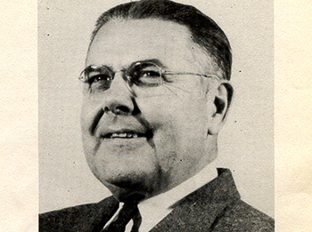
Erwin Louis LeClerg 1901-1981
1901, Born
1924, USDA-ARS, Plant Pathologist
1954, USDA-ARS, Director of Biometrical Services Staff, Beltsville, MD
1964, Retired but continued working with The Biometric Society
1981, Died in Silver Spring of cancer, age 80.

Slide 4
Walter R. Harvey (also in Biometrics)
Dr. Harvey was an employee of Dr. LeClerg in USDA Biometrics 1953-62
“What a wonderful man! When I came to Beltsville I was so grateful to find him there. Software was basically nonexistent. He is an example where the number of papers does not begin to disclose his contributions.” (Dr. Bob Miller)
3,351 citations for his 1960 LSML software
Year | Where | Event
1919 | New Mexico | Born
1952 | Iowa State | PhD, Animal Breeding (with Lush)
1955 | USDA-ARS Beltsville | Electrical computing in agriculture
1960 | USDA-ARS Beltsville | Least Squares Analysis of Data
1963 | Ohio State | Professor
2015 | Columbus | Died, age 95

Slide 5
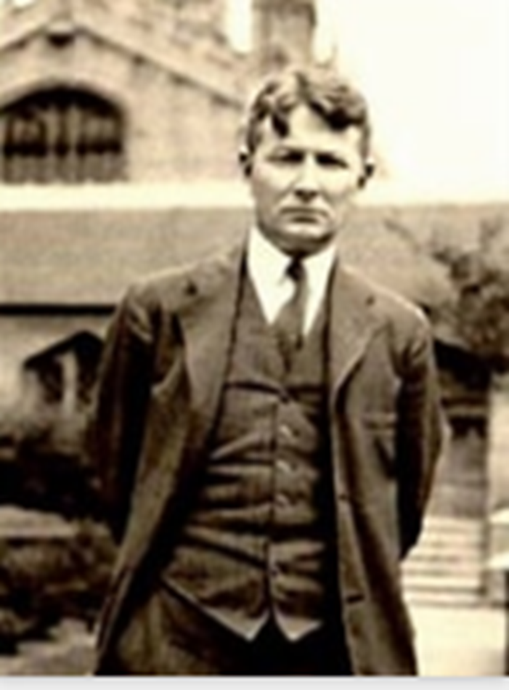
Sewall Wright – Biography and USDA research
Year | Research discoveries at USDA
1917 | Cattle color inheritance
1920 | Heritability (h²)
1920 | Livestock breeding (75-page book)
1921 | Systems of mating
1921 | Multiple regression accuracy (R²)
1921 | Effective population size
1921 | Correlation is not causation
1922 | Inbreeding coefficient (F)
1923 | Path coefficients
1925 | Computing relationships and F
Year | Biography | Location
1889 | Born | MA
1892 | Raised | Galesburg, IL
1911 | B.S. | Galesburg, IL
1912 | M.S. | U. IL, Urbana
1915 | PhD | Harvard U., MA
1916 | USDA | Beltsville, MD
1926 | Professor | Chicago, IL
1955 | Retired | Madison, WI
1988 | Died | Madison, WI

Slide 6
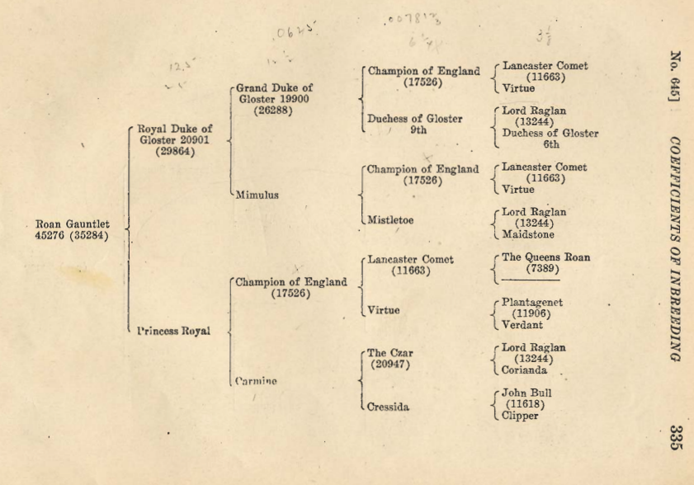
1922 Example pedigree: Shorthorns

Slide 7
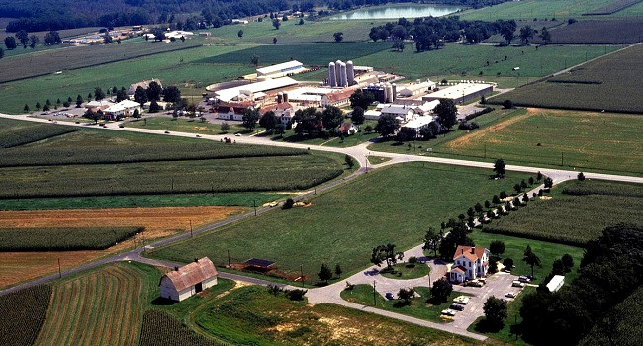
Breeding experiments at BARC 1912-2024
Extreme inbreeding (HO, GU) 1912-1949
Four-breed crosses (HO, JE, GU, and 22 RD imported from DNK) 1939-1954
Feed efficiency of different breeds (AY, BS, HO) 1957-1969
Selection for milk yield vs. net merit (HO) 1970-1983
Transgenic cows (JE) that resist mastitis 2000-2005
High vs. low residual feed intake (HO) 2018-2024

Slide 8
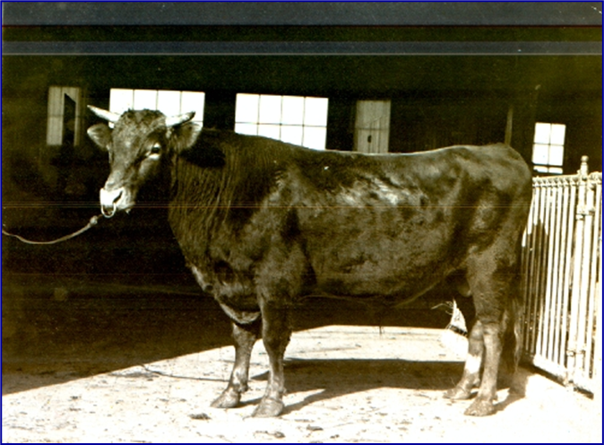
Extreme inbreeding 1912-1949
Dairy breeding program modelled after hybrid corn.
Foundation Guernsey sire (Prince Billy) imported from the Isle of Guernsey in 1910
Guernsey line died due to lethal recessive and Brucellosis epidemic
Foundation Holstein sire (Lad 11th) purchased from Minnesota in 1912
Holstein birth weights decreased from 37 kg to 29 kg
Milk yield decreased by 7% and fat yield by 17% with inbreeding levels near 50%
“Continued inbreeding of whole herds, however, is almost certain to be disastrous.”

Slide 9
Experimental design
8 consecutive generations of mating sires to their daughters, and dams to their sons
8 herd sires used at Beltsville 1912-1949 are shown on right
Each more inbred than the last
Highest inbreeding coefficients ever obtained in dairy cattle (maximum F = 75.1%)

Slide 10
Example of extreme inbreeding
Pedigree for Holstein cow A-148
Sire 1 (Lad) from Minnesota appears 50 times in her pedigree
64.6% inbreeding coefficient

Slide 11
Most inbred cow ever (F = 75.1%)
6
2
1
6
3
2
1
1
A26
6
1
A26
1
A26

Slide 12
Jersey × Holstein F1 crossbreds (9 cows)
USDA Yearbook of Agriculture 1947
From USDA research herd at Beltsville, MD
Cow # | Pounds of Milk | % Butterfat | Pounds of Butterfat
X-1 | 9,784 | 4.85 | 475
X-3 | 13,065 | 4.71 | 615
X-17 | 13,837 | 3.85 | 533
Notes:
AVG: 13054lbs milk (5760kg)
4.57% fat
546lbs protein (260kg)

Slide 13
Red Dane × Jersey
Red Dane × Jersey crossbreds (7 cows)
USDA Yearbook of Agriculture 1947
From USDA research herd at Beltsville, MD
Crossbreds averaged 12,904 pounds of milk and 588 pounds of butterfat, outperforming dams by more than sire proof predictions (Fohrman,1947).
Advanced register Holsteins averaged 13,833 pounds of milk and 493 pounds of fat in 1945.
Notes:
5760kg milk
263kg fat

Slide 14
3-way crosses: Jersey × Red Dane × Holstein (42 cows)
USDA Yearbook of Agriculture 1947
From USDA research herd at Beltsville, MD
Butterfat yield of three breed crosses was greater than from their F₁ crossbred dams.
Three breed crosses averaged 14,927 pounds of milk and 641 pounds of butterfat as 2-year-olds in 1947.
Notes:
6660kg milk
290kg fat
No predictions based on f1 daus:dam so don’t know whether this can be attributed to ‘hybrid vigor’
This group was heavy on the Red Dane sire
These were 3 breed crosses, so more hybrid vigor should be maintained (~85% in 3 breed rotations),
as opposed to rotating only 2 breeds (~65% in 2 breed rotations)

Slide 15
Review of crossbreeding 1939-1954
“When production-proved sires are used for crossbreeding in a 3- or 4-breed rotation, a big increase in milk and butterfat production can be expected in the first cross, and slight increases in subsequent crosses” Fohrman et al., 1954, USDA Tech. Bull. 1074 (127 pages)
Results from 55 foundation purebred cows, 55 2-breed crosses, 58 3-breed crosses, and 23 4-breed crosses.
Statistical comparisons used the daughter-dam method, not contemporary purebred Holsteins.
Touchberry (1992) said “Few things in the entire history of dairy cattle breeding have evoked such a heated response as… the publications of Fohrman.”

Slide 16
Feed efficiency of different breeds 1957-1969
57 Ayrshire, 68 Brown Swiss, and 57 Holstein cows
“Holsteins were more efficient than Brown Swiss, with Ayrshires intermediate.”
“High positive relation between efficiency and various measures of production and income, and uniformly negative relations between efficiency and mean body weight, gain in weight, and four measures of body size.”
Dickinson, F.N., B.T. McDaniel, R.E. McDowell. 1969. Comparative efficiency of feed utilization during first lactation of Ayrshire, Brown Swiss, and Holstein cows. J. Dairy Sci., 52:489-497

Slide 17
Selection for milk only vs net merit (163 cows)
1969-1983: Merit defined as fat-corrected milk yield, percent daughters culled in first lactation, and udder conformation of daughters.
No significant difference in overall profit between the 2 lines.
Balaine, D.S., R.E. Pearson, and R.H. Miller. 1981. Profit Functions in Dairy Cattle and Effect of Measures of Efficiency and Prices. [Origin of Net Merit formula]
Miller, R.H., R.E. Pearson, M.F. Rothschild, and L.A. Fulton. 1981. Comparison of Single and Multiple-Trait selected Sires. Response in Mastitis Traits, - ScienceDirect
Rothschild, M.F., R.H. Miller, and R.E. Pearson. 1983. Reproductive Performance from Daughters of Single and Multiple Trait Selected Sires - ScienceDirect
Pearson, R. E., R. H. Miller, J. W. Smith, L. A. Fulton, M. F. Rothschild, D. S. Balaine, and E. M. Coffey. 1981. Single and multiple trait sire selection. First lactation milk yield and composition, conformation, feed intake, efficiency, and net income. J. Dairy Sci. 64:77.

Slide 18
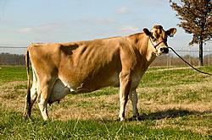
Mastitis resistant cows 2000-2005
Produced 3 transgenic Jersey cows.
Transgenic cows secreting over 3 μg of lysostaphin/ mL of milk are protected against mastitis caused by Staphylococcus aureus.
Our results indicate that genetic engineering can provide a viable tool for enhancing resistance to disease and improve the well-being of livestock.
Wall, Robert J., Anne M Powell, Max J Paape, David E Kerr, Douglas D Bannerman, Vernon G Pursel, Kevin D Wells, Neil Talbot & Harold W Hawk. 2005. Genetically enhanced cows resist intramammary Staphylococcus aureus infection. Nature Biotechnology 23:445–451.

Slide 19
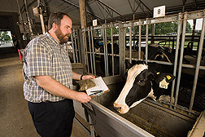
High vs. low residual feed intake (RFI)
2018-2024: Cows with high PTA for RFI mated to high RFI sires, and low RFI cows mated to low RFI sires
Beltsville was only USA research station measuring heifer RFI (226 heifers):
Connor, E. E., J. L. Hutchison, C. P. Van Tassell, and J. B. Cole. 2019. Defining the optimal period length and stage of growth or lactation to estimate residual feed intake in dairy cows. J Dairy Sci. 102:6131–6143.
Except for ST Genetics: 2014-present, >7,000 heifers in Ohio
Beltsville was only USA research station measuring methane until 2023.
BDI (Bureau of Dairy Industry) is herd prefix since 1912.

Slide 20
Topic 2: Long term value of university education
Genomic relationship (G matrix) derivation
Impact of individual bulls
Multi-stage selection
Reliability of predictions
REML estimates of heritability and genetic correlations
Body size and feed cost
Global impact

Slide 21
2008 Derivation of genomic relationship matrix
Pages 1-3 of 1980 population genetics notes (U IL, Dairy Sci 316)
Let gene content be coded as 0, 1, or 2 copies of an allele
Mean of gene content is twice allele frequency = 2p
Variance of gene content = 2p(1-p)
Genomic relationship matrix algebra 2008
Define Z_{ij} for locus i, animal j as the gene content – 2p_{i}
Subtract mean, divide by the sum of variances = ∑ 2p_{i}(1-p_{i})
Matrix G = Z Z’ / ∑ 2p_{i}(1-p_{i})

Slide 22
Genomic relationship matrices: bovine vs. human
Simple quadratic :
G = Z Z’ / Σ 2p_{j}(1-p_{j})
Same math for each G_{ik}
Clones related by 1.0
Positive semi-definite
VanRaden 2008
5300 citations
Different math for G_{ii} vs. G_{ij}:
Divide Z_{ij} by sqrt [2p_{j}(1-p_{j})]
Diagonals G_{ii} get adjusted
Clones not related by 1.0
Negative eigenvalues
Yang et al 2010
4700 citations
https://www.nature.com/articles/ng.608

Slide 23
Yang et al (2010) math no longer used in GCTA
“To obtain a genome-wide relationship, we combine A_{ijk} for all of the SNPs using a common-sense weighting scheme,”
NO! Need to adjust off-diagonals by square root of 2 diagonals

Slide 24
Make the Yang (2010) matrix positive semi-definite
Let W be a diagonal matrix with ratios of the 2 formulas
W_{jj} = ∑_{i}(x_{ij} – 2p_{j})² / [x_{ij}² – (1 + 2p_{j})x_{ij} + 2p_{j}²]
Multiply all elements A_{jk} by square roots of those ratios
A_{adjusted} = W^{.5} (X-2P)’(X-2P) W^{.5}
Analogous relationship matrices
Henderson (1975) numerator matrix A = L D L’
Wright (1922) correlation matrix A_{corr} = W^{.5} A W^{.5}, where W_{ii} is 1 / diagonal A_{ii}

Slide 25
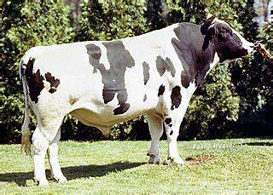
Impact of individual bulls
1980 undergrad term paper on bull Pawnee Farm Arlinda Chief:
“Only rarely does a bull come along… likely to have a tremendous influence on the breed” and I hand-calculated impact of each bull
1988 with Holstein USA, automated the top ancestor list still published
2011, with U IL, found a recessive mutation in Chief causing abortions (HH1)
Global benefit of extra milk from 14% Chief genes was $30 billion vs. $420 million cost of extra abortions
2024: Frequency of HH1 carriers decreased by selection from 4.2% in 2011 to 0.5% today

Slide 26
1984 journal paper (my first one)
Maximizing genetic gain under multiple-stage selection:
Choose animals with less mean but more variance
VanRaden, P.M., A E. Freeman, and M.F. Rothschild. 1984. J. Dairy Sci. 67:1761–1766.
C.R. Henderson said our conclusions were wrong
Published more papers on that topic over the decades:
Choose animals less inbred (2006), with rare favorable alleles (2014), or with more Mendelian Sampling variance (2019)

Slide 27
1984 reliability estimation
Establishing bounds on the accuracies of predictions of breeding value. Master’s Thesis, ISU
Similar projects:
Daughter equivalents in “Derivation, calculation, and use of national animal model information”, 1991
“Reliability of genomic predictions for North American Holstein bulls”, 2009
Interbull Genomic Reliability Working Group, member 2013-2024

Slide 28
1986 REML variance estimation programs
Computational strategies for estimation of variance components. PhD thesis, ISU
Fortran programs used for:
Angus carcass trait EPDs (1986-1997)
Holstein productive life heritability (1994)
Fertility and type heritabilities and correlations (2004, 2016)
Heifer livability and abortion h² (Neupane et al, 2021, 2023)
Sire model still useful for many millions of records

Slide 29
“Cloud” computing, 1988
Holstein staff flew data to Madison twice per year
“On-time delivery of PTAs is more important than better accuracy” (Holstein CEO)
MT sire model tested at IBM Research Center, Los Angeles
Research on memory sharing
Replaced by animal model of Ignacy Misztal in 1992 (U GA)

Slide 30
Cow size: First slide from my 1988 ADSA talk

Slide 31
Cow size: Conclusions from my 1988 ADSA talk
If a cow is bigger and gives more milk, that is good (profitable).
If a cow is bigger but does not give more milk, that is bad (unprofitable).
Relative emphasis should be 5 to -1 for production vs. body size.
Holstein Association should replace PTA Type with Body Size Composite (from U MN research).
[ADSA abstract presented in Edmonton, Alberta, Canada]
P.M. VanRaden, J Dairy Sci 71(Suppl. 1):238

Slide 32
Economic value of body size in Holsteins
1988: ADSA research suggested 5 to -1 emphasis
2000: Net Merit $ had 15 to -1 emphasis on yield : cow size
2018: Body size composite updated to body weight composite
Formula used data from 5 research herds (previously U MN)
2021: NM$ penalty now 5 to -1 on yield : cow size, also Residual Feed Intake (RFI)
2021: TPI includes small 29 to -1 penalty on cow size, some RFI
2023: Canada still does not penalize large cows in their LPI index

Slide 33
1987 Least Cost Ration experiment
Human least cost ration, every day for 37 years.
Invented by me in 1987 at Kohl’s food store (Metro Market), Madison, WI
Costs $2.54 / day for food, drink, and snacks
Breakfast: 3-day rotation of cheapest cereals + whole milk
Lunch: every day a bologna and peanut butter sandwich
Dinner: 4-day rotation of macaroni, spaghetti, rice, noodles
Dessert: every day ice cream
Prevents both starvation and obesity (100% successful so far)

Slide 34
Daily food cost actual US$ or adjusted for inflation
Available at http://www.paulvanraden.com/Nutrition.htm

Slide 35
2020-2023 Weekly body weight history

Slide 36
Some of my fellow grad students
Student | Later position | Country | Years
Bassam al-Safadi | Head, Biotechnology Research (govt) | Syria | 2018-
Sawsan Magid (al-Sharifi) | Minister of Agriculture (govt) | Iraq | 2004-5
M’Naouer Djemali | Director of National Gene Bank | Tunisia | 2006-12
Hiroshi Takahashi | Manager, Global Pig Farms | Japan | 2000-
Sompop Kassumma | Senior Officer, Livestock Dvlp (govt) | Thailand | 2002-
Jay Mattison | CEO of NDHIA and Chair of ICAR | USA | 2017-21
Jean Bertrand | Dean, Undergrad Studies, Clemson U | USA | 2021-
Mark Boggess | Director, US Meat Animal Res. Center | USA | 2018-
Georgios Banos | 1st Director, Interbull Centre | Sweden | 1992-99
Jack Dekkers | Distinguished Professor, Iowa State | USA | 2013-
Chuck Sattler | Vice President-Genetics, Select Sires | USA | 2007-
ISU
----
UWI

Slide 37
CDCB usable genotype counts/year by animal sex

Slide 38
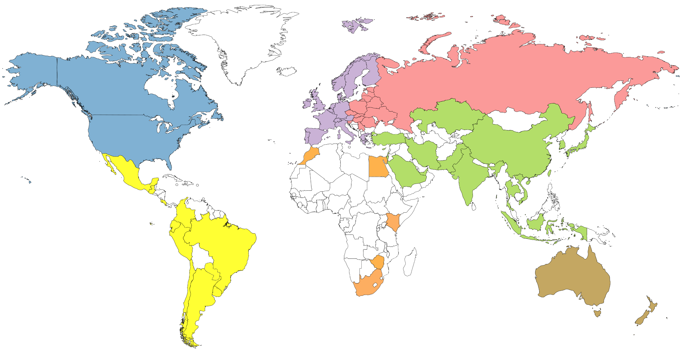
Genotype counts by region (June 2022)
4,974,462
68,684
447,423
420,230
159,563
20,660
67,465

Slide 39
Countries sending most genotypes
Numbers of females born in latest 5 years
Countries with advanced breeding programs each have large databases
Many other countries do not have historical data to compute predictions
Country | Cows genotyped
United States | 3,571,054
Canada | 320,350
Saudi Arabia | 186,499
China | 160,558
Japan | 135,971
Italy | 114,501
Brazil | 102,000

Slide 40
Genetic progress (Holstein)

Slide 41
Predict 50 years of genetic progress (Cole, 2018)
Trait | 50-year progress | 2017 mean | 2067 mean
Milk (pounds) | +9,329 | 27,055 | 36,384
Fat (pounds) | +531 | 1,008 | 1,539
Protein (pounds) | +342 | 825 | 1,167
Productive life (months) | +65 | 26 | 91
Body size (pounds) | –230 | 1,500 | 1,230
Udder composite | +2.65 | 0 | 2.65
Daughter pregnancy rate (%) | +26 | 29 | 55
Cow conception rate (%) | +42 | 35 | 77
Heifer conception rate (%) | +21 | 57 | 78

Slide 42
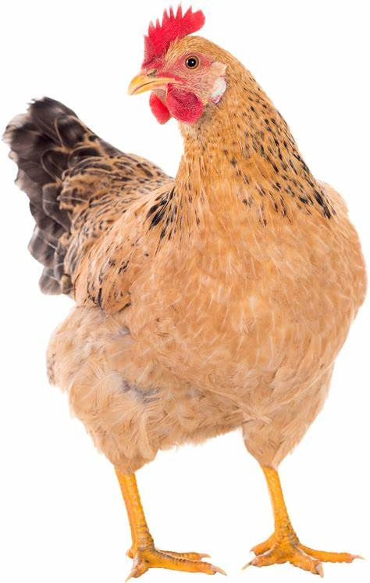
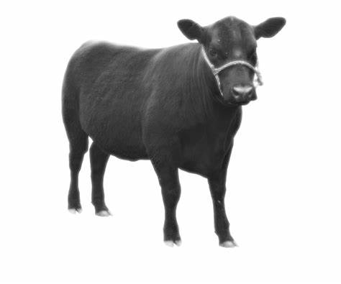
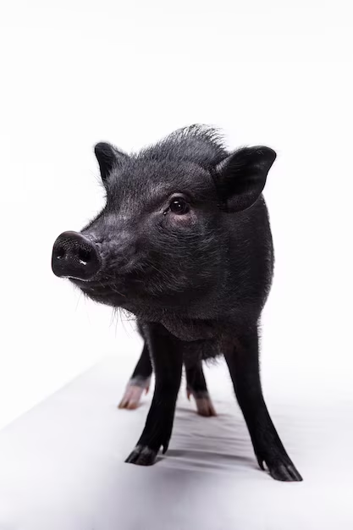
Genotyping in other species
Poultry: Several million per year, Aviagen, Scotland, 2022
Aviagen Group genomics lab further strengthens genetic selection
Lab chief Alfons Koerhuis was student intern here in 1990
Beef: ~ 1 million total, American Angus, 2021
Trends in genetic diversity and the effect of inbreeding in American Angus cattle under genomic selection | Genetics Selection Evolution
Swine: 400,000 total, Pig Improvement Corporation, 2019
All major and many minor crops

Slide 43
Human genotyping and sequencing (2024)
Technology | Database | People genotyped | Variants genotyped
High-density (HD) SNP chip | Ancestry.com | ~25 million | 700,000
 | 23andMe | ~15 million | 700,000
Whole genome sequence | TopMed (U. Michigan) | 160,000 | 840 million
 | Illumina | 600,000 | 500 million
HD imputed to sequence | NIH, Bethesda, MD | 58 million | 300 million
Total raw data = 600,000 people × 40× coverage × 2.7 billion genome length) = 65 million GB

Slide 44
Cooperation of U MD and USDA
From 1988-1992 our USDA email accounts were provided by U MD
Universities were connected sooner than government labs
My email address was vanraden@umdc
My first employee (Cynthia Ernst) married a U MD computer programmer (Richard Hargan)
She is now a crop breeder at Dow AgroSciences
I have coauthored 22 peer-reviewed papers with U MD researchers (College Park and Baltimore)

Slide 45
Conclusions
Computer methods and statistical software pioneered by Beltsville Biometrics under LeClerg
Beltsville research herd did many interesting experiments 1912-2024
Knowledge from college remains useful across decades
Foreign students can also have big impacts
Genetic progress could be even faster over the next century with gene editing or transgenics
Our research has global impacts across many species

Slide 46
Acknowledgments and Disclaimers
Council on Dairy Cattle Breeding (CDCB) and its industry suppliers for data
Taxpayers for funding USDA-ARS-AGIL project 8042-31000-002-00, “Improving dairy animals by increasing accuracy of genomic prediction, evaluating new traits, and redefining selection goals”
AGIL staff for doing this research
Mention of trade names or commercial products in this presentation is solely for the purpose of providing specific information and does not imply recommendation or endorsement by USDA; USDA is an equal opportunity provider and employer

Slide 47
Hobby: Solutions to World Problems
Went to university libraries a lot on weekends 1978-94
Picked a subject, studied until no material left to read
Got ideas beyond theirs
Decided someday to write a book “Solutions to World Problems”
In 1999 started a web site: paulvanraden.com

Slide 48
Erwin L. Leclerg lecture
https://ansc.umd.edu/news/annual-events
The LeClerg Rotary Lectureship in Biometry is a lecture series held annually to honor Erwin L. LeClerg, a former Rotarian and statistician at the U.S.D.A. Agricultural Research Station in Beltsville, Maryland. Each year the lecture series includes research and teaching lectures given by a nationally recognized authority in quantitative genetics or biostatistics. The LeClerg Rotary Lectureship in Biometry is funded by an endowment which was established in 1983 by the College Park Rotary Club and the Rossmoor Aspen Hill Rotary Club to benefit the Biometrics Program at the University of Maryland.

