Slide 1
Northeast Regional PI Station (NE9)
Crops conserved
Two curatorial programs:
Industrial Hemp & Vegetable (tomato, onion, radish, winter squash, cabbage, cauliflower, broccoli, other cole crops, celery, tomatillo, asparagus, buckwheat and other vegetables) Crops (Joanne Labate & one vacancy) The major crops managed by this project represent approximately 40% of the combined dollar value of fresh and processing vegetables in the US.
Clonal Crops (Ben Gutierrez & one vacancy) apples, grapes and tart cherries
Apples, grapes, and tart cherries are among the most valuable fruit crops worldwide, with US production valued at
  $ 6.3 billion for grapes
  $ 3.5 billion for apples
  $ 89.4 million for tart cherry
7%
30%
62%
Vegetables 12707 accessions
Apples 6073 accessions
Grapes 1405 accessions
Tart cherries 131 accessions

Slide 2
Distribution of NE9 Geneva Germplasm
18,199 vegetable and clonal germplasm samples in 2019 and 81,453 samples from 2015 – 2019

Slide 3
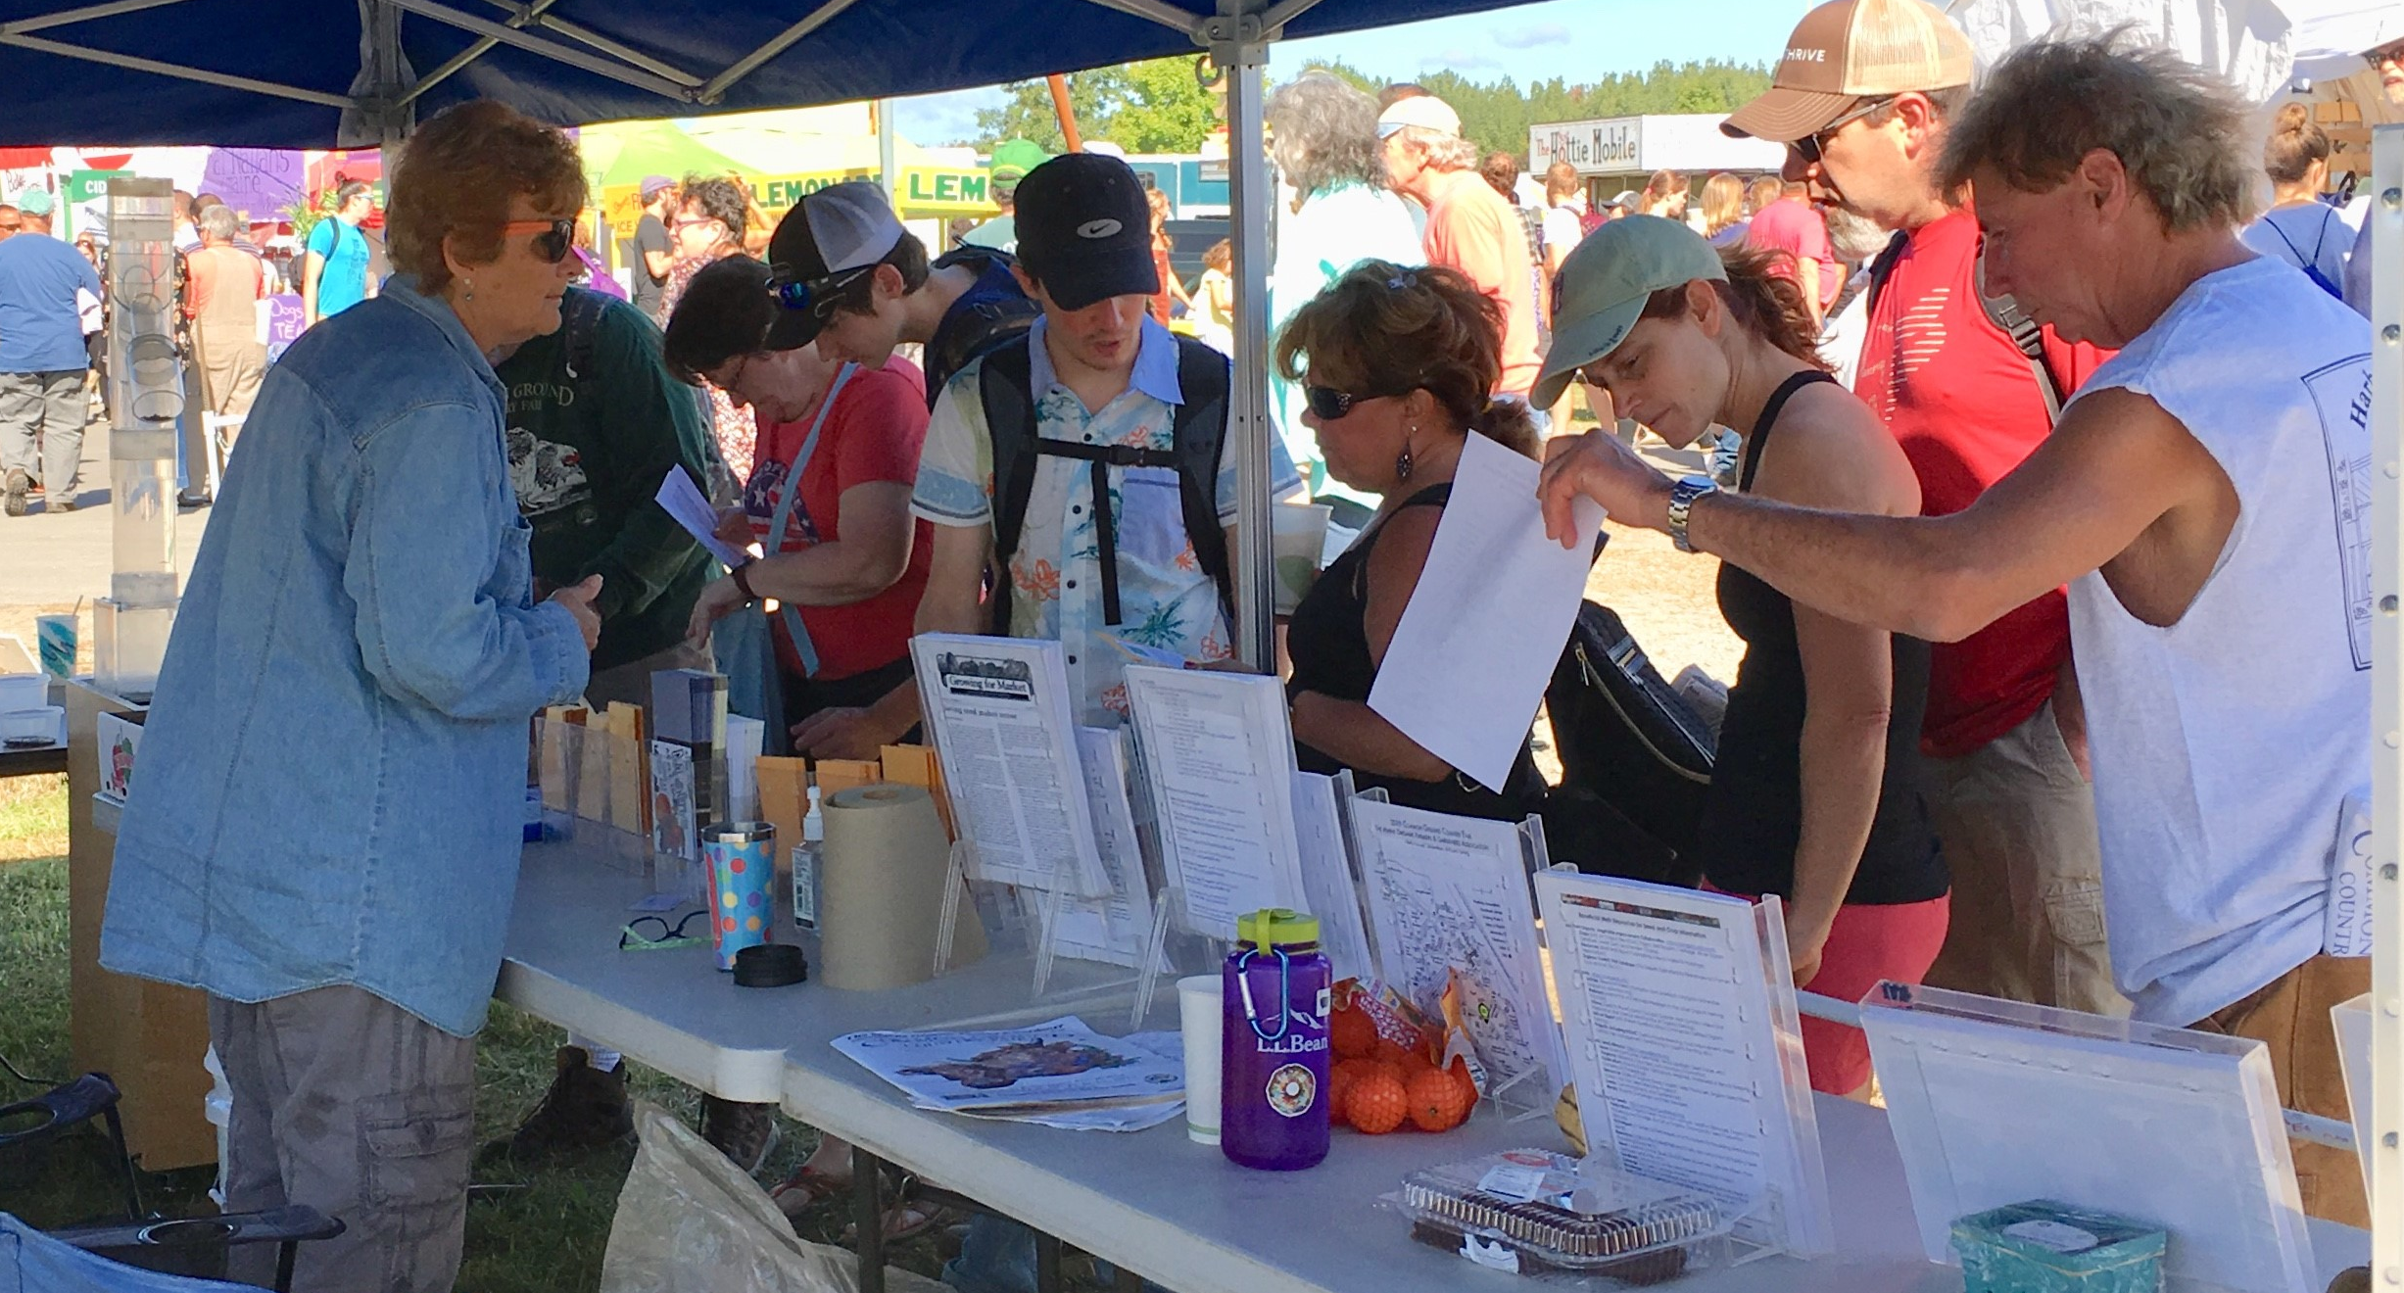
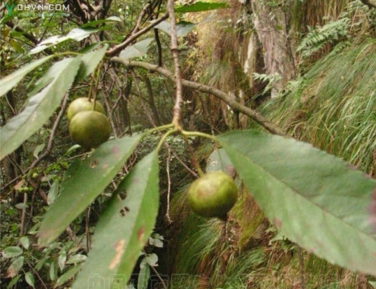
Northeast Regional PI Station (NE9)
Germplasm regeneration, collection, and outreach highlights:
Successful regeneration of 704 accessions from 2015 – 2019 (average 141 seed lots produced/yr), 150 regenerations planned in 2020 for seed production of vegetable germplasm to distribute and replenish stocks.
PGRU continues to support organic farming by providing germplasm and demonstrations for small-scale seed production as part of the Northern Organic Vegetable Improvement Collaborative (NOVIC3).
Foreign exploration to Viet Nam for tropical apple species, Malus doumeri.
seed production outreach NOVICIII
Malus doumeri fruit

Slide 4
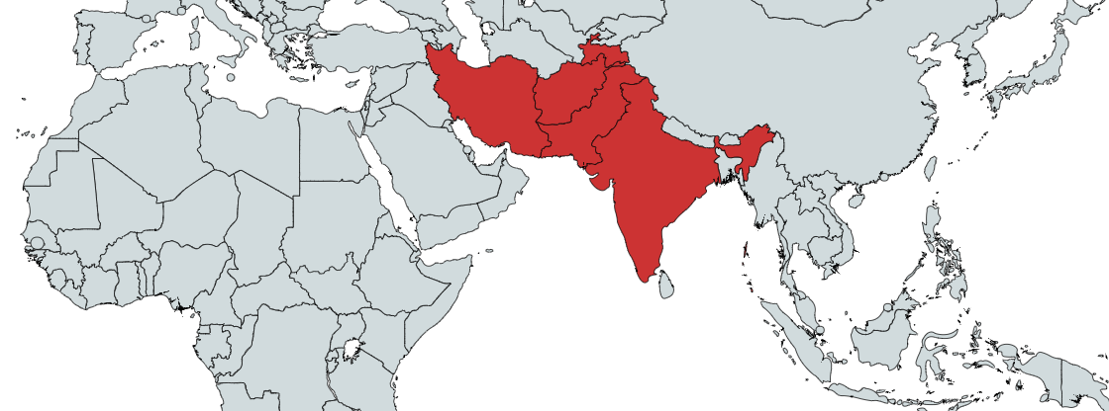
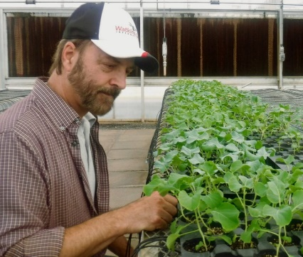
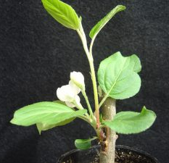
Northeast Regional PI Station (NE9)
Germplasm research highlights:
Onion germplasm from the Indian subcontinent, Iran and central Asia were divergent from onions that dispersed to Europe (and eventually globally). This indicates that Asian germplasm is a potential source of novel alleles.
A fully genotyped, 175-line Brassica oleracea mapping population will be made available through NPGS for analyzing genetics of traits.
Acquisition of LCMS for chemical profiling of crops
onion population structure
Brassica mapping population
Aroma analysis in grapes
budding in apple

Slide 5
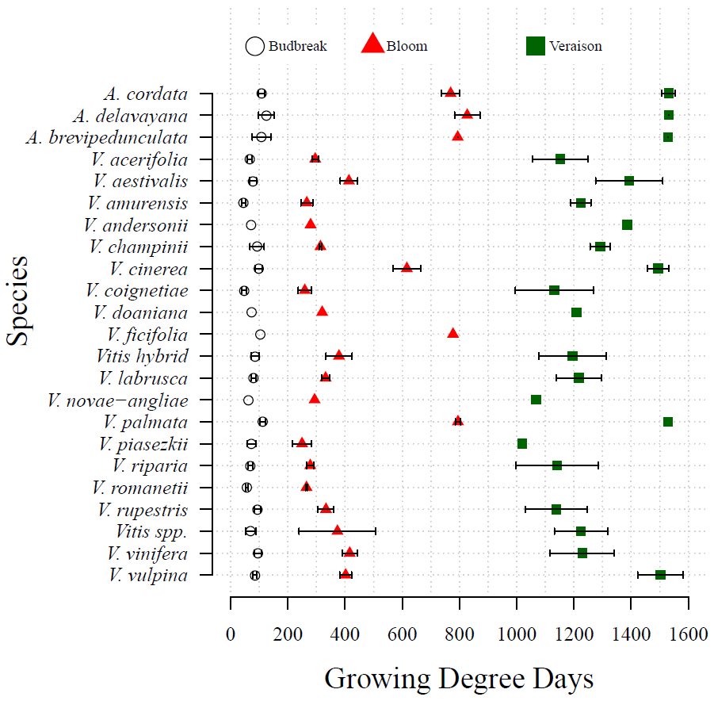
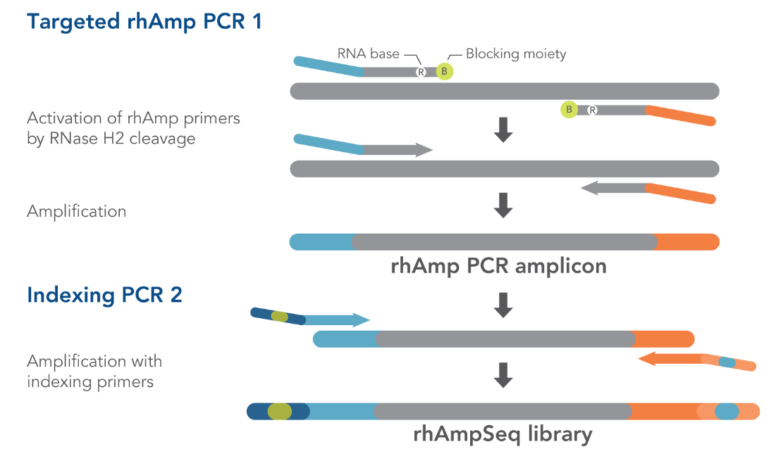
Northeast Regional PI Station (NE9)
Germplasm research highlights:
Cooperated in screenings of Fusarium Basal Rot resistance in Allium cepa and indoor vertical farming potential of Brassica oleracea
The grape collection was characterized for phenological diversity, identifying resources for climate adapted grape breeding.
rhAmp Seq genotyping of Davis and Geneva Vitis collections (2019 and 2020)

