Slide 1
Development of a user-Friendly software tool for validation of predictive models
Thomas p. Oscar, phD
Usda, ARS
Poultry Food Safety research worksite
Princess anne, mD, usa

Slide 2
Introduction
Models that predict pathogen growth are valuable tools for food safety
Verify CCP in HACCP
Help predict consumer exposure in QMRA
Notes:
Models that predict pathogen growth are valuable tools for food safety because the can be used to verify critical control points (CCP) in HACCP programs and they can be used to help predict consumer exposure to the pathogen in quantitative microbial risk assessments (QMRA).

Slide 3
Introduction
Proper validation of models is important because it provides users with confidence that predictions are reliable.
Notes:
Proper validation of models is important because it provides users with confidence that predictions are reliable. This is especially important for models that are used to make important food safety decisions that impact public health.

Slide 4
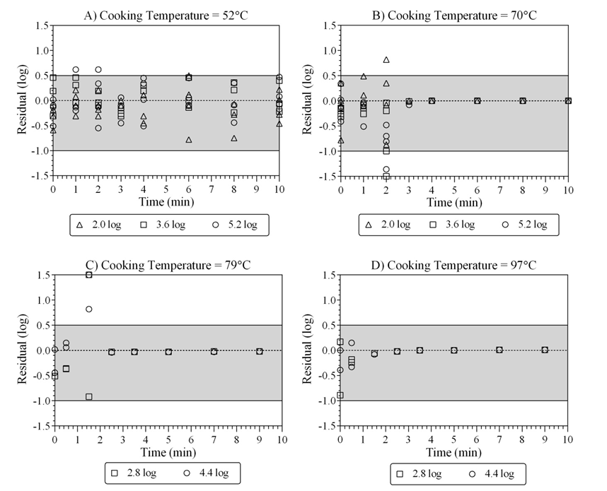
Introduction
Bias and Accuracy Factor Method (Ross, 1996)
Acceptable Prediction Zone (APZ) Method (Oscar, 2005)
Test Data
Model Performance
Notes:
The most widely used method to evaluate model performance is the bias and accuracy factor method. However, this method does not provide accurate evaluations of models that predict log counts. Therefore, the acceptable prediction zone method was developed. However, the APZ method is complex because it has criteria for test data and model performance that must be integrated to obtain an objective evaluation of model performance. Thus, it is not used as often as the bias and accuracy factor method.

Slide 5
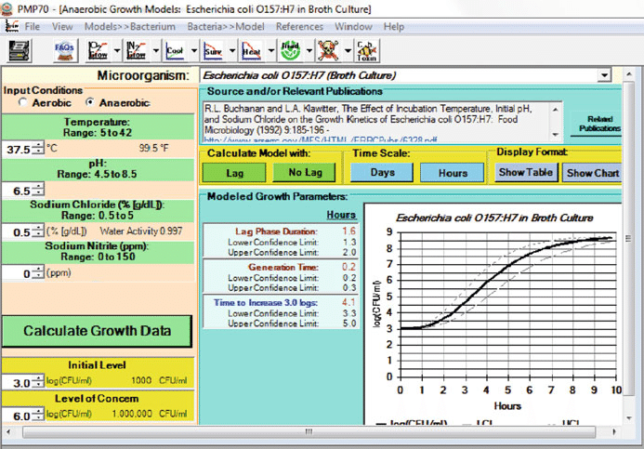
introduction
Pathogen Modeling Program
Notes:
The USDA, Pathogen Modeling Program is an example of a computer software application that is used to transfer complex models to the food industry in a user-friendly format. Because this approach might facilitate wider use of the acceptable prediction zone method,

Slide 6
Objectives
Develop
Develop a computer software tool for the APZ method
Demonstrate
Demonstrate the new tool with a case study
Notes:
the current study was undertaken to develop a user-friendly, computer software tool for the acceptable prediction zone method and to demonstrate how to use it with a case study.

Slide 7
ValT (“Vault”)
Notes:
The new software tool was developed in Excel and is called vault. It consists of three validation steps: one for dependent data, one for interpolation, and one for extrapolation. The odd numbered spreadsheets are for data entry, whereas the even numbered spreadsheets are for model evaluation.

Slide 8
Criteria for test data
Accurate
Unbiased
Type of data
Not confounded
Comparison of observed and predicted values
Sufficiently replicated
Even distribution
Dependent
Independent for interpolation
Independent for extrapolation
Notes:
The criteria for test data in ValT ensure that the evaluation of model performance is accurate and unbiased. These criteria depend on the type of data being evaluated and are designed to ensure that comparisons of observed and predicted values are not confounded. In other words, to ensure that apples are not being compared to oranges.

Slide 9
Criteria for Model Performance
Acceptable residual
Acceptable bias and accuracy
Local prediction problem
Acceptable Prediction Zone
-1 log (fail-safe) to 0.5 log (fail-dangerous)
pAPZ ≥ 0.70
pAPZ < 0.70
two sequential combinations of independent variables
Notes:
In the acceptable prediction zone method a residual is acceptable when it falls in an acceptable prediction zone from -1 log (fail-safe) to 0.5 log (fail-dangerous) and a model is considered to provide predictions with acceptable bias and accuracy when the proportion of residuals in the acceptable prediction zone ≥ 0.7 and there are no local prediction problems. A local prediction problem occurs when the proportion of residuals in the acceptable prediction zone < 0.7 for two sequential combinations of independent variables.

Slide 10
Criteria for Model validation
APZ Method
Satisfy criteria for dependent data and interpolation data
Notes:
Finally, a model is validated in the APZ method when it satisfies all criteria for test data and model performance for both dependent data and independent data for interpolation.

Slide 11
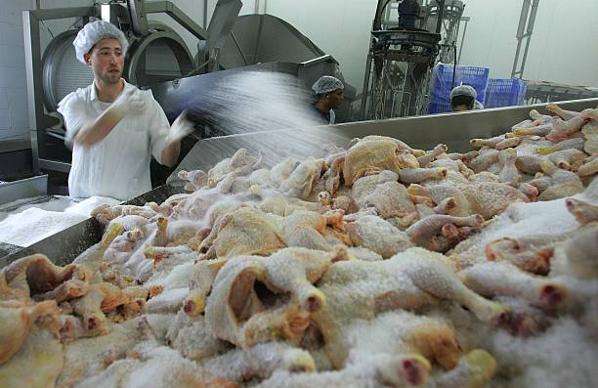
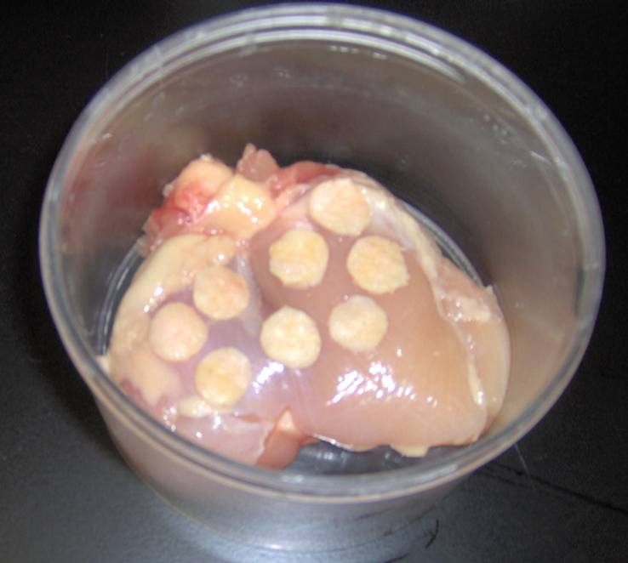
Case study
Tertiary model for growth (log count) of Salmonella Typhimurium DT104 (0.85 log) on chicken skin (2.14 cm²) as a function of time (0 to 8 h) and temperature (5 to 50°C)
Enumeration was by a combination of MPN and CFU methods and was same for all three sets of data:
Dependent
Independent for interpolation
Independent for extrapolation
Oscar, T. P. 2009. J. Food Prot. 72:304-314
Notes:
To demonstrate the new software tool, a published tertiary model for growth of Salmonella on chicken skin was re-evaluated. The model predicts the growth of a low initial number of Salmonella Typhimurium on chicken skin with native microflora. All three sets of test data were collected using the same methods with the exception of the data for extrapolation, which used kosher chicken skin as the food matrix.

Slide 12
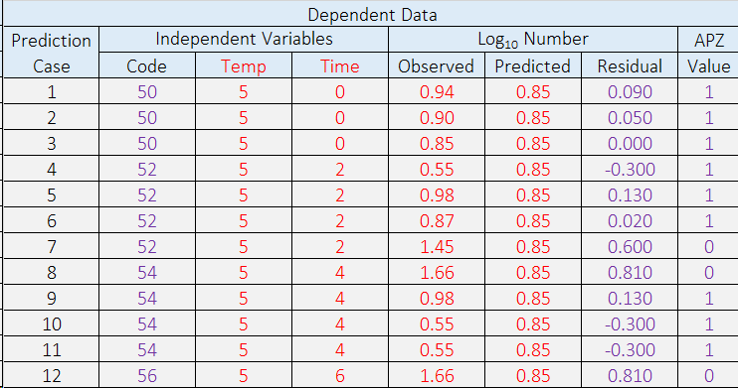
1
Color Code
Red = input
Purple = output
Notes:
The first step of the evaluation process was to enter the dependent data into spreadsheet 1, which calculated the residual for each prediction case and assigned a value of 1 if the residual was inside the acceptable prediction zone or a 0 if the residual was outside the acceptable prediction zone. In addition, a code was generated that was used in spreadsheet 2 to count the number of prediction cases for each combination of independent variables.

Slide 13
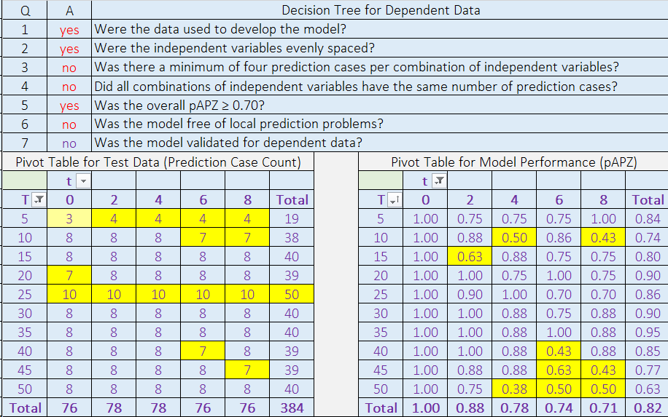
2
Q3
Q4
Q6
Notes:
Spreadsheet 2 of ValT contains a decision tree for dependent data, a pivot table for test data, and a pivot table for model performance. The pivot tables are used to help answer the questions in the decision tree. In this example, the model failed validation for dependent data because it did not satisfy test data questions 3 and 4 and model performance question 6. More specifically, it failed validation because of insufficient replication, uneven distribution of test data, and local prediction problems. Normally, the next step would be to repair the model before proceeding with the evaluation. However, because this is a demonstration, we will now go to the second step of the validation process.

Slide 14
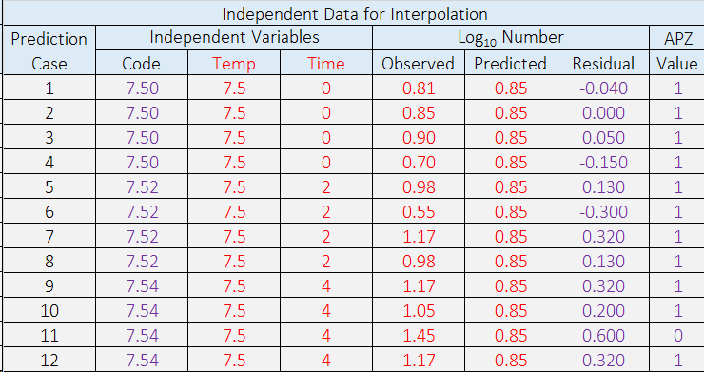
3
Color Code
Red = input
Purple = output
Notes:
The next step was to enter the independent data for interpolation into spreadsheet 3 of ValT. These data were collected with the same methods as those used in model development but at intermediate temperatures.

Slide 15
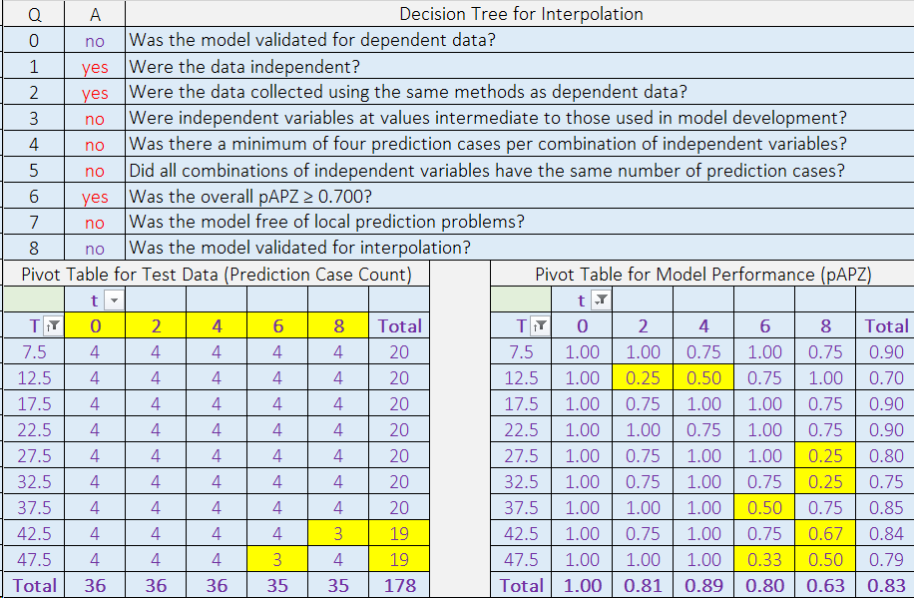
Q0
4
Q3
Q4
Q5
Q7
Notes:
In spreadsheet 4, the model failed validation for interpolation because it failed validation for dependent data, the values for time were not intermediate to those used in model development, there was insufficient replication, there was uneven distribution of data, and there were local prediction problems. Normally the model would be repaired before proceeding to the next step of the evaluation process. However, because this is a demonstration, we will now go to the third and final step of the validation process.

Slide 16
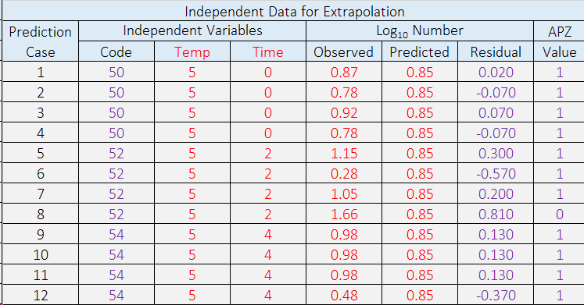
5
Notes:
The next step was to enter the independent data for extrapolation to kosher chicken skin into spreadsheet 5. The methods used to collect these data were the same as those used for model development except that kosher chicken skin was the food matrix.

Slide 17
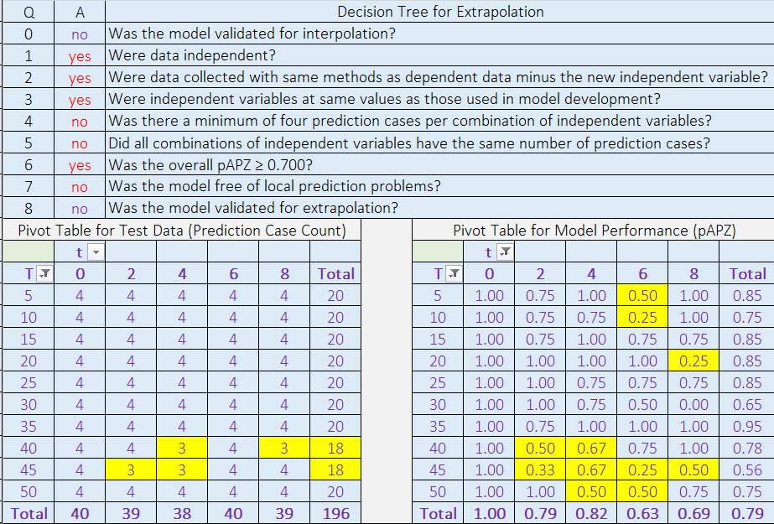
Q0
6
Q4
Q5
Q7
Notes:
In spreadsheet 6, the model failed validation for extrapolation to kosher chicken skin because it failed validation for interpolation, there was insufficient replication, the distribution of data was uneven, and there were local prediction problems. Validation of models for extrapolation is important because it can save time and money by identifying conditions for which new models are not needed.

Slide 18
Comparison with validation results from original study
Old apz criteria
New apz criteria
Dependent (global pAPZ = 0.83)
Interpolation (global pAPZ = 0.84)
Extrapolation (global pAPZ = 0.82)
Validated
Dependent (global pAPZ = 0.82)
Interpolation (global pAPZ = 0.83)
Extrapolation (global pAPZ = 0.79)
Not validated
Notes:
Although the model was previously validated, the model failed validation in the present study because of new and more stringent criteria for test data and model performance. Nonetheless, the new and more stringent criteria are viewed as a positive step toward our goal of producing better and more reliable models for the food industry.

Slide 19
Criteria for test data
↓
Evaluation is accurate and unbiased
Criteria for model performance
↓
Objective decision about validation
Focus of model validation
↓
Tertiary model (log counts)
Notes:
In conclusion, criteria for test data are important because they ensure that evaluations of model performance are accurate and unbiased. Likewise, criteria for model performance are important because they allow one to make an objective decision about model validation. When validating a model, the focus should be the tertiary model that predicts log counts rather than the secondary model that predicts growth rate.

Slide 20
Proper model validation
↓
Confidence predictions are reliable
ValT (“vault”)
↓
Facilitate use of APZ method
Notes:
It is important to remember that proper validation of models is important because it provides user’s with confidence that a model’s predictions are reliable, which is especially important when a model is used to make food safety decisions that impact public health. Finally, it is hoped that the new software tool will make it easier to use the acceptable prediction zone method to develop, evaluate, and validate predictive models for foodborne pathogens.

Slide 21
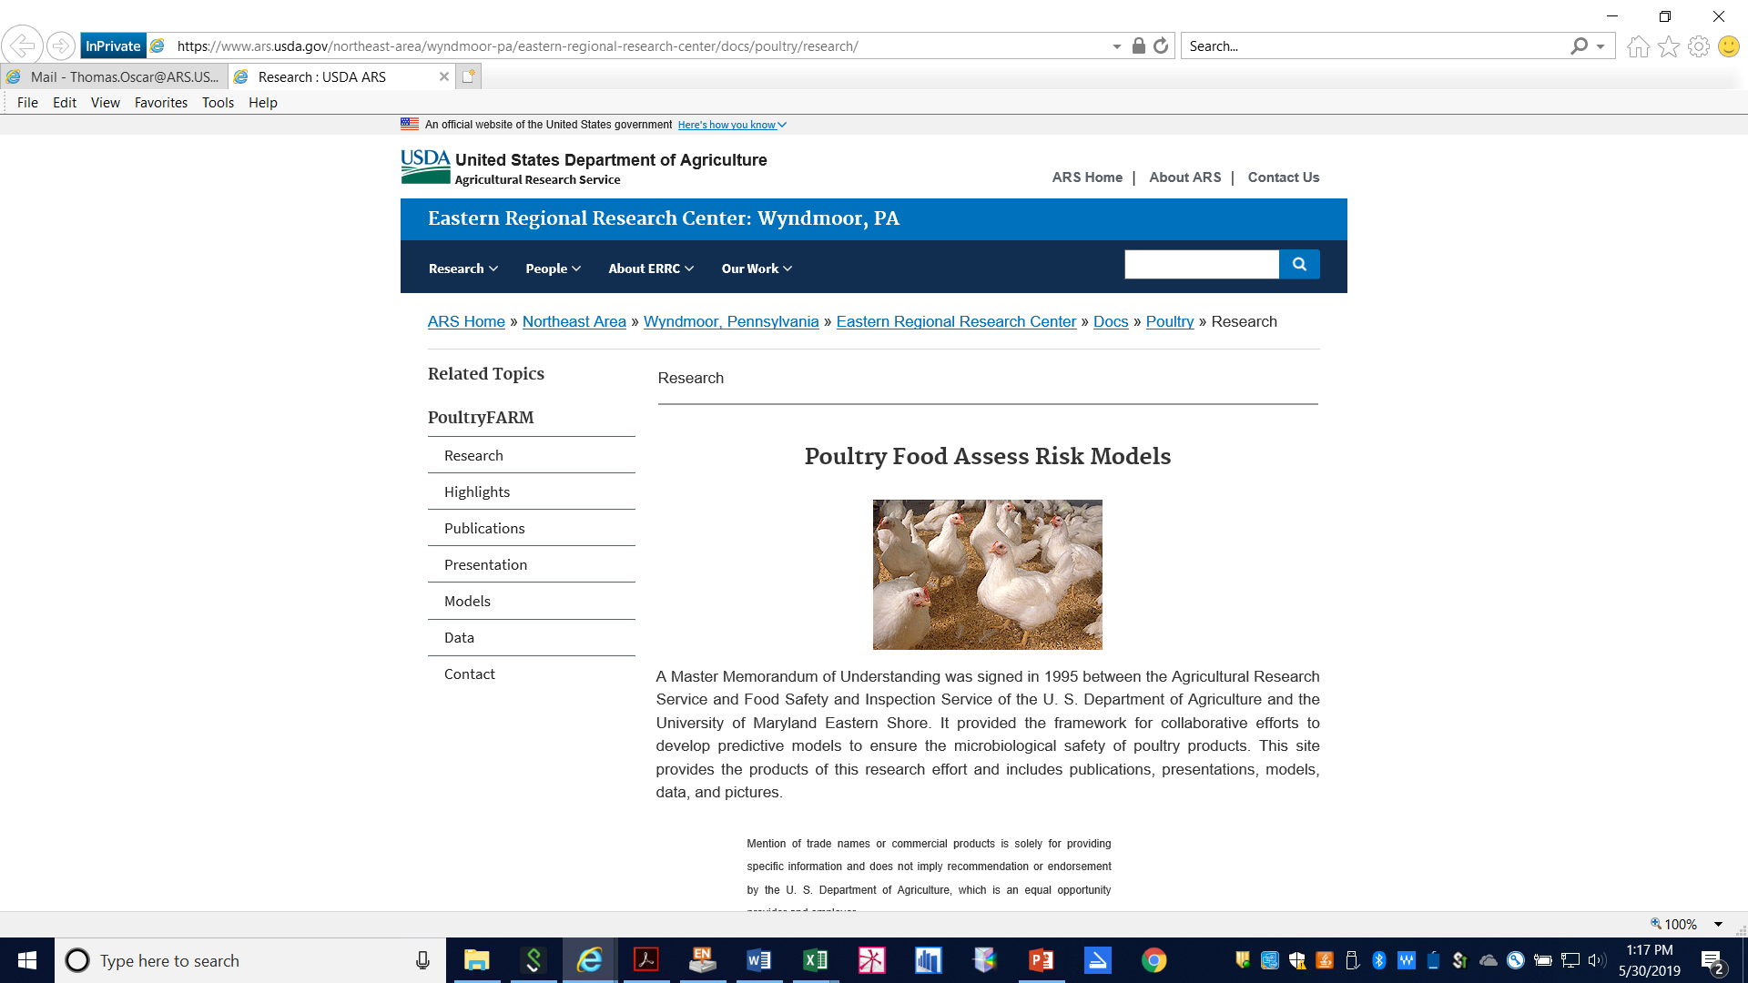
ValT
Notes:
Once this research is published, the new software tool will be made available for free on the USDA, ARS, Poultry FARM website.

Slide 22
Thank you

