Slide 1
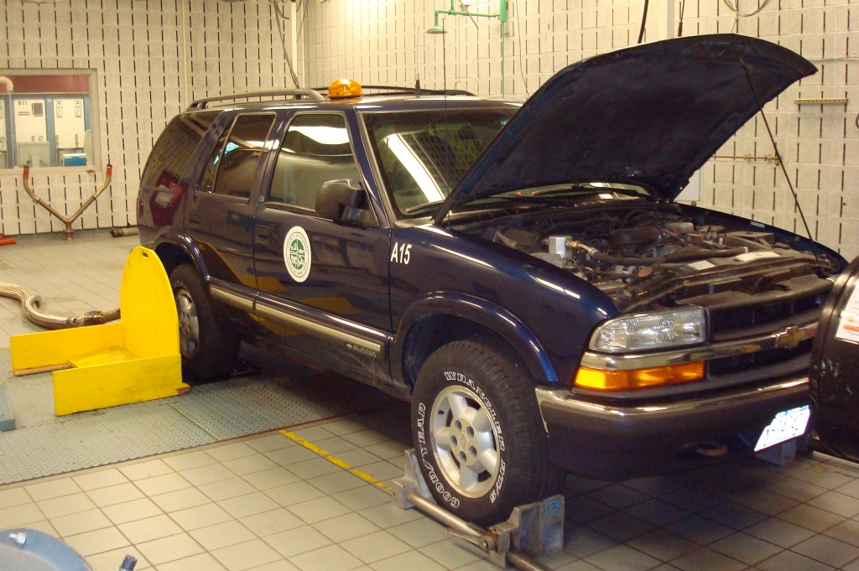
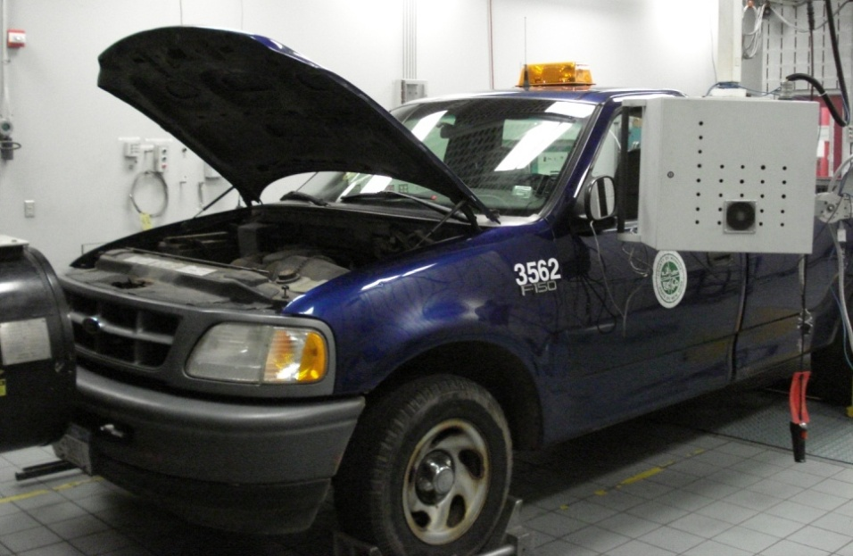
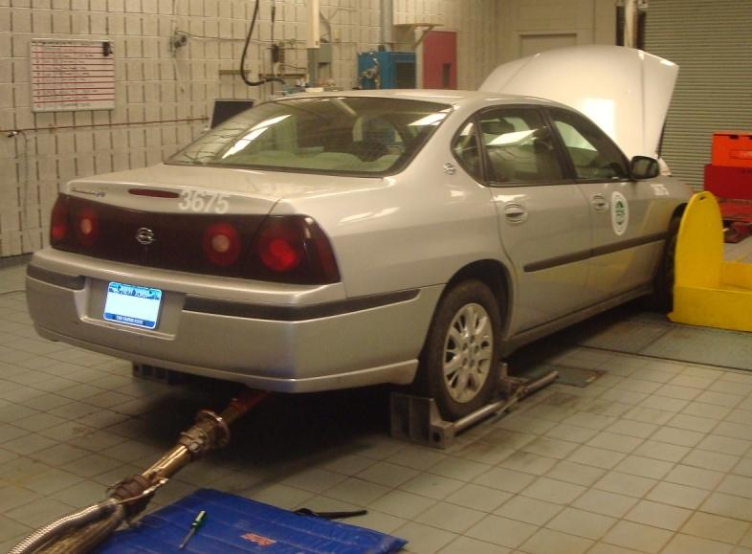
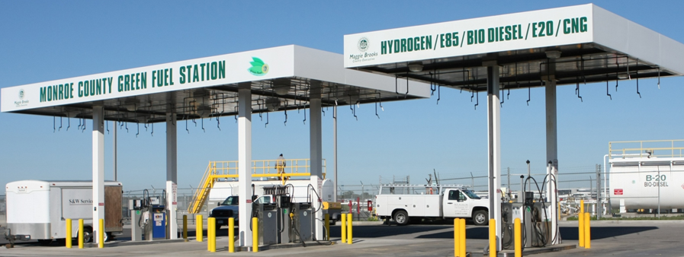

RIT-CIMS/USDOT
E20 Test and Evaluation Program
May 2010
Brian Duddy
Senior Program Manager
RIT – CIMS
585 -475- 2262
bjdasp@rit.edu

Slide 2
Rochester Institute of Technology
Center for Integrated Manufacturing Studies (CIMS)
E20 Test and Evaluation Program
Program Background
Test Objectives
E20 Study Fleet Vehicles
Emissions Testing Plan
Test Results to Date
Fleet Monitoring
Remaining Issues
Summary

Slide 3
RIT CIMS E20 Program Background
In July 2007 CIMS was asked by US DOT to do a study on 10 vehicles running E20 in support of the “20 in 10” initiative.
DOT RITA asked for conventional vehicles, at least 4-7 years old that had not regularly been exposed to E10 ethanol.
We folded this program into an existing research grant for alternative fuels (ethanol, biodiesel & hydrogen).
We were already looking at the performance of E85 in Monroe County (NY) flex fuel fleet.
Aug 07 - MC agreed to dedicate a 10 vehicle set to running on E20. (Light duty trucks and sedan.)
Sept-Oct 07 – Set up fuel storage, driver cards, vehicle monitoring systems, plan for emissions testing (E0&E20).
Nov-Dec 07 – Emissions on E0 to baseline vehicles.

Slide 4

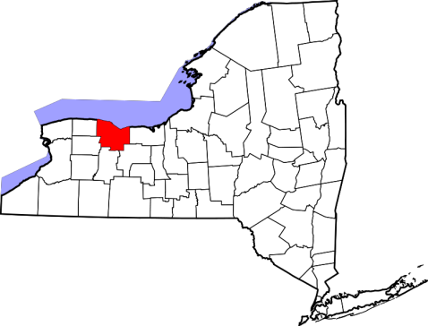
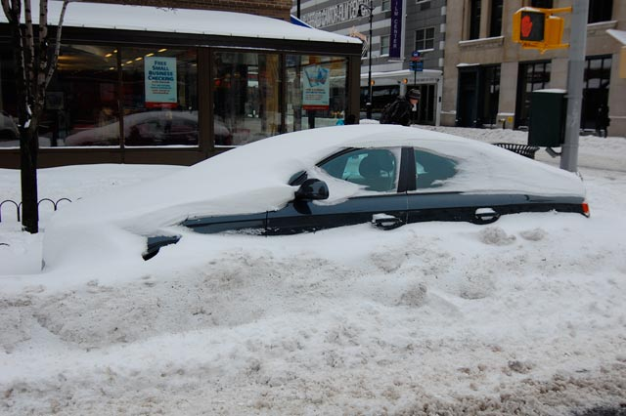
Monroe County / Rochester, NY Area
Testing in Monroe County offered unique opportunities and conditions
  1300 sq. mile region
  Four season testing
    Cold weather starts
    Hot weather soak
  Diverse vehicle set
  Multiple drivers
  Urban and Rural

Slide 5
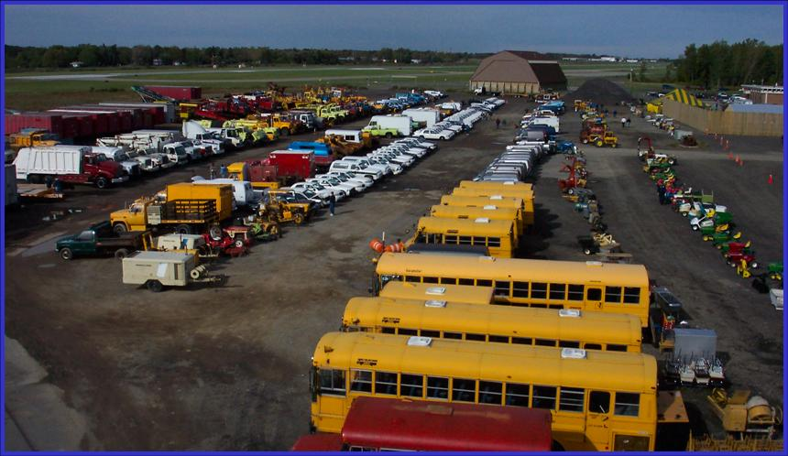
Snapshot of Monroe County Vehicle Fleet
Vehicles running on Ethanol
300 Conventional Light Duty Vehicles – E20 fueled
100 Flex Fuel Vehicles (Impalas, Uplanders) (E20 and E85)
100 Sheriff vehicles (Ford Crown Victoria) (E20 and E85)
Other Alternative Energy Vehicles:
300+ Diesel vehicles (B5/B20)
25 hybrids (Silverados, Malibus, Escapes)
First-generation battery powered vehicles
Hydrogen Fuel Cell Vehicle
(GM Project Driveway)
Green Fueling Station
(B20/E85/E20/Hydrogen/CNG)

Slide 6
RIT CIMS E20 Test Objectives
Impact to public of E20 operation in conventional
vehicles – driveability. (Key DOT Objective)
Exhaust emission deltas between E0 and E20.
Impact to vehicle fleets – durability, maintenance.
Impact to fuel economy vs. E0 operation.
Life cycle cost of E20 fuel operation.
Report on supply chain issues with ethanol fuel.

Slide 7
RIT/MC 10-Vehicle E20 Study Fleet
Monroe County E20 Vehicle Testing List
Model Year | Manfr | Model Type | Date of Emissions Test - gasoline | Mileage at test | Current Mileage
1998 | Ford | F150 Pickup | 3-6 Dec 2007 | 73860 | 101763
2000 | Chevy | Impala Sedan | 6-8 Nov 2007 | 83030 | 99008
2001 | Ford | F250 Pickup 4x4 | 11-14 Nov 2007 | 54499 | 68320
2001 | Ford | F250 Pickup 4x4 | 6-8 Nov 2007 | 107611 | 149664
2001 | Chevy | Silverado Pickup 4x4 | 27-30 Nov 2007 | 119776 | 154439
2001 | Chevy | Suburban/Blazer 4x4 | 27-30 Nov 2007 | 48787 | 66338
2002 | Chevy | G3500 Van | 11-14 Nov 2007 | 82794 | 103304
2002 | Ford | F250 Pickup 4x4 | 11-13 Dec 2007 | 120818 | 134551
2002 | GMC | Sierra Pickup 4x4 | 27-30 Nov 2007 | 51123 | 70477
2004 | Ford | F250 Pickup 4x2 | 1-3 Nov 2007 | 29738 | 61923

Slide 8
RIT E20 Emissions Testing Plan
Tailpipe Emissions from 10 vehicle test group
Baseline Unleaded Nov-Dec 2007 | E20 “Deltas” Jun-Jul 2008 | E20 Mid-Term Aug-Nov 2009 Back-To-Back
5 Gases (NOx, THC, NMHC, CO, CO2) | 5 Gases | 5 Gases & Ethanol in exhaust stream* for NMOG calculations
Fuel Economy (F.E.) E0 Road Fuel | F.E. w/ E20 Road Fuel | F.E. deltas with controlled fuels
* With support from NREL
All testing done at Delphi Technical Center, Rochester NY

Slide 9
Emissions Testing Program
Emissions evaluation performed at Delphi Technical Center Rochester world-class facilities.
  Criteria pollutants measured during FTP75 evaluation.
  Three runs on each fuel – if any anomalies, test was rerun to get three good samples.
  Horiba OPE series emissions analyzer.
  Nov 2009 testing included measuring tailpipe ethanol emissions with equipment provided by NREL.
Real world work vehicles in a high precision testing facility.

Slide 10
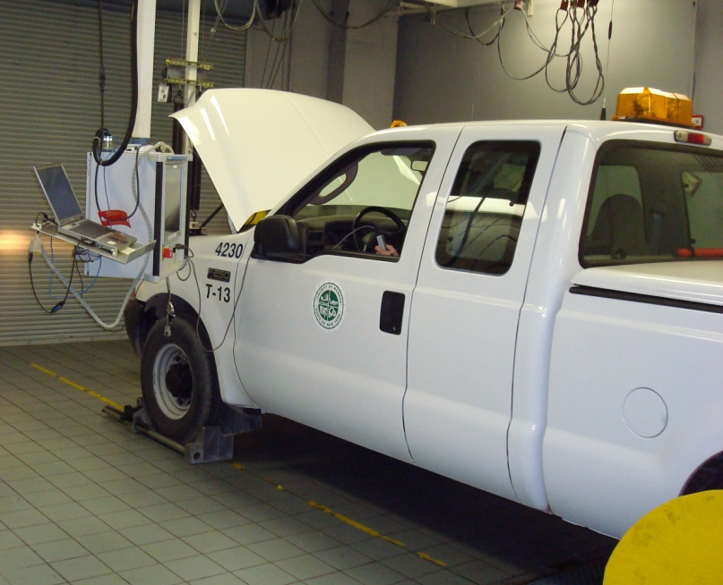
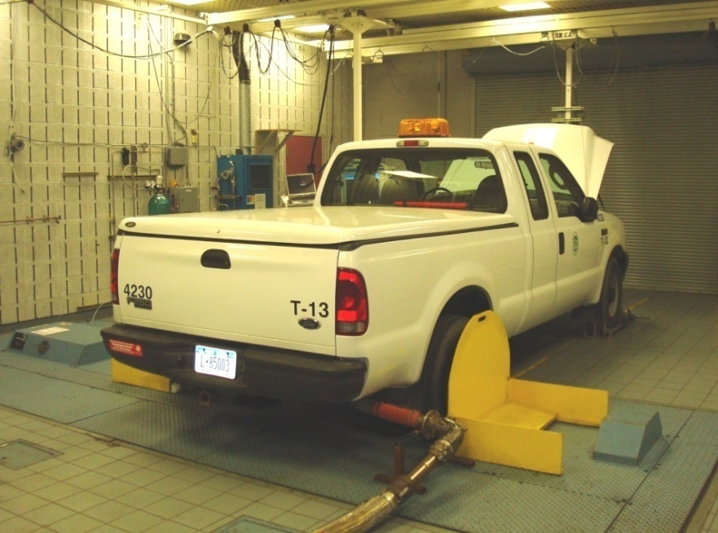
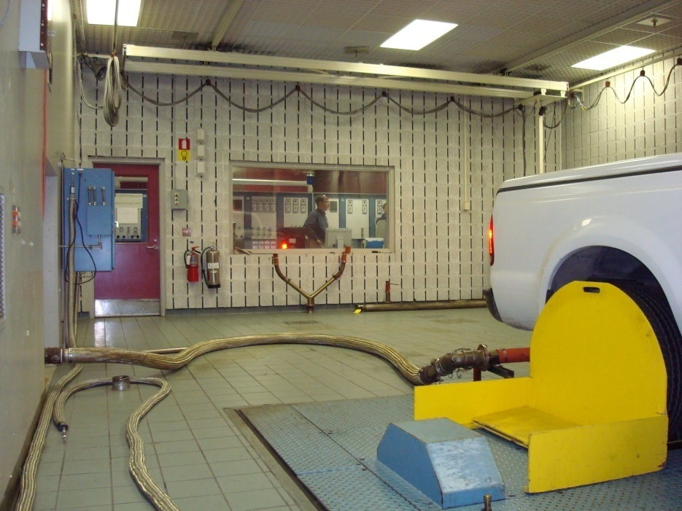
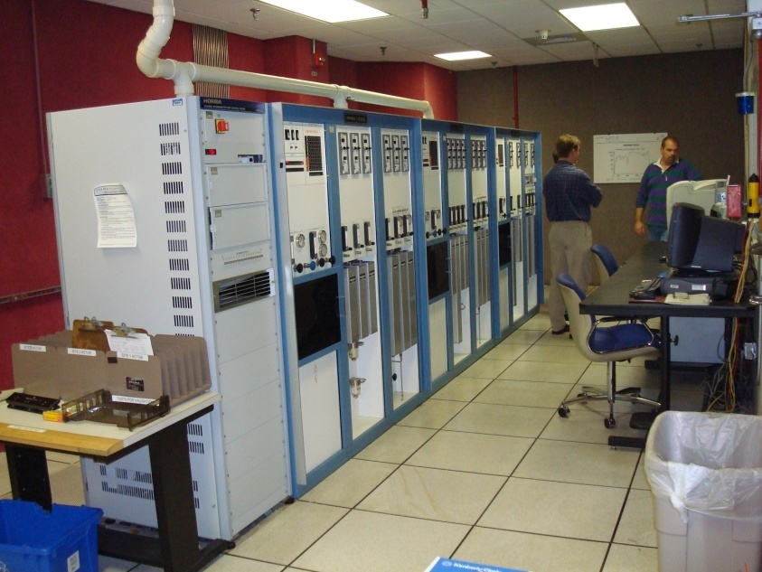
Delphi Vehicle Emissions Lab - Rochester

Slide 11
Delphi TCR Vehicle Emission Lab (VEL2)
BCO(L) 0-100 PPM - 1500 PPM
BCO2 0-1.5% - 3.00%
BHC 0 - 25 PPM - 100 PPM
BNOx 0 - 25 PPM - 150 PPM
BCH4 0 - 25 PPM
Horriba
System
1.999
1.999
1.999
1.999
1.999
1.999
1.999
1.999
1.999
1.999
1.999
1.999
1.999
1.999
1.999
1.999
1.999
1.999
1.999
1.999
1.999
1.999
1.999
1.999
1.999
Bag Bench
Tailpipe Bench
Engine Bench
Bag Bench
Tailpipe Bench
Engine Bench
Sample
Bags
Constant Volume Sampler
Combustion Analysis System
Sample
Conditioning
Unit
Driver’s
Trace
Robertson, 10/96
Critical Flow Venturi
Cooling Fan
Temperature control: 72° ± 2°F
Humidity control: 50 ± 2 grain
8.5” Twin Roll Chassis Dynamometer

Slide 12
RIT E20 Program Timeline
2007
2008
2009
2010
July 2007
DOT Request
Feb 2008
10 Veh on E20
Oct 2008
Driver Interviews
Dec 2009
Paper Pub
Aug 2007
10 Vehicles Identified
Jun 2008
E20 Emissions
Dec 2008
All MC conventional veh on E20
Nov 2010
DOT
Program
Concludes
Nov 2007
E0 Emissions
Sept 2008
EPA Waiver for Full Test Program
Aug 2009
E0-E20 Emissions
MPG/Alcohol

Slide 13
Emissions Test Results
Current Back-to-Back data shows significant improvement in HC and CO and neutral on CO2.
Historic trend indicates some degradation in emissions (expected).

Slide 14
Emissions Test Results
All the measurements for both fuels were well below the EPA limit for Criteria Pollutants
Cold (20°F) start testing vs. ambient indicates degradation in HC and CO, however, less for E20 than E0.

Slide 15
E0-E20 Fuel Economy Results
MC vehicle data was sorted for dedicated fuel use, 1 year of data per fuel, minimum of 20 data points per fuel, same organization for both fuels.
Practical (On-road)
  5.93% average measured reduction in 47 fleet vehicles.
Theoretical (Fuel Energy)
  6.85% calculated reduction based on fuel energy.
Experimental (Delphi)
  Roughly 6.5% reduction based on measured carbon emissions during chassis dynamometer FTP testing.
Results are consistent with expectations for energy content of E20 fuel.

Slide 16
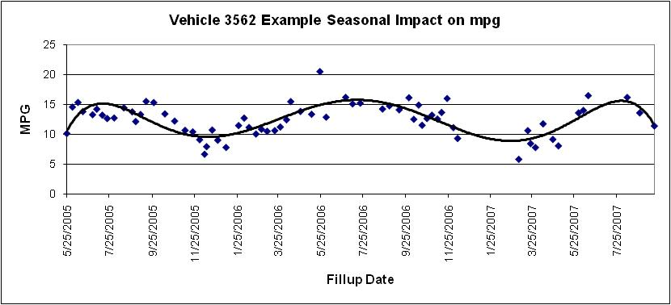
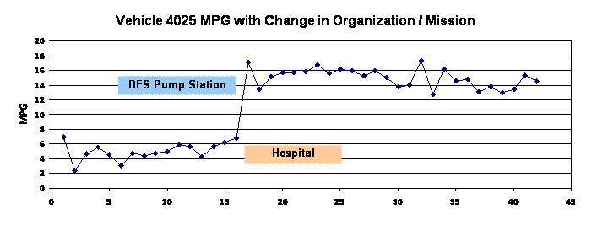
E20 Fuel Economy Results
Fuel economy was determined through on-road data and experimentally.
Odometer and fuel volume collected through MC PetroVend fuel control system.
Data ported to RIT database for analysis.
General observations: on-road fuel economy can be greatly impacted by:
  Seasonal variation
  Usage: organization / mission / driver

Slide 17
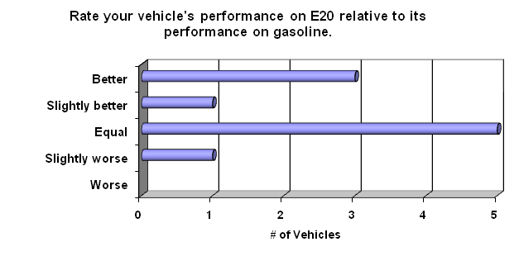
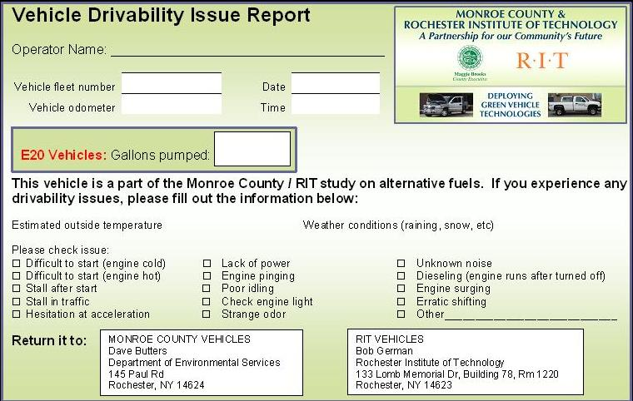
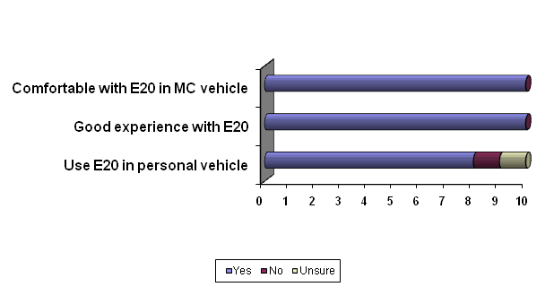
E20 Drivability Results
Driver Surveys
  MC Drivers filled out fueling and performance cards for one calendar year
  Additionally took end-of-year survey
    No driving issues
    Positive comments
    High Mileage vehicle has
    32,000 miles on E20

Slide 18
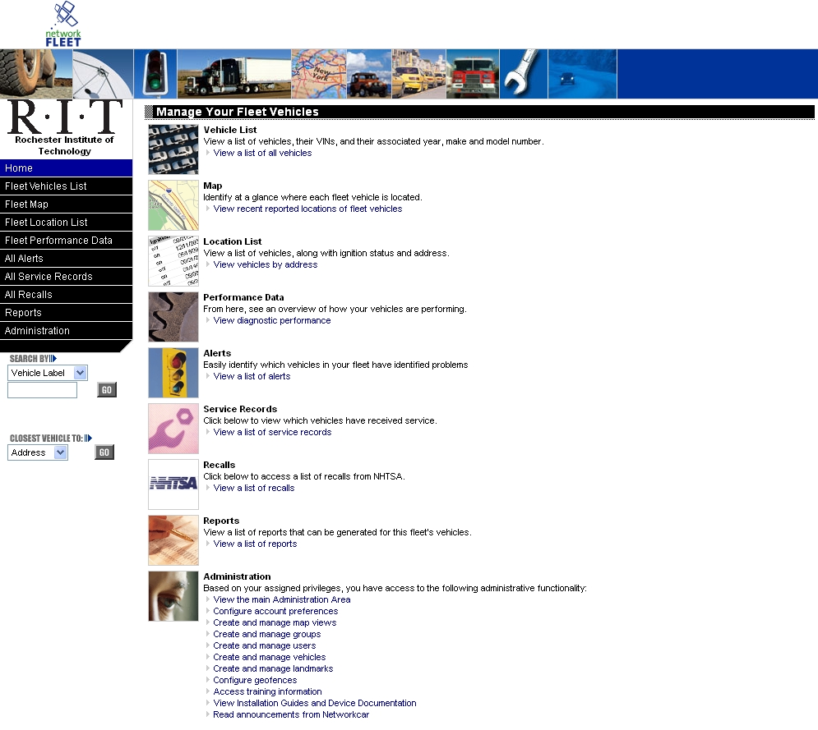
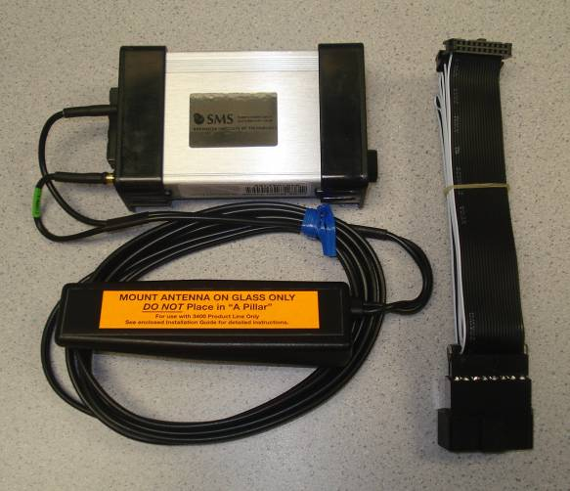
Use of Networkcar Vehicle Monitoring System
All 10 study vehicles and a number of other E20 vehicles are equipped with the commercial Networkcar monitoring system linked into the OBD network.
System provides GPS location, speed ranges, idle time and alerts when vehicle detects a fault or failure.

Slide 19
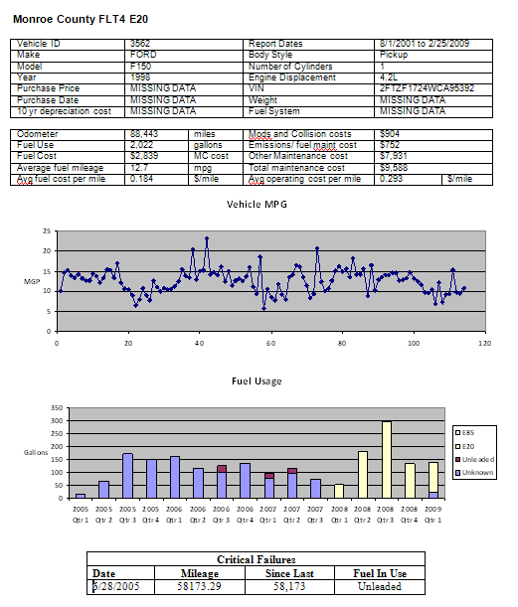
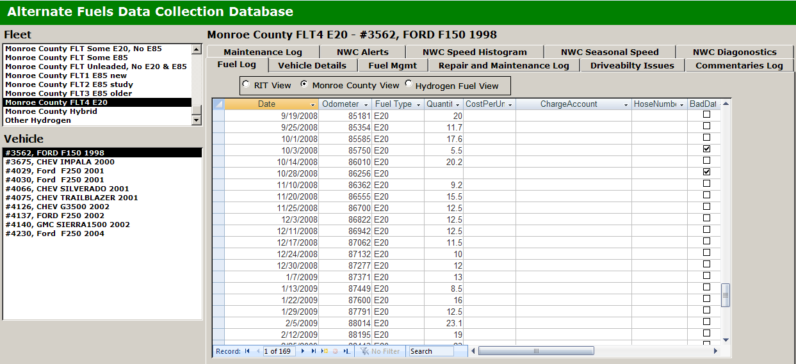
E20 Fleet Tracking
All data on MC and RIT vehicles is imported into RIT proprietary database for all vehicles.
  630 Vehicles; 88,647 Fueling Entries; 15,552 Maintenance Entries.
  Maintenance, fuel use, and TCO can be calculated per fuel.
  Looking for critical system failures MTBCF
Analysis of full E20 TCO is in progress.

Slide 20
RIT Research Highlights
The RIT program features a unique public-private partnership between the University, MC and Delphi.
The RIT project has by far the largest and most comprehensive E20 fleet study: vehicle types and ages, weather, # of drivers.
10 Study vehicles have driven over 200K miles on E20; fleet has consumed over 300K gallons of E20 and driven well over 4 million miles so far…
The results of the E20 program will be folded in to our overall assessment of the “Technology Readiness” of alternative fuels.
E20 and E85 are being evaluated along with biodiesel and hydrogen ICE.

Slide 21
Issues with remaining testing
Our DOT research grant finishes in Nov 2010.
Not addressed in any of the studies: Impact of ethanol on “aftermarket” parts.
Industry and Gov’t still must evaluate motorcycle/recreational vehicle fleets.
The County wishes to continue using E20 in their vehicles, but our testing waiver will expire with our DOT program.
We likely won’t get to see E20 over the “full useful life” of many vehicles before Nov.

Slide 22
Summary
RIT-CIMS was able to execute an effective E20 Test and Evaluation on an aggressive timeline.
Neither CIMS nor Monroe County has uncovered any adverse effects of E20 on their vehicle fleet.
Fuel mileage is impacted, but results are as expected.
Tailpipe emissions are either a “wash” or in some cases, significantly lower.
Drivers and fleet managers are happy with E20.
Total ownership cost is TBD - will depend on supply chain, subsidies, tax credits, etc. (Is E10 cheaper than E0?)

Slide 23

Questions?
Brian Duddy
Senior Program Manager
RIT – CIMS
Rochester NY
585 -475- 2262
bjdasp@rit.edu

